Slide 2
Career Collections
8th Grade Campus Visit

Slide 3
Housekeeping: Norms
Keep cell phones on silent.
Behave like a guest—represent your school well.
Leave campus as clean as it was when you arrived.
Stay engaged in all activities.
Ask related questions.
Follow all instructions.
Stay with your group.

Slide 4
Objectives
After this activity, you will be able to:
Recognize challenges that will prevent you from pursuing postsecondary education (PSE).
Identify solutions that will help you overcome obstacles to pursuing PSE.
List the required PSE, skills, and majors associated with different careers.
Notes:
Other objectives for this lesson include:
Students will identify postsecondary education (PSE) admission requirements for four-year universities (bachelor’s degrees) after completing a campus visit.
Students will identify postsecondary education (PSE) admission requirements for two-year universities (associate degrees) after completing a campus visit.
Students will identify postsecondary education (PSE) admission requirements for career techs (certificates) after completing a campus visit.
Student-friendly alternatives: Discuss why you should pursue education after high school and what challenges could get in the way. Discover careers you may be interested in and what type of education they require.

Slide 5
Commit and Trash
Using a pink sheet of paper, write down your answer to this question:
“What keeps people from going to college?”
Notes:
On each table: pink sheets of paper, bucket, and pens.
On the next slides, students will:
Answer the question on a pink sheet of paper.
Crumple up the sheet and toss it into the bucket.
Trade with group next to them.

Slide 6
Commit and Trash
Crumble the paper and place it in the bucket.
Trade buckets with another group.
Pull ONE paper from the bucket.
Share with the group.

Slide 7
Commit and Trash
As a group, select one of the responses to share out with the whole class.
What are resources that could help you overcome that challenge?

Slide 8
Commit and Trash
On a green sheet of paper, write down your answer to this question:
“Why do you think people should go to college?”
Notes:
On each table: green sheets of paper, bucket, and pens.
On the next slide, students will:
Answer the question on a pink sheet of paper.
Crumple up the sheet and toss it into the bucket.
Trade with group next to them.

Slide 9
Commit and Trash
Crumble the paper and place it in the bucket.
Trade buckets with another group.
Pull ONE paper from the bucket.
Share with the group.

Slide 10
Exploring Career Options
Having a career you like often depends on finding a career that fits your skills and interests.
Notes:
Tell students, “Let’s explore your interests and how they can be tied to different careers.”

Slide 11
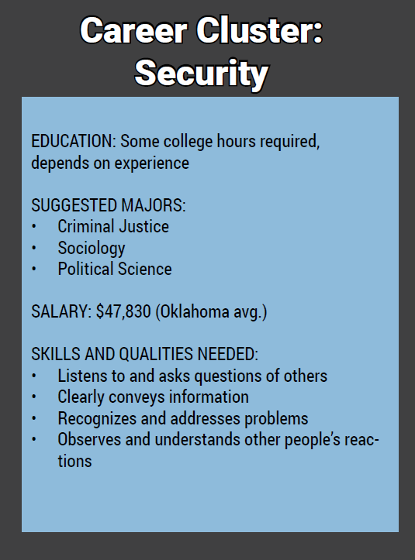
What information can be found on the career cards?

Slide 12
Career Card Sort
Select one card at a time.
Read the information on the card.
Use the information on the card to sort it onto the proper section on the card sort mat.
Note: You have six cards and only five spaces. One box will have two cards.

Slide 13
Card Sort Answers
Requires a bachelor’s degree only | Petroleum Engineer Airline Pilot
Salary is less that $50k | Librarian & Chef Museum Curator
Has a suggested program | Aircraft Mechanic Wind Turbine Tech
Career cluster is Information & Communication Technology | Web Developer Information Security Analyst
Degree beyond a bachelor’s is required | Physician Assistant Physical Therapist & Veterinarian

Slide 14
Which careers do you have questions about?
Chef Aircraft Equipment Mechanic/Technician Highway Patrol Officer Airline Pilot Museum Curator Petroleum Engineer | Physical Therapist Information Security Analyst Veterinarian Librarian Physician Assistant Web Developer Wind Turbine Technician

Slide 15
How do you pay for a career tech or college?
Notes:
Ask students if they are aware of the difference in tuition costs for in-state and out-of-state schools. Emphasize that they need to plan how to pay for postsecondary education.

Slide 16
Oklahoma’s Promise
Oklahoma Higher Learning Access Program
2017–2018 Scholarships Awarded:
$72,173,055
2018–2019 Estimated Scholarships Awarded:
$76,800,000
Notes:
The Oklahoma’s Promise scholarship is only available in Oklahoma.
Image source: Clker-Free-Vector-Images. (2012 April). Dollar, Money. Pixabay. https://pixabay.com/vectors/dollar-money-signs-business-42338/

Slide 17
Oklahoma’s Promise Requirements
Oklahoma resident
8th, 9th, or 10th grade
Household income is $55,000 or less (x < $55,000)
Take 17 units of required high school classes
Make a 2.5 GPA or higher in 9th–12th grades
Notes:
Required units:
4 years of English
3 lab sciences
3 years of math
3 years of history
2 language or computer tech classes
1 additional elective class
1 fine arts class
Consider using the attached copy of the most recent OK Promise Application for students' reference.
Depending on your students' ages and knowledge, you may want to explain what GPA is and how it is calculated. Additionally, emphasize that a 2.5 GPA qualifies for Oklahoma's Promise, but this GPA is not high enough for admission to the University of Oklahoma, for example—so students need to set their sights higher!

Slide 18
How to apply for Oklahoma’s Promise?
Complete the application in the 8th, 9^{th,} or 10th grade.
Ask your family to attend GEAR UP family nights at your school.
Ask your school counselor to help complete the application.

Slide 19
Reflection
What were your ideas about barriers to postsecondary education before today’s activity?
What have you learned today?
Have your thoughts, opinions, or knowledge changed?

