Slide 2
Housekeeping: Norms
Keep cell phones on silent.
Participate in all activities.
Clean up after yourself.
Ask questions.

Slide 3
Objectives
You will:
Recognize the factors that influence your ability to gain acceptance to the postsecondary education (PSE) option of your choice.
List the different expenses related to PSE.
Identify at least one solution to fund PSE.

Slide 4
What do you think PSEs look for when they decide who they will admit to their school?
Notes:
In small groups (3-4 students), have students compile a list of potential ideas. Have groups decide on the top three ideas to share.

Slide 6
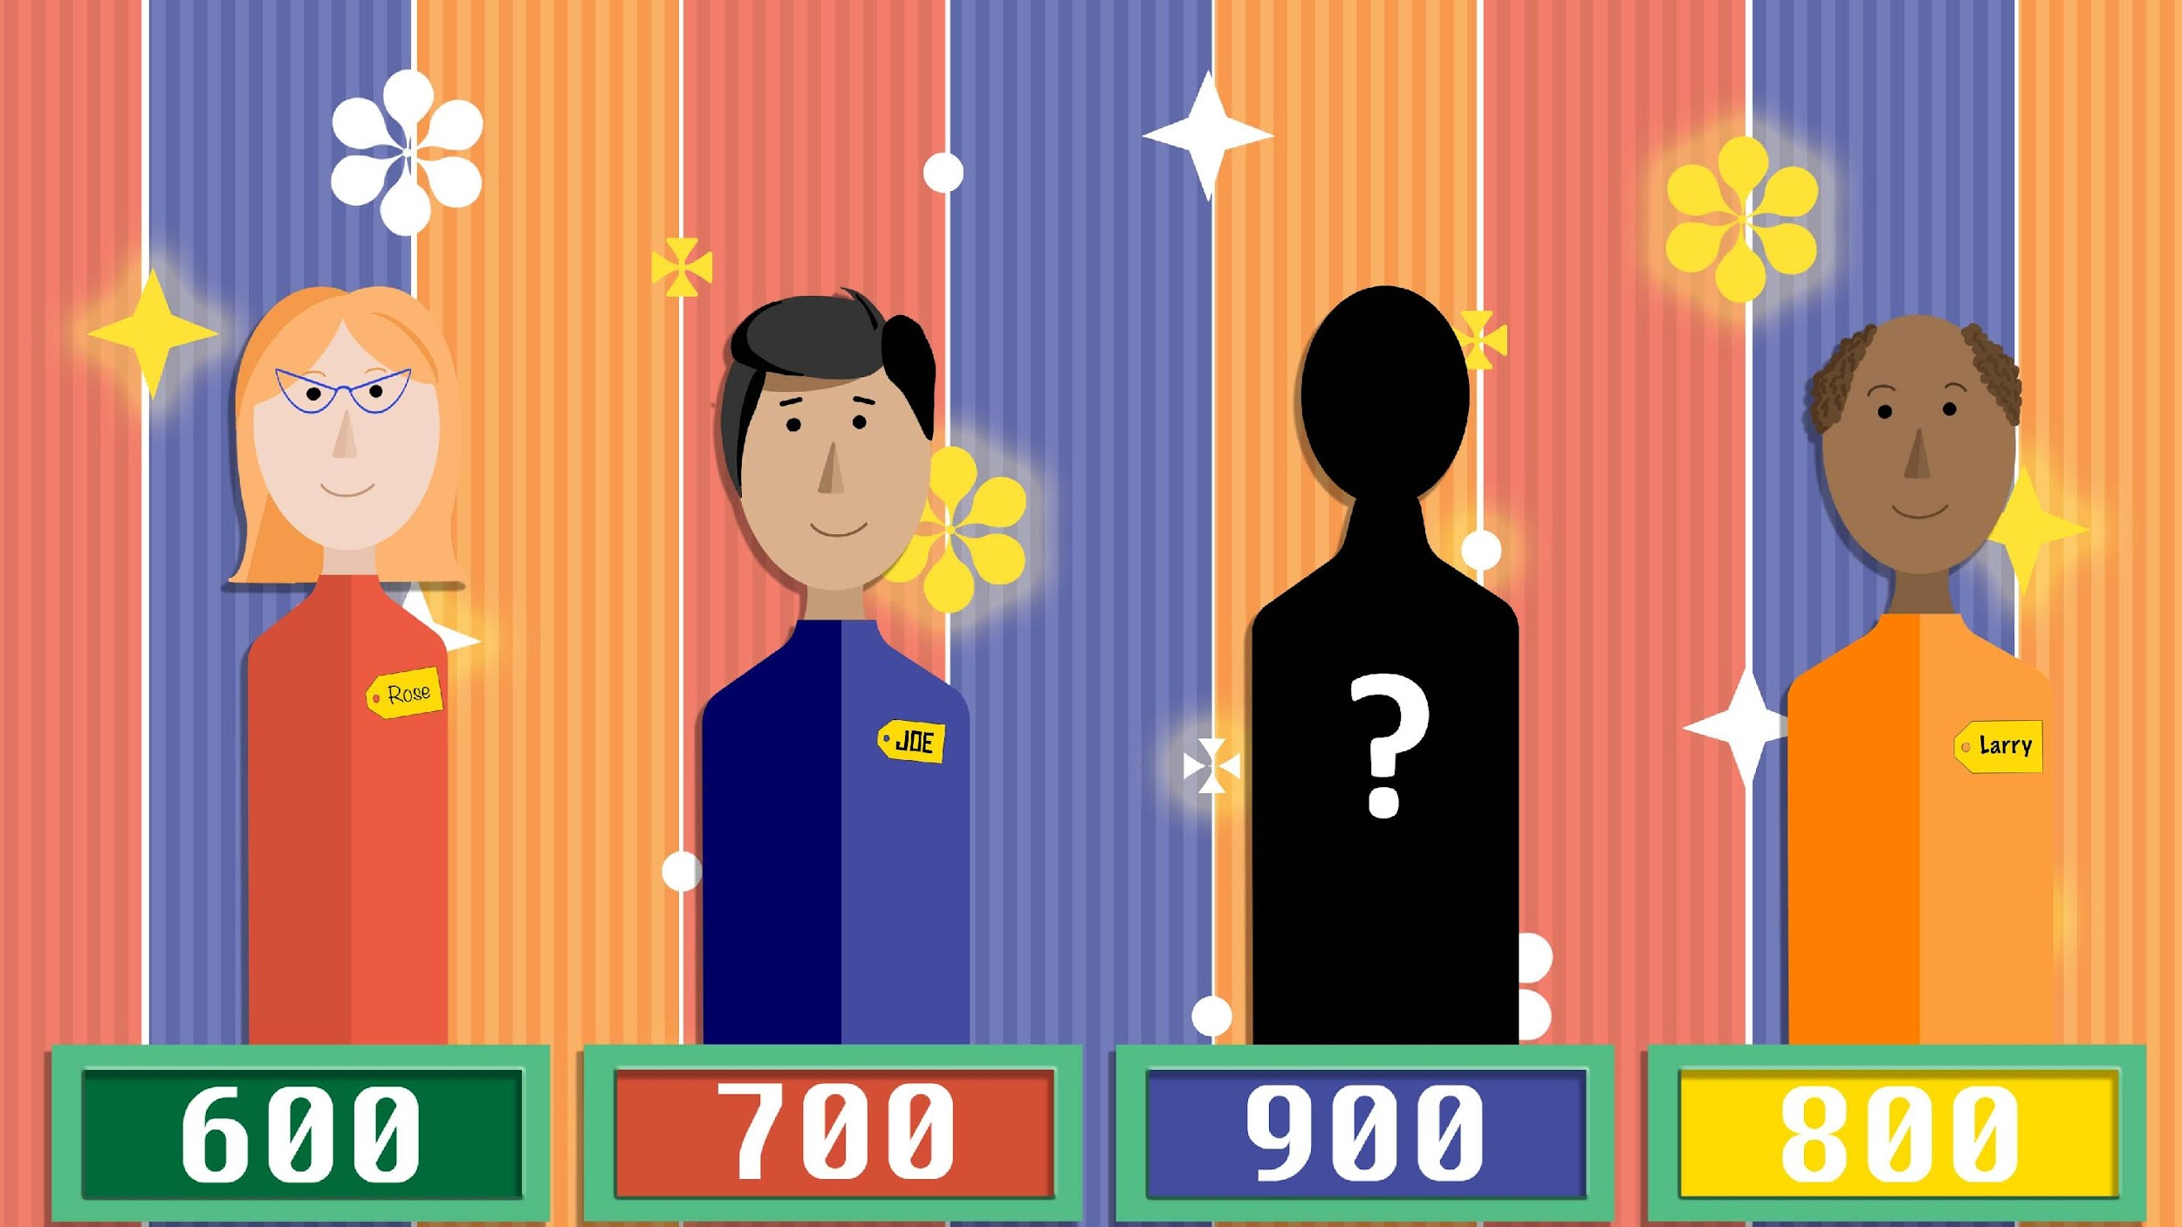

Slide 8
Arrow Cards
After each statement, decide as a group if Paul Steven Edwards (PSE) will move up or down the mountain.
Within your group, decide who will hold the arrow card.
For moving up the mountain, hold the arrow card pointing up.
For moving down the mountain, hold the arrow card pointing down.

Slide 9
Paul Steven Edwards:
Paul Steven Edwards is a 10th grader from Anywhere High School. Paul is interested in researching post secondary education (PSE) options to help him decide what he will do after he graduates from high school.
Over the next several slides, Paul is going to make various decisions during high school, and you are going to decide if the statements will help Paul get closer or further away from his goal of attending Anywhere PSE School.

Slide 10
You have perfect attendance.

Slide 11
You graduated in the top 10% of your class.

Slide 12
You have a part-time job to help your family with expenses.

Slide 13
You plagiarized on your English paper.

Slide 14
You attended a writing workshop to help write your admissions essay.

Slide 15
You have trouble showing up to class.

Slide 16
You attended an optional ACT prep course to prepare to take the test.

Slide 17
You met with your counselor to explore options after high school.

Slide 18
You earned a D in one course, but you communicated with the admissions office about the circumstances around the grade.

Slide 19
You are an Eagle Scout or a Girl Scout Ambassador.

Slide 20
You and your family went to a GEAR UP Family Night, and you applied for Oklahoma’s Promise.

Slide 21
You are not involved in extracurricular activities.

Slide 22
You stayed up too late the night before the SAT and fell asleep during the test.

Slide 23
CONGRATULATIONS! YOU’VE BEEN ACCEPTED TO ANYWHERE PSE SCHOOL!!

Slide 24
Paul Steven Edwards:
Now that Paul has achieved his goal of being accepted to Anywhere PSE School, he wants to become an anything career. He is attending Anywhere PSE school to help him achieve this new career goal.
Over the next couple of slides, Paul is going to make various decisions about his post secondary education, and you are going to decide if the statements will help Paul get closer or further away from his goal of becoming an anything career.

Slide 25
You forgot to budget for textbooks.

Slide 26
Your grades are not the best, but you wrote a short story to receive a scholarship.

Slide 27
You didn’t realize paying for PSE was more than just the tuition.

Slide 28
Your family is unable to pay for college, but you qualify for financial aid like Oklahoma’s Promise.

Slide 29
Discussion
What key items allowed the climber to move up?
What key items made the climber move down?
Which of these items can you do to “move up” towards a PSE goal?

Slide 30
Oklahoma’s Promise
Oklahoma resident
8th, 9th, 10th, or 11th grade
Household income is $60,000 or less
Complete 17 units of required high school classes
Make a 2.5 GPA or higher in 9th-12th grades

Slide 31
What have you already done to meet PSE requirements?

Slide 32
Checklist
Put a check mark by the items you have already completed.
Put a star by the items you can complete this school year.

