Slide 2
Housekeeping Norms
Keep cell phones on silent
Participate in all activities
Clean up after yourself
Ask questions

Slide 3
Objectives
Understand the admissions process and common college expenses.
Analyze how personal choices impact college applications and funding opportunities.
Understand how Oklahoma’s Promise and FAFSA help with college expenses.

Slide 4
Essential Question
As 11th-graders, what do we need to be doing to be college ready?

Slide 7
Did you participate in an extracurricular activity (ECA) or decide to protect your GPA?

Slide 8
ECA +5
GPA -5

Slide 9
Will you take AP English your senior year?

Slide 10
No -2
Yes +3

Slide 11
Did you take the ACT a second time?

Slide 12
No -4
Yes +6

Slide 13
Have you been on a campus visit?

Slide 14
Yes +2
No -2

Slide 15
Did you apply for
OK Promise?

Slide 16
No -6
Yes +6

Slide 17
Have you applied
for FAFSA?

Slide 18
Yes +5
No -5

Slide 19
Do you go to a water park with your friends or volunteer at your local animal shelter?

Slide 20
Volunteer +5
Waterpark -5

Slide 21
Do you take concurrent enrollment courses at a local college?

Slide 22
No -5
Yes +5

Slide 23
Do you ask for a recommendation letter from your teacher/counselor or from your mom?

Slide 24
Teacher/
Counselor +5
Mom -5

Slide 25
Do you apply for a local scholarship for $250?

Slide 26
No -3
Yes +3

Slide 27
The deadline to apply for a PSE is coming up. Do you apply for the PSE or go hang out with your friends over winter break?

Slide 28
Hang out with friends -5
Apply for PSE +5

Slide 29
Did you talk to your counselor about your options after high school?

Slide 30
Yes +2
No -2

Slide 33
Do you go to a PSE or start your career?

Slide 34
PSE +5
Career +3

Slide 35
You have been invited to Disney World with your best friend this summer, but you are struggling financially. Do you: take out a small loan to help pay for your expenses/trip or do you pass on the trip?

Slide 36
Small loan -4
Pass on the trip +2

Slide 37
You have parked in an illegal parking space.
-8

Slide 38
Your workplace/campus requires you to buy a parking pass. Do you pay $250 for a parking pass or risk getting a ticket?

Slide 39
Buy a permit +2
Risk a ticket -3

Slide 40
PSE path:
You dropped out of an elective course and enrolled in a required course. Add 7 points.
Career:
You want to get a promotion, so you decided to go to night school. Add 7 points.

Slide 41
Do you choose to live alone or find some roommates?

Slide 42
Live Alone -3
Roomies +2

Slide 43
Now that you have graduated, add 5 points for starting your career to pay for your student loans.
Now that you have been promoted, add 5 points for your career promotion.

Slide 44
Add scores from while in High School and After High School for your total score!

Slide 46
Oklahoma’s Promise
Oklahoma resident
8th, 9th, 10th, or 11th grade
Household income less than:
$60,000 with 1 or 2 dependent children
$70,000 with 3 or 4 dependent children
$80,000 with 5 or more dependent children
Complete 17 units of required high school classes
Make a 2.5 GPA or higher in 9th-12th grades

Slide 48
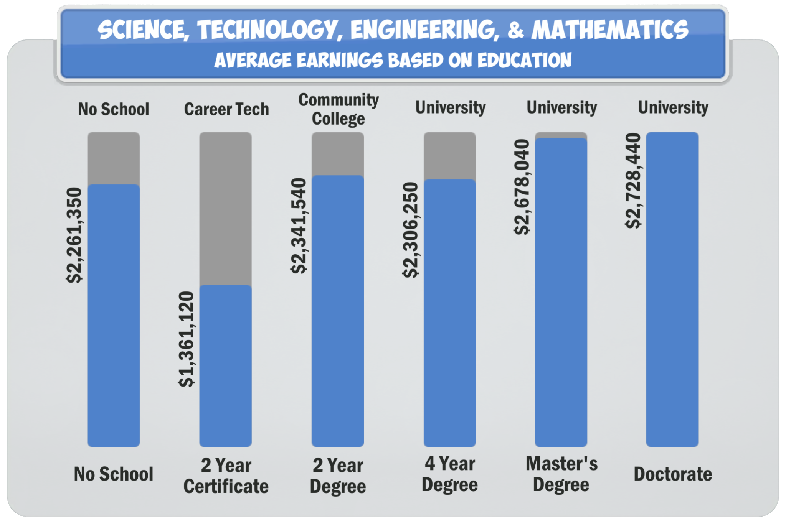

Slide 49
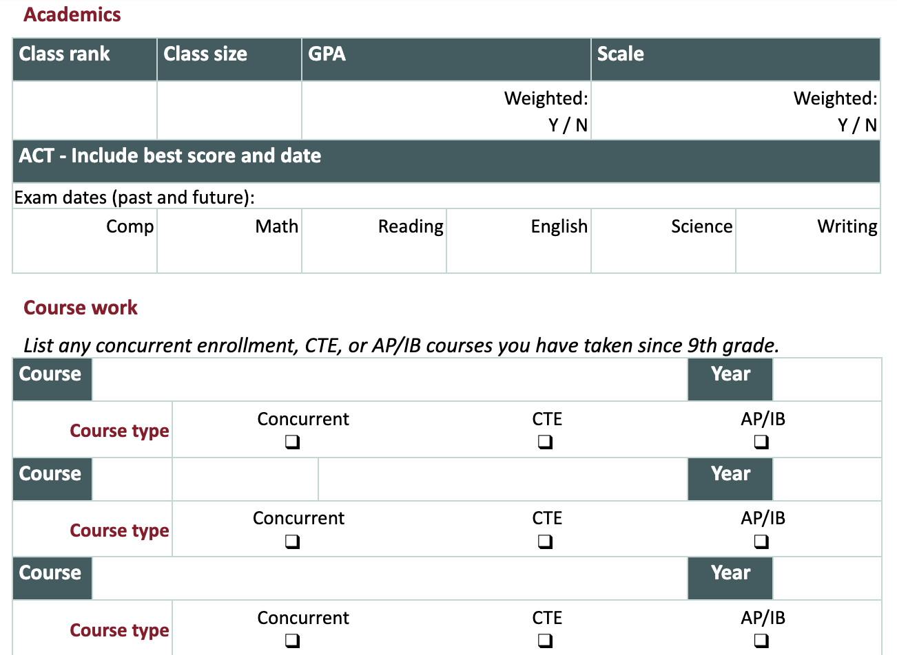

Slide 50
Essay Prompt
Identify whether you wish to attend a university, a 2-year college, a Technology Center, or go straight into a career.
How does your choice, as you know it now, satisfy your desire for a particular kind of learning, community, and future? Please list specific examples and how they relate to your choice.

Slide 51
Questions?

