Slide 2
Back It Up
Backward Planning

Slide 3
Essential Question
How can we use backward planning to make sure tasks are completed on time?

Slide 4
Learning Objectives
Reflect on the challenges with thinking in reverse.
Analyze a task for component parts.
Evaluate when subtasks should be completed to accomplish a larger goal.

Slide 5
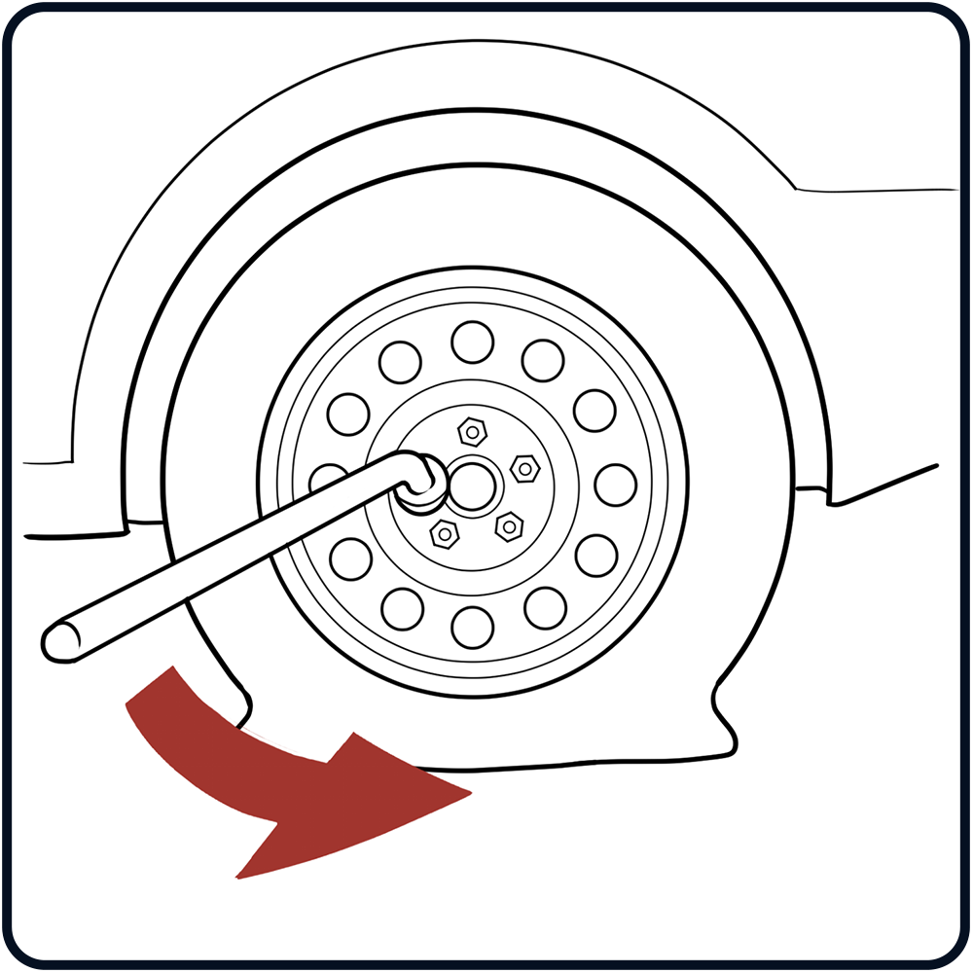
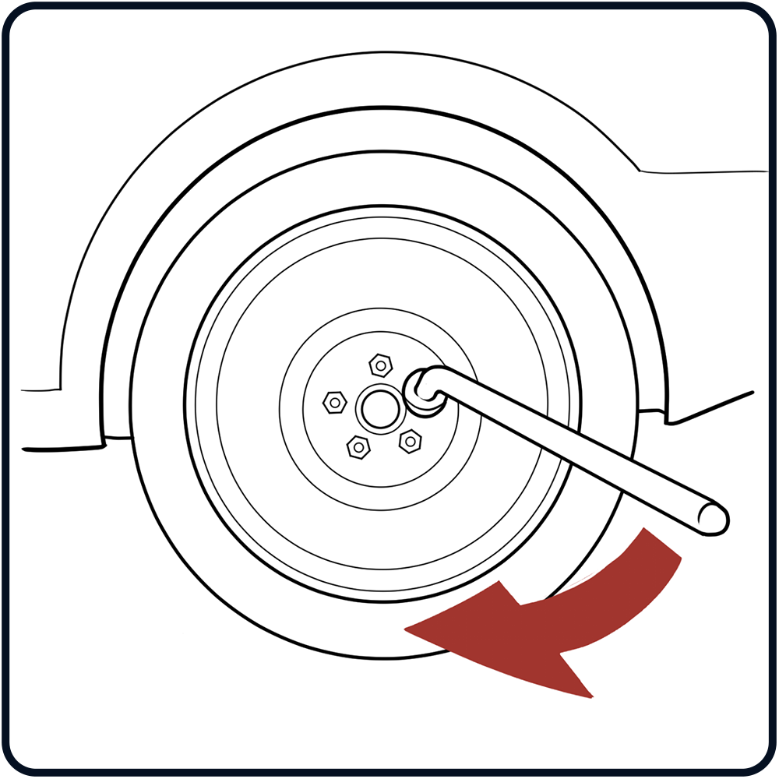
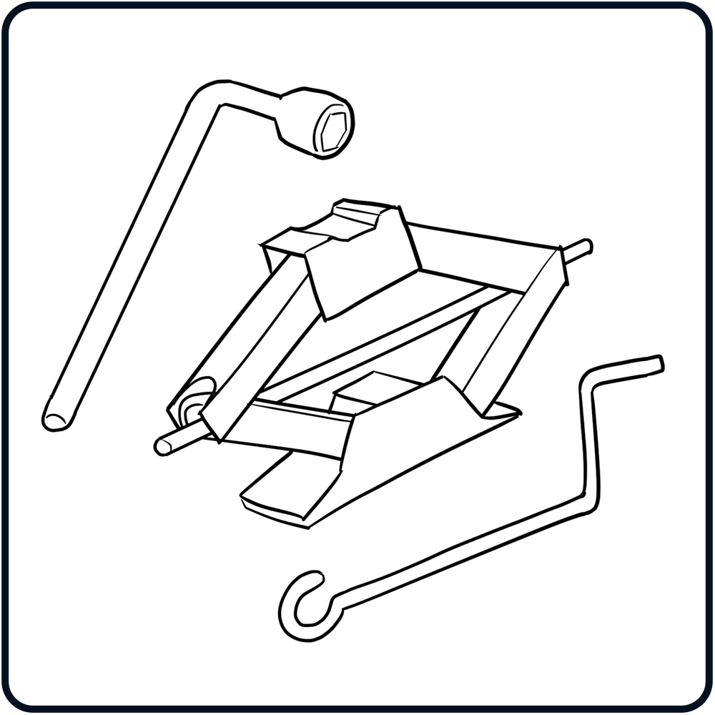
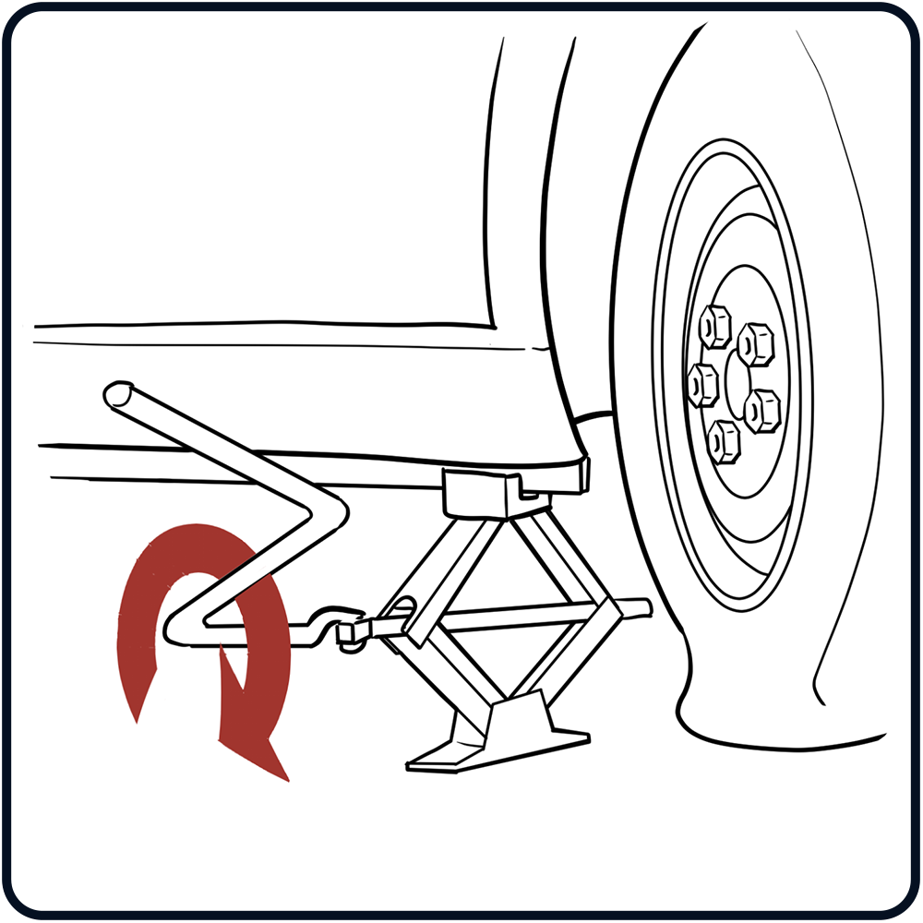
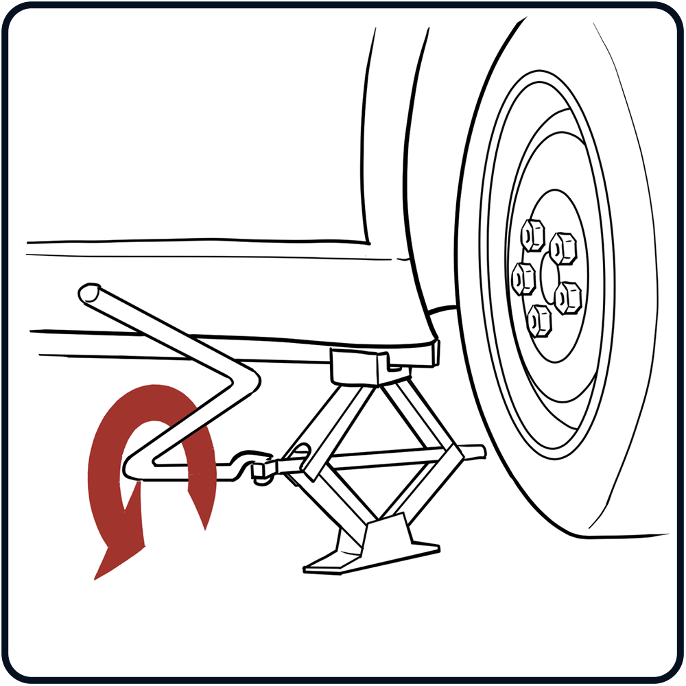
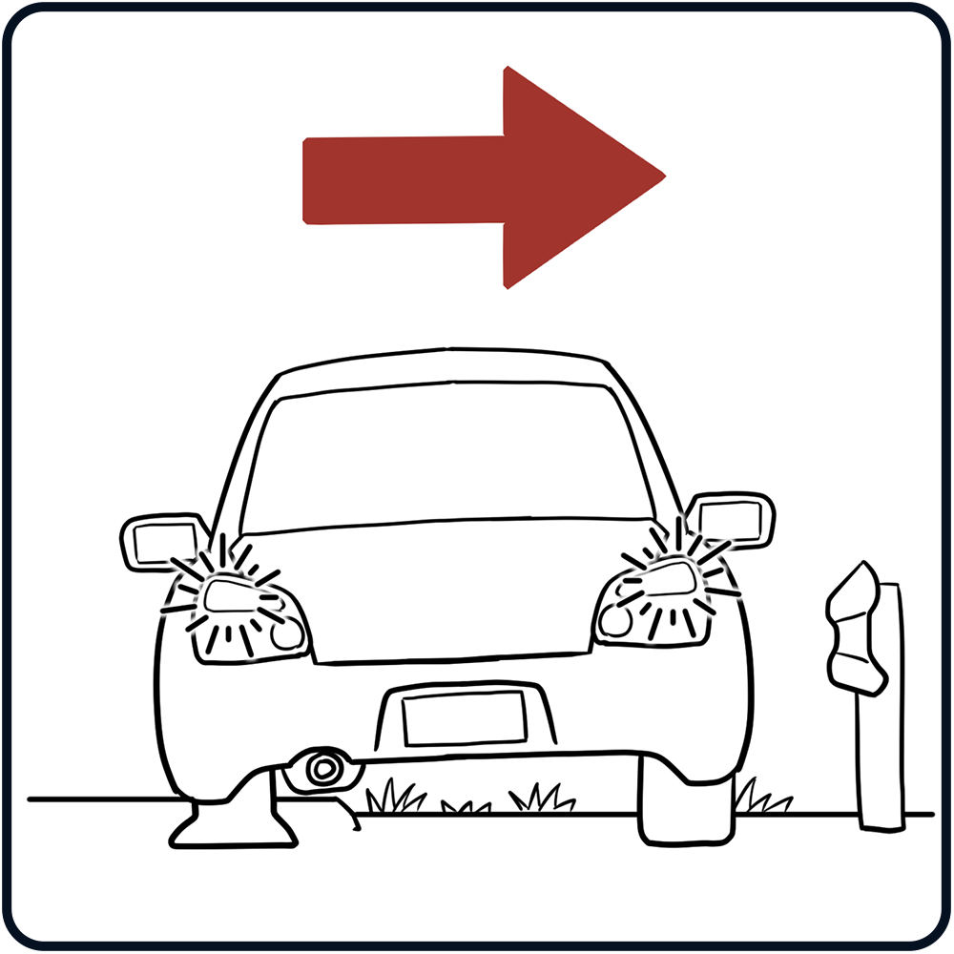
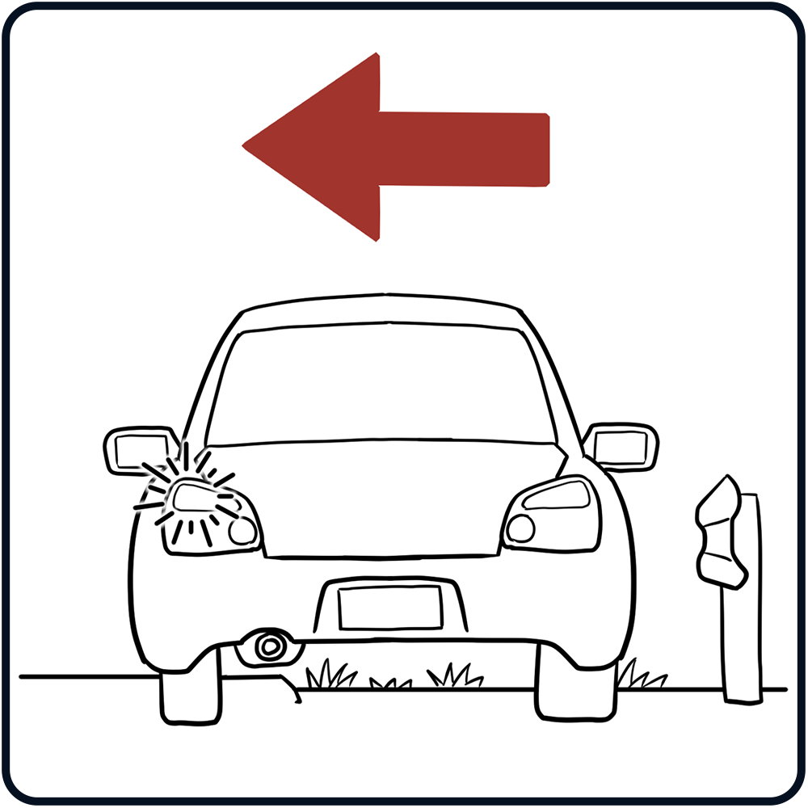
Sequence Puzzle
Arrange the image cards showing how to change a tire.
What order represents the steps you need to take to be successful?

Slide 7
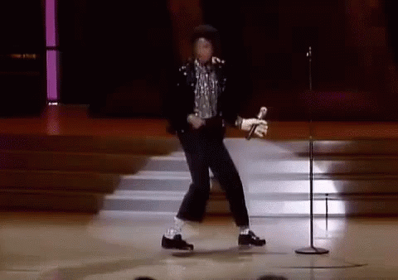
Backward Charades
Notes:
https://media1.tenor.com/images/0c209184c296fbbe3de84842df290123/tenor.gif?itemid=4163427

Slide 8
Ben-Hur Done That
How long would it take to read a book this thick?
What if the book is all pictures?
Or what if the font size is super small?
Notes:
img source:https://www.eveningstarbooks.net/pages/books/00005707/lew-wallace/ben-hur-a-tale-of-the-christ
It has approximately 520 pages. Ask students to imagine that they had two months to read the book and write a 5-page report. When should they get started?

Slide 9
Doing the Math
520 pages ➗ 60 days = 8 pages/day
OR if you need a month to write the report…
520 pages ➗ 30 days = 17 pages/day

Slide 10
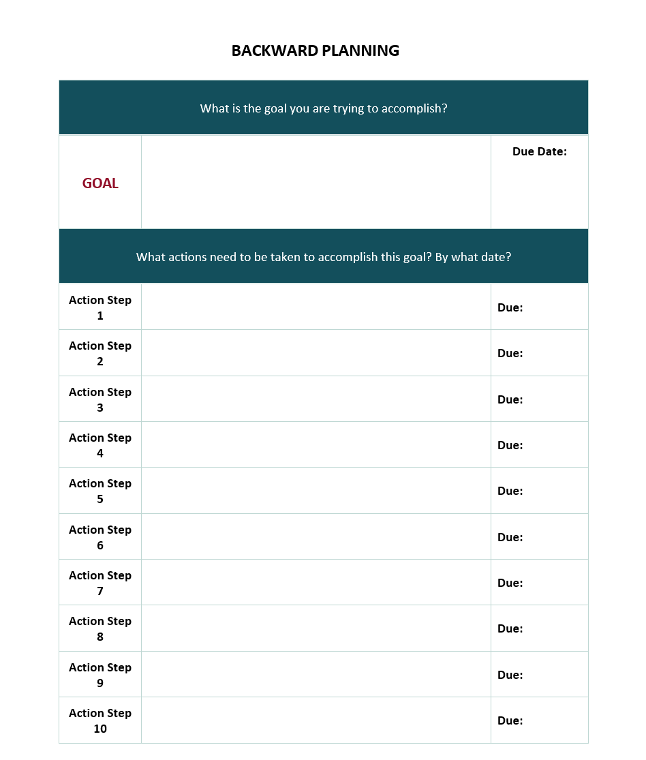
Backward Planning Goal

Slide 11
A goal without a plan is just a wish.
—Antoine de Saint-Exupéry

