Slide 2
Present It With Pictures
Convincing With an Infographic

Slide 3
Essential Question
Aside from the five-paragraph essay, how else might we effectively communicate ideas in a way that is visually engaging and persuasive?

Slide 4
Learning Objectives
Define the key components of a research-based infographic.
Identify the steps necessary to convey ideas in an infographic.
Create an infographic that combines visual elements with researched information.

Slide 5
Notes:
stop sign: http://clipart-library.com/clipart/6Tp5EXjyc.htm
pedestrian crossing: https://www.clipartmax.com/middle/m2i8d3m2Z5b1Z5d3_pedestrian-crossing-sign-traffic-signs/
no left turn: http://clipart-library.com/clipart/1539903.htm

Slide 6
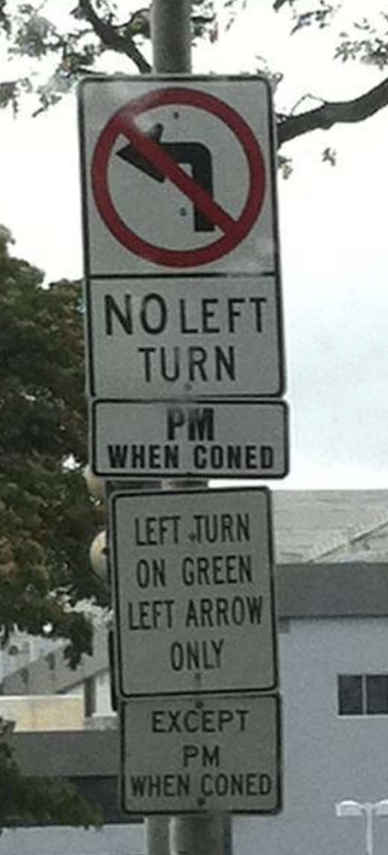
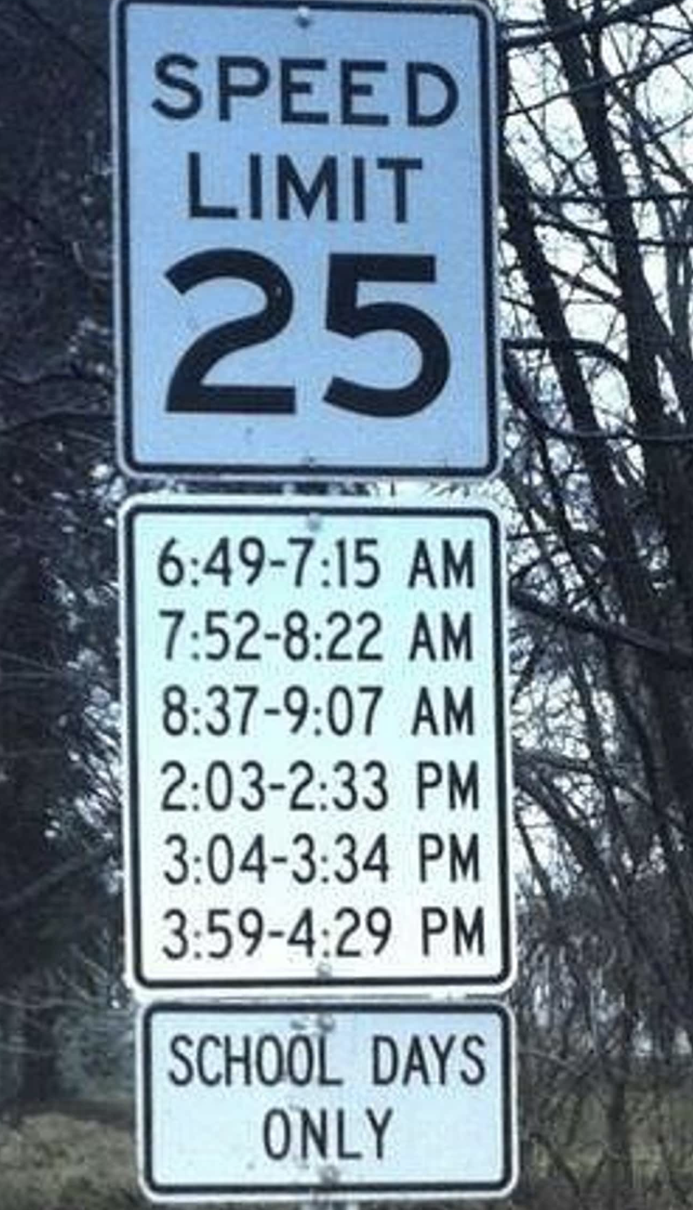

Slide 7
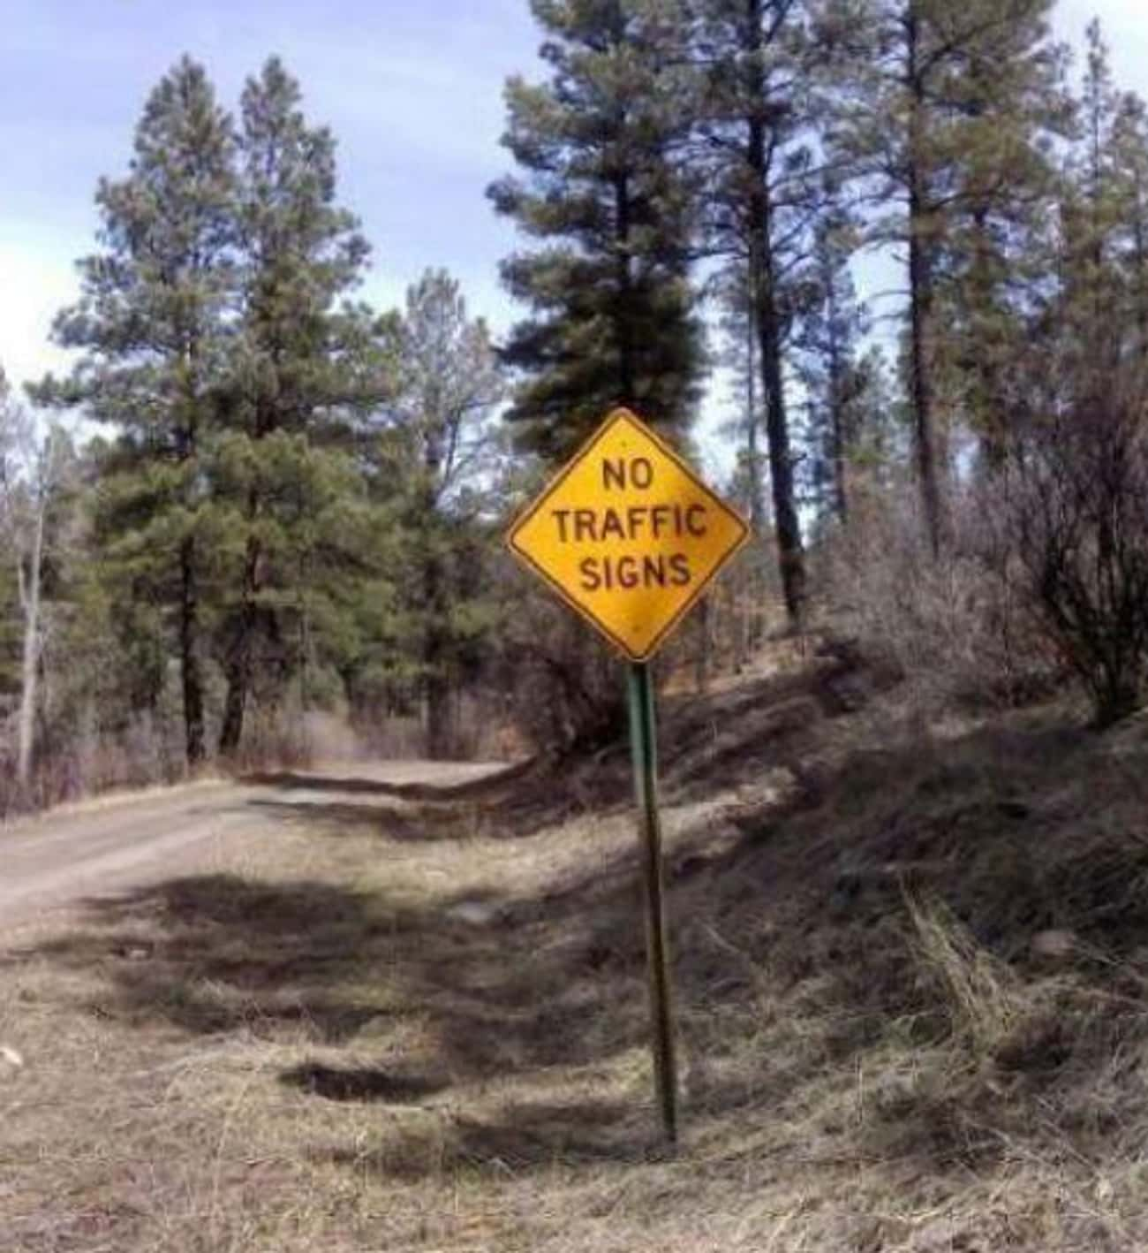
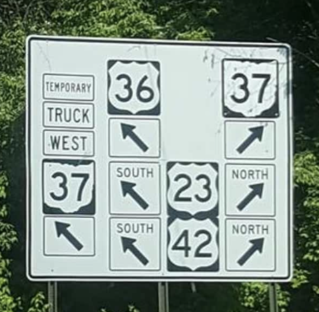

Slide 8
Comparing Text and Infographics
Read.
Highlight important information.
Write a note about why each thing you highlighted is important.

Slide 9
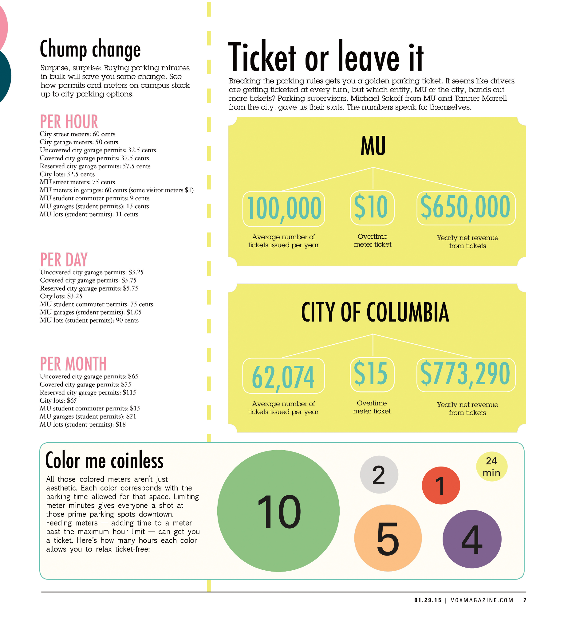
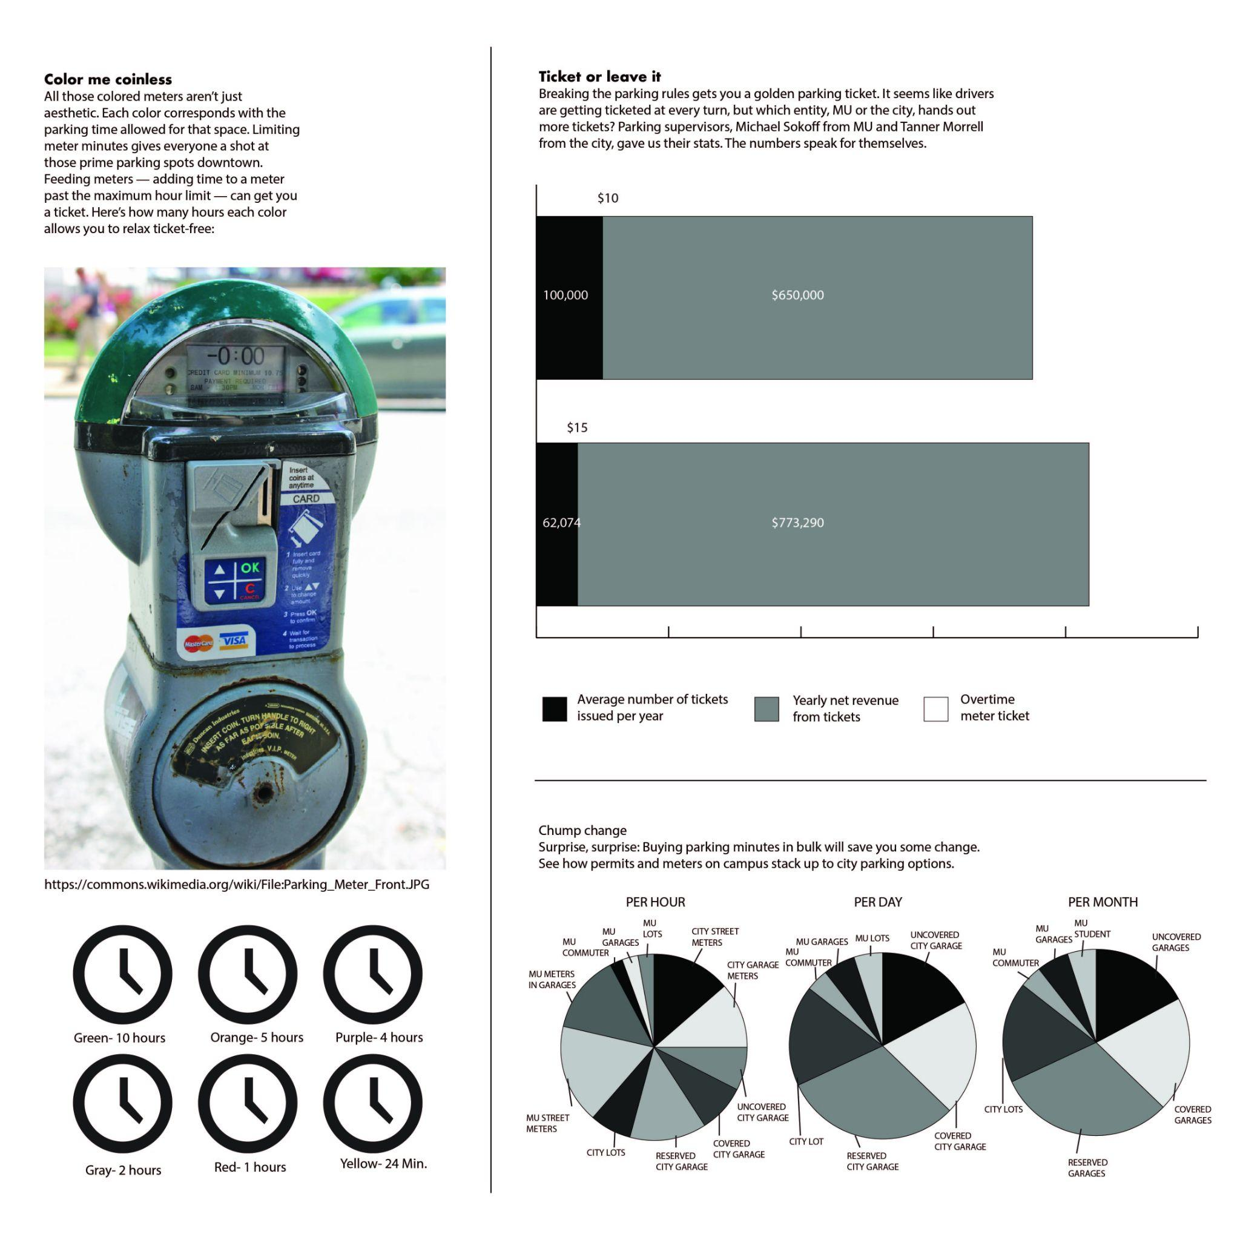
Example
Non-Example

Slide 10
Creating an Infographic
Remember to:
Provide information to a general audience of adults and/or high school teens.
Convey a main idea clearly to the reader.
Provide 3 supporting points for the main idea.
Apply principles of visual aesthetics to engage a potential reader.

Slide 11
Peer Feedback
Look for:
Providing information to a general audience of adults and/or high school teens.
Conveying a main idea clearly.
Providing 3 supporting points for the main idea.
Applying principles of visual aesthetics to engage.

