Slide 2
Road Trip to the Future
Exploring Historically Black Colleges and Universities

Slide 3
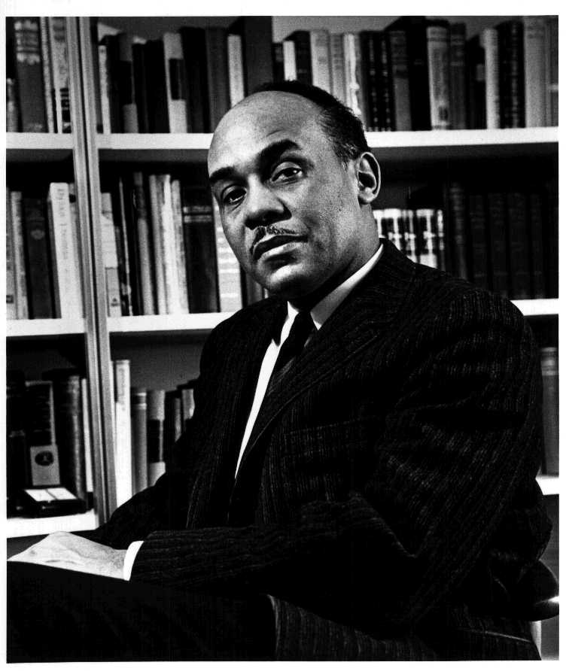
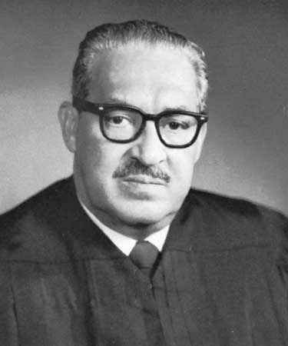
Ralph Waldo Ellison
Celebrated Oklahoman and Douglas High School graduate.
Writer, literary critic, best known for his novel Invisible Man.
Thurgood Marshall
American lawyer and Civil Rights activist.
First African-American Associate Justice of the
Supreme Court.
Notes:
Stephen Winick (June 2, 2017). Ralph Ellison, Invisible Folklorist. Folklife Today. Library of Congress.
https://blogs.loc.gov/folklife/files/2017/05/Ralph_Ellison_photo_portrait_seated.jpg
Marshall, Thurgood. (2006). In M. I. Urofsky (Ed.), Biographical encyclopedia of the Supreme Court. http://library.cqpress.com/scc/bioenc-427-18168-979368

Slide 4
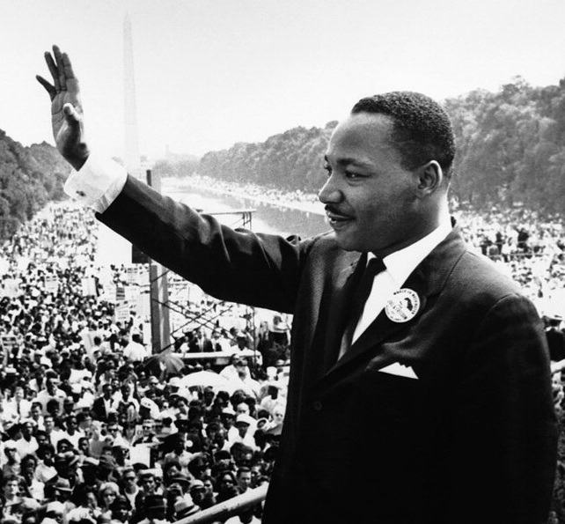
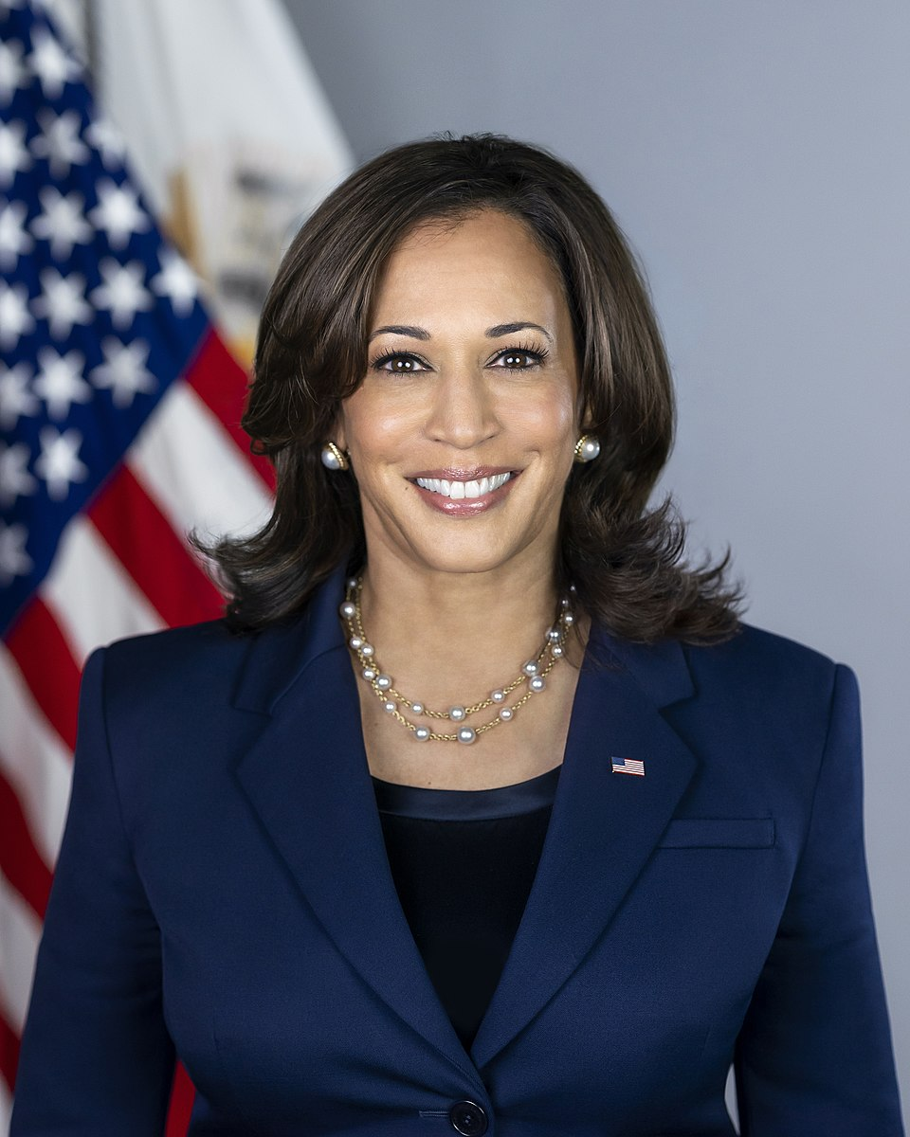
Kamala Devi Harris
American attorney and politician previously serving as Attorney General of the State of California and U.S. Senator.
49th Vice President of the United States of America and first African American and Asian American VP.
First female vice president and the highest-ranking female official in U.S. history to date.
Dr. Martin Luther King, Jr.
American Baptist Minister and one of the visible spokesperson and leader for the Civil Rights Movement.
Notes:
Public Affairs Office. (2010, Jan 14). Martin Luther King Jr. addresses a crowd from the steps of the Lincoln Memorial where he delivered his famous, “I Have a Dream,” speech during the Aug. 28, 1963, march on Washington, D.C. Retrieved from MARINES: https://www.mcasiwakuni.marines.mil/Images-photos/igphoto/255288/
The White House. (n.d.). Kamala Harris: The Vice President. Retrieved from The White House: https://www.whitehouse.gov/administration/vice-president-harris/

Slide 5
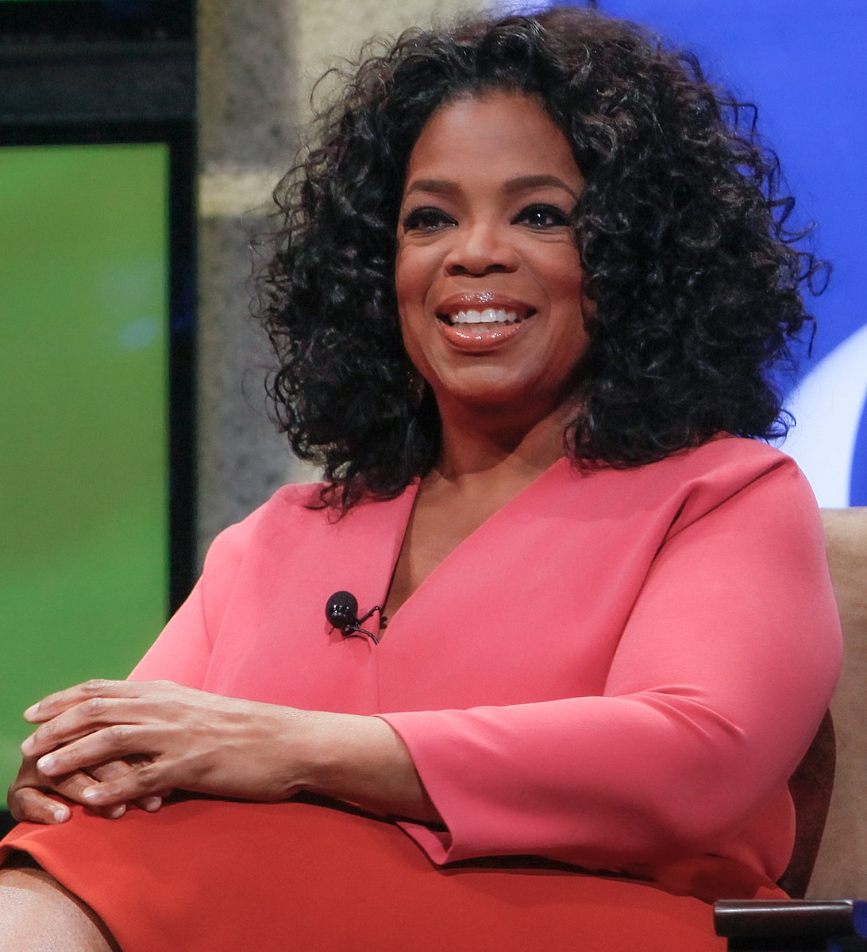
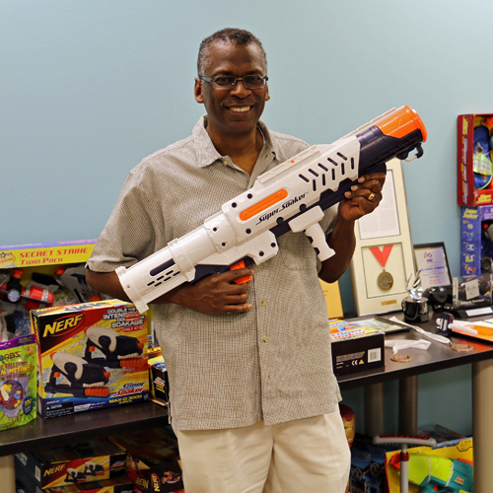
Oprah Gail Winfrey
American talk show host, TV producer, actress, and philanthropist.
Chairman and CEO of Harpo Productions and the Oprah Winfrey Network (OWN).
Lonnie George Johnson
American inventor, aerospace engineer, and entrepreneur.
Founder and President of Johnson Research and Development CO, formerly served in U.S. Air Force and NASA.
In 1989 invented the Super Soaker water gun, one of the best selling toys to date.
Notes:
INTX: The Internet & Television Expo. (16, June 2011). 2011: Oprah at the Cable Show. Retrieved from https://www.flickr.com/photos/intxncta/29902986311/
Johnson Research & Development Co., Inc. (n.d.). Lonnie Johnson with Super Soaker and Nerf toys.

Slide 6
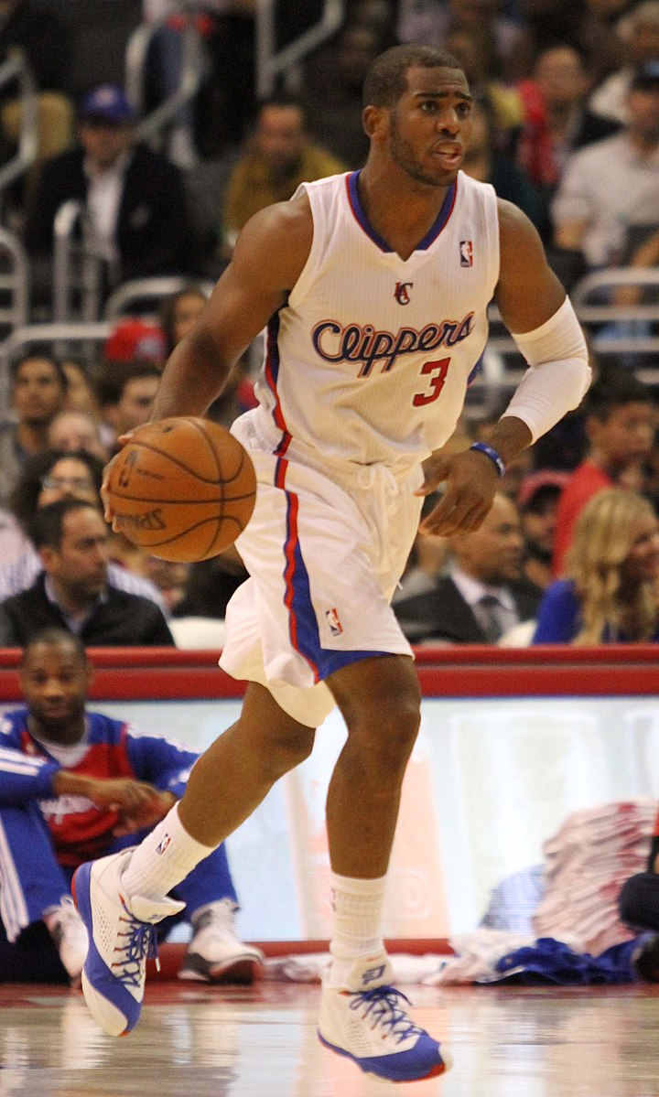
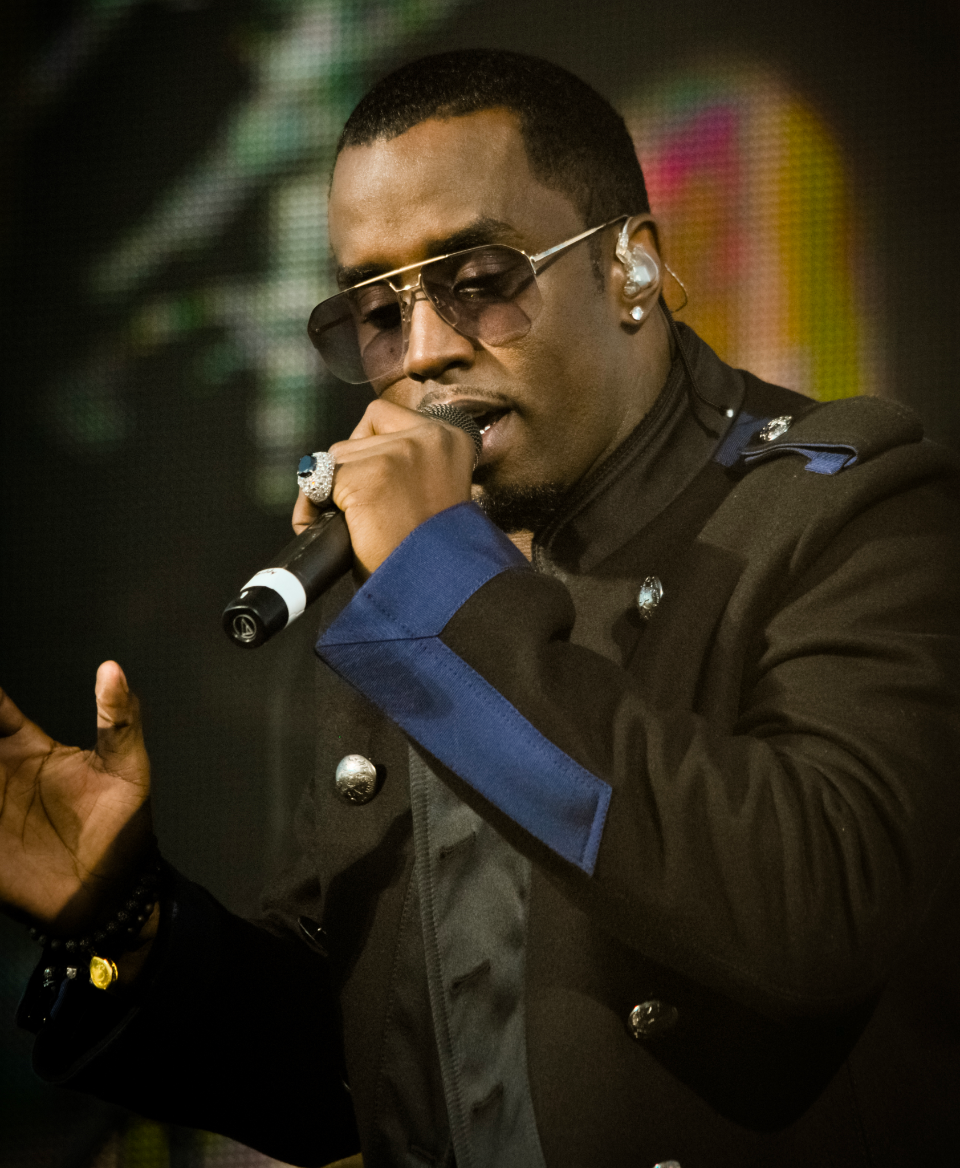
Chris Paul “CP3”
American NBA Player, formerly played for the OKC Thunder and actively playing with the Phoenix Suns.
Among one of the highest paid athletes.
Has represented Team USA in the Olympics.
Sean “Diddy” Combs
American rapper, record executive, and entrepreneur.
Founded Bad Boy Records–an American record label and Sean John clothing line.
Notes:
Reckless Dream Photography. (2010, December 11). Diddy Dirty Money. Diddy 23.
Verse Photography. (2013, Nov 18). Chris Paul with the Los Angeles Clippers in 2013. https://www.flickr.com/photos/versecg/10953692104/in/album-72157637862173195/

Slide 7
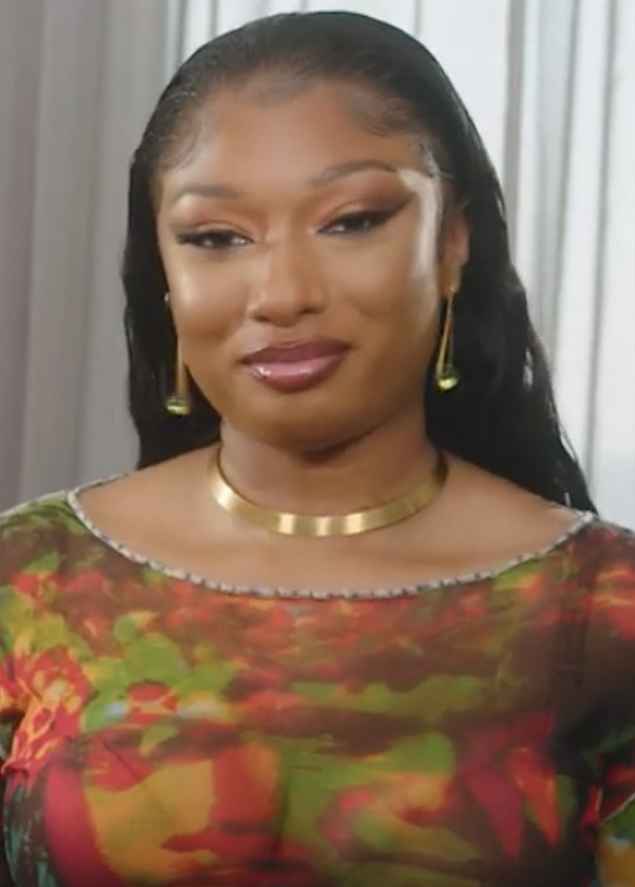
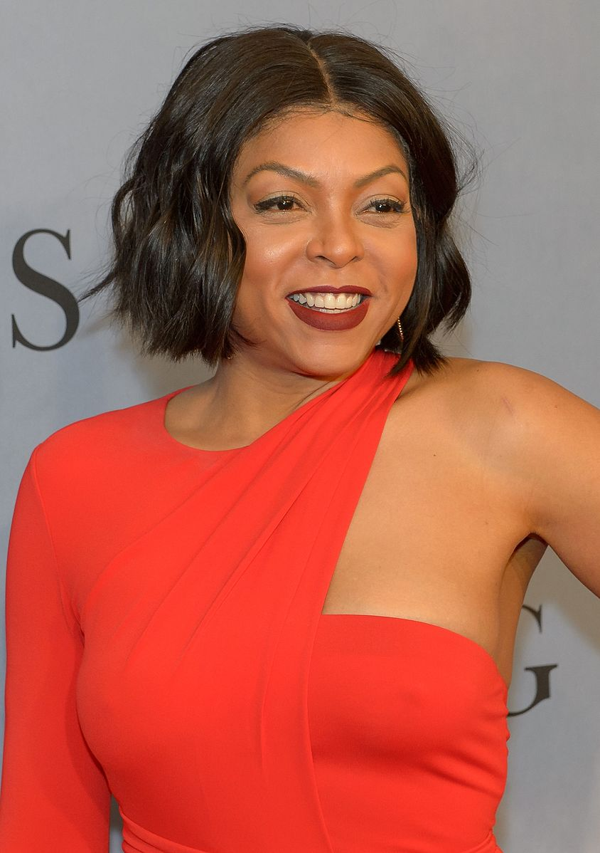
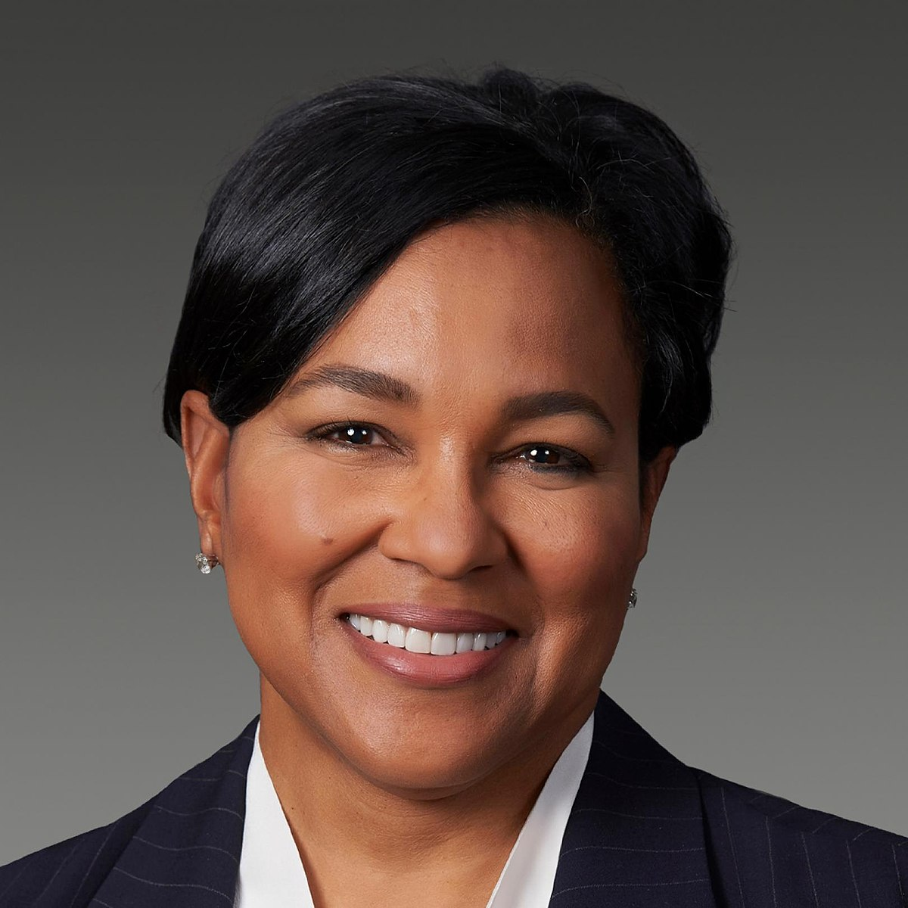
Megan Jovon Ruth Pete
American rapper artist known as “Megan Thee Stallion.”
Grammy award winning artist and featured in Time magazine's 100 most influential people in the world list.
Taraji P. Henson
American actress, singer, and writer.
New York Times best selling author and featured in Time magazine's 100 most influential people in the world list.
Member of the White House’s Board of Advisors on Historically Black Colleges and Universities.
Rosalind G. Brewer
American business woman, first African-American woman to serve as CEO of Walgreen’s Boots Alliance.
Former CEO of Sam’s Club and served as group President and COO of Starbucks.
Notes:
Ashley Graham. (2021, Sept 17). Megan Thee Stallion in a video from Ashley Graham in September 2021. https://www.youtube.com/watch?v=Fio7C-3WMd8
NASA. (2016, Dec 10). American actress and singer Taraji P. Henson. https://www.flickr.com/photos/nasahqphoto/31525359096/
Walgreens Boots Alliance. Rosalind Brewer. https://www.walgreensbootsalliance.com/about-us/leadership/rosalind-brewer

Slide 8
Tell Me Everything
From politicians to entertainers to corporate America, what might all of these successful African-Americans have in common?

Slide 9
Historically Black Colleges and Universities
All of these individuals have graduated or are currently attending an Historically Black College or University (HBCU).
HBCUs are institutions that established with the intention of providing access to higher education to the African-American community.

Slide 10
Lesson Objectives
Analyze the historical background of HBCUs.
Collaborate to research several HBCUs to identify which school best meets personal and academic goals.

Slide 11
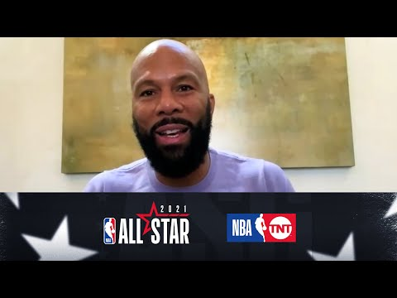
The Importance of HBCUs

Slide 12

Stop and Jot
As you read through the handout “The Rise of Historically Black Colleges and Universities,” stop and jot down a brief summary of each section.
Be sure to include all information important to the understanding of that section.

Slide 13
Essential Questions
Why have Historically Black Colleges and Universities been so important?
Do you think they will continue to be important?

Slide 14
HBCUs Research Project
In groups, research a Historically Black College and University to gain more information about the school.
Go to the website: http://www.thehundred-seven.org/hbculist.html
Select the college/university, and using the Research Project Handout, follow along with the questions.

Slide 15

Anchor Chart
In your groups, create an Anchor Chart to
represent the school you researched.
The Chart must be visually strong and include a mixture of words and pictures.
Refer to the Anchor Chart Instructions and Requirements on the Research Handout for the list of everything to include.

Slide 16
Gallery Walk
Select a spokesperson to speak on behalf of your school.
All other group members will rotate to other charts to learn about the different schools.
As you rotate, think of which school interests you the most and come up with one question you would ask if you were to visit.
Once you have written your question, post it on that school’s chart.

