Slide 2
Iteration of Design from Shapes

Slide 3
Warm-up Activity
Draw a shape of your choosing and fill it with one solid color. It can be as basic or complex as you’d like.
You can use markers, pens, pencils, or pastels, but stick to one medium for the entirety of the lesson.

Slide 4
Essential Question
How does shape inform character design?

Slide 5
Lesson Objective
Develop an original character through iteration.

Slide 6
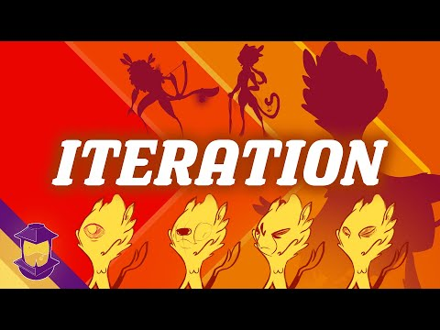
Notes:
YouTube. (2021, August 5). Drawing shapes into faces! YouTube. Retrieved June 7, 2022, from https://www.youtube.com/watch?v=FQd3h9tTMvk

Slide 7
Commit and Toss
Answer the following question on a sticky note, crumple it up, and throw it in a waste basket:
What was your key takeaway from the video?

Slide 8
Modeled design
Watch as you are led through the process.

Slide 9
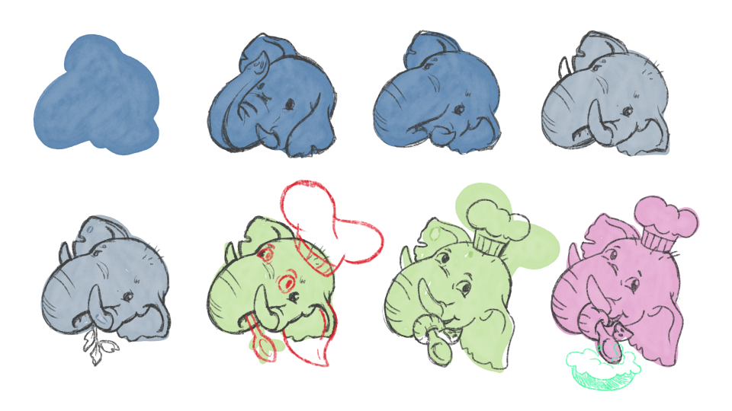
Sample using an irregular shape

Slide 10
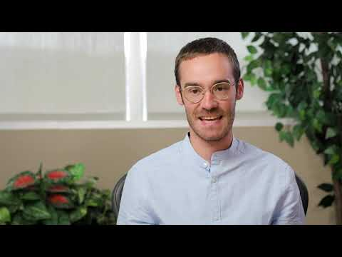
Day 1 Student Survey
Notes:
https://www.youtube.com/watch?v=KUqHWMUljSw

Slide 11
Day 1 Student Survey
https://bit.ly/day1-k20Lesson

Slide 12
Day 2
Take one minute to reflect on yesterday’s lesson. After you think through what we did, on a scale of Fist to Five (0-5) show on you hand your level of understanding.

Slide 13
Guided Practice
Using a triangle, design a fish. Follow your teacher’s instructions on how to get the design started.
You can alter the proportions of the shape
You can alter the shade of the color
Each time you make a change, make it next to the previous version of the drawing so we can see progress.

Slide 14
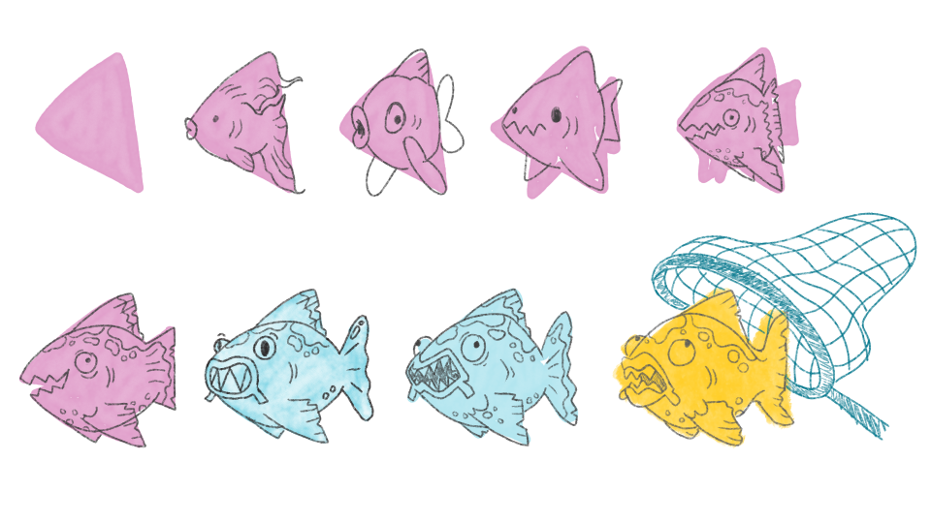
Sample using a triangle

Slide 15
Independent practice
Using your original shape and color from yesterday, make a character of your own. Remember, you can change anything, but no erasing, always start a new iteration next to the one previous.

Slide 16
“Exit” Ticket
Answer the following questions:
What did you learn from this experience?
Did starting from such basic components hinder or hurt your creativity? Why?
Did this change your perception of any popular character from a media franchise with which you are familiar?

Slide 17
Day 2 Student Survey
Notes:
https://www.youtube.com/watch?v=hHqmk_9XVR0

Slide 18
Day 2 Student Survey
https://bit.ly/day2-k20lesson

