Slide 2
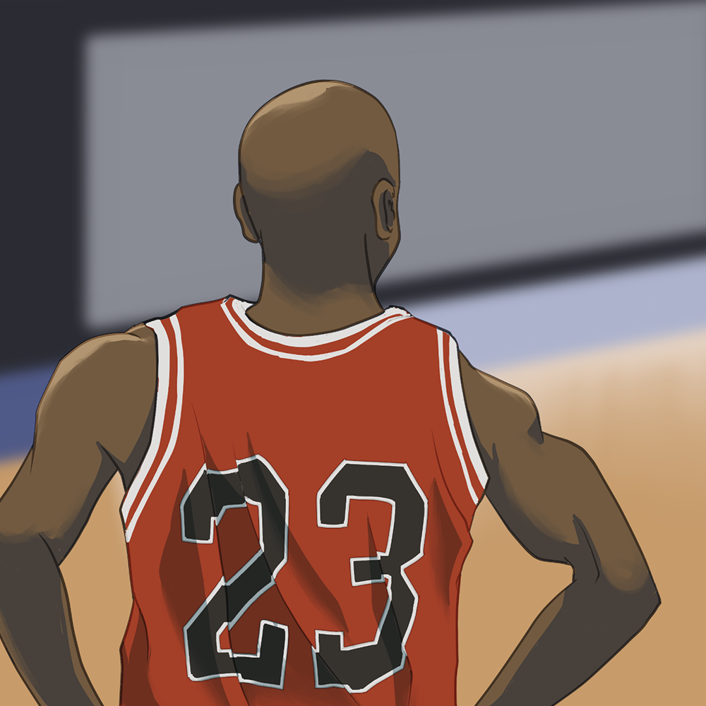
Famous Failures
Growth Mindset

Slide 3
Essential Question
How can our thoughts and beliefs about failure affect our success in school and life?

Slide 4
Learning Objectives
Recognize when a fixed mindset has been reformed into a growth mindset.
Reevaluate a current challenge that can be approached with a growth mindset versus a fixed mindset.
Determine how the lessons from the Famous Failures apply to personal challenges.

Slide 5

S-I-T
As you watch the video, take note of things you found:
S: Surprising
I: Interesting
T: Troubling
Notes:
YouTube. (2012). Famous Failures. YouTube. Retrieved July 27, 2022, from https://www.youtube.com/watch?v=zLYECIjmnQs&list=PL6P49nXsj_RyRa8udbr2ac_Xb9Sw4Pu5R&index=6.

Slide 6
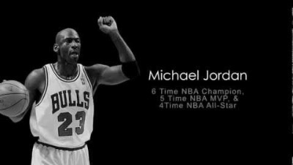
Notes:
MotivatingSuccess. (2012). Famous Failures [Video]. YouTube. https://www.youtube.com/watch?v=zLYECIjmnQs&list=PL6P49nXsj_RyRa8udbr2ac_Xb9Sw4Pu5R&index=6

Slide 7
Famous Failures
I have not failed. I’ve just found 10,000 ways that won’t work.
—Thomas A. Edison

Slide 8

Famous Failures
Explore the 48 Famous Failures Who Will Inspire You to Achieve.
Narrow down your interest to one individual.
Take some time to look for additional information on other websites as needed.
Notes:
Kanaat, R. (2020, November 6). 48 famous failures who will inspire you to achieve. Wanderlust Worker. Retrieved July 27, 2022, from https://www.wanderlustworker.com/48-famous-failures-who-will-inspire-you-to-achieve/

Slide 9

Researching Your Famous Failure
Create a poster that includes:
Name and photo of the person you researched
Why this person is important
Challenges they faced along the way
How they overcame their challenges

Slide 10
Sharing Your Famous Failure
Share your poster with your group.
Make sure you share the following:
  Name and photo of the person you researched
  Why this person is important
  Challenges they faced along the way
  How they overcame their challenges

Slide 11
S-I-T
As your peers present their Famous Failure, take note of things you find:
S: Surprising
I: Interesting
T: Troubling

Slide 12
Growth vs. Fixed Mindset
A growth mindset means that you believe your intelligence and talents can be developed over time. A fixed mindset means that you believe intelligence is fixed—so if you’re not good at something, you might believe you’ll never be good at it.
—Jennifer Smith

Slide 13
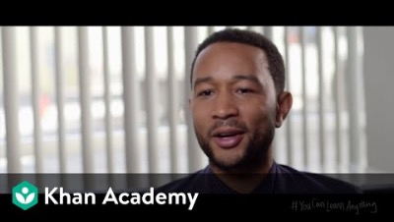
Notes:
Khan Academy. (2014). John Legend: Success through effort [Video]. YouTube. https://www.youtube.com/watch?v=LUtcigWSBsw&list=PL6P49nXsj_RyRa8udbr2ac_Xb9Sw4Pu5R&index=5

Slide 14

Growth Mindset Goal Activity
With your partner:
THINK of a situation or experience that you approach with a fixed mindset.
WHY does that situation or experience keep you from success or how does it challenge you?
WHAT can you do to approach the situation or experience with a growth mindset?
WHO might help you succeed? WHO might hinder your success?
WHAT other strategies could you apply to accomplish this growth mindset?
CREATE a growth mindset goal statement.

Slide 15
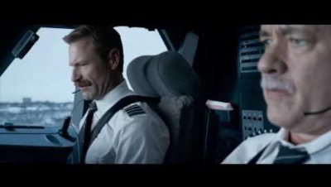
Notes:
Trader, J. (2017). Sully 2016 Plane Crash Scene Landing in the Hudson River [Video]. YouTube. https://www.youtube.com/watch?v=fJ5ZLdJDBrg

Slide 16
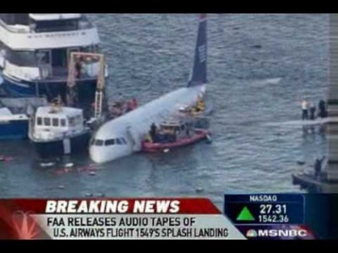
Notes:
Speakmymind02. (2009). U.S. Air Cockpit Audio Tapes "We're Gonna Be In The Hudson” [Video]. YouTube. https://www.youtube.com/watch?v=JItbos1tYZs

Slide 17

Airplane Landing
Summarize what you are taking away from these Famous Failures.
When you are done, fold your paper into an airplane.
In honor of Captain Chesley
“Sully” Sullenberger, fly your summary to the front of the classroom!

