Slide 2
A Study in Studying
Developing Effective Study Skills for College

Slide 3
I Used to Think…But Now I Know
Read the scenario at the top of the handout.
After reading, fill out the left-hand column “I Used to Think…” listing possible study skills you would use if you were in the scenario.
Notes:
K20 Center. (2020, September 16). I used to think…but now I know. Strategies. https://learn.k20center.ou.edu/strategy/137

Slide 4
Essential Question
Which study skills will help you succeed in high school and college?

Slide 5
Learning Objectives
Acquire an understanding of study skills that will enable you to succeed in high school and college-level classes.
Identify instances in which you will be able to employ these study skills over the course of your academic careers.

Slide 6
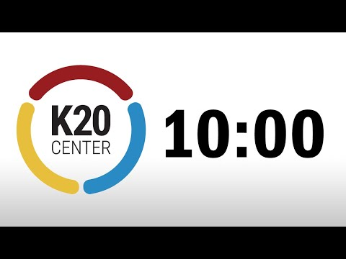
Explore
Before you begin reading, formulate a plan with your partner to ensure you complete the reading within 10 minutes.
With your partner, read the assigned article. Keep the following in mind:
Partner #1 - Be able to summarize your reading and share with the class.
Partner #2 - Identify and describe the strategy you used to assist in memorizing the material read.
Notes:
Video Source: K20 Center. (2021, September 21). K20 Center 10-minute timer [Video]. YouTube. https://www.youtube.com/watch?v=9gy-1Z2Sa-c

Slide 7
High School Study Skills
With your partner, read the list of study skills that can be used in your high school classes.
After you have finished reading, fill out the left-hand column of the H-Chart by answering the following questions:
Which study skills would be useful for you during your time in high school?
How will they help you study?
Notes:
K20 Center. (2020, September 16). Paired texts H-chart. Strategies. https://learn.k20center.ou.edu/strategy/132

Slide 8
Collegiate Study Skills
Continue reading with your partner the list of study skills that can be used in college classes.
After you have finished reading, fill out the right-hand column of the H-Chart by answering the following questions:
Which study skills would be useful for you when you’re in college?
How will they help you study?
Notes:
K20 Center. (2020, September 16). Paired texts H-chart. Strategies. https://learn.k20center.ou.edu/strategy/132

Slide 9
Commonalities
Complete the Paired Text H-Chart by answering the following questions in the center:
What do these skills have in common?
How can they help you improve your studying abilities?
Notes:
K20 Center. (2020, September 16). Paired texts H-chart. Strategies. https://learn.k20center.ou.edu/strategy/132

Slide 10
At-Home Reading
At home, read your chosen article using the following format:
Read 1-2 pages, setting a timer for 15 minutes.
Read 3-5 pages, setting a timer for 30 minutes.
Read 6-7 pages, setting a timer for 45 minutes.
Read 8-10 pages, setting a timer for 60 minutes.
As you read, use one of the strategies from the study skills handout.

Slide 11
Presentation Details
Construct a presentation to include the following information about your article.
Part #1 Study Skills:
List the skill you used to complete the at-home reading.
Identify how the skill was helpful.
Would you recommend the skill to others? Why or why not?
Part #2 Article Information:
Describe the main idea and topics addressed in the article.
What did you learn from reading th!e article?
Feel free to present this information in a creative way. Have fun!
(e.g., poster, PowerPoint presentation, science demonstration, etc.)

Slide 12
I Used to Think… But Now I Know
Locate the handout we used at the beginning of this activity.
In the right-hand column, write what you have learned about study skills for both high school and college.
Identify the ones you have found to be the most helpful and plan to use in the future.
Notes:
K20 Center. (2020, September 16). I used to think…but now I know. Strategies. https://learn.k20center.ou.edu/strategy/137

