Slide 2
Didn’t See That Coming
Planning Ahead

Slide 3
Essential Questions
How can we use calendars to stay on track and to avoid roadblocks that keep us from our goals?

Slide 4
Learning Objectives
Analyze problems that are likely to keep a task from being completed.
Determine solutions for dealing with roadblocks when planning a task.
Evaluate calendar plans for what worked and what can be improved.

Slide 5
Roadblock Game
Visit:
chrome://dino/
Play a few rounds
until time is called.

Slide 6
Card Sort
With your partner:
Take a moment to review all of the different roadblocks you might encounter
Determine which cards can be sorted into the following categories:
Near: A roadblock that needs to be addressed immediately.
Far: A roadblock that will not stop your progress right now.
Discuss why you might group these items together.

Slide 7
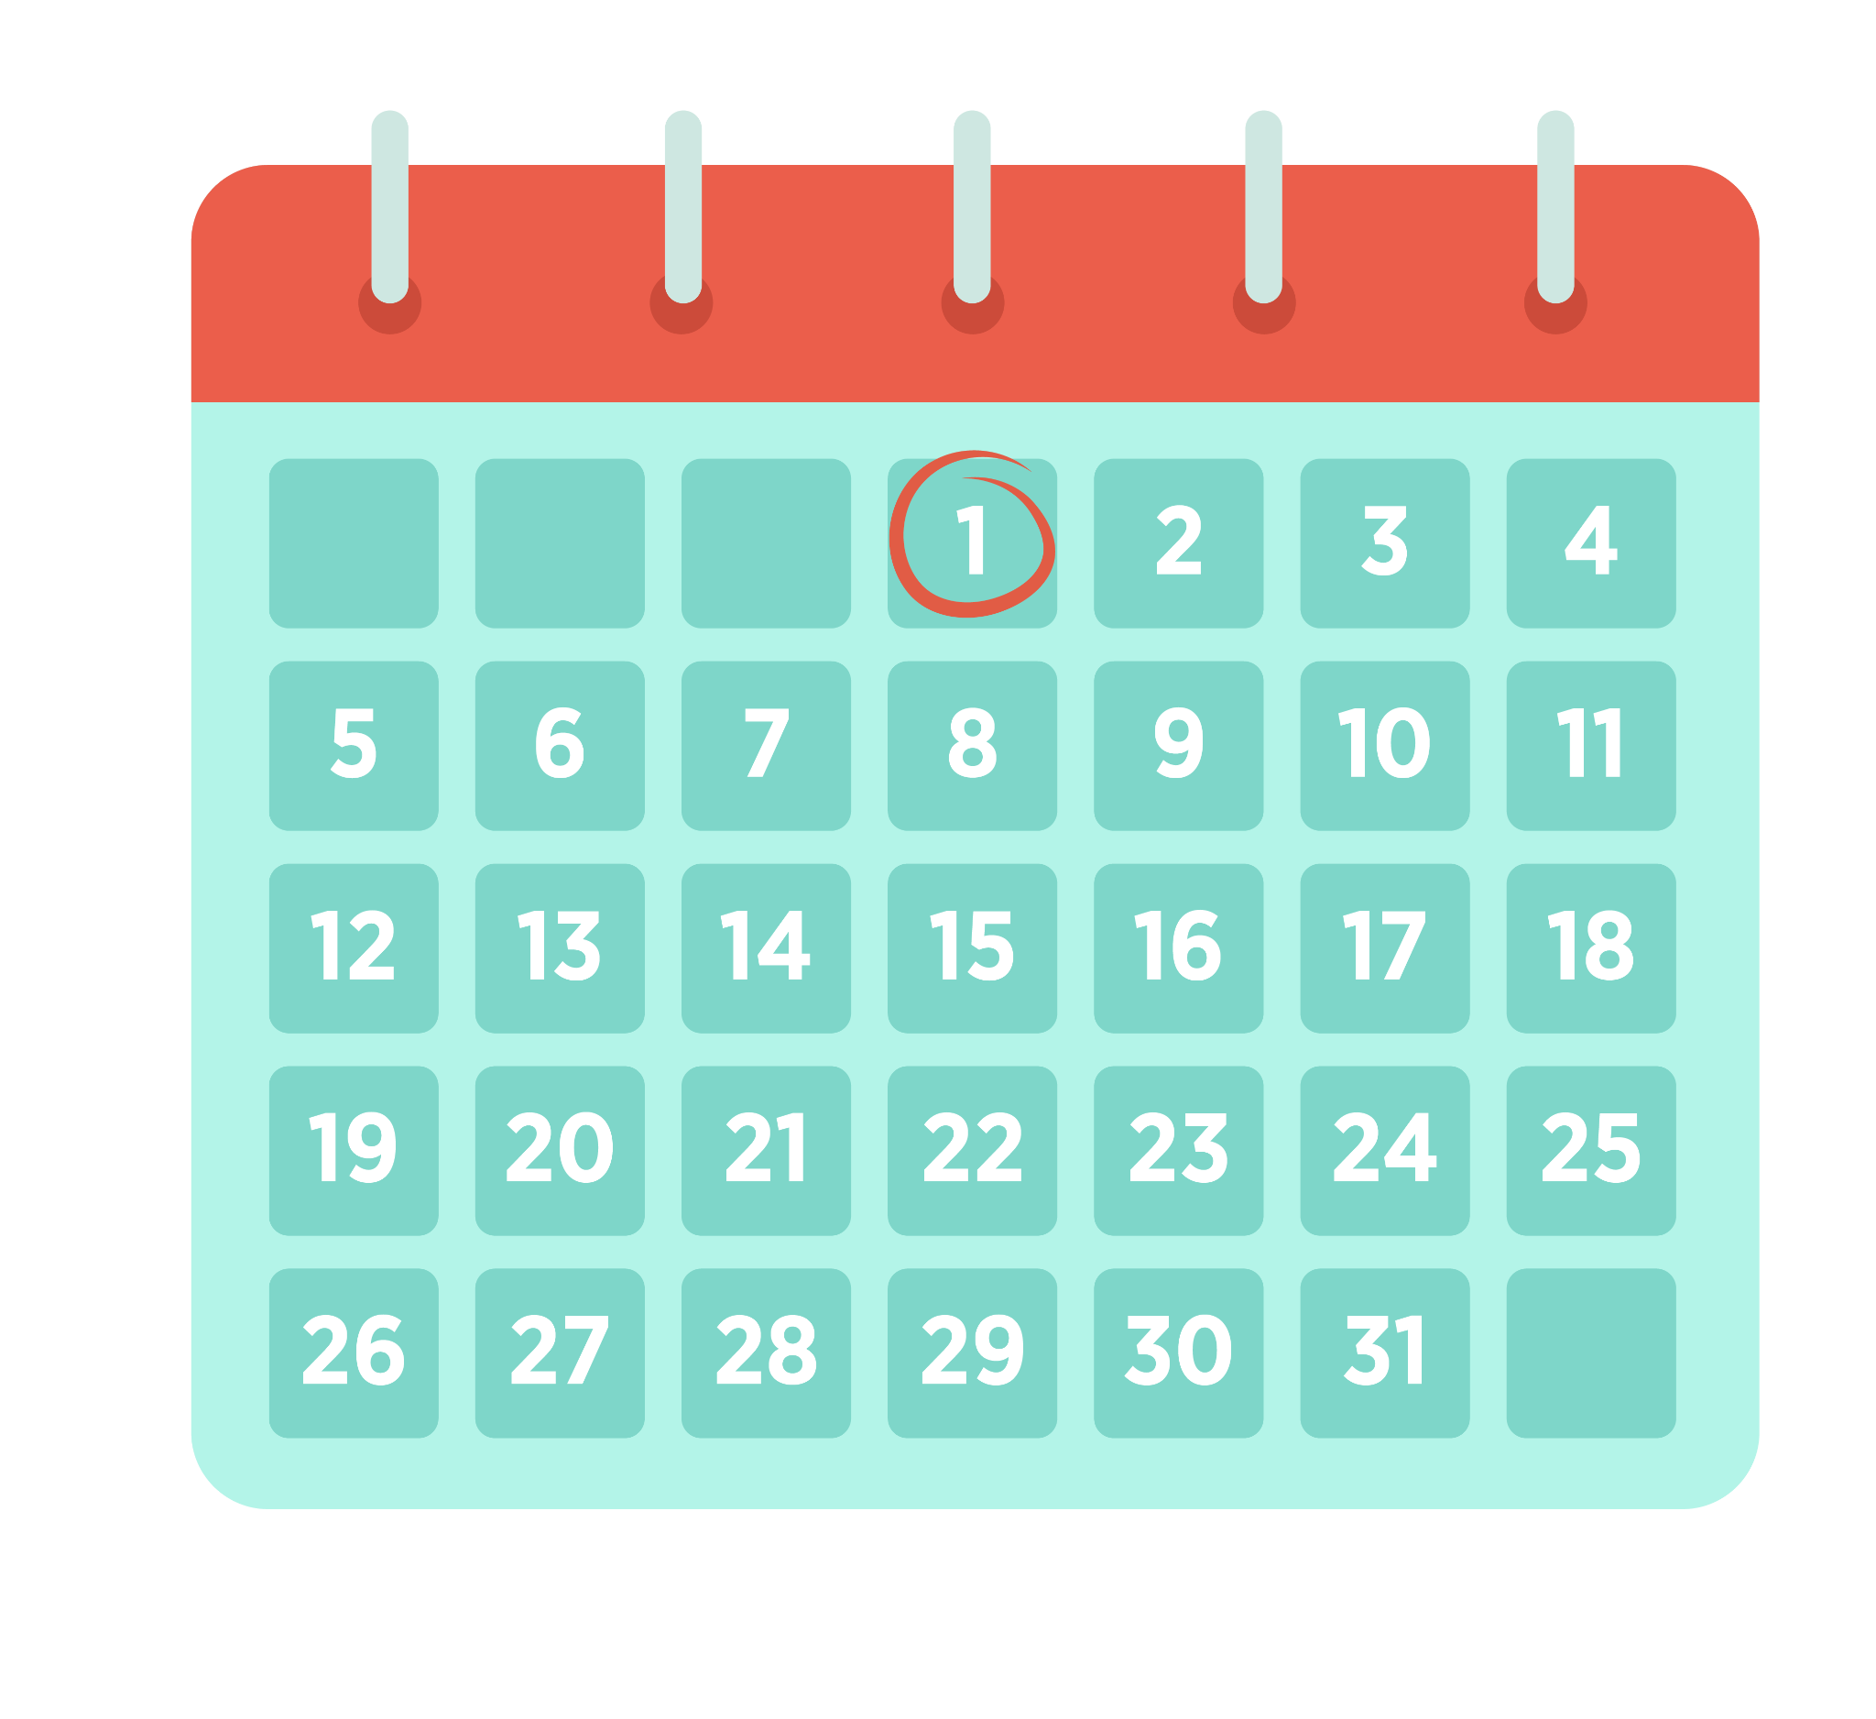
A Calendar’s Purpose
A calendar helps us see things that are coming up that we may need to avoid or workaround to be successful.
It also helps us uncover clear paths where we could take time to focus and make progress on goals.
Notes:
Image by K20 Graphic Designer Ann Marcelli

Slide 8
Categorical Highlighting
Determine which items would be categorized as the following:
Pink - Focus Time
Blue - Breaks
Green - Time on Task
Yellow - Solving a Problem
In the margins, explain why you categorized an event a particular way.
Notes:
K20 Center. (n.d.). Categorical Highlighting. Strategies. https://learn.k20center.ou.edu/strategy/192

Slide 9
Categorical Highlighting
Review the calendar with a partner.
What did you highlight/categorize similarly?
What did you highlight/categorize differently?

Slide 10
My Roadblocks
Take some time to write down some personal upcoming roadblocks.
Determine which roadblocks can be sorted into the following categories:
Near: A roadblock that needs to be addressed immediately.
Far: A roadblock that will not stop your progress right now.
Notes:
Image by K20 Graphic Designer Ann Marcelli

Slide 11
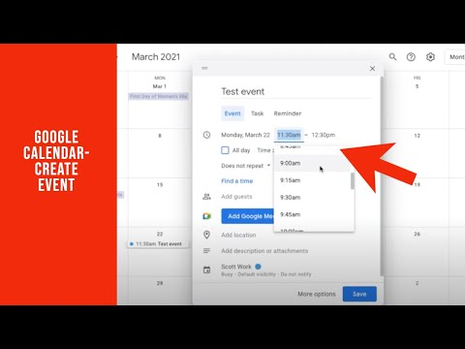

Slide 12
My Calendar
Log in to your calendar.
Use your calendar to plan your upcoming tasks.
Are there blocks of free time you could use to complete a task or focus on an assignment?
Reserve time on your calendar to work on these tasks.
Are there blocks of free time you could set aside to relax and refresh your mind?
Reserve time on your calendar for fun time.
Notes:
Image by K20 Graphic Designer Ann Marcelli

Slide 13
My Calendar
Use your calendar to plan your upcoming tasks.
Are there blocks of free time you could use to complete a task or focus on an assignment?
Reserve time on your calendar to work on these tasks.
Are there blocks of free time you could set aside to relax and refresh your mind?
Reserve time on your calendar for fun time.
Notes:
Image by K20 Graphic Designer Ann Marcelli

Slide 14
My Calendar
How did your calendar help you get tasks done?
How did it help to make sure you had time to relax?
Notes:
Image by K20 Graphic Designer Ann Marcelli

