Slide 2
What’s My Motivation?
Staying Motivated

Slide 3
Essential Questions
How can we stay motivated to complete a task?

Slide 4
Learning Objectives
Analyze what motivates us to do our best work.
Apply our understanding of motivation to make a plan to encourage us to do our best work.

Slide 5
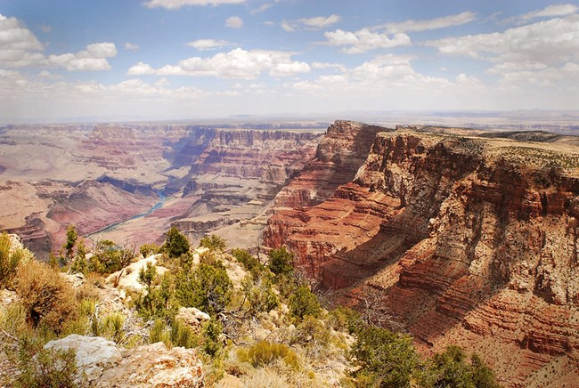
Would You Rather?
Go on vacation to New York City
Go camping at the Grand Canyon
Notes:
imgs from Google Slides image search

Slide 6
Would You Rather?
Read a book
Go water skiing
Notes:
imgs from Google Slides image search

Slide 7
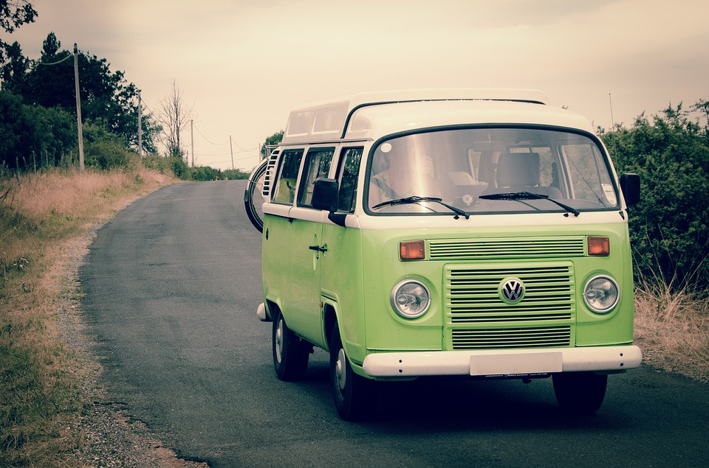
Would You Rather?
Go on a long road trip
Fly out of town
Notes:
imgs from Google Slides image search

Slide 8
Would You Rather?
Would you rather go on vacation to New York City or camping at the Grand Canyon?
Would you rather read a book or go water skiing?
Would you rather go on a long road trip or fly out of town for the weekend?

Slide 9
What Motivates You?
For each question choose the one thing you would most prefer.
After answering all the questions, use the Scoring Key to record your results.
How to Score:
Each choice has one of 5 letters at the end.
Count how many of each letter you chose.
Record the results in the Scoring Key on the last page.

Slide 10
What Motivates You?
What were your top 2 results?
What surprised you about your results?

Slide 11
Two Types of Motivation
Extrinsic Motivation: To participate in an activity for the reward of an object.
Example: prize, monetary reward, promotion
Intrinsic Motivation: To participate in an activity for an internal reward or a feeling.
Example: desire to please, succeed, complete a task, or be seen as dependable

Slide 12
Motivation Card Sort
Cut out your cards.
Use the cards with extrinsic and intrinsic to create groups of different types of motivation.
As a group, sort your cards into the group you believe they belong to.
Discuss the pros and cons of each motivation.
Be prepared to share your thinking with the class.
Notes:
K20 Center. (n.d.). Card Sort. Strategies. https://learn.k20center.ou.edu/strategy/147

Slide 13
My Vision Board
Create a vision board for a goal you have.
Keep in mind the following:
What is your goal?
What are you good at that will help you reach your goal?
What do you want to get better at that will help you reach your goal?
How can you connect and build relationships with others who will help you reach your goal?
Share your vision board with the class.
Notes:
K20 Center. (n.d.). Vision Boards. Strategies. https://learn.k20center.ou.edu/strategy/2054

Slide 14
Exit Ticket
How did making a vision board help you think about the motivation for your goals?

