Slide 2
The Case for Curiosity
Research and Writing Skills

Slide 3
Video
insert club relevant video here

Slide 4
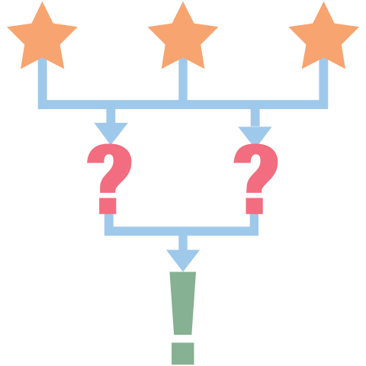
3-2-1
What are 3 things that fascinated you in this video?
What are 2 things you are interested to learn more about?
What is 1 question you would ask the maker of the video in order to learn more about the things you are wondering about?
Notes:
K20 Center. (2020, September 16). 3-2-1. Strategies. https://learn.k20center.ou.edu/strategy/117

Slide 5
Essential Question
How do we become better writers and researchers?

Slide 6
Learning Objectives
Identify the skills needed in order to conduct thorough research and write effective papers.
Determine which research and writing techniques work best for you as you research and write about a subject that interests you.
Create an outline as you conduct your research and prepare to write a paper.

Slide 7
Stoplight Questions
Red Questions can be answered with a quick Google search.
Yellow Questions have potential. They ask “how” or “why” but do not require inferences.
Green Questions encourage others to create new knowledge. They can be “how” or “why,” but also might be “If…then…” questions.
Notes:
K20 Center. (2021, April 14). Stoplight questions. Strategies. https://learn.k20center.ou.edu/strategy/943

Slide 8
Rewrite Research Question
Remember, good researchers will ask a question with an answer that will allow people to draw new conclusions about a topic.
Take a moment to reread your question.
Does it help others draw new conclusions?
How could you rephrase it?
Edit your research question to guide others to new conclusions on the topic.

Slide 9
Primary vs. Secondary Sources
Notes:
University of Houston Libraries. (2020, March 18). What are primary and secondary sources? [Video]. YouTube. https://www.youtube.com/watch?v=X3JrQ6sHZ8c

Slide 10
A-CLAP
Authority. Is the author listed, and if so, what are their qualifications?
Currency. How current is the source?
Leaning. What is the author’s leaning? Is the information presented objectively?
Accuracy. Is the source accurate?
Purpose. What is the purpose of the source?
Notes:
K20 Center. (2021, March 24). A-CLAP. Strategies. https://learn.k20center.ou.edu/strategy/183

Slide 11
Scavenger Hunt
As you go through the library, look for the following resources:
3-5 printed resources (at least one of each below)
Books
Magazines
Newspaper Articles
1-2 digital resources
Internet articles
Blog posts

Slide 12
Bill Leamon’s Study Skills
Research the topic.
Write an outline of the paper.
Write a rough draft.
Review the paper.
Make major revisions.
Give it to someone in the writing lab to review.
Make all necessary final edits.
Give it a careful final review.
Print the paper.
Hand it in or submit it online.

Slide 13
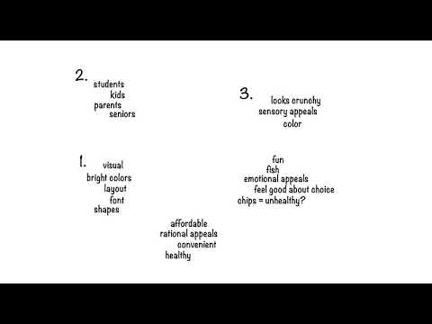
Outlining a Research Paper
Notes:
UNC Writing Center. (2019, January 14). Outlines - UNC Writing Center [Video]. YouTube. https://www.youtube.com/watch?v=aZUrlFY84Kw

Slide 14
Outlining a Research Paper
Introduction
Explain what your paper is about.
Pique the reader's interest.
Body
Give 3-5 main points with supporting sub-points.
Support ideas with quotes.
Conclusion
Very briefly review the main points.
State your “takeaway.”
Do not include new detailed information.
Notes:
GNBCEC. (2011, Sept 25). Follow. (n.d.). 10 steps to writing a research paper. Share and Discover Knowledge on SlideShare. Retrieved August 8, 2022, from https://www.slideshare.net/gnbces/10-steps-to-writing-a-research-paper
.

Slide 15
Partner Speaks
Switch outlines with a partner.
Read through your partner’s outline and keep in mind their research question as you do. Share the following with your partner:
Did your partner successfully create an outline that will allow them to write a good research paper?
Does each section of the outline succeed in answering the research question?
What do you like about your partner’s outline? How could they improve it?
Be prepared to share a summary of your partner’s research project and answer the following questions:
What is your partner’s research question?
What did you learn from your partner’s research outline?
Notes:
K20 Center. (2021, February 12). Partner Speaks. Strategies. https://learn.k20center.ou.edu/strategy/62

Slide 16
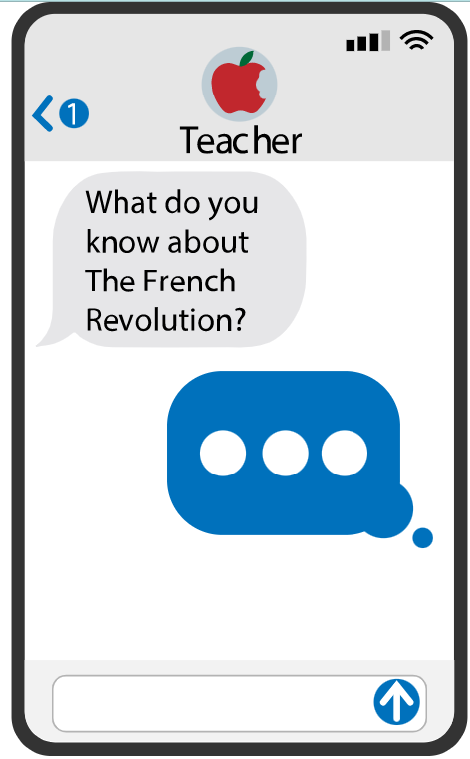
Quick Write
During this Quick Write, write the introduction for your research paper. At this time, do not worry about grammar or spelling. Your goal is to write as much as you can during the time provided.
Think of the following as your write your introduction:
What would you say if you only had a few minutes to tell someone about your research question?
Why does this particular topic interest you?
Why is this topic important?
Notes:
K20 Center. (2021, February 12). Quick write. Strategies. https://learn.k20center.ou.edu/strategy/1127

