Slide 2
Seinfeld’s SMART Steps to Success
Goal Setting

Slide 3
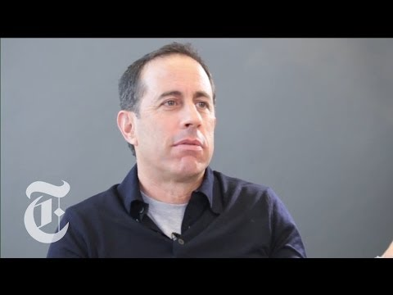
Notes:
Following the video ask students the following questions:
What is his goal?
What was he trying to do?
How did he become so successful?
Slide about who Jerry Seinfeld is and one about “The Chain”

Slide 4
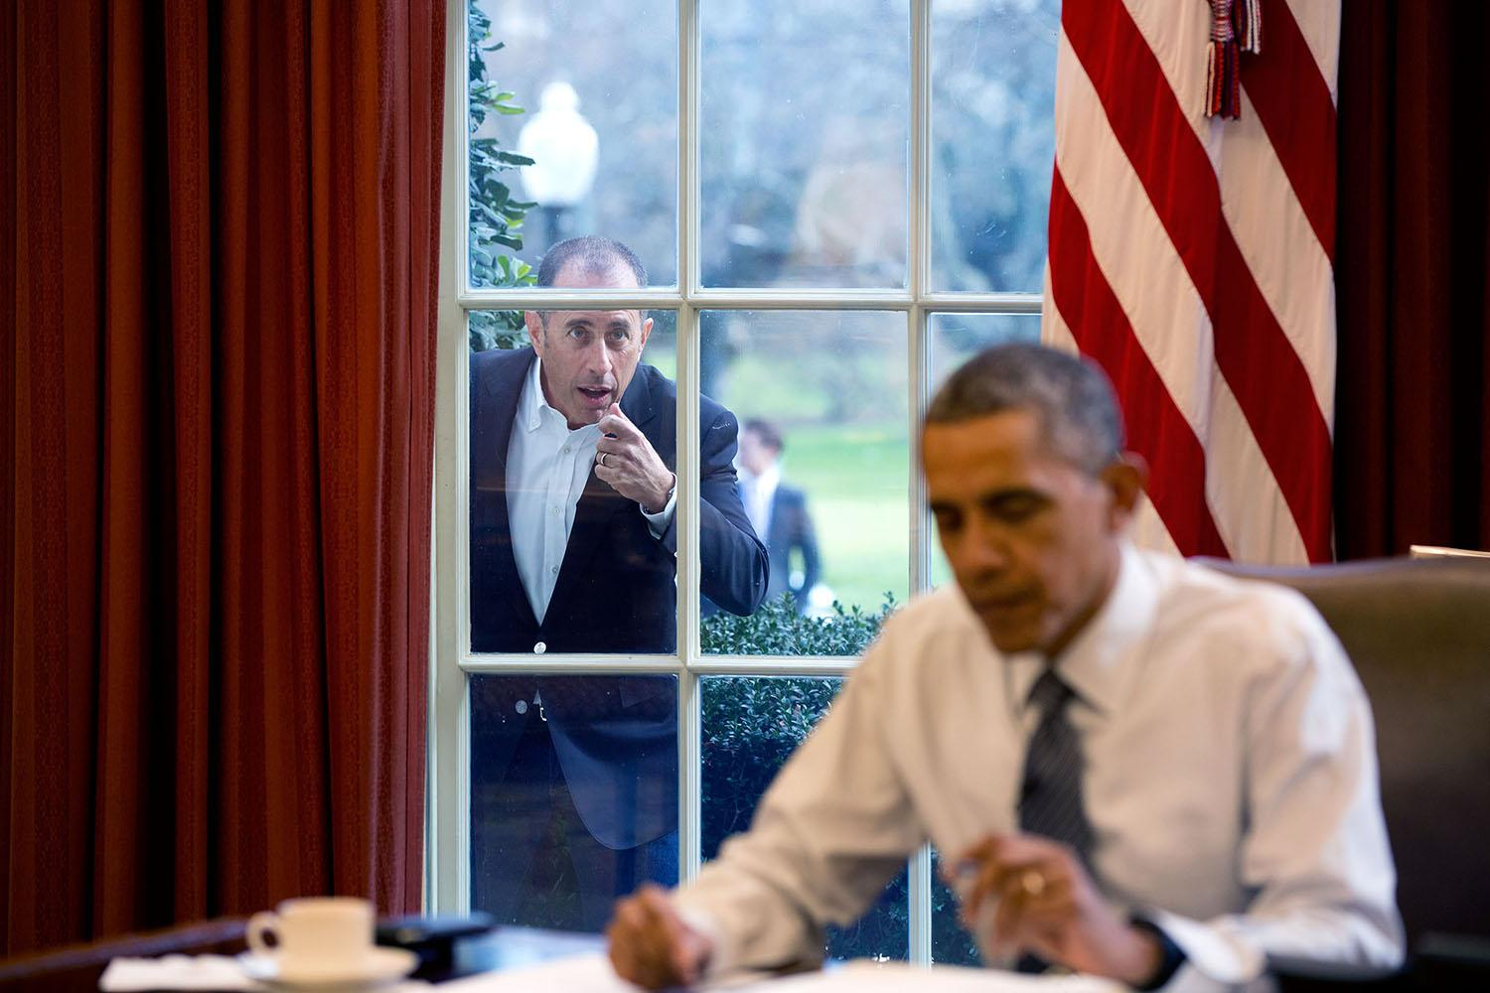
Who is Jerry Seinfeld
Career
  Stand-up comedian
  Actor
  Writer
  Producer
  Most known for his semi-fictionalized portrayal of himself in the show Seinfeld
Awards
  Nominated for 19 Primetime Emmy Awards
  Won 1 Primetime Emmy Award
  Nominated for 4 Grammy Awards
  Nominated for 4 Golden Globe Awards
  Won 1 Golden Globe Award
  Nominated for 4 Screen Actors Guild Awards
  Won 3 Screen Actors Guild Awards
Notes:
https://commons.wikimedia.org/wiki/File:Jerry_Seinfeld_knocks_on_the_Oval_Office_window.jpg

Slide 5
Essential Questions
Why is it important to have a goal that is specific?

Slide 6
Learning Objectives
Students will be able to:
Identify an area of personal and academic growth
Write a SMART goal
Reflect on their daily progress

Slide 7
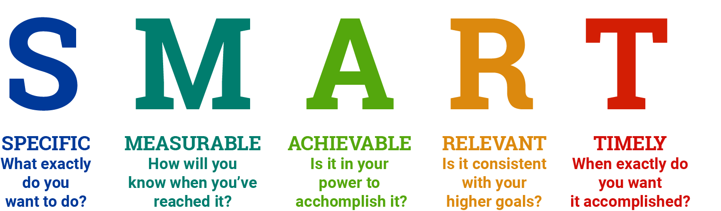
What is a SMART Goal?

Slide 8
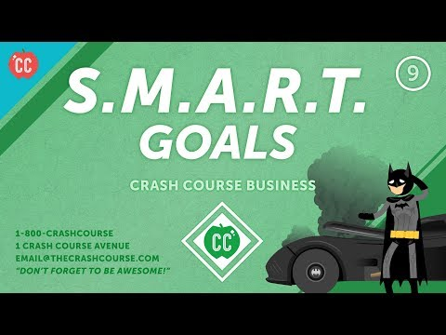
Notes:
Watch in advance and decide if this video will be useful for your students or too advanced.

Slide 9

Personal Goals- Brainstorm
What are some personal goals you might want to achieve?
Write as many goal ideas down as you can in two minutes
Don’t worry about making them SMART yet
We will refine later
2
mins

Slide 10
Academic Goals- Brainstorm
What are some academic goals you might want to achieve?
Write as many goal ideas down as you can in two minutes
Don’t worry about making them SMART yet
We will refine later
2
mins

Slide 11
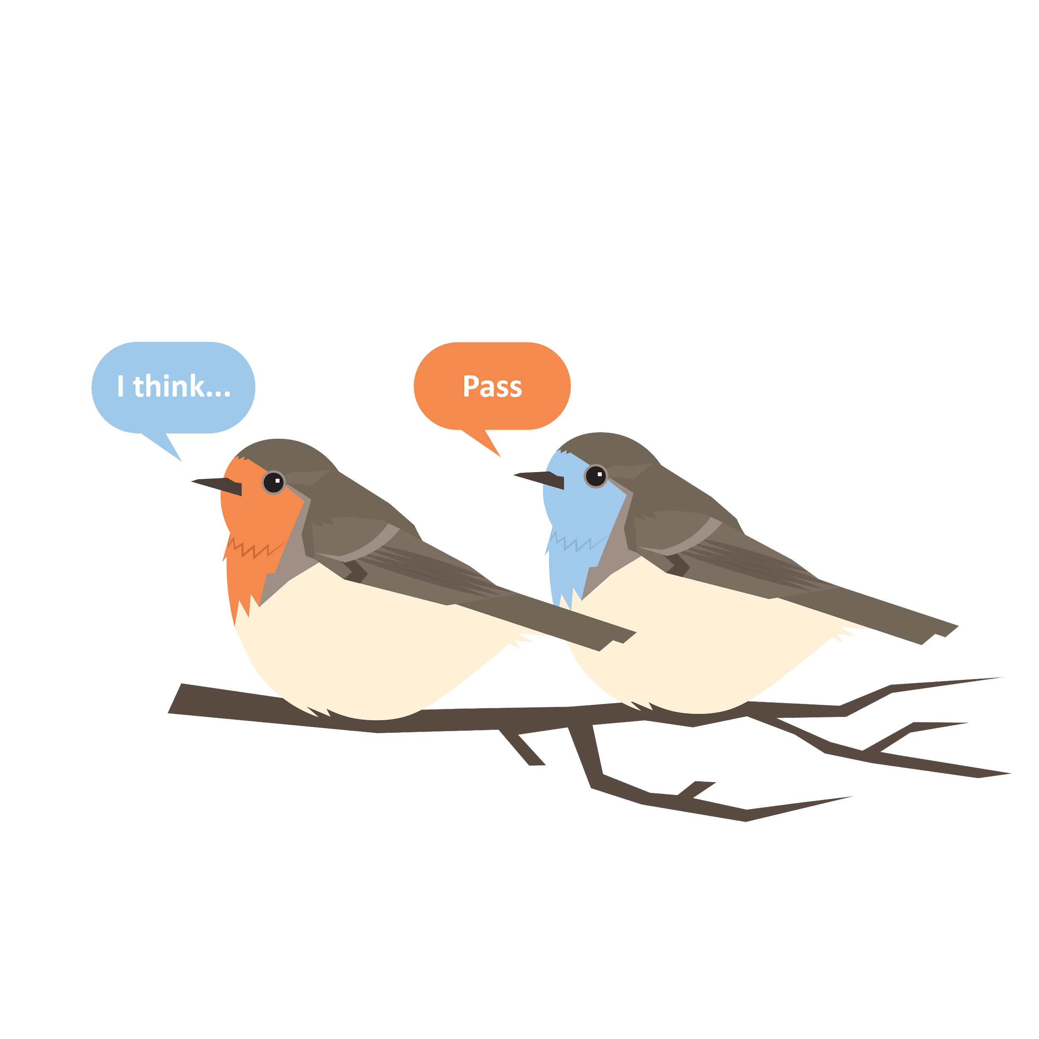
“This Club Will be a Success If…”
Take turns finishing the sentence above.
Keep going around the room until we run out of ideas.

Slide 12
Finding your SMART Goal
Do one of the goals (personal or academic) from your brainstorming session align to our whole group
club goals brainstorm?
Highlight your goals that are the most aligned.
Restate this goal in a way that that reflects
the alignment to what you hope to get out of this club.

Slide 13
Make sure your SMART Goal includes:

Slide 14
Is Your Goal is Specific?
Include the following:
What are you trying to accomplish?
What three (3) steps will you take each day to achieve this goal?
Where might your steps for achieving this goal take place?
Who will be involved?

Slide 15
Is your Goal Measurable?
Include the following:
What will success look like?
How will you measure if you are making progress?
How often will you check your progress?
If it will take several months, set milestones.

Slide 16
Is Your Goal Achievable?
Include the following:
Is your goal of a manageable size? Your goal should inspire motivation and help you on your way to bigger things, but not be so big it’s overwhelming.
Do you expect to encounter obstacles? How will you address them?
What do you need to succeed? Do you have the necessary skills and resources to accomplish this goal? If not, how will you ensure you have what you need?

Slide 17
Is Your Goal Relevant?
Include the following:
Why is this goal important for you to accomplish?
How does this goal help you reach bigger goals?

Slide 18
Is Your Goal Timely?
Include the following:
Set a target date for completing your tasks.
What you can accomplish realistically in that time frame?
If your goal will take three (3) months to complete,
it’s helpful to think about what you should have achieved half-way through.

Slide 19

Milestones
Milestones are a series of steps along the way that when added up will result in the completion of your main goal.
Actions or habits
Observed change over time
Notes:
For example, if you have set a goal to improve your sleeping habits, milestones might be successfully turning off screens 1 hour before bedtime for a week in a row, successfully getting to sleep by the desired time for # of days in a row, holding a regular pattern of sleeping nine hours at night for a # of weeks, feeling more alert in your first class of the day,… etc.

Slide 20
Don’t Break the Chain
He said the way to be a better comic was to create better jokes and the way to create better jokes was to write every day.
He told me to get a big wall calendar that has a whole year on one page and hang it on a prominent wall. The next step was to get a big red magic marker. He said for each day that I do my task of writing, I get to put a big red X over that day.
“After a few days you'll have a chain. Just keep at it and the chain will grow longer every day. You'll like seeing that chain, especially when you get a few weeks under your belt. Your only job is to not break the chain.”
Brad Isaac on “Tips for a Young Comedian from Jerry Seinfeld”

Slide 21
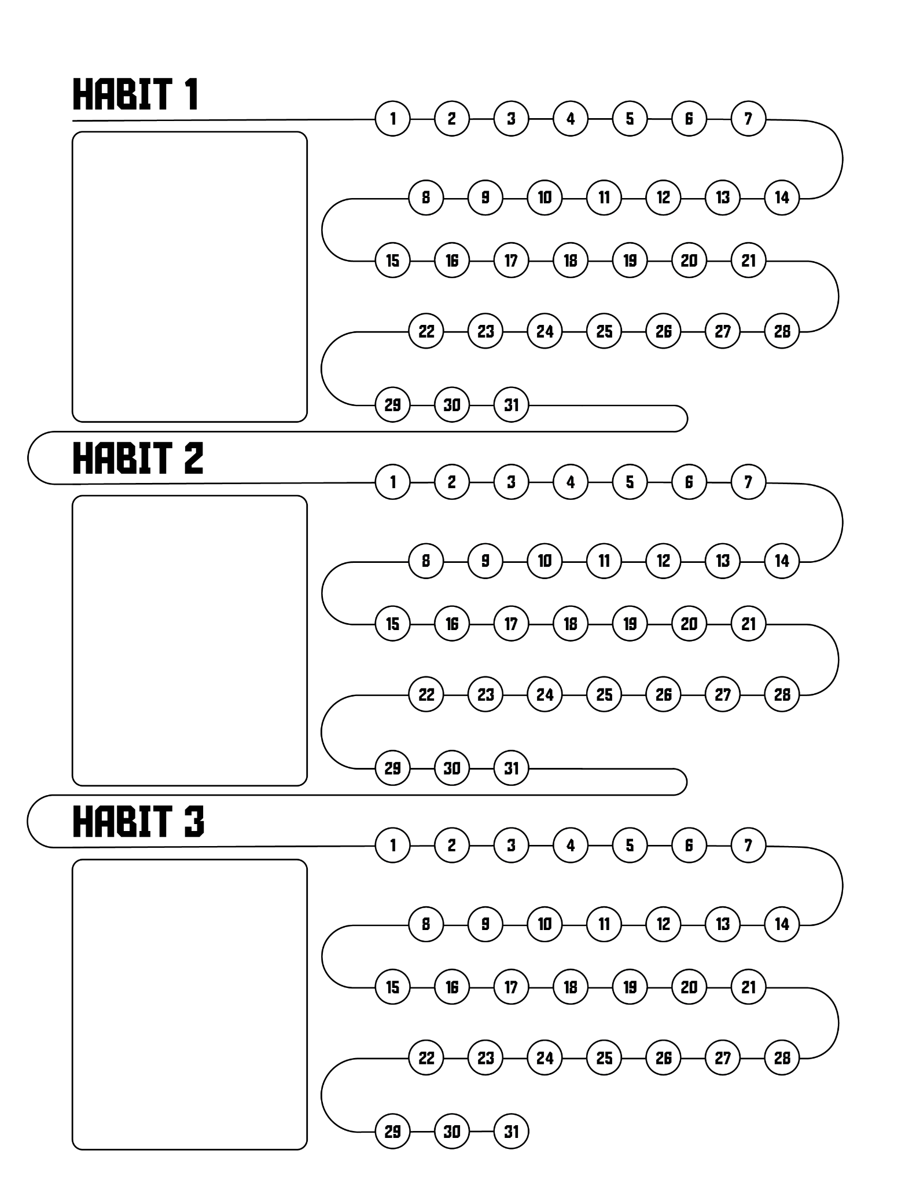
Habit Tracking
In each habit box write one (1) of your three (3) steps that you said you would do each day to help you achieve your goal.
Each day, if you complete the habit/step, color in the number that corresponds to the calendar date.

Slide 22

My Vision Board
Create a vision board for your goals.
Keep in mind the following:
  What is your goal?
  Why do you want to accomplish this goal?
  What are some visual reminders that will help motivate you?
You will be sharing your vision board with a partner.
Notes:
K20 Center. (n.d.). Vision Boards. Strategies. https://learn.k20center.ou.edu/strategy/2054

Slide 23
Don’t Break the Chain
If I don’t do a set in two weeks, I feel it. I read an article a few years ago that said when you practice a sport a lot, you literally become a broadband: the nerve pathway in your brain contains a lot more information. As soon as you stop practicing, the pathway begins shrinking back down. Reading that changed my life. I used to wonder, Why am I doing these sets, getting on a stage? Don’t I know how to do this already? The answer is no. You must keep doing it. The broadband starts to narrow the moment you stop.
Jerry Seinfeld Intends to Die Standing Up

Slide 24
Reflection
How are you doing on tracking those habits?
Did you meet your goal?
If you’re not on track to meet your goals, what can you do to help you meet your goal?

Slide 25
TikTok
Choose a song that describes your goal setting and tracking process and/or your feelings
End text screen, Answer this question: How does working towards your goal help you work towards your post-secondary education?

