Slide 2
Road Trip to the Future
Exploring Hispanic-Serving Institutions

Slide 3
Essential Question
How is equity being supported in higher education?

Slide 4
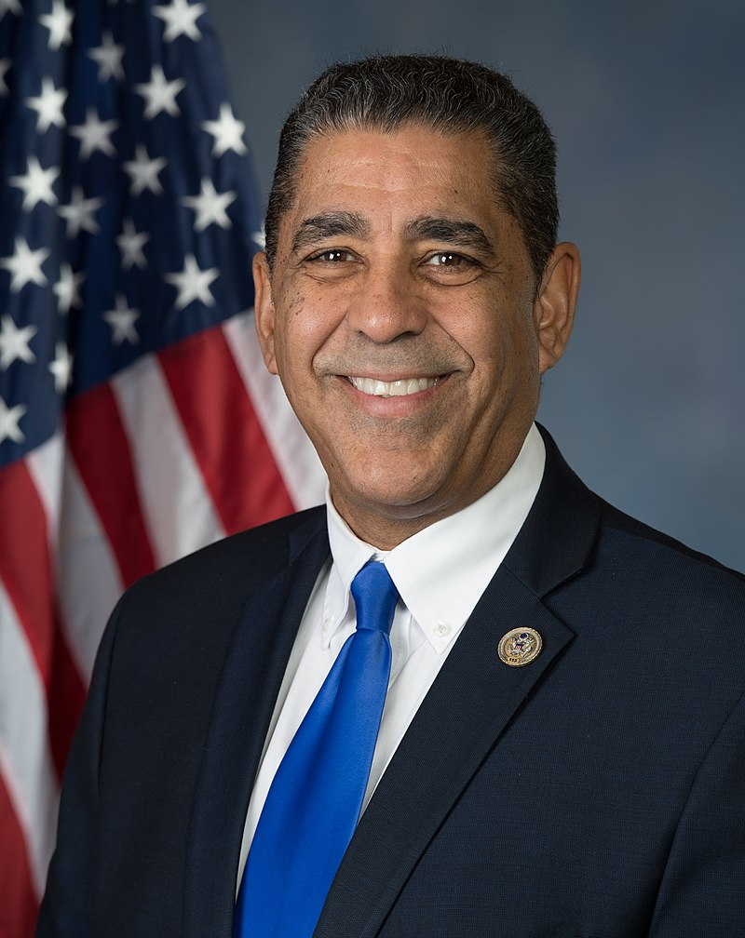
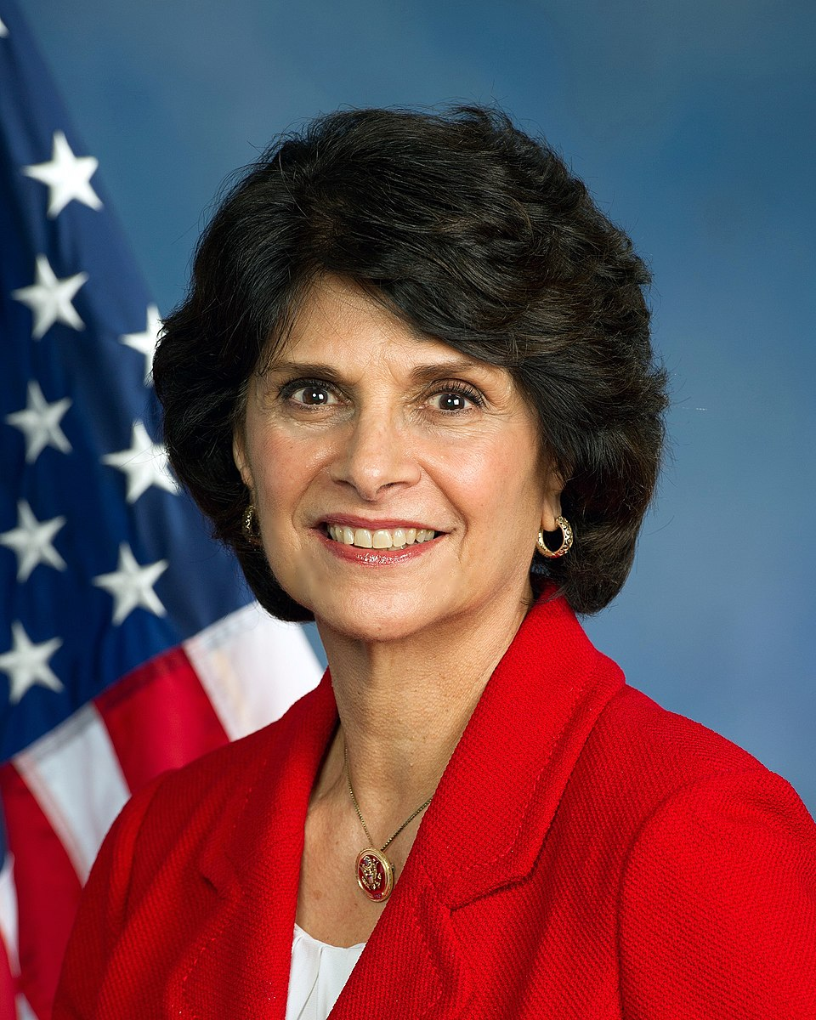
Adriano Espaillat
Lucille Roybal-Allard
American politician and U.S. representative for New York
First Dominican American and first formerly undocumented immigrant to serve in Congress
Vice Chair of Diversity and Inclusion for the Congressional Hispanic Caucus
American politician and U.S. representative for California
First Mexican American woman elected to Congress
First Latina to serve on the House Appropriations Committee and first woman to chair the Congressional Hispanic Caucus
Founded the Women’s Working Group on Immigration Reform
Notes:
U.S. Office of Photography. (14 May 2017). Adriano Espaillat 115th Congress photo jpg [Image]. Wikimedia Commons. https://commons.wikimedia.org/wiki/File:Adriano_Espaillat_115th_Congress_photo.jpg
United States Government (2013). Lucille Roybal-Allard, member of the United States Congress [Image]. https://roybal-allard.house.gov/biography/photo.htm
Roybal-Allard: California State University-LA
Adriano Espaillat: Queens College

Slide 5
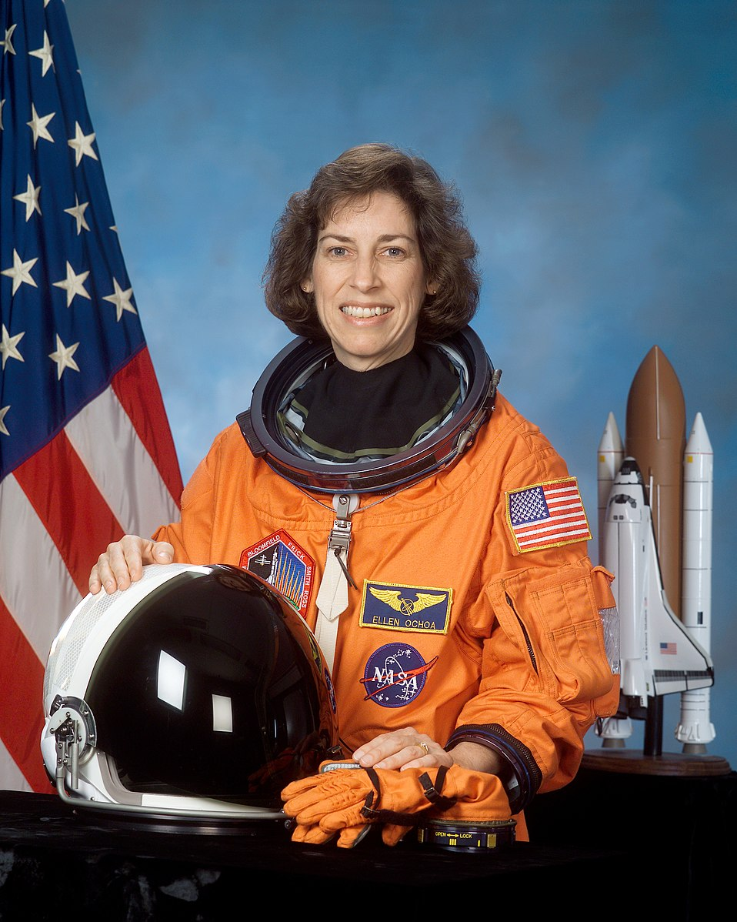
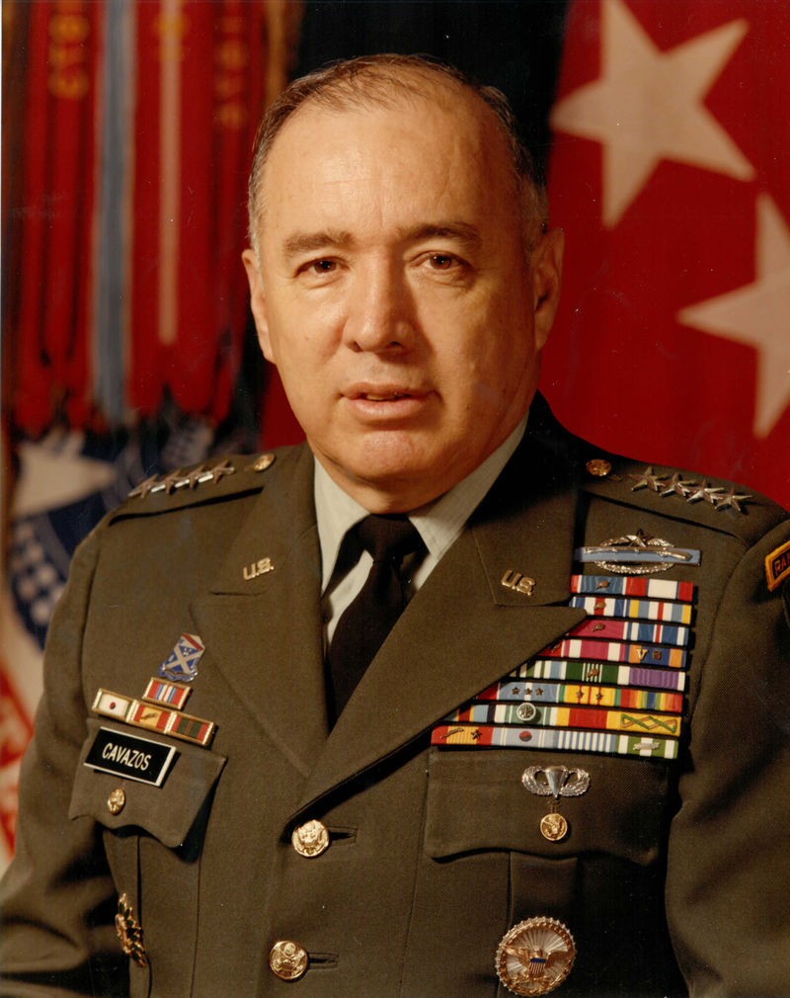
Ellen Ochoa
Richard E. Cavazos
American engineer and former astronaut
First Hispanic director and second female director of the Johnson Space Center
First Hispanic woman to go to space
United States Army officer
First Mexican American to reach the rank of Brigadier General in the U.S. Army
First Hispanic four-star general
Served 33 years, with his final role as head of the U.S. Army Forces Command
Notes:
NASA. (12 February 2002). Astronauta de la NASA. Ellen Ochoa. NASA astronaut, mission specialist [Image]. spacelight.nasa.gov
U.S. Army (2007). General w:Richard E. Cavazos (born 1924), U.S. Army, First Hispanic U.S. Army 4-star general [Image]. http://www.army.mil/hispanicamericans/images/profile_cavazos.jpg
Ochoa-San Diego State University
Cavazos-Texas Tech University

Slide 6
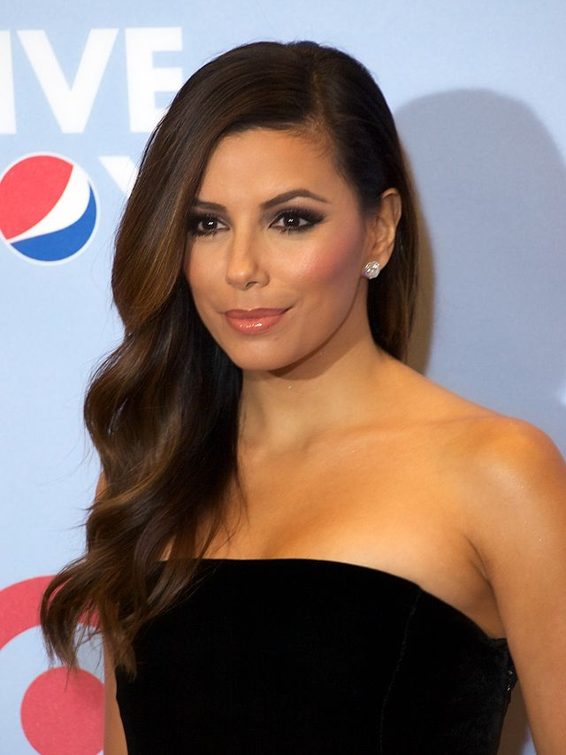
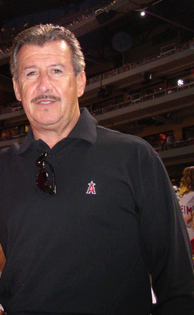
Eva Longoria
Arturo Moreno
American actress, producer, director, and philanthropist
Founder of the Eva Longoria Foundation, which works to empower Latinas to excel in school and attend college
American businessperson
Built his initial fortune by selling billboard advertising company Outdoor Systems for $8.7 billion
Owner of the Los Angeles Angels baseball team
First Mexican American to own a major U.S. sports team
Notes:
Hispanic Lifestyle. (Sept. 12 2012). Eva Longoria at the Alma Awards 2012 [Image]. https://www.flickr.com/photos/hispaniclifestyle/7998000427/
Jemil (June 9 2007). Picture of Arte Moreno with a fan (me) [Image]. Image credit of Jodi Miller.Wikimedia Commons. https://commons.wikimedia.org/wiki/File:Arte-Moreno.gif
Longoria- Texas A&M University-Kingsville & California State University Northridge
Moreno-University of Arizona

Slide 7
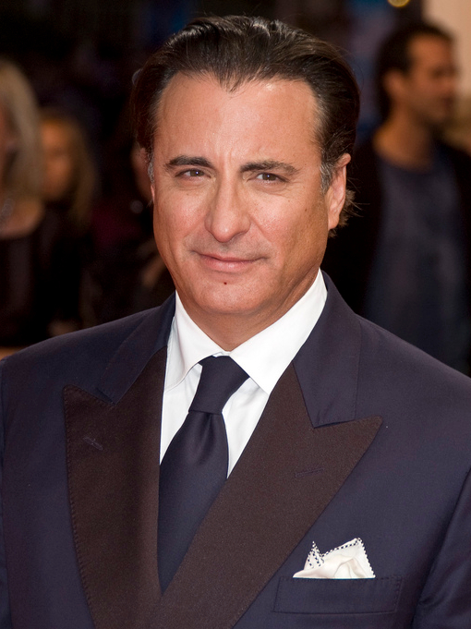
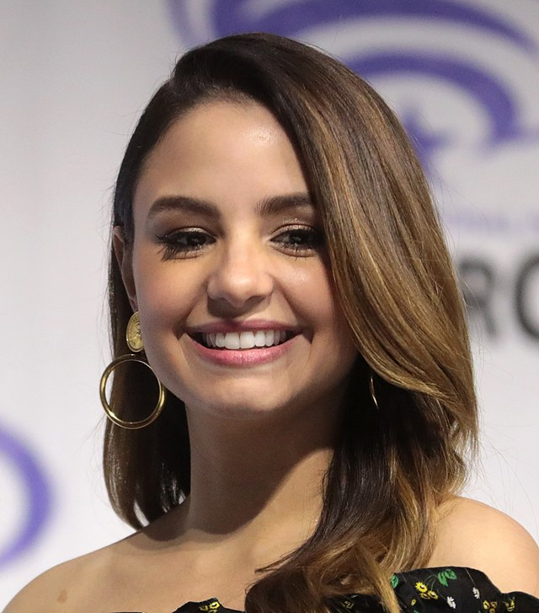
Andy Garcia
Aimee Carrero
Cuban-American actor, director, rapper, record executive, and entrepreneur
Appeared of numerous films, including The Godfather, Part III, the Ocean's Eleven series, and Mamma Mia
Most recently starred in Father of the Bride
Actress of Dominican and Puerto Rican descent
Voices the title role in The Disney Channel's first Latina princess series, Elena of Avalor
Other roles include Cartoon Network's Level Up, Netflix’s Maid, Fox’s Family Guy, and Freeform’s Young and Hungry
Notes:
Flickr. (2014 , October 14). Andy Garcia at the 2009 Deauville American Film Festival [Image]. https://commons.wikimedia.org/wiki/File:Andy_Garcia_at_the_2009_Deauville_American_Film_Festival-01.jpg
Skidmore, G. (2019, March 30). File:Aimee Carrero by Gage Skidmore.jpg [Image]. Wikimedia Commons. https://commons.wikimedia.org/wiki/File:Aimee_Carrero_by_Gage_Skidmore.jpg
Garcia-Florida International University
Carrero-Florida International University

Slide 8
Tell Me Everything
From politicians to entertainers to corporate America, what might all of these successful Hispanic/Latino individuals have in common?

Slide 9
Hispanic-Serving Institutions
All of these individuals have graduated from a college/university designated as a Hispanic-serving institution (HSI).
HSIs are defined as institutions of higher education with at least 25 percent of full-time undergraduate students identifying as Hispanic.
HSIs serve to intentionally create equity in higher education and support the success of their Hispanic/Latino students.

Slide 10
Lesson Objectives
Analyze the historical background of Hispanic-Serving Institutions (HSI).
Collaborate to research HSIs to identify how a school could meet your personal and academic goals.

Slide 11

The Importance of HSIs

Slide 12

Stop and Jot
Read through the handout.
At the end of each section, stop and jot down a brief summary.
Be sure to include all information important to your understanding of the section.

Slide 13
Essential Question
Why is there becoming a greater need for Hispanic-serving institutions?

Slide 14
HSI Research Project
Use the following link to visit the list of HSIs: http://k20.ou.edu/hsis
As a group, select a college or university from the list and use the Research Project Task Sheet to follow along with the questions.
Research the HSI to gain more information about the school.

Slide 15

Anchor Chart
In your groups, create an Anchor Chart to
represent the school you researched.
The chart must be visually strong and include a mixture of words and pictures.
Refer to the Anchor Chart Instructions and Requirements on the Research Project Task Sheet for the list of everything to include.

Slide 16
Gallery Walk
Select a spokesperson to stay behind and speak on behalf of your group.
All other group members, rotate around the room to visit the other groups’ charts.
As you rotate, identify one chart or school that catches your interest. On your sticky note, write down a question that you’d ask if you were to visit that school. Place your note on the wall next to the chart.

