Slide 2
What Comes First, The Chicken or The Egg?
Positive Mental Attitude vs. Growth Mindset

Slide 3
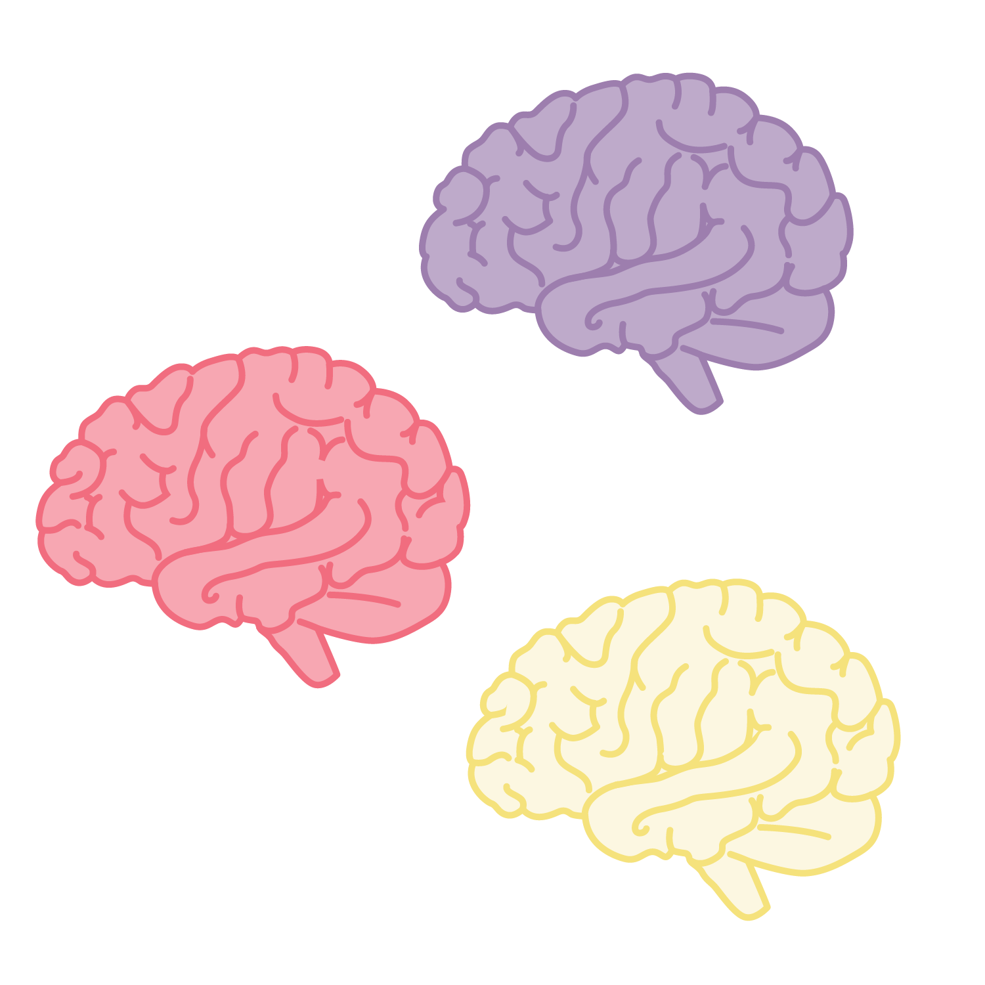
Collaborative Brain Dump
What do you know about Positive Mental Attitudes?
Write each thought on a sticky note.
Notes:
Based on your club group size, consider if you will do this in small groups, individually, or whole group.
Move to slide 6 and share the instructional strategy Collective Brain Dump with your students.
Pass out sticky notes and have your students write down everything they think they know about Positive Mental Attitude (PMA).
Each new thing they write down should go on its own sticky note.
K20 Center. (n.d.). Collective Brain Dump. Strategies. K20 LEARN | Collective Brain Dump (ou.edu)

Slide 4
Essential Question
How can our thoughts and beliefs about failure affect our success in school and life?

Slide 5
Learning Objectives
Students will be able to:
Research ways to develop a consistent Positive Mental Attitude (PMA).
Explore how brain development contributes to the development of a Positive Mental Attitude (PMA).

Slide 6
Collaborative Brain Dump
Now think about what you know about Growth Mindset.
Sort your stack of notes into two (3) piles:
  Growth Mindset
  Positive Mental Attitude
Notes:
K20 Center. (n.d.). Collective Brain Dump. Strategies. K20 LEARN | Collective Brain Dump (ou.edu)

Slide 7
Growth Mindset
“A growth mindset means that you believe your intelligence and talents can be developed over time.”
-Jennifer Smith

Slide 8
Positive Mental Attitude (PMA)
Positive mental attitude is the philosophy that having an optimistic disposition in every situation in one's life attracts positive changes and increases achievement.
Adherents employ a state of mind that continues to seek, find, and execute ways to win, or find a desirable outcome, regardless of the circumstances.
It opposes negativity, defeatism, and hopelessness.
Optimism and hope are vital to the development of PMA.

Slide 9
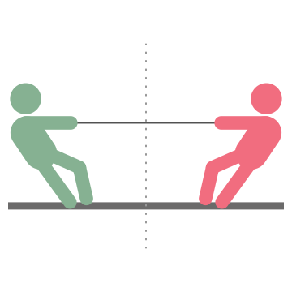
Tug Of War
Take a look at each of your sticky notes.
Where does each note fall on the continuum between Positive Mental Attitude and Growth Mindset?
Place it there on the line.
Notes:
OpenClipart-Vectors. (2013). Rope. https://pixabay.com/vectors/rope-cord-sisal-string-material-160161/.

Slide 10
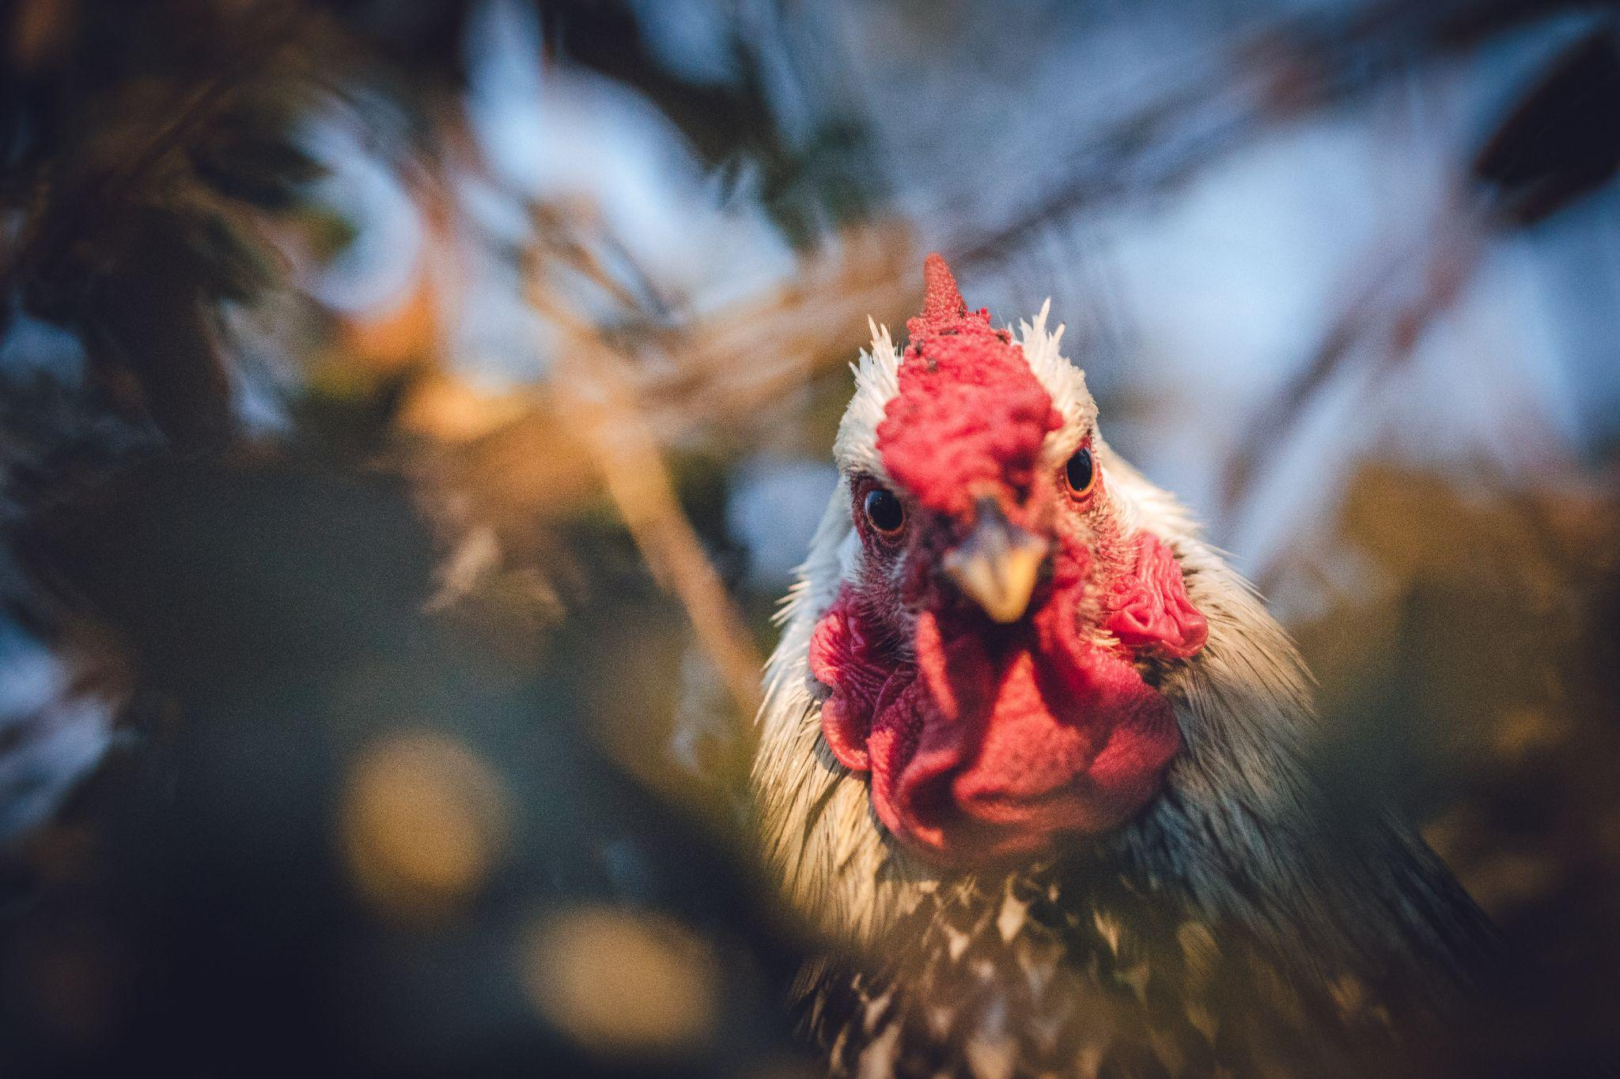
What comes First?
?
?
The chicken or the egg?
Positive Mental Attitude
or Growth Mindset?
?
Notes:
https://www.freepik.com/free-photo/white-black-rooster_13140976.htm?query=hen%20and%20egg&collectionId=2131&&position=8&from_view=collections

Slide 11

video
Notes:
Use this video as a launching off point to their poster design activity. Remind students that positive mental attitude includes self talk and habits that affect our frame of mind. Move to next slide to go over seven key ideas of PMA and the poster activity instructions.

Slide 12


Anchor Charts
Explore and create a poster for each of the seven key ideas of Positive Mental Attitude:
Believe in success.
Develop confidence in yourself.
Avoid thinking in extremes.
Don't overgeneralize.
Celebrate your success.
Stop believing your inner idiot.
Stop thinking of perfection.
Notes:
Divide your students into 7 groups; one for each key idea. .
Each group will create a motivational poster for the assigned key idea of positive mental attitude provided to them.
Each group should explore their assigned key idea and plan their poster so that it encourages positive mental attitude based on that key idea.
They may include tips, tricks, quotes, and photos, and/or drawings to achieve this goal.
Let student know that the final results will be posted around the school in key places with a lot of traffic to encourage a mindset change.
https://www.amazon.com/Sweetzer-Orange-Mindset-Classroom-Decorations/dp/B08DNDP43R/ref=asc_df_B08DNDP43R/?tag=hyprod-20&linkCode=df0&hvadid=459678723586&hvpos=&hvnetw=g&hvrand=8212857510402886883&hvpone=&hvptwo=&hvqmt=&hvdev=c&hvdvcmdl=&hvlocint=&hvlocphy=9026222&hvtargid=pla-961029569925&th=1

Slide 13
Revisit Tug of War?
Are there any notes on the continuum that you would move after learning more about Positive Mental Attitude?

Slide 14
Note of Positivity
Write down one (1) note of positivity on a piece of paper and fold it up.

Slide 15
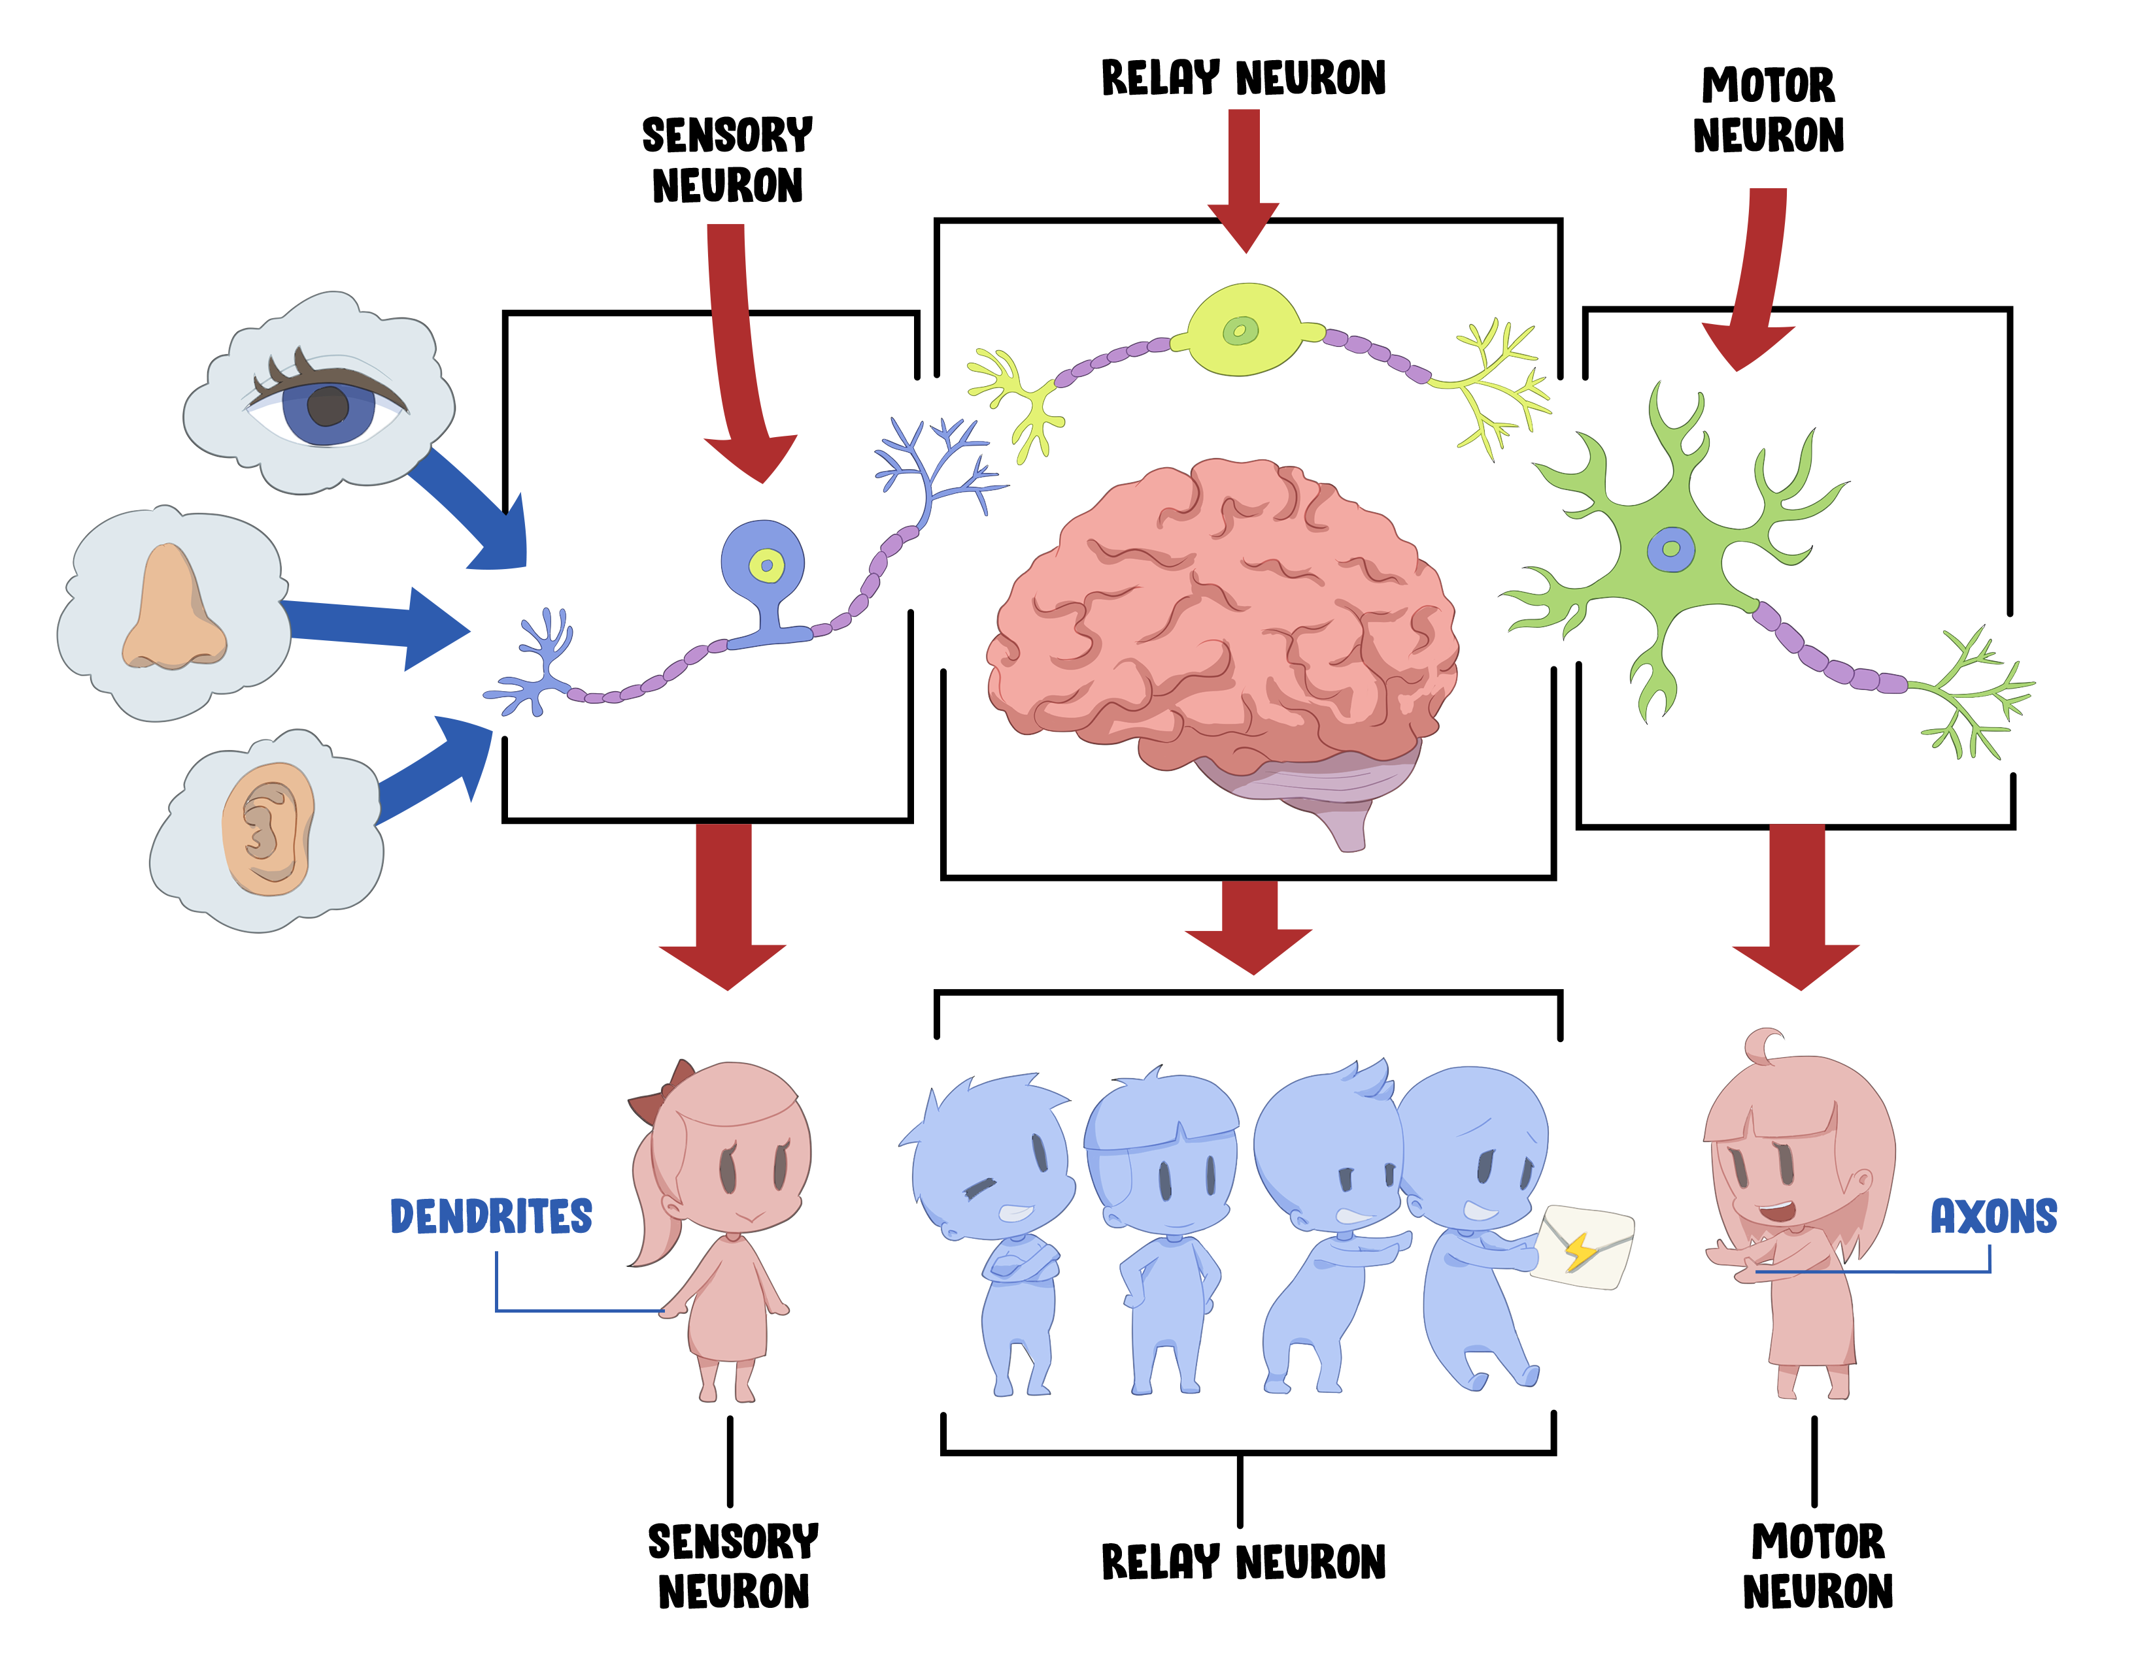
Neural Relay Race

Slide 16
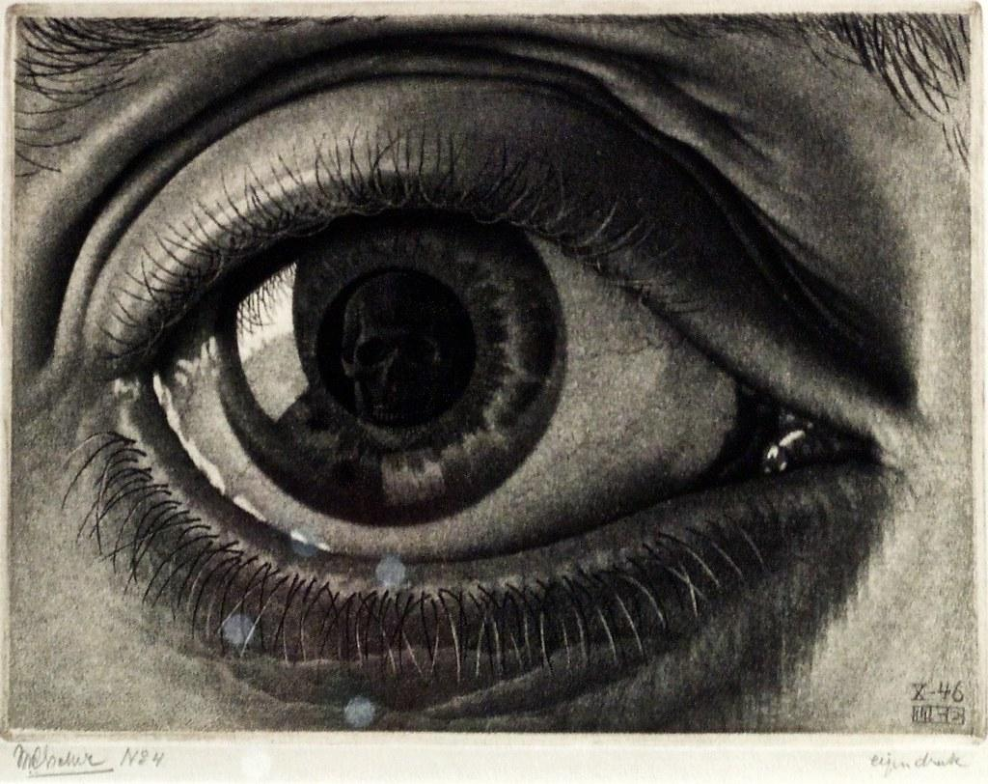
Visual Cue
Draw or write something on your note card that will remind you to keep positive mental attitude.
Place it somewhere you will see it everyday.
Eye (1946) - Maurits Cornelis Escher (1898 - 1972)
Notes:
Have students share out their visual cues and explain in their own words how this visual cue will help their neural pathways grow and strengthen their Positive Mental Attitude.
image source: https://www.flickr.com/photos/pedrosimoes7/39167723472

