Slide 2
Road Trip to the Future: Exploring Tribal Colleges and Universities

Slide 3
Essential Question
How is equity supported in higher education?

Slide 4
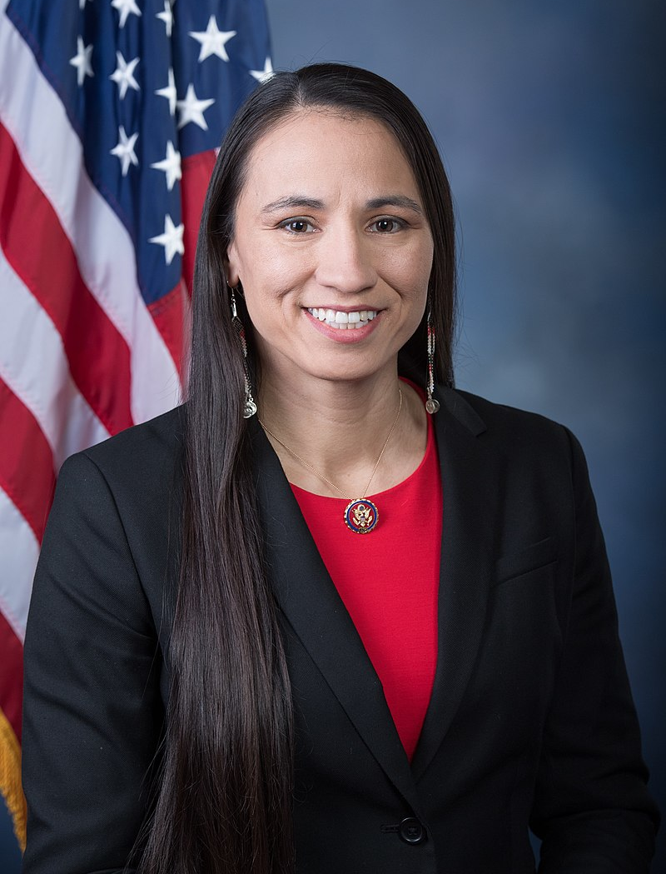
Sharice Davids
Native American attorney and politician serving as the U.S. Representative for Kansas.
One of the first two Native American women elected to Congress.
Vice Chair of the Congressional Native American Caucus and Co-chair of the Congressional LGBT+ Equality Caucus.
Notes:
File:Sharice Davids.jpg - Wikimedia Commons. (n.d.). Retrieved January 23, 2023, from https://commons.wikimedia.org/wiki/File:Sharice_Davids.jpg

Slide 5
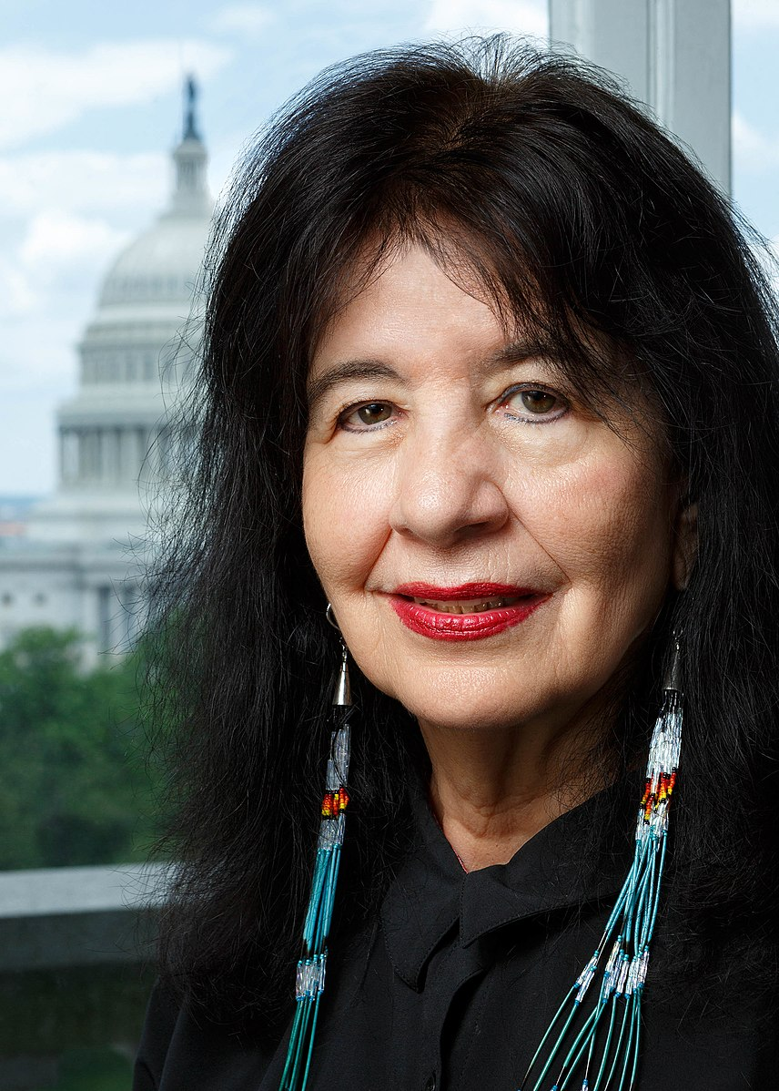
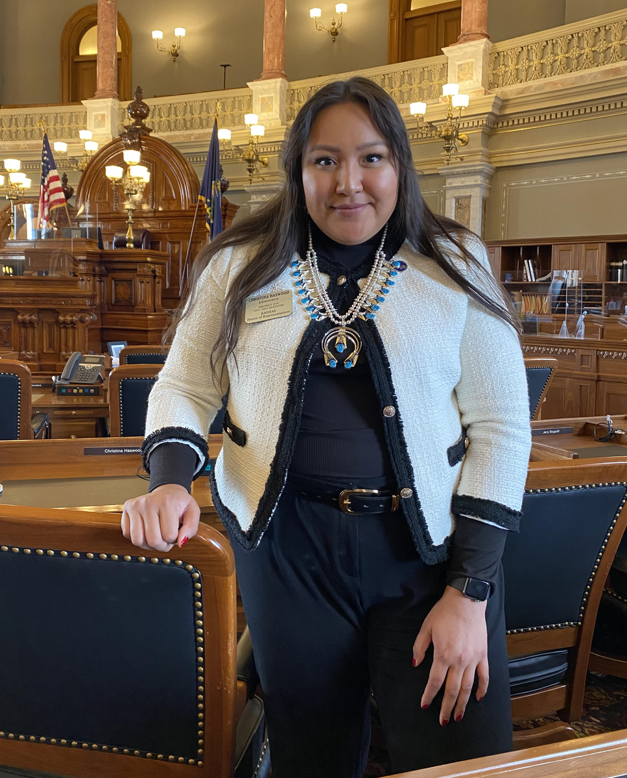
Joy Harjo
Christina Haswood
Native American politician serving as a member of the Kansas House of Representative.
Among the youngest members of the Kansas Legislature and one of three Native Americans elected to the Legislative session.
Poet, musician, playwright, author, and educator from Oklahoma.
Served as the 23rd United States Poet Laureate–the official poet of the United States.
Author of nine books of poetry, two award-winning children’s books, and seven music albums.
Notes:
File:Joy Harjo Smiling, 2019.jpg - wikimedia commons. (n.d.). Retrieved January 23, 2023, from https://commons.wikimedia.org/wiki/File:Joy_Harjo_smiling,_2019.jpg
File: Haswood cropped.png. (2021, March 26). Retrieved January 23, 2023, from https://commons.wikimedia.org/wiki/File:Haswood_cropped.png

Slide 6
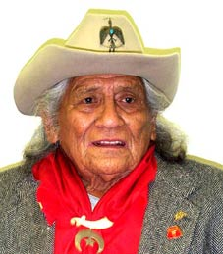
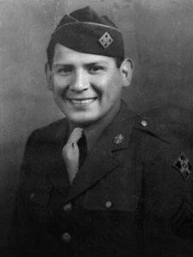
Charles Joyce Chibitty
Native American and U.S. Army code talker in WWII from Oklahoma.
Helped transmit coded messages in the Comanche language on the battlefield as a radio operator in the European Theater.
Participated in Battle of Normandy (D-Day) and Battle of the Bulge.
Recipient of the Congressional Gold Medal.
Notes:
Wikimedia Foundation. (2023, January 5). Charles Chibitty. Wikipedia. Retrieved January 23, 2023, from https://en.wikipedia.org/wiki/Charles_Chibitty
Charles Chibitty: Comanche code-talker. www.army.mil. (n.d.). Retrieved January 23, 2023, from https://www.army.mil/article/90294/charles_chibitty_comanche_code_talker

Slide 7
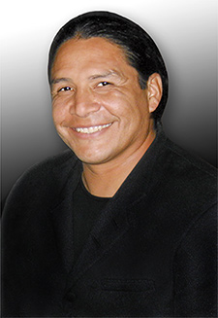
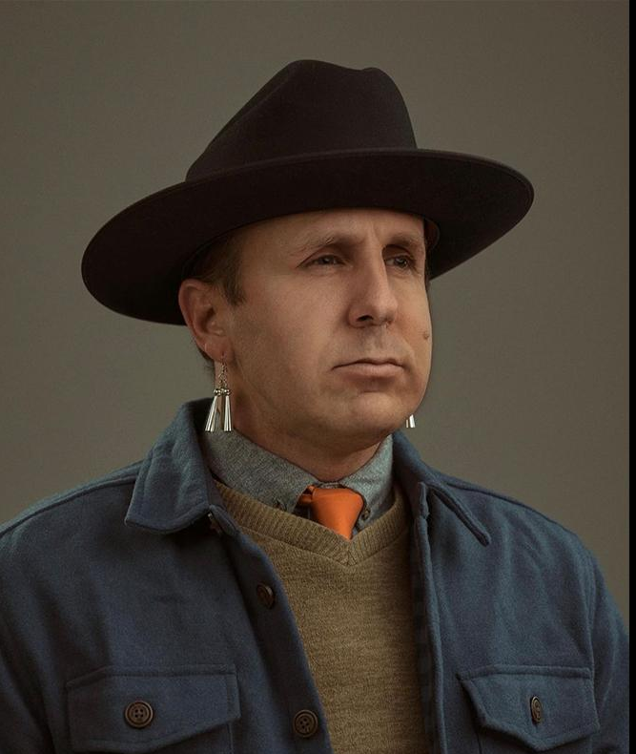
Ryan RedCorn
Oklahoma filmmaker, graphic designer, comedian and photographer.
Serves as staff writer for Hulu’s Reservation Dogs.
His photography work has been featured in “National Geographic.”
Founder of the comedy group The 1491s who have made appearances on the “The Daily Show with Jon Stewart” and “TEDx Talks.”
Steve Reevis
Native American actor and member of the Blackfeet Tribe.
Has starred in films such as Fargo, Dances with Wolves, The Longest Yard, TNT’s Into the West, and Fox’s Bones.
Notes:
Wikimedia Foundation. (2022, March 29). Steve Reevis. Wikipedia. Retrieved January 23, 2023, from https://en.wikipedia.org/wiki/Steve_Reevis
Buffalo Nickel Creative. (2022, February 10). Indigenous filmmakers: Q&A with Ryan Redcorn. Osage News. Retrieved January 23, 2023, from https://osagenews.org/indigenous-filmmakers-qa-with-ryan-redcorn/

Slide 8
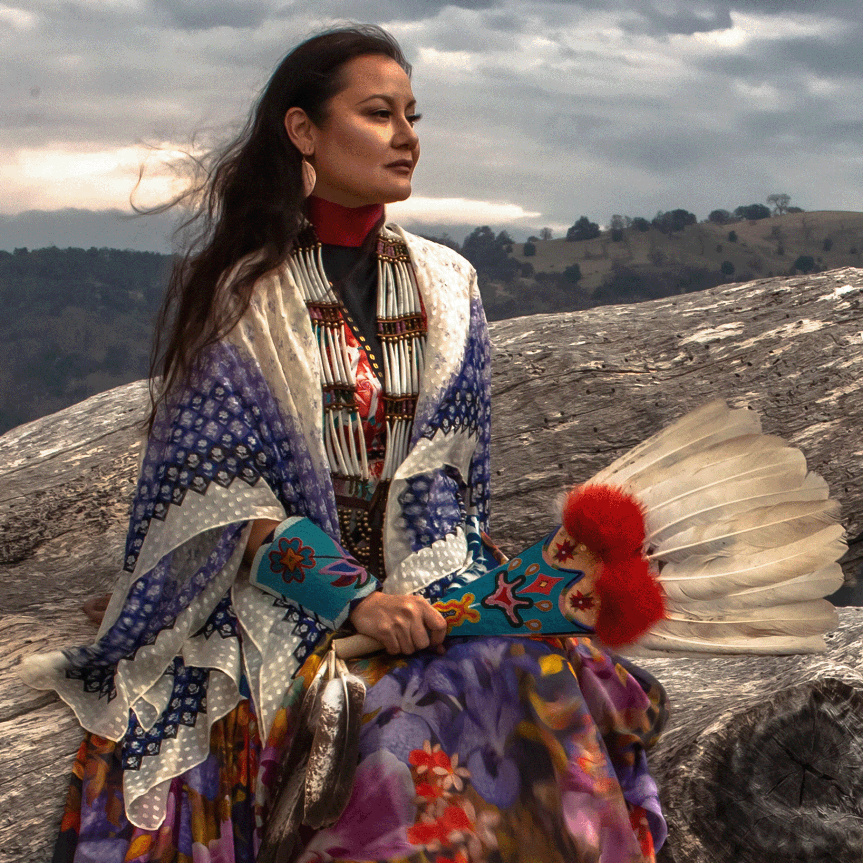
Jamie Okuma
Visual artist and fashion designer also known for her beadwork and mixed-media sculpture.
Has won six Best in Show awards from the Heard Indian Market and Santa Fe Indian Market.
Her work is included in collections of the following museums:
Minneapolis Institute of Art
The Metropolitan Museum of Art
Nelson-Atkins Museum of Art
The Smithsonian Institution's National Museum of American Indian
Notes:
About. jamieokuma. (n.d.). Retrieved January 23, 2023, from https://www.jokuma.com/about

Slide 9
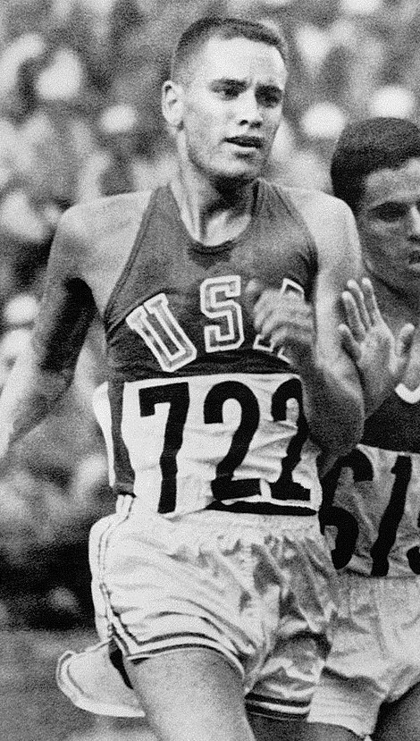
Billy Mills
An Oglala Lakota member and former track and field athlete.
Gold Medalist in the 10K meter run in the 1964 Tokyo Olympics.
First non-European to win Olympic event and remains only winner from the Americas.
Co-founder of the nonprofit Running Strong for American Indian Youth.
Notes:
File : Billymills Crossing Finish Line 1964olympics.JPG. (n.d.). Retrieved January 23, 2023, from https://commons.wikimedia.org/wiki/File:BillyMills_Crossing_Finish_Line_1964Olympics.jpg

Slide 10
Tell Me Everything
From politicians to entertainers to athletes, what might all of these successful individuals have in common?

Slide 11
Tribal Colleges and Universities
All of these individuals have graduated a college/university from a Tribal Colleges and University (TCUs).
TCUs are institutions that offer opportunities for Native Americans to pursue higher education, generally located near reservations.
TCUs aim to preserve and communicate traditional native culture, provide higher education and career or technical opportunities to tribal members, and enhance economic opportunities within the community.
Notes:
Encyclopedia.com. (2023, January 23). ." encyclopedia of education. . encyclopedia.com. 17 Jan. 2023 . Encyclopedia.com. Retrieved January 23, 2023, from https://www.encyclopedia.com/education/encyclopedias-almanacs-transcripts-and-maps/tribal-colleges-and-universities

Slide 12
Lesson Objectives
Students analyze the historical background of Tribal Colleges and Universities (TCUs).
Students collaborate to research TCUs to identify which school best meets their personal and academic goals.

Slide 13
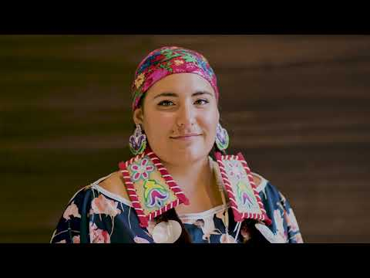
The Importance of TCUs
Notes:
TheCollegeFund. (2020, January 8). Stand with Native students. YouTube. Retrieved January 23, 2023, from https://www.youtube.com/watch?v=cEasvWEIigg&t=4s

Slide 14
Stop and Jot
As you read through the handout “The Rise of Tribal Colleges and Universities,” stop and jot down a brief summary of each section.
Be sure to include all information important to the understanding of that section.

Slide 15
Essential Question
Why is there a greater need for Tribal Colleges and Universities (TCUs) today?

Slide 16
TCU Research Project
In groups, research a Tribal College or University to gain more information about the school.
Use the following link to go directly to the list of schools: http://k20.ou.edu/tribalcolleges
As a group, select a college/university and using the Research Project Handout follow along with the questions.
Notes:
Create a Wakelet w/ all of the TCU’s.

Slide 17
Anchor Chart
In your groups, create an Anchor Chart to represent the school you researched.
The Chart must be visually strong and include a mixture of words and pictures.
Refer to the Anchor Chart Instructions and Requirements on the Research Handout for the list of everything to include.

Slide 18
Gallery Walk
Select a spokesperson to speak on behalf of your school.
All other group members rotate to other charts to learn about the different tribal colleges.
As you rotate, think of which school interests you the most and come up with one question you’d ask if you were to visit the campus.
Once you have written your question, post it on that school’s chart.

