Slide 2
COLLEGE! Is it Worth the Time and Money?
A Pre-Campus Visit Activity

Slide 3
A college degree is worth the time and money.
Four Corners:
Identify and go stand in the location that reflects your opinion on this statement.
Notes:
Time: 5-7 min
Post the four “Four Corners” signs around the room. (Strongly Agree, Agree, Disagree, Strongly Disagree)
Have students go to the corner that reflects their option on this statement.
Once in their “corners” have them decide on a statement that defends their position. For example, in the disagree corner, they might say: “I disagree with this statement because there are good jobs like _____________ that do not require a college degree.”
Depending on the size of the groups in each corner, you many want to divide them into smaller groups of 2-4 in the corner to develop a position statement.

Slide 4
How much do you know about your career options?
You will find a set of cards at your table that have salary figures and career titles listed.
Match the career to its salary.
You have 8 minutes to math them up!
Go!
Notes:
Time: 10 minutes
A handout is available in the kit for students to record their guesses. This activity should be done in at least partners.

Slide 5
Answer Key
CAREER | MEDIAN SALARY
Cosmetologist | $22,500
Pharmacy Technician | $24,355
Medical Secretary | $25,000
Carpenter | $36,889
Mental Health Counselor | $42,590
Licensed Practical Nurse (LPN) | $42,821
Truck Driver | $45,000
Interpreter & Translator | $50,610
Home Health RN | $55,569
Civil Engineer | $61,458
Market Research Analyst | $67,130
Air Traffic Controller | $74,922
Physical Therapist | $79,830
Biomedical Engineer | $88,360
Veterinarian | $91,250
Pharmacist | $111,148
Notes:
Check answers and discussion time 5 min
Remember these are median salaries (not average). This is an important discussion to have because some jobs require additional training or years of experience to hit the upper levels of pay.
You can also have students discuss what other factors could effect pay such as supply and demand (nursing), weather (construction), stress level of job (Air traffic controller, home health RN), location (some areas are weak in some job sectors while others are stronger).
Numbers can be updated using Bureau of Labor Statistics: Occupational Outlook Handbook website: https://www.bls.gov/ooh/home.htm (but all handouts will also need to be updated as well)

Slide 6
Salary Match-Up
NOW THAT YOU HAVE THE CORRECT SALARIES
Separate the careers into groups by their color and decide which group represents these four categories:
High School Diploma Only*
Trade School/Vo-tech/Associates Degree
Bachelors Degree
Masters Degree or Above
Notes:
Time: 1 min
The cards are color coded. Point out to the students that each color represents a different certification or degree level. Explain the difference between a trade school/vo-tech certification and a college degree. Also explain the difference between Associates, Bachelors, and Masters/Doctorate degrees.
Discuss any misconceptions or common questions you heard while the students were in their groups.
*All of the HS/GED careers have either on-the-job training/apprentice type programs or optional certification programs that increase the pay.

Slide 7
Answer Key
CAREER | EDUCATION LEVEL
Mental Health Counselor | Bachelors
Home Health RN | Bachelors
Civil Engineer | Bachelors
Market Research Analyst | Bachelors
Biomedical Engineer | Bachelors
Cosmetologist | Certification
Licensed Practical Nurse (LPN) | Certification
Truck Driver | Certification
Air Traffic Controller | Certification
Pharmacy Technician | HS/GED*
Medical Secretary | HS/GED*
Carpenter | HS/GED*
Interpreter & Translator | HS/GED*
Physical Therapist | Masters+
Veterinarian | Masters+
Pharmacist | Masters+
Notes:
Discuss any misconceptions or common questions you heard while the students were in their groups.
*All of the HS/GED careers have either on-the-job training/apprentice type programs or optional certification programs that increase the pay.

Slide 8
Discussion
What surprised you about the salaries?
How do salaries differ from positions that require a degree and those that do not?
What factors, other than salary, would you have to consider before choosing a career?
Notes:
Time: 10 minutes
Have students think about the answers independently and jot down a few thoughts on a piece of paper.
Then have them talk about these three questions in their partners or small groups. After giving them 3-5 minutes to share in pairs/small groups, ask the groups to share out what they came up with. Make sure each group has a chance to share something.

Slide 9
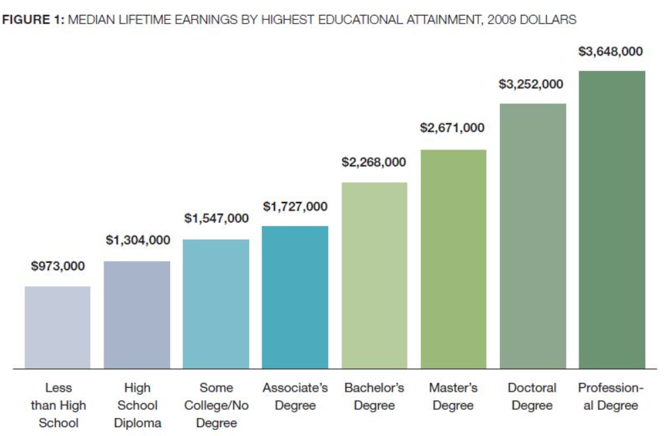
MEDIAN LIFETIME EARNINGS BY EDUCATIONAL LEVEL
NEARLY
$1,000,000
MORE OVER A LIFETIME
*Source: http://cew.georgetown.edu/collegepayoff/
Notes:
This is a great visual that speaks to the importance of thinking long term, which is difficult for many teenagers. Although there are some jobs with decent salaries that do not require a degree, they often do not have benefits or retirement. Working conditions in jobs like construction or truck driving make it harder to stay in that career for an entire lifetime.
Carnevale, A. P., Rose, S. J., & Cheah, B. (2013). The college payoff: Education, occupations, lifetime earnings. Retrieved from https://cew.georgetown.edu/cew-reports/the-college-payoff/#infographic

Slide 10
Besides money, what are other possible benefits of a college degree?
Is college worth it?
Notes:
After talking about lifetime earnings and the financial benefits of a college degree, next ask the students to consider benefits other than money. Give them a minute to reflect and answer independently and then have them turn to a different partner and discuss the question together. Some possible answers might include: better health, longer life, easier to find a job, better job satisfaction, health care benefits, better working conditions, more engaged citizens.

Slide 11
Top 5 Biggest Concerns about College
With a partner, make a list of the top five concerns that high school student might have about college
Notes:
Time 5 minutes
Have students quickly list 5 concerns that they have or think other high school students might have about going to college.

Slide 12
Question Generators
Trade your top five list with another pair of students.
For each concern on the list your receive, generate and write down a question you might ask during a college visit to address that concern.
When you are done, give the list back and briefly discuss the suggested questions.
Notes:
Time 5-7 min

Slide 13
Exit Ticket
Based on today’s activities, what are two questions that you have?
Commit to finding out the answer to during the upcoming Campus Visit.
Notes:
As an exit ticket (slide 13), have students write down at least one or two questions that you have based on today’s lesson that you can commit to finding out the answer to during the upcoming Campus Visit. Have students write their names on their exit ticket and turn it in. After class, give their responses to your site facilitator to keep until the visit.

Slide 14
Follow Up
Share your experiences:
What did you learn from the Campus Visit?
Did you receive an answer to your Exit Ticket question?
Notes:
The Follow Up Activity is to attend the Campus Visit.
Slide 14 may be used to facilitate a whole group or small group discussion among students who attend the Campus Visit.
Then students report out their experiences upon return considering what they found regarding their question(s) from their Exit Ticket.
Students take turns sharing out with the whole group or with small groups about what they learned from the Campus Visit.

