Slide 2
What Jobs Need What Education?
7th Grade Campus Visit

Slide 3
Housekeeping: Norms
Keep cell phones on silent.
Behave like a guest—represent your school well.
Leave campus as clean as it was when you arrived.
Stay engaged in all activities.
Ask related questions.
Follow all instructions.
Stay with your group.

Slide 4
Objectives
After this activity, you will be able to:
  Describe three types of postsecondary education options.
  List jobs that people with various types of degrees can get.
Notes:
Remember to define postsecondary education (PSE) with students. It’s important that students know that PSE covers all education following high school, not just 4-year programs.

Slide 5
Have you ever been to a college campus before?
Notes:
If participating in an in-person campus visit, ask students to raise their hands if they have been to the campus before. If they have, ask them why. For example, students may have attended a campus football game, visited an older sibling who attends, etc.
If participating in a virtual campus visit, ask the students the question on the slide as worded.

Slide 6

Always, Sometimes, or Never True
With your group, read the statements.
Decide whether each statement is always true, sometimes true, or never true.
Notes:
Share out by reading each question on the following slides and gauging student responses.

Slide 7
Always, Sometimes, or Never True
A person who goes to college earns more money than a person who doesn’t.
Notes:
Sometimes true. Depends on the job. For example, an oil field worker may make more than a teacher, but an oil field worker’s job also very physical. The economy also plays a big role in keeping that job. In these cases, it’s important for students to weigh their options and think about what's most important to them.

Slide 8
Always, Sometimes, or Never True
To make it in today’s world, you must have a 4-year degree.
Notes:
Sometimes true. Ask students what “making it” looks like to them. Have a conversation about how this may look different person to person.

Slide 9
Always, Sometimes, or Never True
Over the course of a lifetime, a college graduate will earn twice as much as a high school graduate.
Notes:
Sometimes true. However, it helps. National statistics show that, on average, someone with a bachelor’s degree typically makes $1 million more in a lifetime than someone with a high school diploma.

Slide 10
Always, Sometimes, or Never True
A college education will offer you more money, more job choices, and more freedom.
Notes:
Sometimes true. Break this statement down. “More money”—sometimes, as just discussed. “Job choices”—yes, those with degrees have more jobs to choose from, as they can apply for jobs that require degrees as well as jobs that don’t. “Freedom”—help students understand that this can include the ability to find a job, have one’s own home and car, travel when desired, etc.

Slide 11
Always, Sometimes, or Never True
Businesses want employees with more than a high school diploma.
Notes:
Sometimes true. Not all jobs require a high school diploma. Ask students if they know anyone in high school, such as a sibling, who is working and where. Many high school students who haven't graduated yet are also working; therefore, a high school diploma is not required to work. Consider leading students into a discussion about how much someone in those types of jobs make, and discuss how income tends to be much lower in a job that requires no high school diploma than a job that requires a diploma or PSE.

Slide 12
Always, Sometimes, or Never True
People with college educations generally have more jobs to choose from.
Notes:
Always true. People with degrees can apply for the same jobs that people with high school diplomas can apply for, as well as applying for jobs that require a degree.

Slide 13
Always, Sometimes, or Never True
It’s better to go directly to work instead of paying for college.
Notes:
Sometimes true. It depends on what a student ultimately wants to do after high school. It's important to review the term “investment” with students and help them understand that time and money do go into PSE, but those who invest in PSE usually get a large return on that investment.

Slide 14

Let’s talk about money.
Earning a bachelor’s degree allows students to earn, on average, one million dollars more than high school graduates over the course of their careers (Abel and Deitz, 2014).
Notes:
Ask students to raise their hands if they like money. Ask students to share out a few things they’d like to buy with that money (cars, house, games etc). Use this conversation to lead into the information on this slide. Remind students that, on average, a bachelor’s degree leads to $1 million more in earnings over the course of a lifetime than a high school diploma.
Image source: 3D Animation Production Company. (2018 August). Pixabay. https://pixabay.com/illustrations/piggy-bank-money-save-finance-3612928/

Slide 15
Essential Question
What types of education are needed for different types of careers?

Slide 16

Card Sort
Begin by taking one career card and matching it to an appropriate category on your poster.
Career Tech: Certificate
2-Year Degree: Cssociate Degree
4-Year Degree: Bachelor’s Degree
Continue doing so until you’ve matched each card with a category.
Notes:
Card Sort Activity: Groups of 2–5 work well for this activity.
Pass out the prepared Card Sort sets and Card Sort Activity Graphic Organizers (first page only). Invite students to take each Career Card and match it to an appropriate category on the Card Sort Activity Graphic Organizer (career tech, 2-year degree, or 4-year degree).
Have students continue with this process until they've sorted all of the cards into a category. If students are uncertain, ask them to simply do their best—the answers will be revealed when everyone is finished. If you choose to give students a hint, consider revealing that there are four cards in each category. Or, you may consider selecting one of the careers to discuss briefly and let students know which category it belongs in.

Slide 17
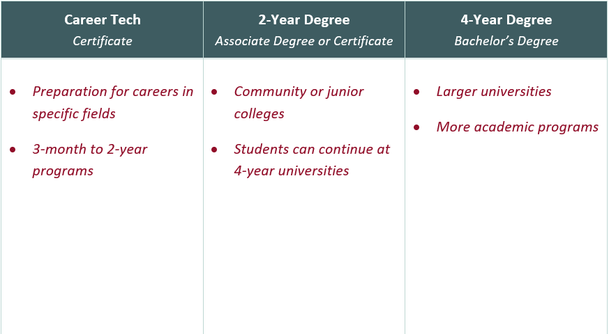
Card Sort
Notes:
Pass out the second page of the Card Sort Graphic Organizer, which include the bulleted definitions. Give students an opportunity to re-sort their cards based on the appropriate definitions. Ask the class to share any changes they made after discovering more about each category.

Slide 18




Career Tech
A certificate is awarded in a specialized field.
Programs can take three months to two years to complete.
Welder Salary: $40,240 | Childcare Worker Salary: $22,290 | Cosmetologist Salary: $24,900 | Mechanic Salary: $39, 550
Notes:
Ask students: what is a nearby career tech that you could attend?
Review the careers and the annual salary on the screen. These salaries are national averages, not local.
Image sources:
Goumenidis, K. (2004). US Navy hull technician 3rd class Casey Caudill, of priest river, Idaho, practices different welding techniques to improve his skills aboard USS Ronald Reagan. Wikimedia Commons. https://commons.wikimedia.org/wiki/File:US_Navy_04 0225-N-8213G-058_Hull_Technician_3rd_Class_Casey_C audill,_of_Priest_River,_Idaho,_practices_differen t_welding_techniques_to_improve_his_skills_aboard_ USS_Ronald_Reagan_(CVN_76).jpg
freepik.diller. (n.d.). Steel scissors. Freepik. https://www.freepik.com/free-photo/steel-scissors-lie-wave-silk-brown-hair-with-black-comb_2612555.htm
jcomp. (n.d.). Mechanic man repairing car. Freepik. https://www.freepik.com/free-photo/mechanic-man-re pairing-car_3805867.htm
Spiske, M. (2018 April). Toddler pouring sand. Unsplash. https://unsplash.com/photos/z02yFSgVRbA

Slide 19




2-Year Degree
An associate degree or certificate is awarded at a community or junior college. After completing an associate degree, many students continue their educations at 4-year institutions.
Fitness Trainer Salary: $39,210 | Firefighter Salary: $49,080 | Computer Programmer Salary: $82,240 | Dental Hygienist Salary: $74,010
Notes:
Review careers and salaries.
The listed firefighter salary tends to spark conversation. Note to students that you need many types of certifications to be a fireman in a larger city station, and that this salary does not refer to volunteer firefighters. If you want to be a firefighter in a larger town, you need to have an associate degree or higher in many cases, as the field is very competitive.
The dental hygienist career requires an associate degree at minimum, but you can also pursue a bachelor’s for higher pay and more job choices.
Ask students: what is a nearby 2-year college that you could attend?
Image sources:
Amoy, P. (2019 April). Person holding computer mouse. Unsplash. https://unsplash.com/photos/6DfEbkqsTiA
Chesin, M. (2019 December). Fireman wearing mask. Unsplash. https://unsplash.com/photos/HWTXLsPdut4
Hasani, A. (2020 June). Man in white crew neck t-shirt. Unsplash. https://unsplash.com/photos/5yCiIj1fxmc
Shaw, H. (2019 September). Woman doing dental. Unsplash. https://unsplash.com/photos/Dqrlp6cMLkE

Slide 20




4-Year Degree
A bachelor's degree is awarded after completing required classes. Universities are generally larger and offer more academic options.
Accountant Salary: $69,350 | Sports Reporter Salary: $43,490 | FBI Agent Salary: $62,960 | Engineer Salary: $85,880
Notes:
Ask students: what is a nearby 4-year college that you could attend?
Image sources:
Cull, K. (2019 September). Man holding DSLR camera. Unsplash. https://unsplash.com/photos/YXdrb9qr8cs
Graham, S. (2016 January). Person holding pencil near laptop computer. Unsplash. https://unsplash.com/photos/5fNmWej4tAA
Ikegame, S. (2009). FBI in Vancouver, TV series “Fringe” shooting. Wikimedia Commons. https://commons.wikimedia.org/wiki/File:F_B_I_(3769245201).jpg
mindandi. (n.d.). Image of engineering objects on workplace top view. Freepik. https://www.freepik.com/free-photo/image-engineering-objects-workplace-top-view-construction-concept-engineering-tools-vintage-tone-retro-filter-effect-soft-focus-selective-focus_1239244.htm

Slide 21
Let’s Talk About Money
“
“
There is real, independent evidence that shows that higher education leads to higher pay.
According to the Bureau of Labor Statistics, college graduates age 25 and over earn nearly twice as much as workers who have only a high school diploma.
Source: National Association for College Admission Counseling. (2017). Step by step: College awareness and planning for families,
counselors and communities. https://www.nacacnet.org/advocacy--ethics/initiatives/steps/

Slide 22
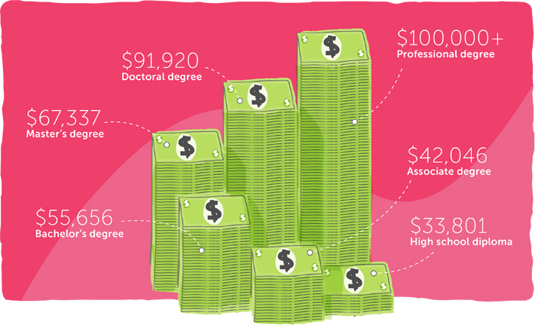
Source: U.S. Census Bureau. (2008). Learn more, earn more. CollegeBoard. https://bigfuture.collegeboard.org/get-started/kno w-yourself/learn-more-earn-more

Slide 23
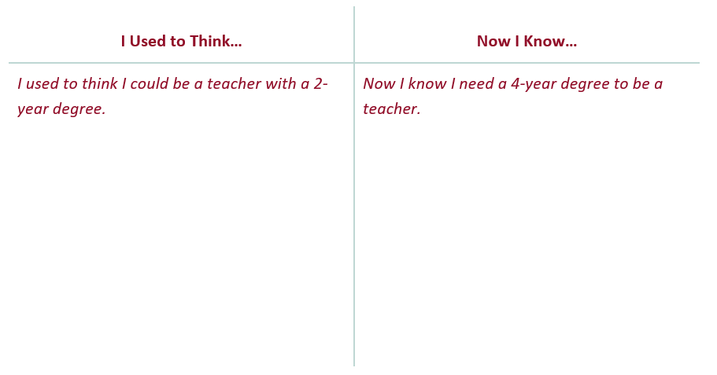
I Used To Think… But Now I Know
Notes:
Pass out an “I Used to Think... But Now I Know” half-sheet to each student. Ask students to reflect on their ideas about postsecondary education before the lesson versus what they've learned today. Have their thoughts, opinions, or knowledge changed? Invite students to list at least one idea they had before the event in the "I Used to Think..." column and then something new they've learned as a result of the campus visit in the "Now I Know..." column.

