Slide 1
Welcome!
We will begin shortly!
Getting to Know Google Tools for Families

Slide 2
Getting to Know Google Tools for Families
Notes:
Welcome everyone to the GEAR UP presentation of the Google Tools for Families webinar! [insert introductions]
Transition: Now, Have you ever wondered what GEAR UP is about? Let’s take a moment and let Danny explain.

Slide 3

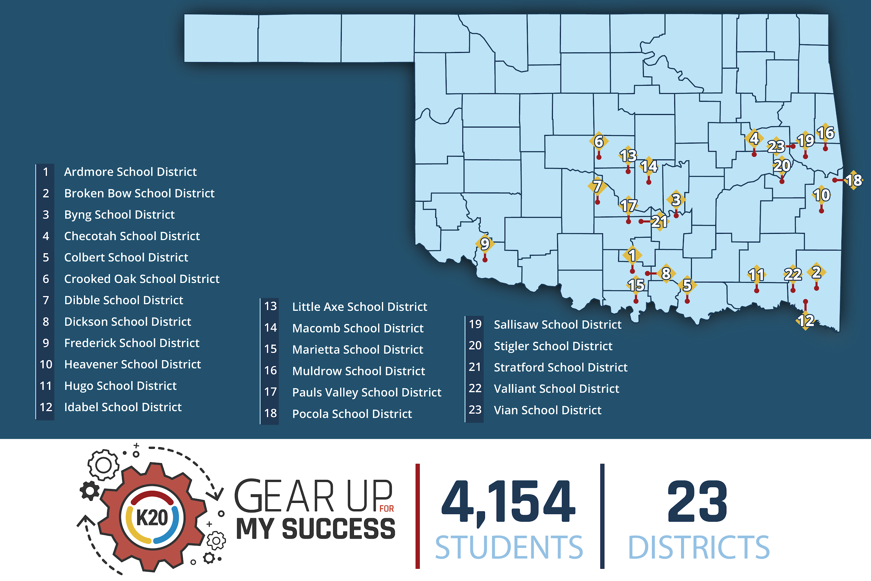
Notes:
GEAR UP is a nation-wide U.S. Department of Education competitive grant program whose ultimate goal is to increase the number of low-income students who are prepared for a post-secondary education and to help those students be successful in their transition from high school to college. We are a cohort model that starts with students in the 6th and 7th grades and follows them through their first year of college. Our cohort students are now 8th and 9th graders. We take a holistic approach to preparing students for a post-secondary education based on proven, research based practices. We work with school leadership, parents, teachers and students through a variety of projects and events, like this one. And even in the classroom.
Transition: And speaking of grant goals...

Slide 4
GEAR UP Grant Goals:
Increase cohort academic performance and preparation for postsecondary education.
Increase high school graduation and postsecondary education participation.
Increase student educational expectations and student and family knowledge of postsecondary education options, preparation, and financing.
Notes:
If you are unfamiliar with K20 GEAR UP for MY SUCCESS, let’s share with you some of the goals our grant focuses on when working with our cohort schools and students.
First, we hope to increase cohort academic performance and preparation for post-secondary education.
Secondly, we want all cohort schools to increase high school graduation rates and post-secondary education participation.
Lastly, it is important to increase student educational expectations and student and family knowledge of postsecondary education options, preparation, and financing.

Slide 5
Objectives:
The K20 GEAR UP Google Tools for Families presentation engages parents to become better informed about Google education software so they have the necessary skills to forge the parent-school-community partnerships essential to improving academic achievement for students.
Notes:
Today our objectives will be showcasing tools that focus on Google Classroom and Google Workplace, formerly known as G Suite. By the end of this webinar you will have a better understanding of the Google education software AND how you can use it to work in partnership with your school to help improve academic achievement for your student.

Slide 6
Session Goals:
Participants will analyze and identify parental engagement and involvement within a virtual platform.
Participants will engage in numerous features of Google Tools and how they can support their students in a virtual environment.
Notes:
The goals for this session are, first, to provide the opportunity to analyze and identify parental engagement and involvement within a virtual platform; and second, provide you with the opportunity to engage in numerous features of Google Classroom and experience how you can support your student in a virtual environment.
Before we get started, you should know that this webinar will be recorded and made available to you in your email and YouTube soon. That you can view the webinar at your own pace at a later time. We know there is so much to learn that it will be very helpful for you to go back to view it again.

Slide 7





Topics for today’s session:
Google Docs
Google Sheets
Google Slides
Google Drive
Google Explore
Notes:
We look forward to assisting you in your journey in understanding the ins and outs of Google Suite/Workspace. We are going to dive right in and take a look at some features you students’ probably utilize on a weekly or even daily basis. Today we are going to review the basic features of Google Docs, Google Sheets, Google Slides, Google Drive, and a little unknown secret “Google Explore”.
Transition: Now, let’s move on to our first activity.

Slide 8

This Session Will Be a Success If...
What are you hoping to leave this webinar being able to do?
What questions do you hope will be answered?
[insert link]
[insert QR code]
Notes:
Form link [insert here]
What are your hoping to leave this webinar being able to do?
I hope to be able help my student who may struggle with a google doc or slide presentation.
Having resources to help my student in google classroom, but also with the work the need to create.
I want to learn the basic steps on how to use Google Slides.
I want to learn the basic steps on how to use Google docs.
What questions do you hope will be answered?
Will I have access to this webinar after this session?
How can students share their work with me?
What if my cannot find their work?
Can my student only access their work during the school day?
Are students only allowed to contact their teachers during the school day?
Short answer for any additional comments or questions

Slide 9























The Wide World of Google
Notes:
If you notice on your screen, Google has so many products available to use. Even more interesting, these tools are utilized around the world. In this session we will be focusing on the ones your students may use most often in school. We know that Google can be overwhelming, but hope that some of the resources we share with you today will help and encourage you to learn more. I use Google everyday, learn new features all the time, and even get frustrated and confused, too. Us older folks struggle a little more with mastering the ever changing world of technology. Sometimes I miss the good old days of growing up in the 80s, anyone feel that way, too. Transition: Well enough of dating myself, let’s learn about some of the features of Google!

Slide 10
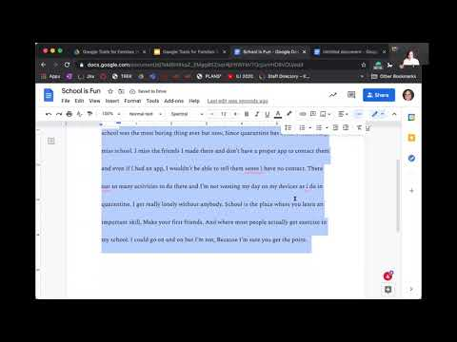

Slide 11







Docs | Google Tools for Families (pg 1 of 2)
Choose Google Docs and Click on “New”
Title your page and click the toolbar at the top alignment options and center
Line spacing, select a dropdown menu will appear and you may select several line spacing options.
Changing font, Drag the cursor over your title and highlight, your title should be highlighted blue or gray.
Select the different options from the toolbar Change the font and size, color, bold, and highlight.
If you make a mistake, you can always use the “undo” or “redo” options.
Want to make the page smaller or larger? Click on the toolbar and a drop down menu will appear that will allow you to adjust the size of the page.

Slide 12

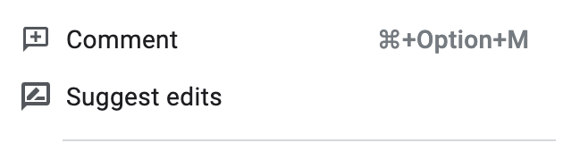

Docs | Google Tools for Families (pg 2 of 2)
Inserting an image, click the on the toolbar. A drop down menu will appear and you may select from your computer, Google Drive, or search the web.
Want to see the latest edits and changes history? To the right of the “Help” button, select “Last Edit” Note: this may listed differently each time based on when the last edit was made.
You may see comments that have been made by the teacher. Place your cursor where you would like to insert a comment, right click your trackpad or mouse and a drop down menu will appear. Select comment and a comment text box will appear.
Google Explore is a great search tool for students to use when they need to research vocabulary, topics, and insert images to their assignments. Select the explore at the bottom left of the page. Type what you are looking for in the search bar and notice you can select “web”, “images”, or students can search their “Drive”.

Slide 13


Slide 14





Slides | Google Tools for Families (pg 1 0f 3)
Choose Google Docs and Select “Blank”
At the right of your presentation, a column appears titled “Themes” Scroll through the different options and select a theme and click the “X” on the upper right hand corner to close the column.
At the left of your presentation, this column allows you to navigate your slides. You may move the slides around, delete, hide, and copy.
  Select slide 1, right click and a menu will appear with options.
  Select “Change background”, a background menu will appear.
  Select a new color.
  Additional options include inserting an image.
Inserting a Text box, select on the toolbar. Your cursor will become a symbol, you will move the cursor to the slide and drag the blue square to the desired size.

Slide 15

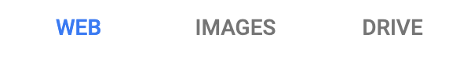


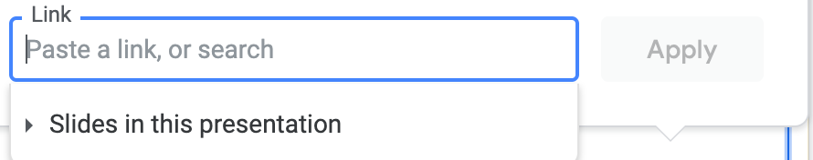
Slides | Google Tools for Families (pg 2 0f 3)
Google Explore and inserting videos and/or URL links. Click the Explore button
Inserting videos and URL links (web addresses) and Google Explore search and box will appear to the right.
  Type “photosynthesis” in the search.
  You have three (3) options to choose from
  Select the first option from “web results” and a new window will open.
  Copy the URL at the top of the page and return to your “Slides” presentation.
  Select at the top of the page, a drop down menu will appear and select and insert your URL

Slide 16
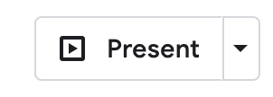
Slides | Google Tools for Families (pg 3 0f 3)
Present mode, this will allow the presenter to show a full screen view.
  The upper right of your screen select.
  Your screen will expand to full view.
  You may use the “return” or “arrow” keys on your keyboard to advance your slides.
  To exit present mode, select “esc” on your keyboard.

Slide 17
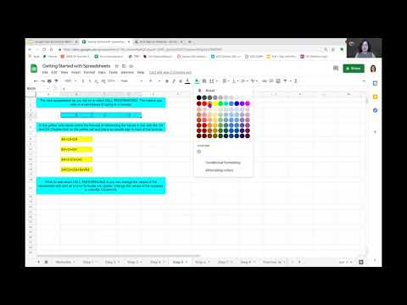

Slide 18

Sheets
Open the “Getting Started with Spreadsheets” document from [insert link here]
There are several tabs at the bottom of the screen that will guide you, step-by-step, through how to use the basic features of Google Sheets. You can progress through the document by clicking these tabs.
Complete as much or as little as you want to learn about topics such as:
  What are cells?
  How do you use in-cell calculations?
  How do you make the spreadsheet have different cells work together?
  How do you merge cells?
  How do you add borders?
  How do you make a lot of text fit in a cell?
Notes:
http://k20.ou.edu/tools1
SUM and Tutorial - https://www.youtube.com/watch?v=pJsEyK5Ay_E
Practice Spreadsheet from Alice Keeler: https://docs.google.com/spreadsheets/d/1_f12lAbZXcD_ztRcbNDbBoD9M9heJ7RAoxG6FFF4Yfo/copy
Tweaked Spreadsheet: https://docs.google.com/spreadsheets/d/1l_IX_aZVmHNr32adWYtPdf984_V9LRBSyc65UrF7Yqw/edit?usp=sharing
Force-copy tweaked spreadsheet: https://docs.google.com/spreadsheets/d/1l_IX_aZVmHNr32adWYtPdf984_V9LRBSyc65UrF7Yqw/copy

Slide 19

Explore
Open a new Doc.
Title it “World History Notes.”
Using a bulleted list, jot down anything you know about Christopher Columbus.
Select the “Explore” button in the bottom right corner of your screen.
Using the “Web” tab, find more information about Christopher Columbus.
Using the “Images” tab, drag and drop an image into your notes.
Using the “Drive” tab, search for any other notes you might have.
Don’t forget to push the Explore button in other Google apps!

Slide 20

Stoplight
How are you feeling about these Google tools?
  Red - Still new and learning.
  Yellow - Feeling good but have some questions.
  Green - Feeling like an expert!
[insert QR code]
[insert link here]
Notes:
Link: [insert here]

Slide 21
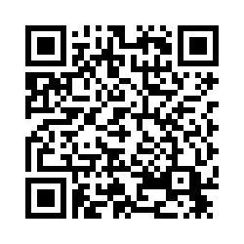
Survey
http://k20.ou.edu/g
We would love your feedback! Please use the tiny url or scan the QR code with your electronic device. Thank you for joining us today!
Notes:
Thank you everyone for joining us today. We truly appreciate you taking time out of your busy schedule to learn tips and tricks of Google Tools. And now it’s time for our last task for today, the session evaluation.
Please take a moment to use the tinyURL posted on the slide and in chat, or you may use your phone or other electronic device, to scan the QR code with your camera to access the evaluation.
Your feedback is important to us, because we use the feedback for all of our events to help improve our services. In order to use your feedback in our college readiness research, we have to have your explicit permission to the information collected in your evaluation. All of your responses will be anonymous and will assist us in further improving our services to you and your school, as well as schools in Oklahoma and across the country.
I’ll give you a moment to access the evaluation.
Notice that there is a space for you to enter your email address and another space for participant ID. Ignore the space for the participant ID, it is not needed.
Do you have any questions about the evaluation process?
Again, thank you for joining us and for taking the time to provide us with this feedback. It has been a pleasure sharing this time with you today and have a nice evening!

