Slide 1

Family Night

Slide 2
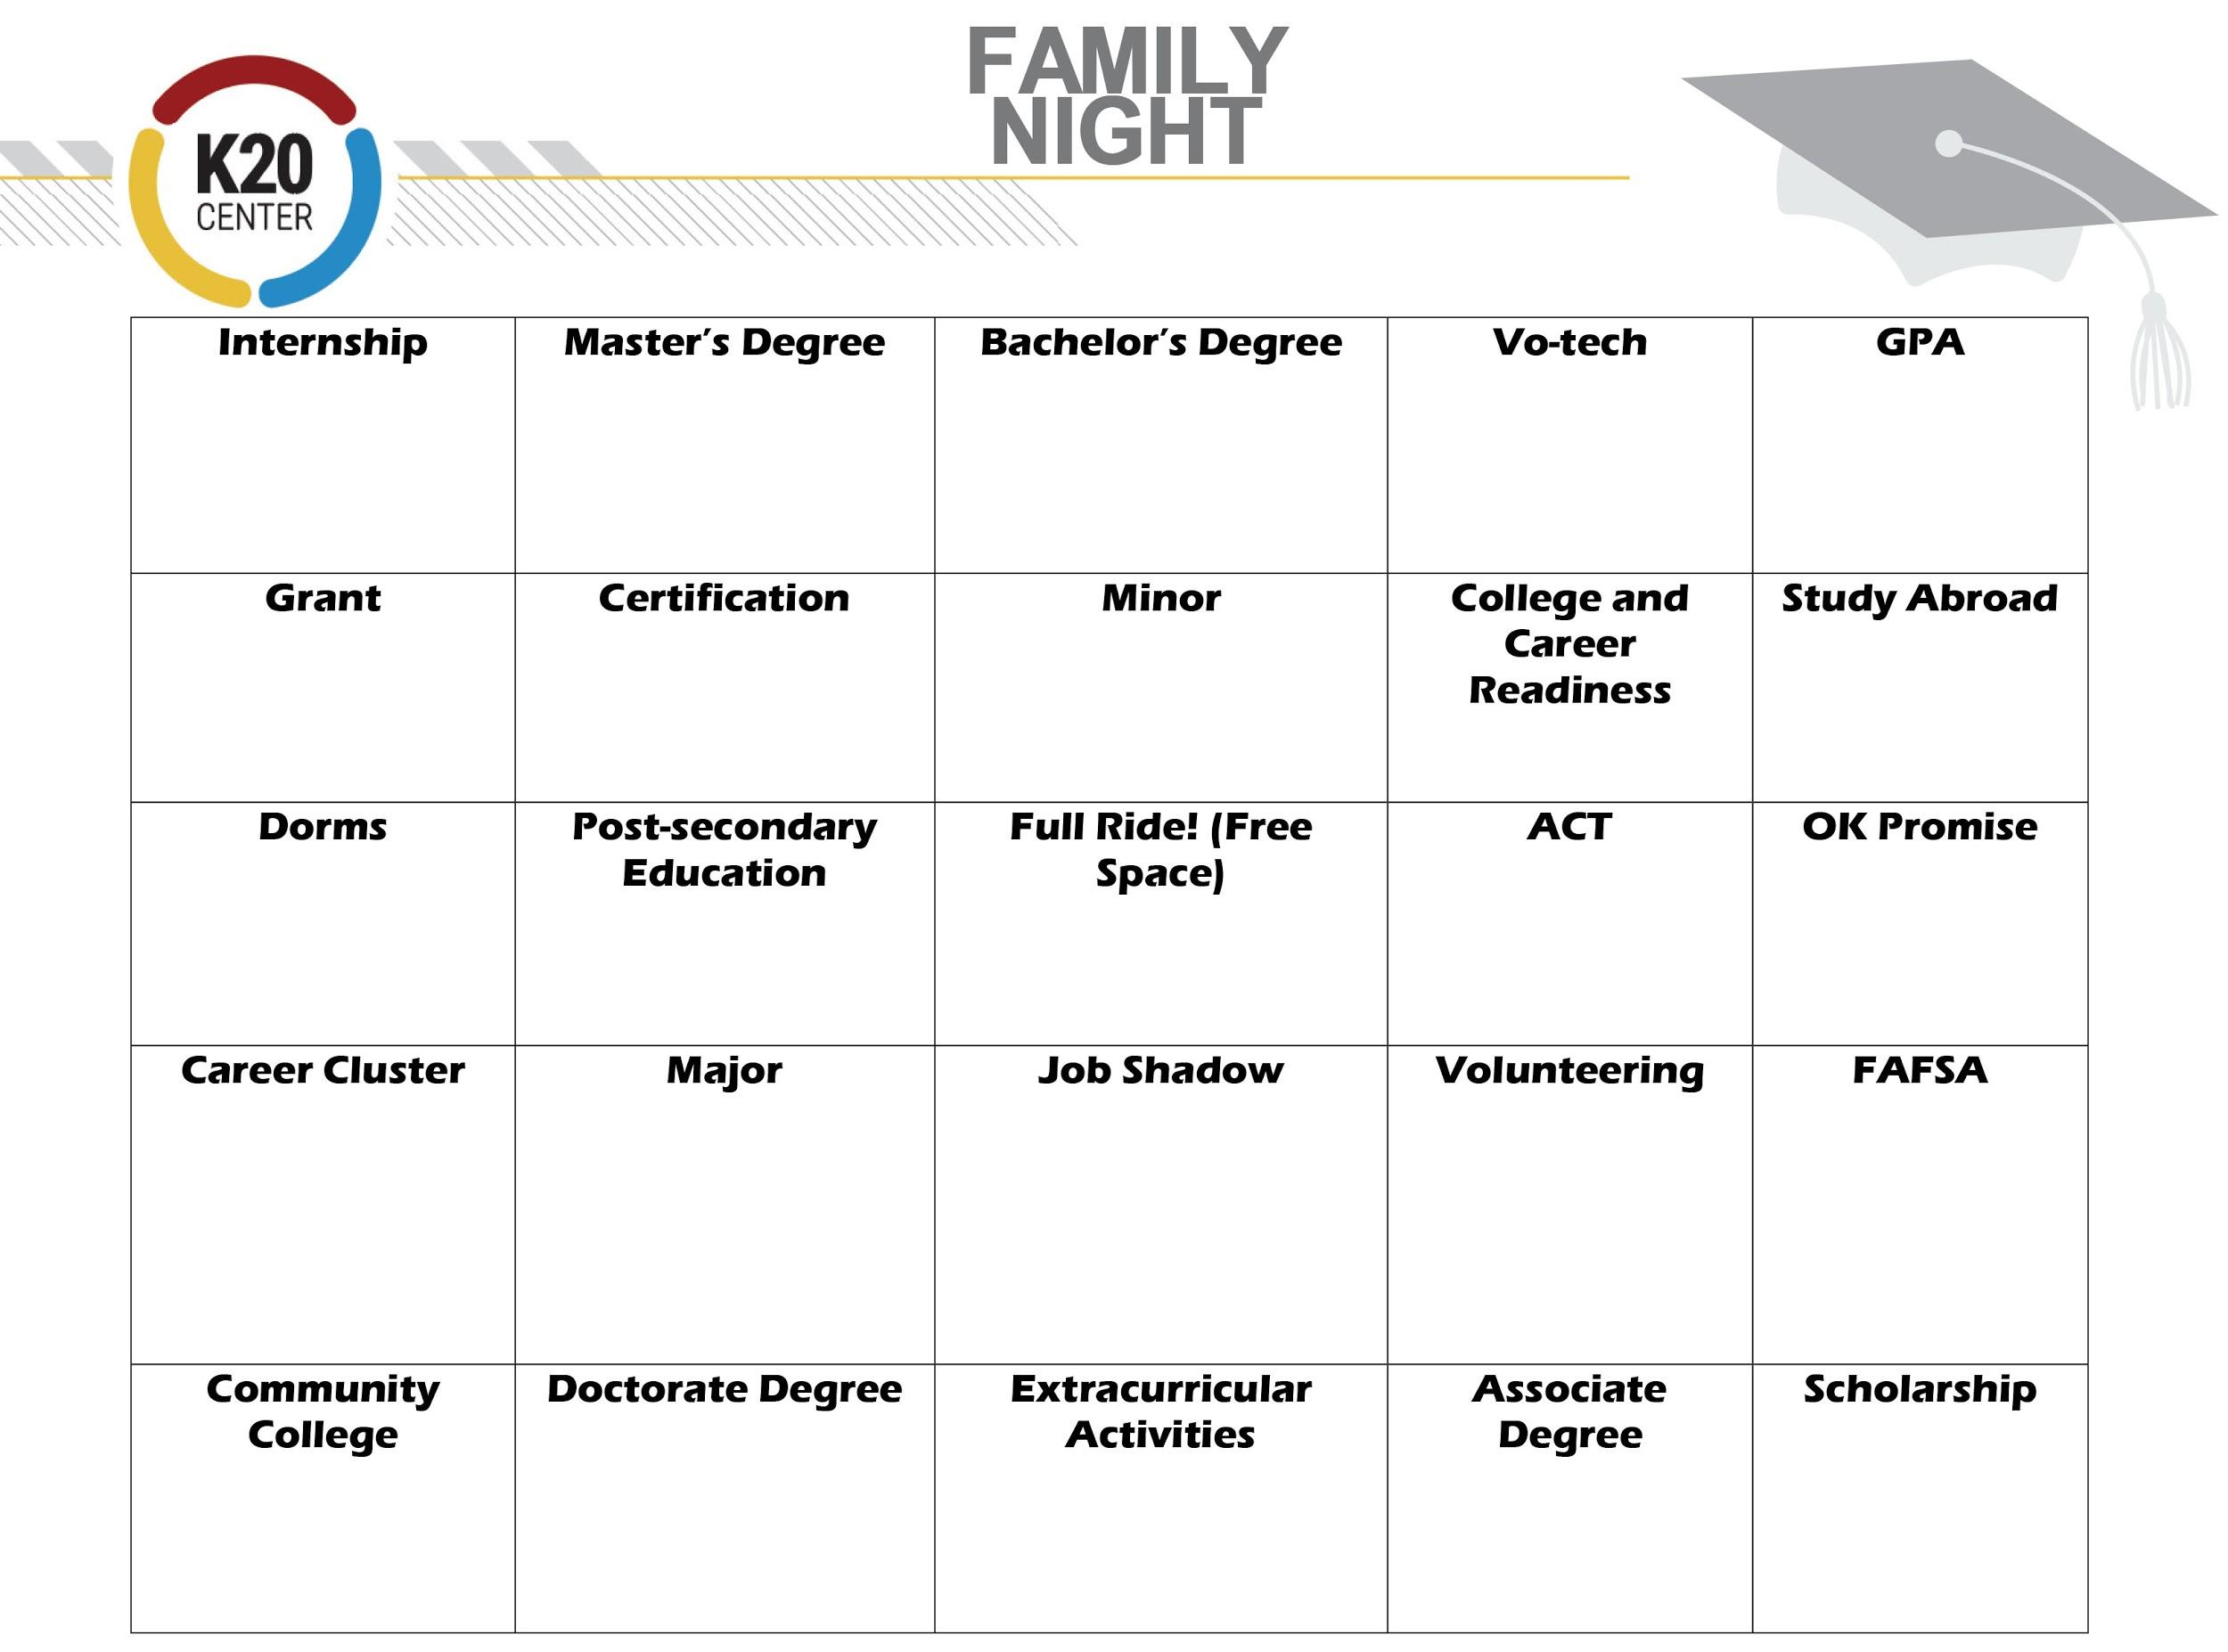
Match 5 words in any row to win: Across, down or horizontally.
Remember to yell “BINGO!” when you have 5 in a row!
Notes:
Word list: GPA, Major, College and Career Readiness, Community College, Vo-Tech, FAFSA, ACT’s, Minor, Scholarship, Grant, Dorms, Full Ride, Study Abroad, Bachelor's Degree, Associates Degree, Masters Degree, Doctorate Degree, Certification, Career Cluster, Post Secondary Education, Internship, Job Shadow, Extracurricular Activities, Volunteering.
Presenter Directions: 15 min - You can start your event with this game of Bingo, to allow time for families arriving late. This can also encourage families to arrive on time, if you promote heavily and have prizes to give away for the bingo. Suggested time for Bingo is 15 minutes, but you can adjust based on your needs.
Click on the link to print 10 different bingo boards. Families may not know the definitions of these words… so you can just say the names.

Slide 3
Agenda
College and career vocabulary bingo and door prizes
Introductions & objectives: What is GEAR UP? What do we offer to families?
Why PSE?
Lifetime earnings (Top 10 reasons)—How much is a college degree worth?—PSE options
Career interest survey—Compare results—OKcollegestart.org
Oklahoma's Promise scholarship and Oklahoma 529 Savings Plan
"I used to think... But now I know”—Reflection and next three action steps
Questions, prizes, survey, and evaluation
Notes:
1 min

Slide 4
What is GEAR UP? Why are we here?
Three federally funded grants that have been awarded to 46 secondary schools across Oklahoma, spanning the 7 years.
Increase the academic preparedness for higher education and future careers upon graduating from participating schools.
Increase high school graduation rates and higher education enrollment rates of participating schools.
Increase students' and families' knowledge of higher education options, preparation, and financing.
Notes:
1 min

Slide 5
What GEAR UP offers for our families
College campus visits
College readiness family events
Exclusive Parent Leadership Academy
Professional mentoring for students
Professional development for whole school
Notes:
1 min

Slide 6
Turn and Talk…
Find another family and discuss the following question:
What are the benefits of continuing education
after high school graduation?
Notes:
5 min Have families discuss the question at their tables . After 3 mins, have a few groups share out.

Slide 7









Top 10 Reasons for Pursuing a Postsecondary Education (PSE)
More in Lifetime Earnings
Higher Levels of Civic Engagement (vote, run for office, volunteer)
Healthier Family Life (lower divorce rates, children achieve higher in school)
Longer Life Expectancy
Better Mental and Physical Health
Professional Mentors and a Lifetime Network
Sense of Accomplishment and Independence
Higher Job Satisfaction
Increased Creativity and Problem Solving
Prepared for the Tech Economy
Notes:
2 min
Great! So many of the ideas you came up with are exactly what the research says that the top ten reasons are to continuing your education after high school:

Slide 8
How much is a college degree worth?
Notes:
3 min So, let’s talk time and money! Who needs more of either? Do you need more time to do the things you want to do? Do you need more money as well? Would you agree that time and money are a major concern when you think about higher education?

Slide 9
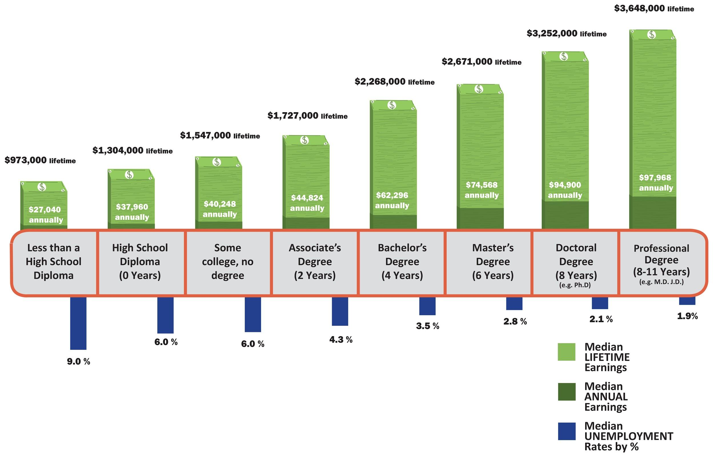
Median Lifetime/Annual Earnings & Typical Time Commitment per Education Level
Notes:
Ask participants what they notice about this graphic. You may want to have a few page size ones printed out on tables for participants to see more clearly.

Slide 10
Types of PSE (Postsecondary Education)
1–2 Years | Certification Program | Career Tech
2 years | Associate’s Degree | Community College
4 Years | Bachelor's Degree | University
6 Years | Master’s Degree | University
8+ Years | Doctorate Degree | University
You can also serve in the military full time or part time
and get training/college credit.

Slide 11

Career Interest Survey
Go to www.okcollegestart.org
Create an account or login.
Click on the Career Planning
tab at the top.
Notes:
15 min Career Interest Survey Handout
Log in to the OK College Start Website and go through the steps as you explain to participants, so they can see the steps and the items you are clicking on. Have adult facilitators walking around, making sure all participants are able to follow the steps. Don’t move on until each family has completed each step…

Slide 12
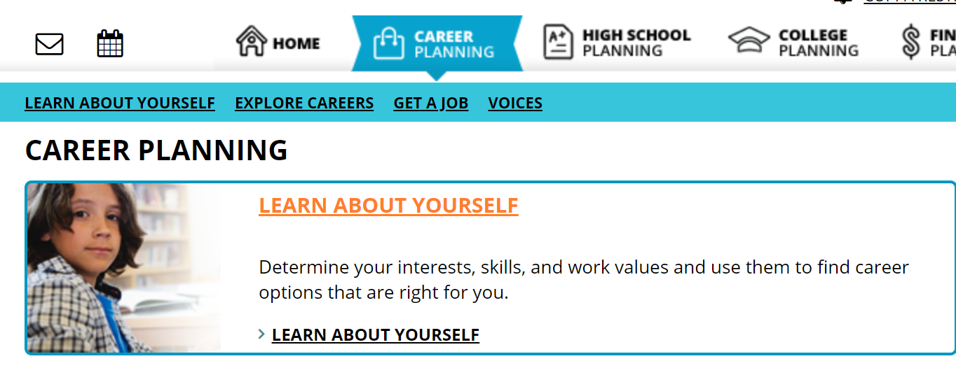
Click “Learn About Yourself”

Slide 13
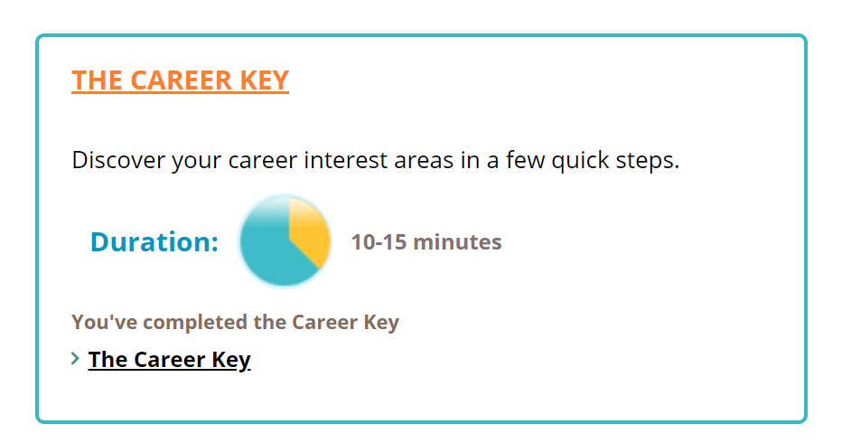
Click “The Career Key”

Slide 14
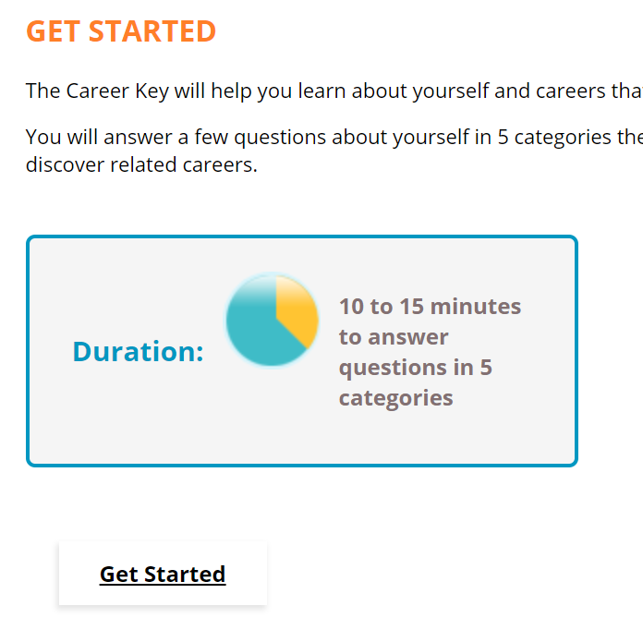
Click “Get Started”

Slide 15
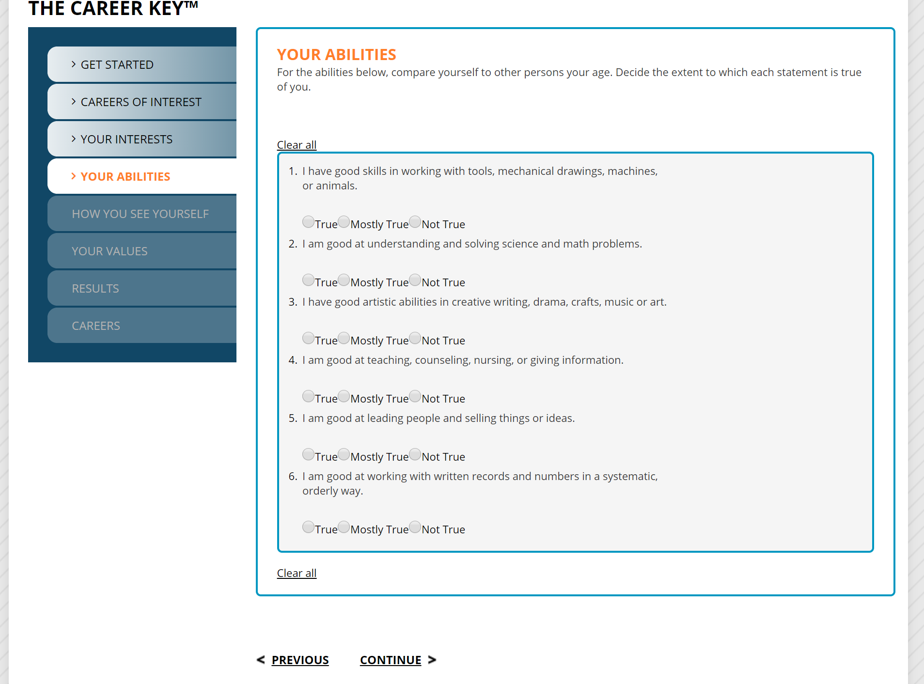
Answer each survey question to the best of your ability.
After you answer each set of questions, click the continue button at the bottom to move on to the next section.

Slide 16
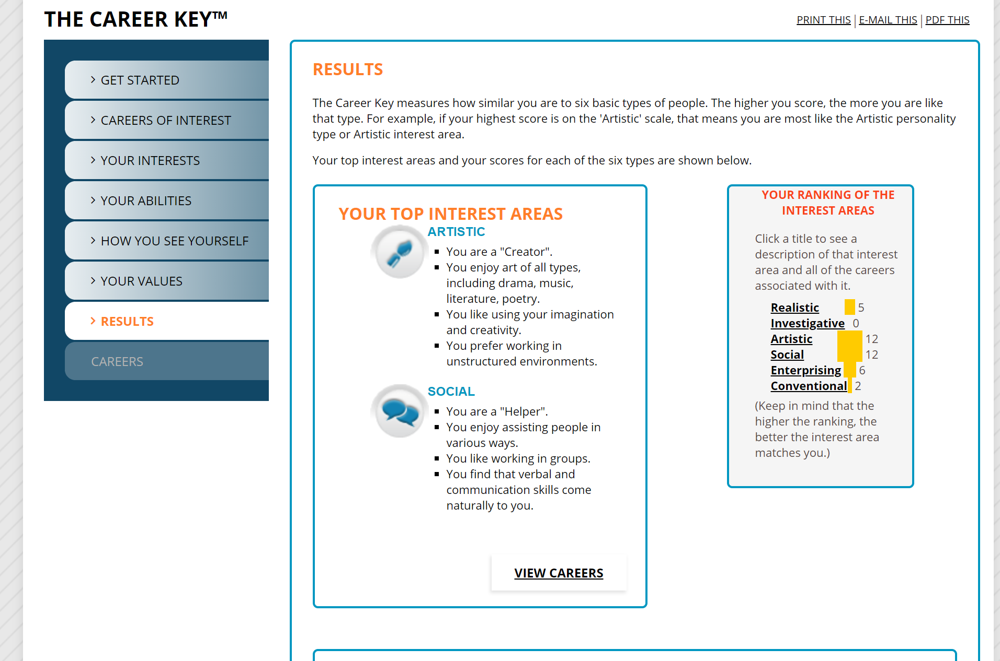
Click "View Careers”
    Once you have answered all of the questions, you will find your top two interest areas.

Slide 17
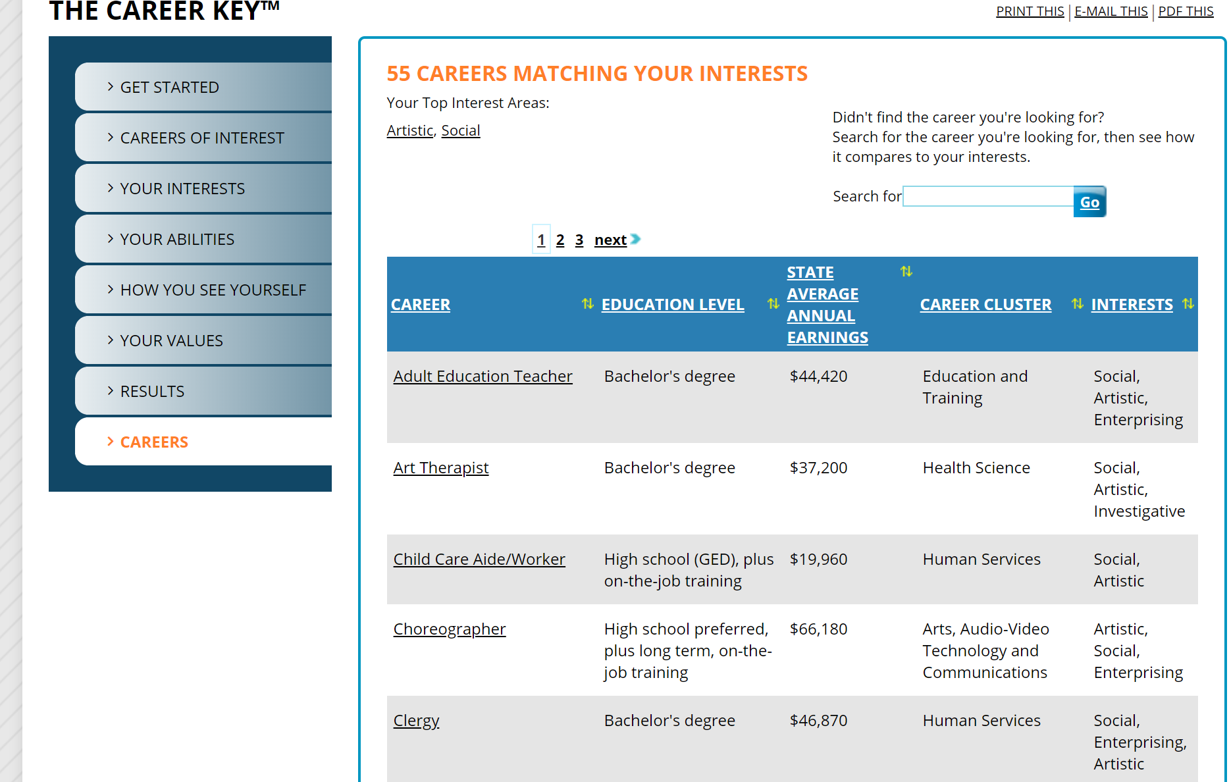
Choose two possible matches that you may be interested in.
Copy the information for the top two choices in your trading cards.
The site will show you many possible career choices based on your survey results. You’ll also see Average Earnings and Educational Level.
You can click on the name of the career to read more about each one.

Slide 18
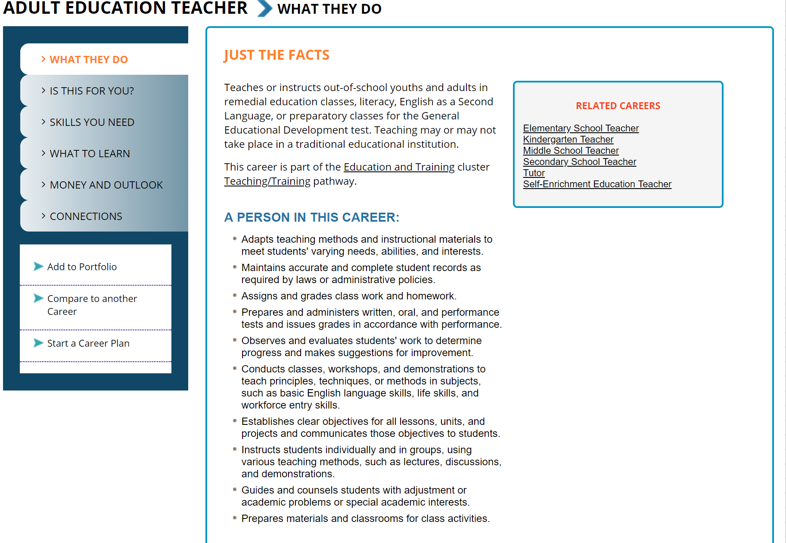
Read "What They Do”.
And add a little information that you think makes this career choice perfect for you!
Is there anything you are not excited about? Add that to your trading card as well! Is there another career choice that you like better?

Slide 19
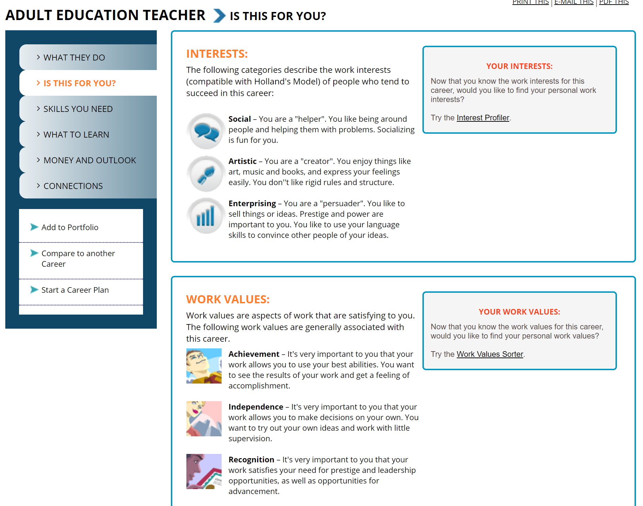
Now Read “Is This For You?” Add a little information that you think makes this career choice perfect for you!
Is there anything you are not excited about? Add that to you trading card as well!

Slide 20
Discussion & Results
Were you surprised by your Career Interest Survey results?
Did the results of the survey make you want to discover new career interests?
Now that you have the information, you can go back into your account and use your results to further investigate possible careers!
Notes:
5 min

Slide 21

What is Oklahoma’s Promise?
Oklahoma's Promise offers qualified Oklahoma students an opportunity to earn a scholarship for college tuition.
Requirements:
Must be an Oklahoma resident.
Must enroll in the 8th, 9th, or 10th grade.
The parents' federal adjusted gross income must not exceed $55K per year.
Special income provisions may apply to: Children adopted under certain circumstances. Families receiving Social Security disability and death benefits.
Regarding US residency:
Students in 8th–10th grades may apply for Oklahoma’s Promise while working on residency. Once residency is established, they will be eligible to receive the scholarship.
Notes:
5 min

Slide 22

Start saving for your child or grandchild.
No matter what their age—the time to start is now.
Tax-advantaged savings plan for education expenses.
Parents, family, and friends can contribute to the account.
Funds can be used for many education expenses, such as tuition, books, technology, and more.
Notes:
2 min

Slide 23
Useful resources:
https://www.okcollegestart.org/
https://okcareerguide.kuder.com/account/login-register?studentregister=1
http://www.ucango2.org/
https://www.okhighered.org/okpromise/
https://www.ok4saving.org/
Notes:
3 min

Slide 24
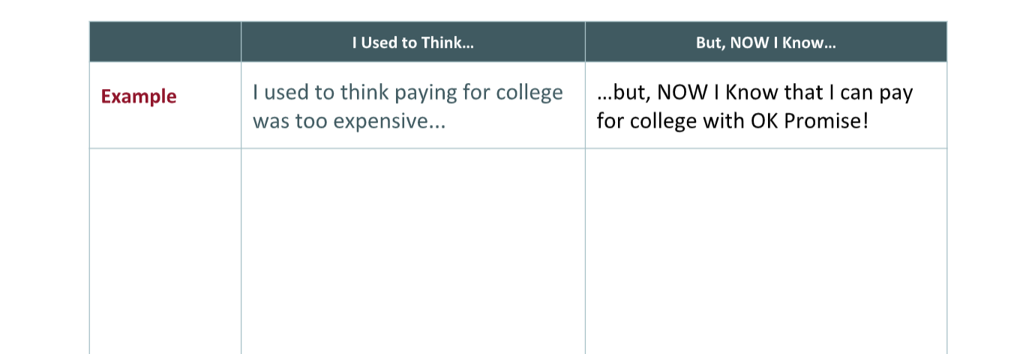
I Used to Think… But, NOW I Know…
With your student, discuss something you thought about postsecondary education before you came today.
Each of you write down one statement that begins with I used to THINK… on the left side. Then, list something you learned today by writing a statement on the right side that begins with But NOW I Know...
At the bottom, write your
next 3 action steps!
Notes:
5 min I Used to Think…Now I Know…:
Speaker: Think back to how you felt about education after HIgh school before you came today. Discuss with your student and come up with each of your own statements that begins with I used to think… on the left side… and a But, NOW I Know on the right side of something you learned today. At the bottom write your next 3 action steps are….for example, maybe filling out OK Promise, or opening a 529 savings account...etc,
Example: I used to think I had to attend a 2-year college to become a teacher…but, now I know it takes at least 4 years.

Slide 25
Rapid Feedback Forms Questions?
Prizes?
Contact information:
Notes:
2 min

