Slide 2
Primary Sources for Primary Grades
Comparing and Contrasting Today’s Classrooms with Classrooms from the Past

Slide 3
Essential Questions
How do clues from pictures help us understand the lives of people in the past and present?
How were schools different in the past, and why have they changed over time?

Slide 4
Lesson Objectives
We will explore and explain how primary sources can help us learn about the past.
We will apply critical reading and thinking skills to interpret, evaluate, and respond to primary sources.

Slide 5
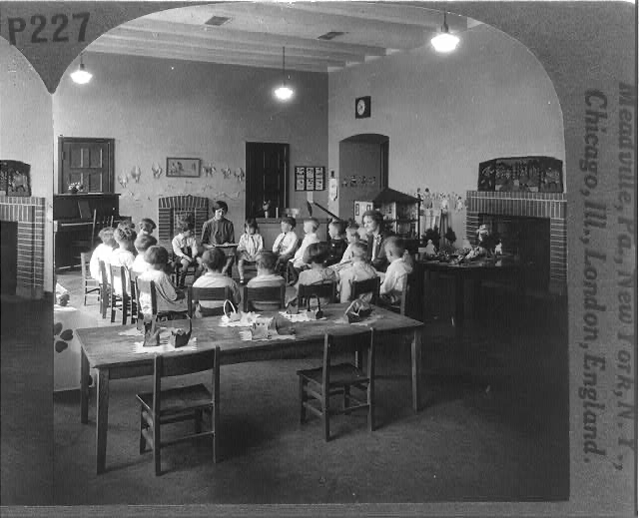
Storytime in First Grade
Notes:
Keystone View Company. (1927). Story Hour in the First Grade [Photograph]. Library of Congress. https://www.loc.gov/item/97505969/

Slide 6
First Grade at Work
Notes:
Keystone View Company. (1927). First Grade at Work [Photograph]. Library of Congress. https://www.loc.gov/item/97505974/

Slide 7
Upper Grades in Maryland One-room School
Notes:
Rusinow, I. (1941). Charles County, Maryland, Upper-grade Pupils in the Waldorf Elementary School [Photograph]. National Archives and Records Administration. https://catalog.archives.gov/id/521562

Slide 8
1922 Lesson on How to Use a Telephone
Notes:
American Telephone and Telegraph Company. (1922). Image from Page 62 of "Bell Telephone Magazine, Spring 1950" [Photograph]. Internet Archive. https://archive.org/stream/belltelephonemag00vol2930amerrich/belltelephonemag00vol2930amerrich#page/n62/mode/1up

Slide 9
Essential Questions
How do clues from pictures help us understand the lives of people in the past and present?
How were schools different in the past, and why have they changed over time?

Slide 10
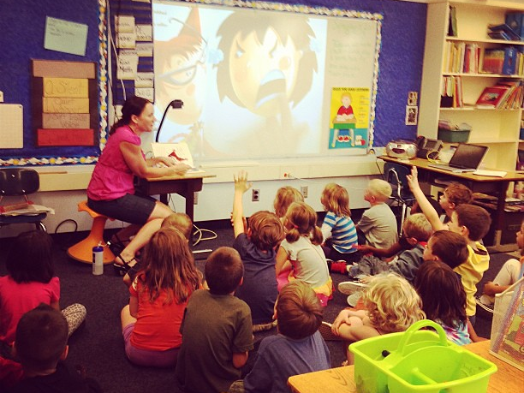
First-grade Classroom, Present Day
Notes:
Lauer, T. (2013, September 5). Visiting Ms. Murphy's 1st Grade Classroom [Photograph]. Flickr. https://www.flickr.com/photos/37996574045@N01/9680110561

Slide 11
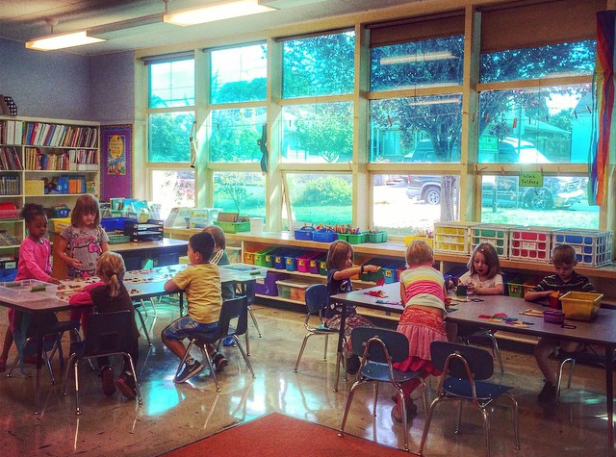
Present-day Classroom #2
Notes:
Lauer, T. (2014, September 4). Visiting Mrs. Jamesbarry's 1st Grade Classroom [Photograph]. Flickr. https://www.flickr.com/photos/37996574045@N01/15141517705

Slide 12
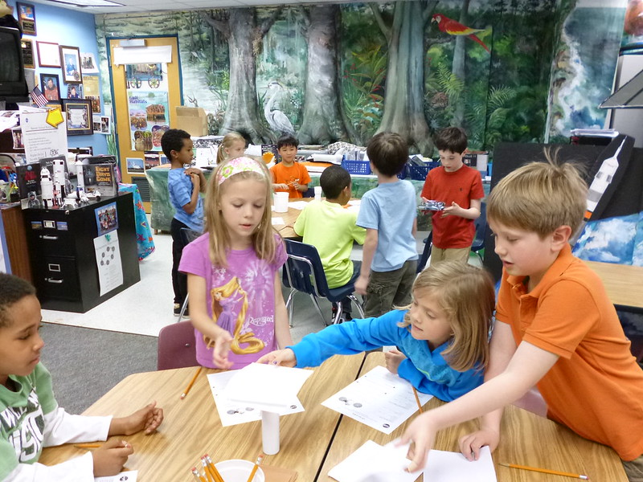
Present-day Classroom #3
Notes:
Sullivan, L. (2014, May 1). P1010133 [Photograph]. Flickr. https://www.flickr.com/photos/32561453@N05/13896719320

Slide 13
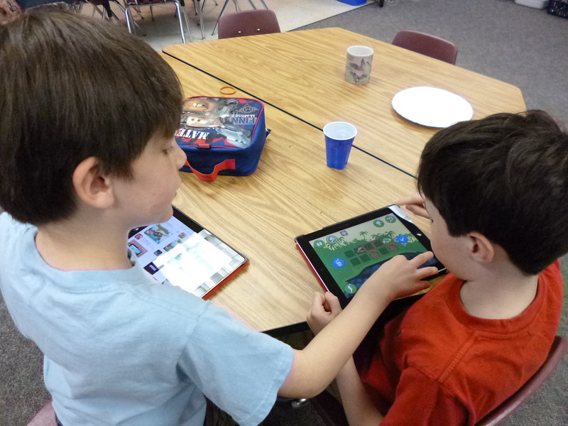
Present-day Classroom #4
Notes:
Sullivan, L. (2014, May 1). P1010191 [Photograph]. Flickr. https://www.flickr.com/photos/32561453@N05/14083291455

Slide 14
Venn Diagram

Slide 15
School of the Future
Create your drawing.
Add a title and caption to describe what is happening in your picture.

Slide 16

Reflection Time
How were schools different in the past?
Why have schools changed over time?
What do you still wonder about these changes? What questions do you have?

Slide 17
Essential Questions
How do clues from pictures help us understand the lives of people in the past and present?
How were schools different in the past, and why have they changed over time?

