Slide 1
It’s OPTIC-al
On your paper, write OPTIC down the left side.
O- write observations about the visuals you see
P- list the parts, or details, you notice
T- assess the title
How does it relate?
If there is no title, give it one
I- determine the interrelationships of the visuals
How do they work together?
C- come to a conclusion about the image

Slide 2
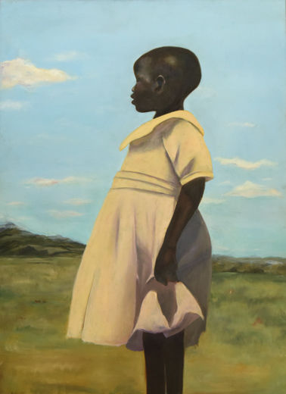
O- write observations about the visuals you see
P- list the parts, or details, you notice
T- assess the title
How does it relate?
If there is no title, give it one
I- determine the interrelationships of the visuals
How do they work together?
C- come to a conclusion about the image
Forrester, T. (2016). Uganda [Online image]. Retrieved June 18, 2020 from https://www.metmuseum.org/exhibitions/listings/2016/ps-art-2016/works-of-art
Notes:
Uganda
Cliffannie Forrester
Age 17, Grade 12
High School of Art & Design, Manhattan
Art Teacher: Maria Jimenez
Oil on canvas

Slide 3
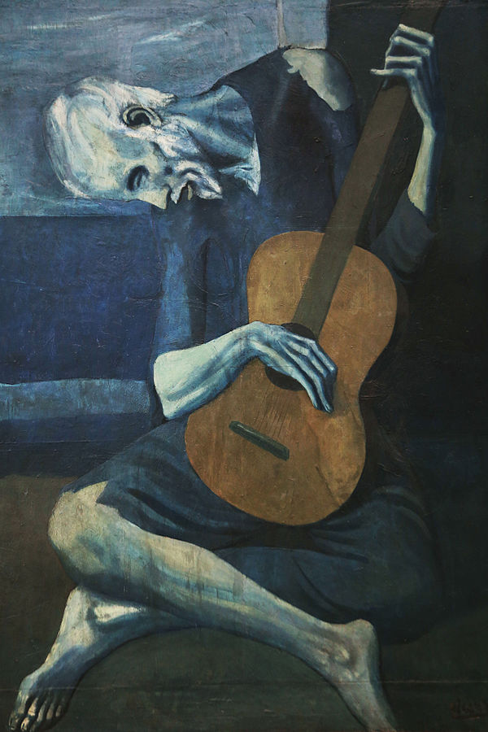
O- write observations about the visuals you see
P- list the parts, or details, you notice
T- assess the title
How does it relate?
If there is no title, give it one
I- determine the interrelationships of the visuals
How do they work together?
C- come to a conclusion about the image
Picasso, P. (1904). The Old guitarist [Online image]. Retrieved June 18, 2020 from https://en.wikipedia.org/wiki/The_Old_Guitarist
Notes:
The Old Guitarist
Artist Pablo Picasso
Year 1903–04
Medium Oil on panel
Dimensions 122.9 cm × 82.6 cm (48.4 in × 32.5 in)
Location Art Institute of Chicago

Slide 4
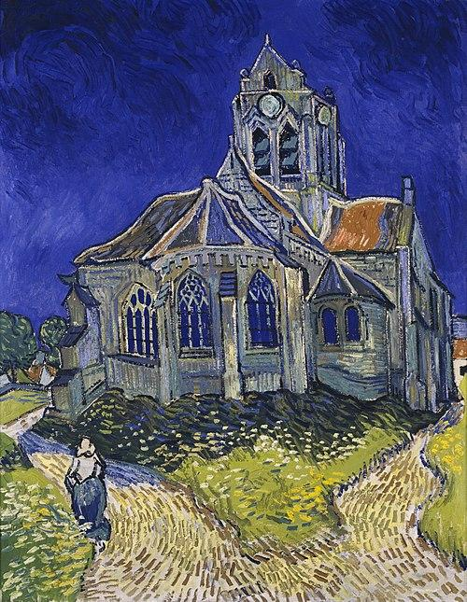
O- write observations about the visuals you see
P- list the parts, or details, you notice
T- assess the title
How does it relate?
If there is no title, give it one
I- determine the interrelationships of the visuals
How do they work together?
C- come to a conclusion about the image
Van Gogh, V. (1890). The Church at Auvers [Online image]. Retrieved June 18, 2020 from https://en.wikipedia.org/wiki/Visual_arts
Notes:
The Church at Auvers
Artist Vincent van Gogh
Year 1890
Catalogue
F789JH2006
Medium Oil on canvas
Dimensions 74 cm × 94 cm (37 in × 29.1 in)
Location Musée d'Orsay, Paris

Slide 5
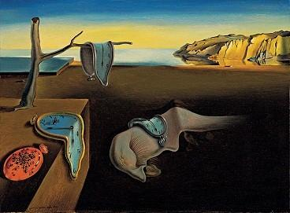
O- write observations about the visuals you see
P- list the parts, or details, you notice
T- assess the title
How does it relate?
If there is no title, give it one
I- determine the interrelationships of the visuals
How do they work together?
C- come to a conclusion about the image
Dali, S. (1931). The Persistence of memory [Online image]. Retrieved June 18, 2020 from https://en.wikipedia.org/wiki/The_Persistence_of_Memory
Notes:
The Persistence of Memory
Artist Salvador Dalí
Year 1931
Medium Oil on canvas
Dimensions 24 cm × 33 cm (9.5 in × 13 in)
Location Museum of Modern Art, New York City

Slide 6
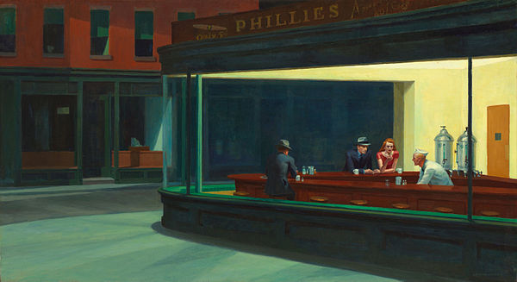
O- write observations about the visuals you see
P- list the parts, or details, you notice
T- assess the title
How does it relate?
If there is no title, give it one
I- determine the interrelationships of the visuals
How do they work together?
C- come to a conclusion about the image
Hopper, E. (1942). Nighthawks [Online image]. Retrieved June 18, 2020 from https://en.wikipedia.org/wiki/Nighthawks_(painting)
Notes:
Nighthawks
Artist Edward Hopper
Year 1942
Medium oil paint, canvas
Movement American realism
Dimensions 84.1 cm (33.1 in) × 152.4 cm (60.0 in)
Location Art Institute of Chicago, United States

