Slide 2
Being Mindful of Sadness
in “The Scarlet Ibis”
English Language Arts
Grade 9

Slide 3
Essential Question
How does a character’s state of mind affect their development and the development of the theme in a text?

Slide 4
Learning Objective
Students will be able to analyze the development of character and theme in a text.

Slide 5
How do you deal with uncertain times?
Respond to the prompt above. Write for the full time.

Slide 6
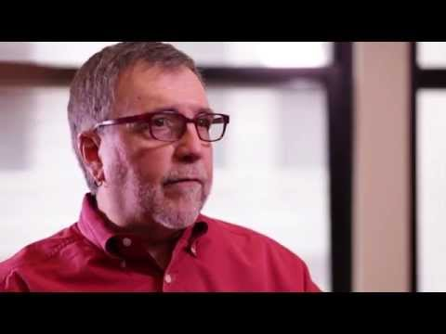
What is Mental Health Counseling?
Notes:
NYU Steinhardt (Oct 2, 2014). What is mental health counseling? [video]. Youtube. Retrieved January 4, 2021 from https://www.youtube.com/watch?v=UpsQX4nxZUI

Slide 7
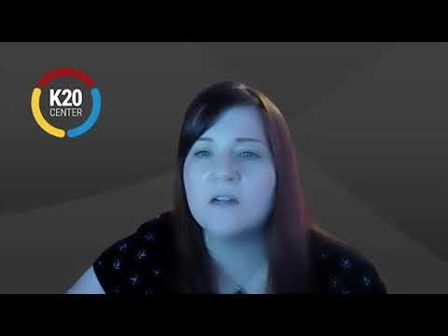
What is Social Work?
Notes:
K20 Center. (January 8, 2021). Social Worker - Jessica Schonlau - Zoom Into Your Career [video]. Youtube. Retrieved from https://www.youtube.com/watch?v=iD9roYUbBGw&feature=youtu.be

Slide 8
It’s OPTIC-AL
On your paper, write O-P-T-I-C down the left side.
O- Write observations about the visuals you see.
P- List the parts or details you notice.
T- assess the title.
How does it relate?
If there is no title, give it one.
I- determine the interrelationships of the visuals.
How do they work together?
C- come to a conclusion about the image.

Slide 9
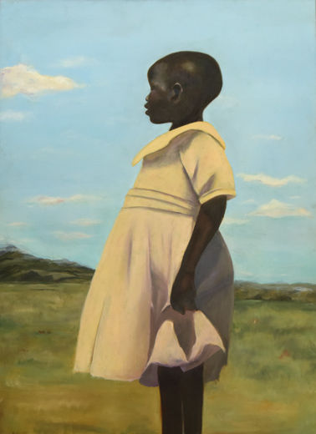
O- Write observations about the visuals you see.
P- List the parts or details you notice.
T- Assess the title.
How does it relate?
If there is no title, give it one.
I- Determine the interrelationships of the visuals.
How do they work together?
C- Come to a conclusion about the image.
Forrester, C. (2016). Uganda [Online image]. Retrieved June 18, 2020, from https://www.metmuseum.org/exhibitions/listings/2016/ps-art-2016/works-of-art
Notes:
Uganda
Cliffannie Forrester
Age 17, Grade 12
High School of Art & Design, Manhattan
Art Teacher: Maria Jimenez
Oil on canvas
Image 81 of 89 in PS Art 2016 Art Award slideshow

Slide 10
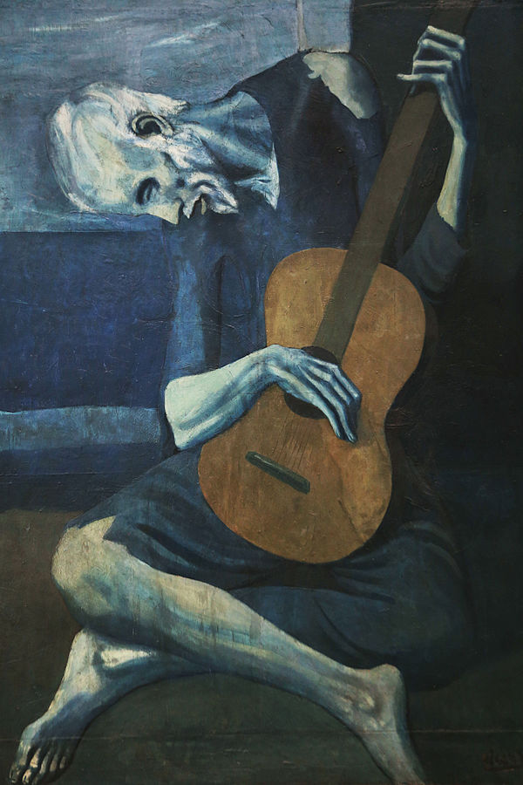
O- Write observations about the visuals you see.
P- List the parts or details you notice.
T- Assess the title.
How does it relate?
If there is no title, give it one.
I- Determine the interrelationships of the visuals.
How do they work together?
C- Come to a conclusion about the image.
Picasso, P. (1904). The Old Guitarist [Online image]. Retrieved June 18, 2020, from https://en.wikipedia.org/wiki/The_Old_Guitarist
Notes:
The Old Guitarist
Artist Pablo Picasso
Year 1903–04
Medium Oil on panel
Dimensions 122.9 cm × 82.6 cm (48.4 in × 32.5 in)
Location Art Institute of Chicago

Slide 11
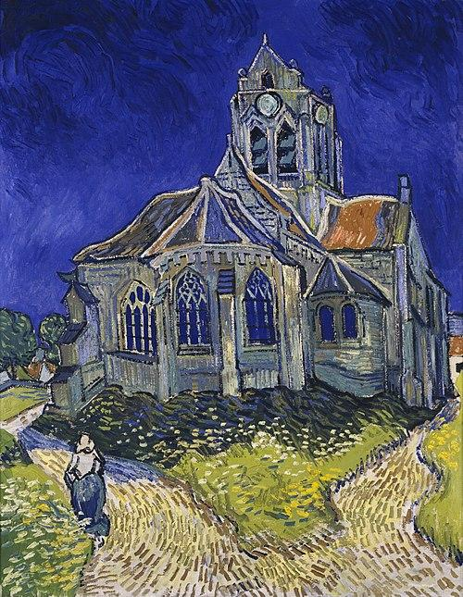
O- Write observations about the visuals you see.
P- List the parts or details you notice.
T- Assess the title.
How does it relate?
If there is no title, give it one.
I- Determine the interrelationships of the visuals
How do they work together?
C- Come to a conclusion about the image.
Van Gogh, V. (1890). The Church at Auvers [Online image]. Retrieved June 18, 2020, from https://en.wikipedia.org/wiki/Visual_arts
Notes:
The Church at Auvers
Artist Vincent van Gogh
Year 1890
Catalogue
F789JH2006
Medium Oil on canvas
Dimensions 74 cm × 94 cm (37 in × 29.1 in)
Location Musée d'Orsay, Paris

Slide 12
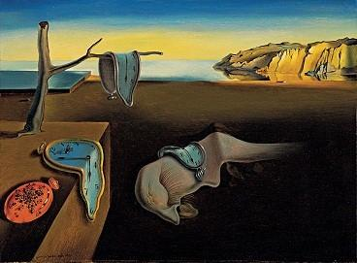
O- Write observations about the visuals you see.
P- List the parts or details you notice.
T- Assess the title.
How does it relate?
If there is no title, give it one.
I- Determine the interrelationships of the visuals
How do they work together?
C- Come to a conclusion about the image.
Dali, S. (1931). The Persistence of Memory [Online image]. Retrieved June 18, 2020, from https://en.wikipedia.org/wiki/The_Persistence_of_Memory
Notes:
The Persistence of Memory
Artist Salvador Dalí
Year 1931
Medium Oil on canvas
Dimensions 24 cm × 33 cm (9.5 in × 13 in)
Location Museum of Modern Art, New York City

Slide 13
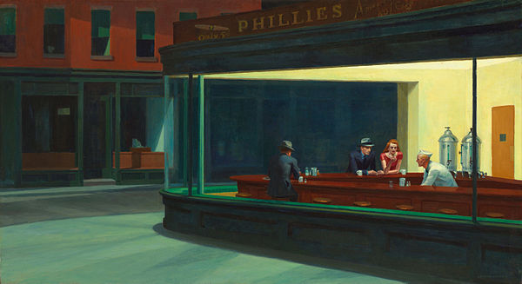
O- Write observations about the visuals you see.
P- List the parts or details you notice.
T- Assess the title
How does it relate?
If there is no title, give it one.
I- Determine the interrelationships of the visuals.
How do they work together?
C- Come to a conclusion about the image.
Hopper, E. (1942). Nighthawks [Online image]. Retrieved June 18, 2020, from https://en.wikipedia.org/wiki/Nighthawks_(painting)
Notes:
Nighthawks
Artist Edward Hopper
Year 1942
Medium oil paint, canvas
Movement American realism
Dimensions 84.1 cm (33.1 in) × 152.4 cm (60.0 in)
Location Art Institute of Chicago, United States

Slide 14
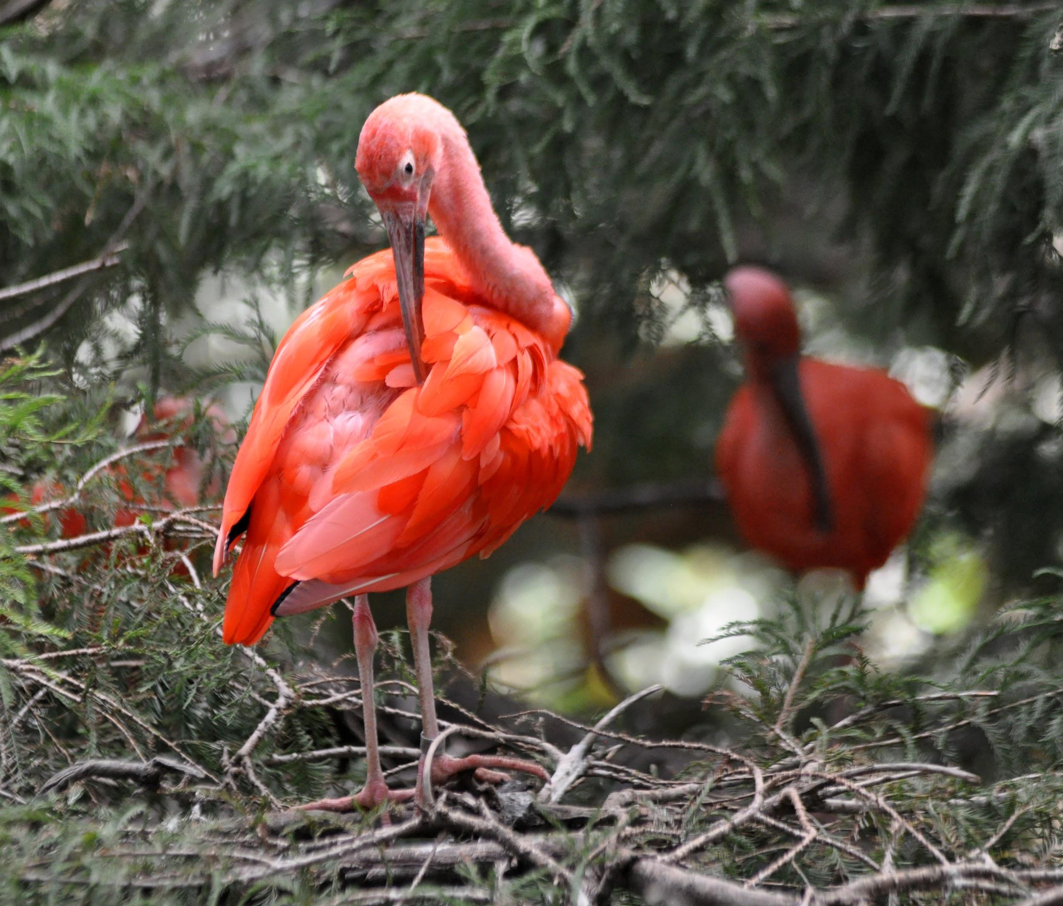
“The Scarlet Ibis” by James Hurst
As you read, think about the main character’s emotional state throughout the story.
How do you know what he is feeling throughout the story?
How do his emotions change throughout the story?
What do his emotions tell us about the theme(s) in the story?
Milne, P. (June 28, 2011). Scarlet Ibis [image]. Flickr. Retrieved January 13, 2021, from https://www.flickr.com/photos/48307594@N00/6037953333

Slide 15
After Reading “The Scarlet Ibis”
Complete the Text Chart
Discussion
How does the author develop the character of Brother in the text?
How is the reader supposed to feel about Brother?
What the Text Says | Character’s Mood/ State of Mind | Reaction Created in the Reader

Slide 16
11 Self-Care Tips
Says/Matters Chart
Making Connections to “The Scarlet Ibis”
What the Text Says (copy and paste the direct quote from the article here) | Why it Matters/ Connection to “The Scarlet Ibis”
What do the video and text say?
Include these in the chart on the “Says” side.
Why does this matter?
Include why you chose these on the “Matters” side.
Explain connections you made.

Slide 17
11 Self-Care Tips
Notes:
Bereson, G. (May 5, 2019). 11 self care tips for teens and young adults. The Clay Center for Young Healthy Minds. Retrieved January 14, 2021, from https://www.mghclaycenter.org/parenting-concerns/11-self-care-tips-for-teens-and-young-adults/

Slide 18
Processing Sadness
Option 1
Option 2
Create a poster where Brother has a conversation with someone who can provide him with some insight into or ways to process his sadness. Some choices are:
Mom
Dad
Aunt Nicey
Friend
Counselor
Create a poster that provides specific tips for someone in class to use who may be having a difficult time processing their own feelings.
Then, choose a character from the story and write a paragraph that explains how that character can change or add to the purpose stated in your poster.

Slide 19
Option 1: Brother Processes His Sadness: Two Voices
Create a poster where Brother has a conversation with someone else who provides him with some insights or ways to process his sadness.
Mom
Dad
Aunt Nicey
Friend
Counselor

Slide 20
Option 2: Processing Emotions
Create a poster providing specific tips for someone who may be having a difficult time processing their feelings.
Choose a character from “The Scarlet Ibis” and write a paragraph discussing how that character might change or add to the purpose stated in the poster.

