Slide 2
Robot Teacher
Programming and Algorithms

Slide 3
Essential Question
How do computers think and work?
How can we make computers do things we want them to do?

Slide 4
Lesson Objectives
Understand that computers have to be programmed to do work.
Analyze a problem and determine steps needed to reach a goal.
Solve problems to complete a computer programming task successfully.

Slide 5
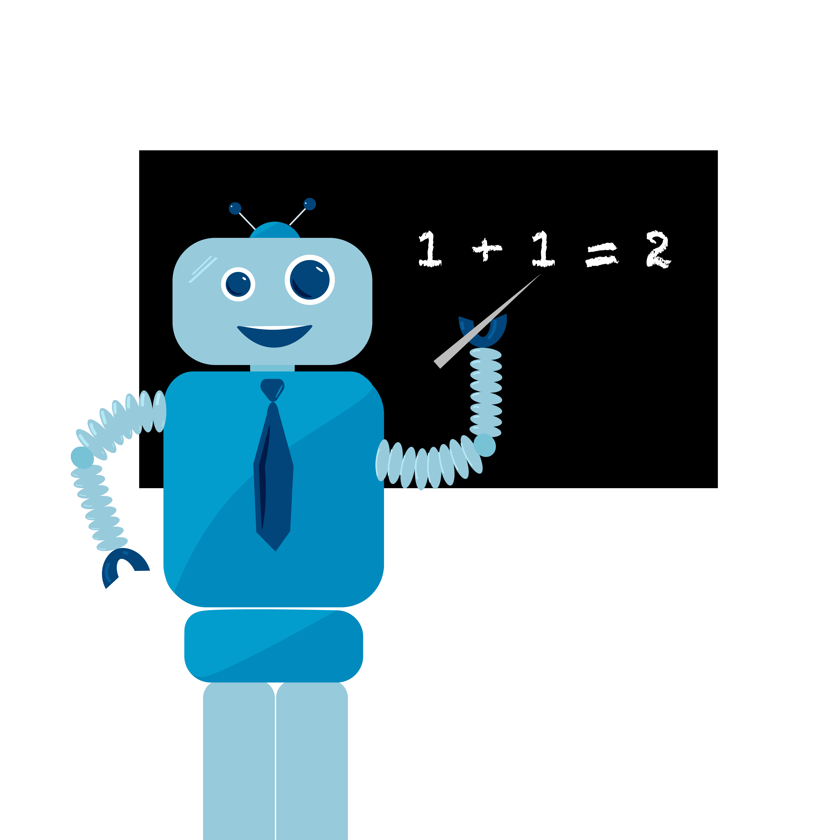
Robot Teacher

Slide 6
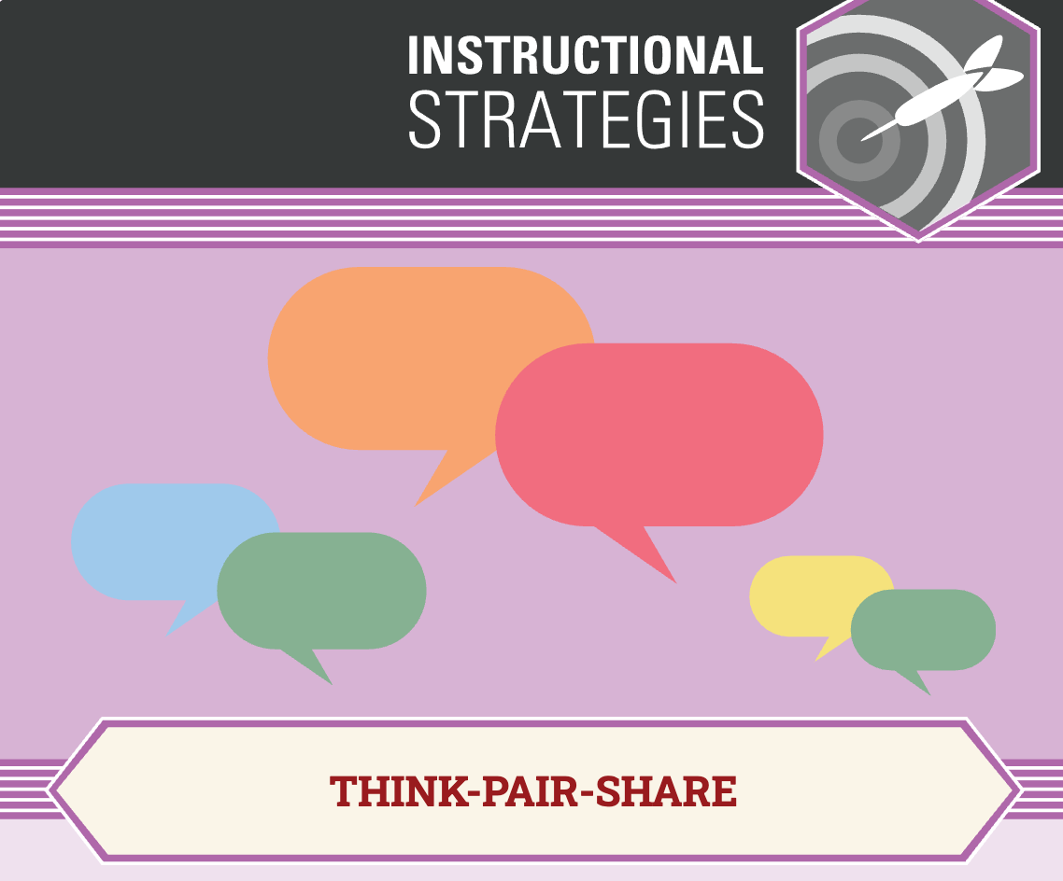
Think-Pair-Share
What about commanding the robot teacher was fun?
What was hard?
Notes:
K20 Center. (n.d.). Think-Pair-Share. Strategies. https://learn.k20center.ou.edu/strategy/139

Slide 7

I Notice I Wonder
What did you learn?
What are you curious about?
Notes:
K20 Center. (n.d.). I Notice I Wonder. Strategies. https://learn.k20center.ou.edu/strategy/139

Slide 8
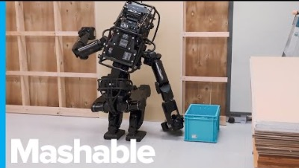
Robot Construction Worker
Notes:
Mashable. (November 8, 2018). This robot is training to become a construction worker: Genius moments. [Video]. Youtube. https://www.youtube.com/watch?v=JMLPhk6b0gA

Slide 9
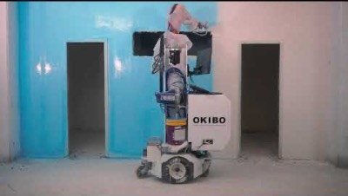
Robot Painter
Notes:
Okibo. (February 27, 2020). Autonomous Painting Robot. [Video]. Youtube. https://www.youtube.com/watch?v=hm9ZSN37jVM

Slide 10
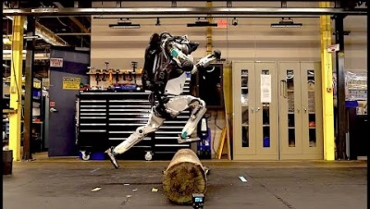
Robots Balancing and Moving
Notes:
AwesomeTech. (March 7, 2020). Boston Dynamics' amazing robots Atlas and Handle. [Video]. Youtube. https://www.youtube.com/watch?v=uhND7Mvp3f4

Slide 11
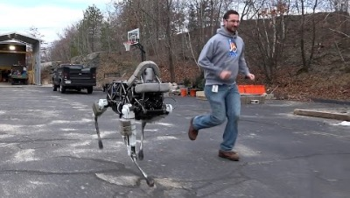
Robot Dog
Notes:
Boston Dynamics. (February 9, 2015). Introducing Spot Classic (previously Spot). [Video]. Youtube. https://www.youtube.com/watch?v=M8YjvHYbZ9w
[V

Slide 12
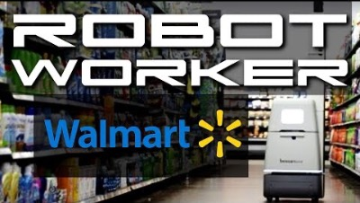
Walmart Robot
Notes:
UPHIGH Productions. (September, 18 2019). Walmart's autonomous scanning robots. [Video]. Youtube. https://www.youtube.com/watch?v=ubDKUZ-lidc

Slide 13
Follow the Leader
Work with a partner
Plan an algorithm
Share your program for the class to follow

Slide 14
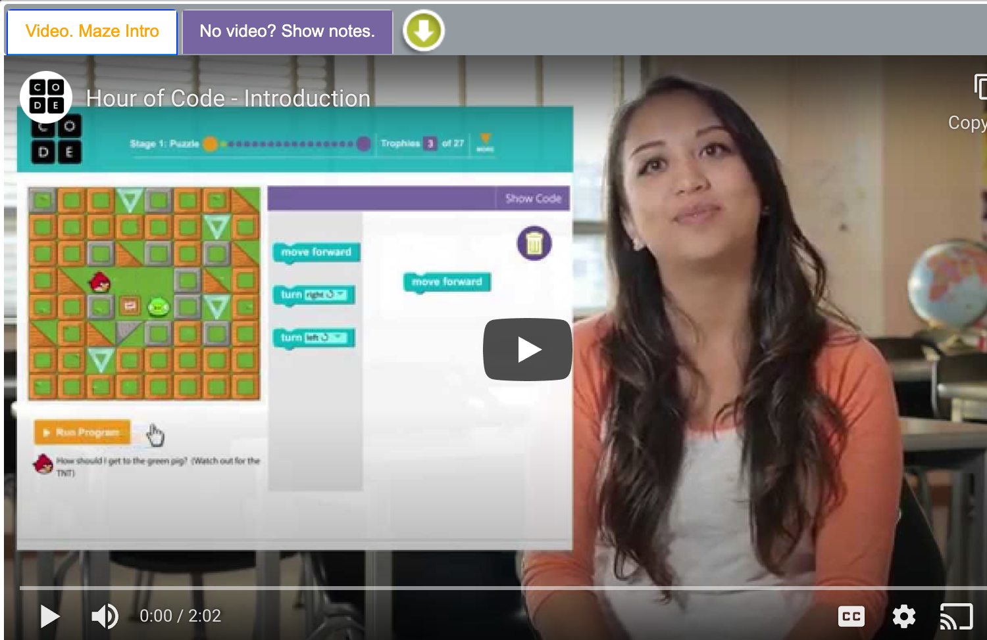
Code.org
Notes:
https://studio.code.org/hoc/1

Slide 15

Anchor Chart
Tips for block coding
Notes:
K20 Center. (n.d.). Anchor Charts. Strategies. https://learn.k20center.ou.edu/strategy/58.

