Slide 1
Let’s Lasso the Moon
Phases of the Moon

Slide 2

I Notice, I Wonder
As you watch the video, think about some things:
What do you notice?
What do you wonder?
Notes:
K20 Center. (n.d.). I notice, I wonder. Strategies. https://learn.k20center.ou.edu/strategy/180

Slide 3
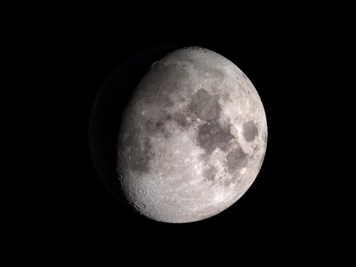
Notes:
NASA Goddard (Producer). (2014, December 9). NASA | Moon Phases 2015, Northern Hemisphere (Moon Only) [Video file]. https://www.youtube.com/watch?v=LC5rEhxGqT4&feature=youtu.be

Slide 4
Essential Question
What predictions can we make about objects we see in the sky?

Slide 5
Learning Objectives
Recognize the eight (8) phases of the moon.
Analyze the patterns to make predictions about the moon.

Slide 6

Were you born on a full moon?
Scan the QR code with the camera on your tablet
-or-
https://www.moongiant.com/birthday-moon/

Slide 7
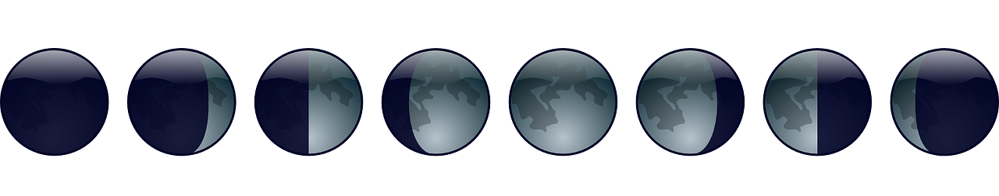
Were you born on a full moon?
On your circle sheet of paper draw what the moon looked like on the night that you were born.
Notes:
Clker-Free-Vector-Images. (2012, April 5). [Lunar Phases]. https://pixabay.com/vectors/lunar-phase-moon-lunar-phase-cycle-25451/

Slide 8

Elbow Partner
What do your moons have in common?
How are they different?
What are some things you notice about your group’s moons?
Notes:
K20 Center. (n.d.). Elbow partners. Strategies. https://learn.k20center.ou.edu/strategy/116

Slide 9
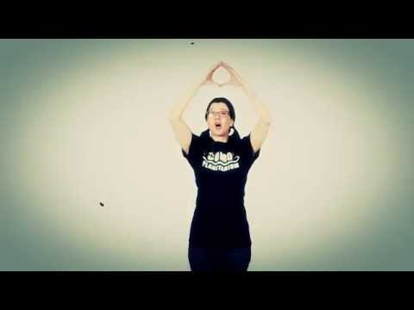
Notes:
Como Planetarium (2015, October 23). The Moon Phase Song [Video]. YouTube. https://www.youtube.com/watch?v=cFm4ZdM9C7s&feature=youtu.be

Slide 10
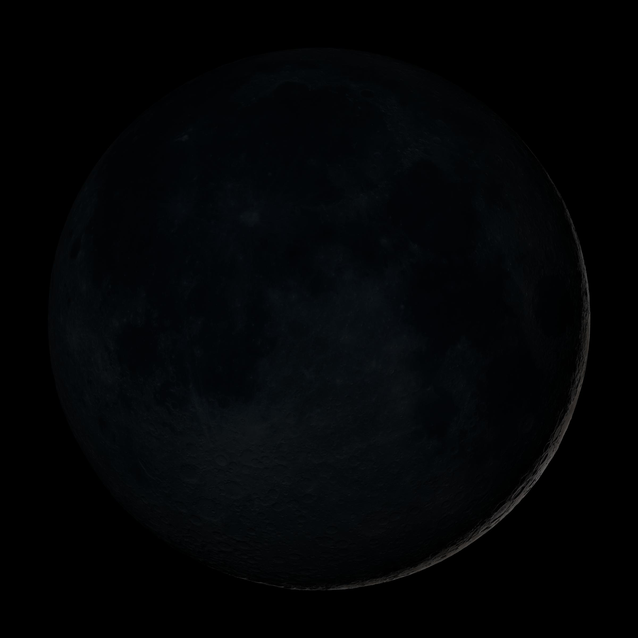
New Moon
Notes:
NASA Goddard Space Flight Center. (2011, June 15). New Moon [Digital image]. https://www.flickr.com/photos/gsfc/5837033098/in/photostream/

Slide 11
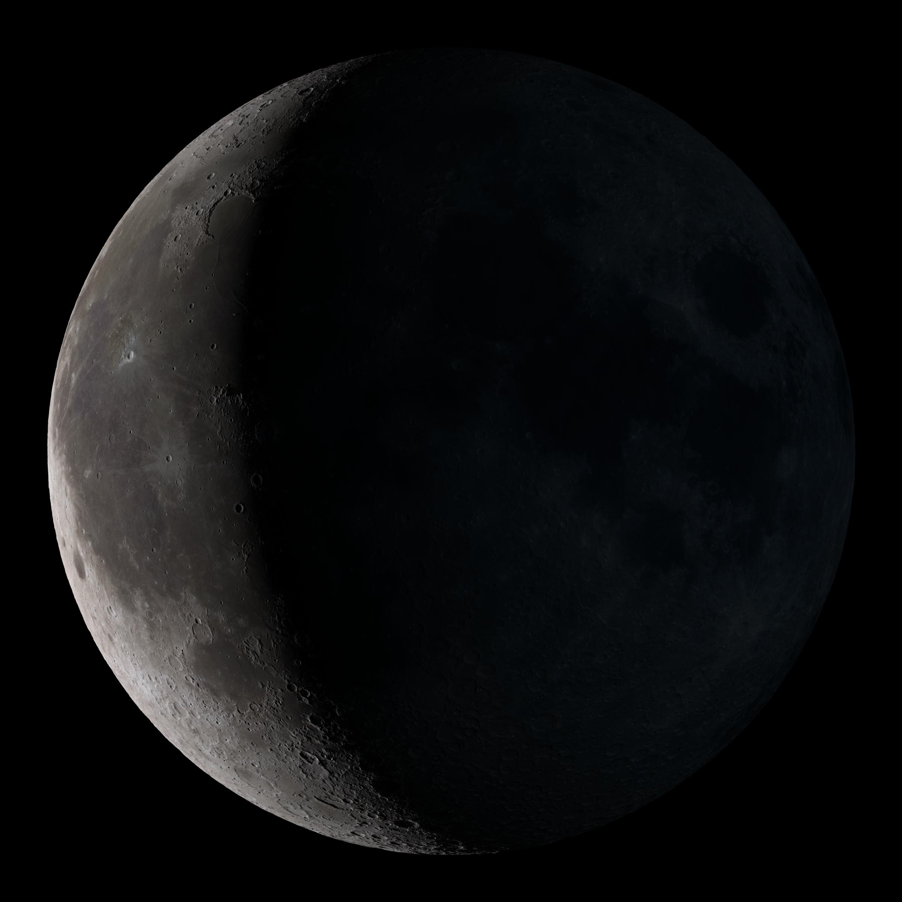
Waning Crescent
Notes:
NASA Goddard Space Flight Center. (2011, June 15). Waning Crescent [Digital image]. https://www.flickr.com/photos/gsfc/5837032862/in/photostream/

Slide 12
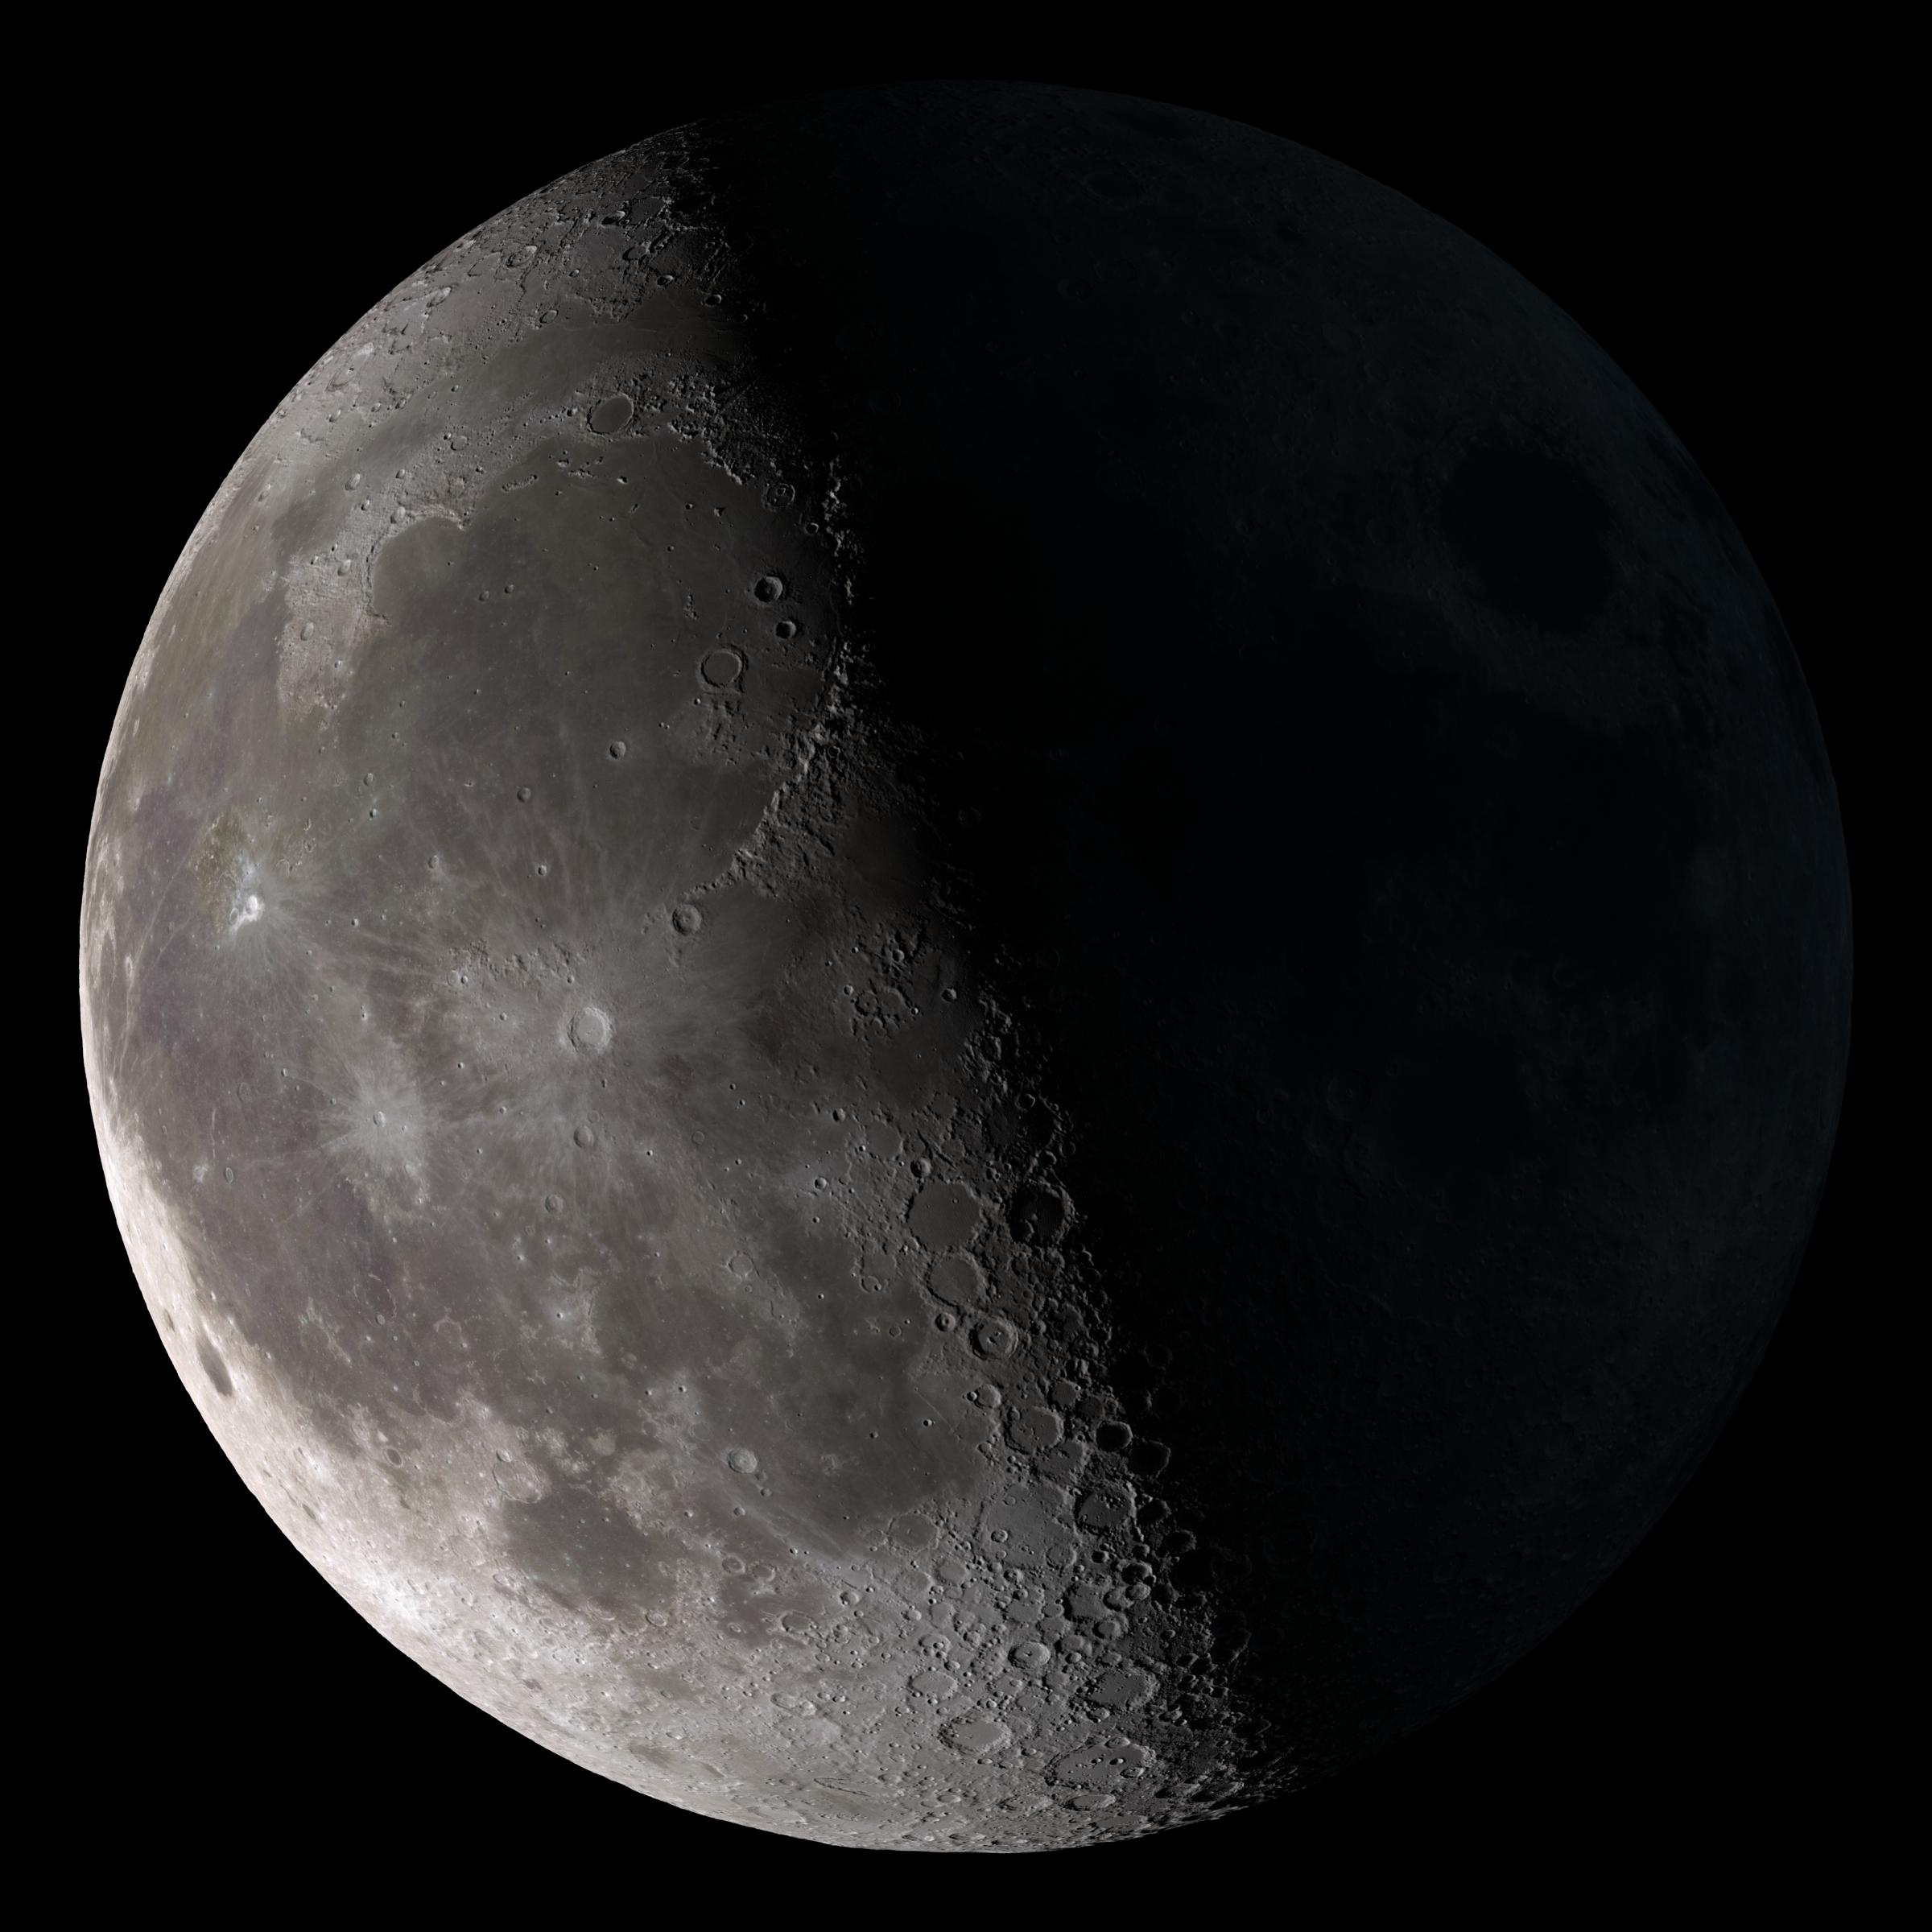
Third Quarter
Notes:
NASA Goddard Space Flight Center. (2011, June 15). Full Moon [Digital image]. https://www.flickr.com/photos/gsfc/5836482263/in/photostream/

Slide 13
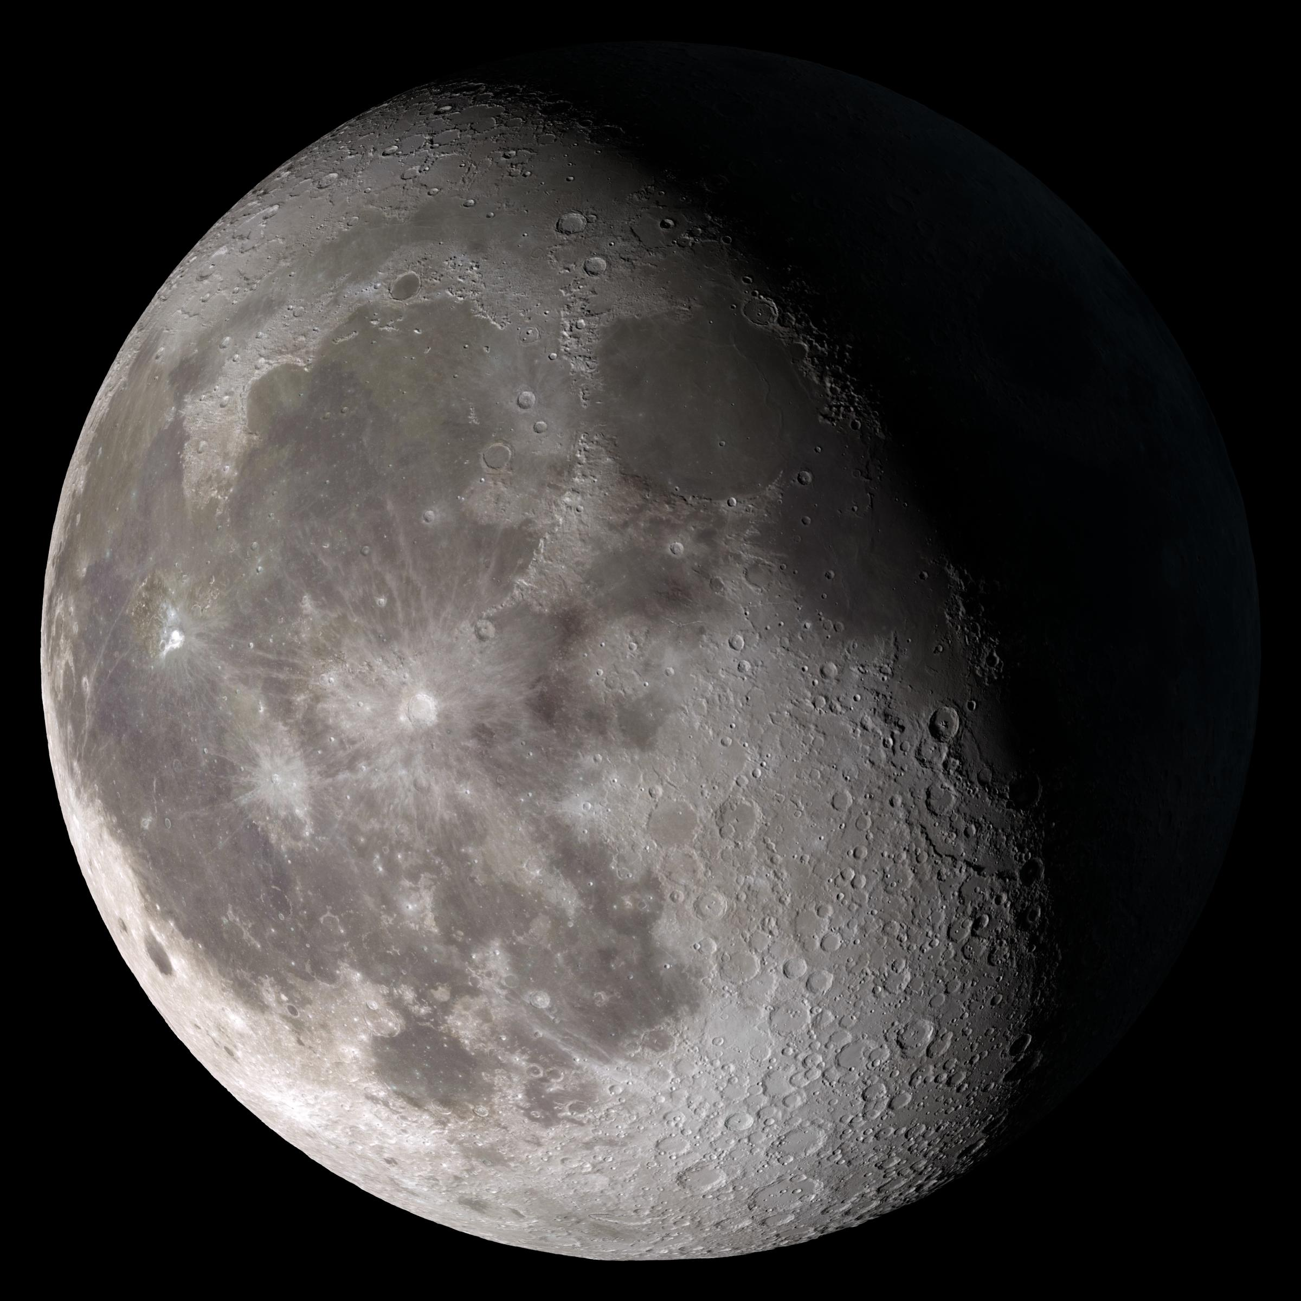
Waning Gibbous
Notes:
NASA Goddard Space Flight Center. (2011, June 15). Waning Gibbous [Digital image]. https://www.flickr.com/photos/gsfc/5837032132/in/photostream/

Slide 14
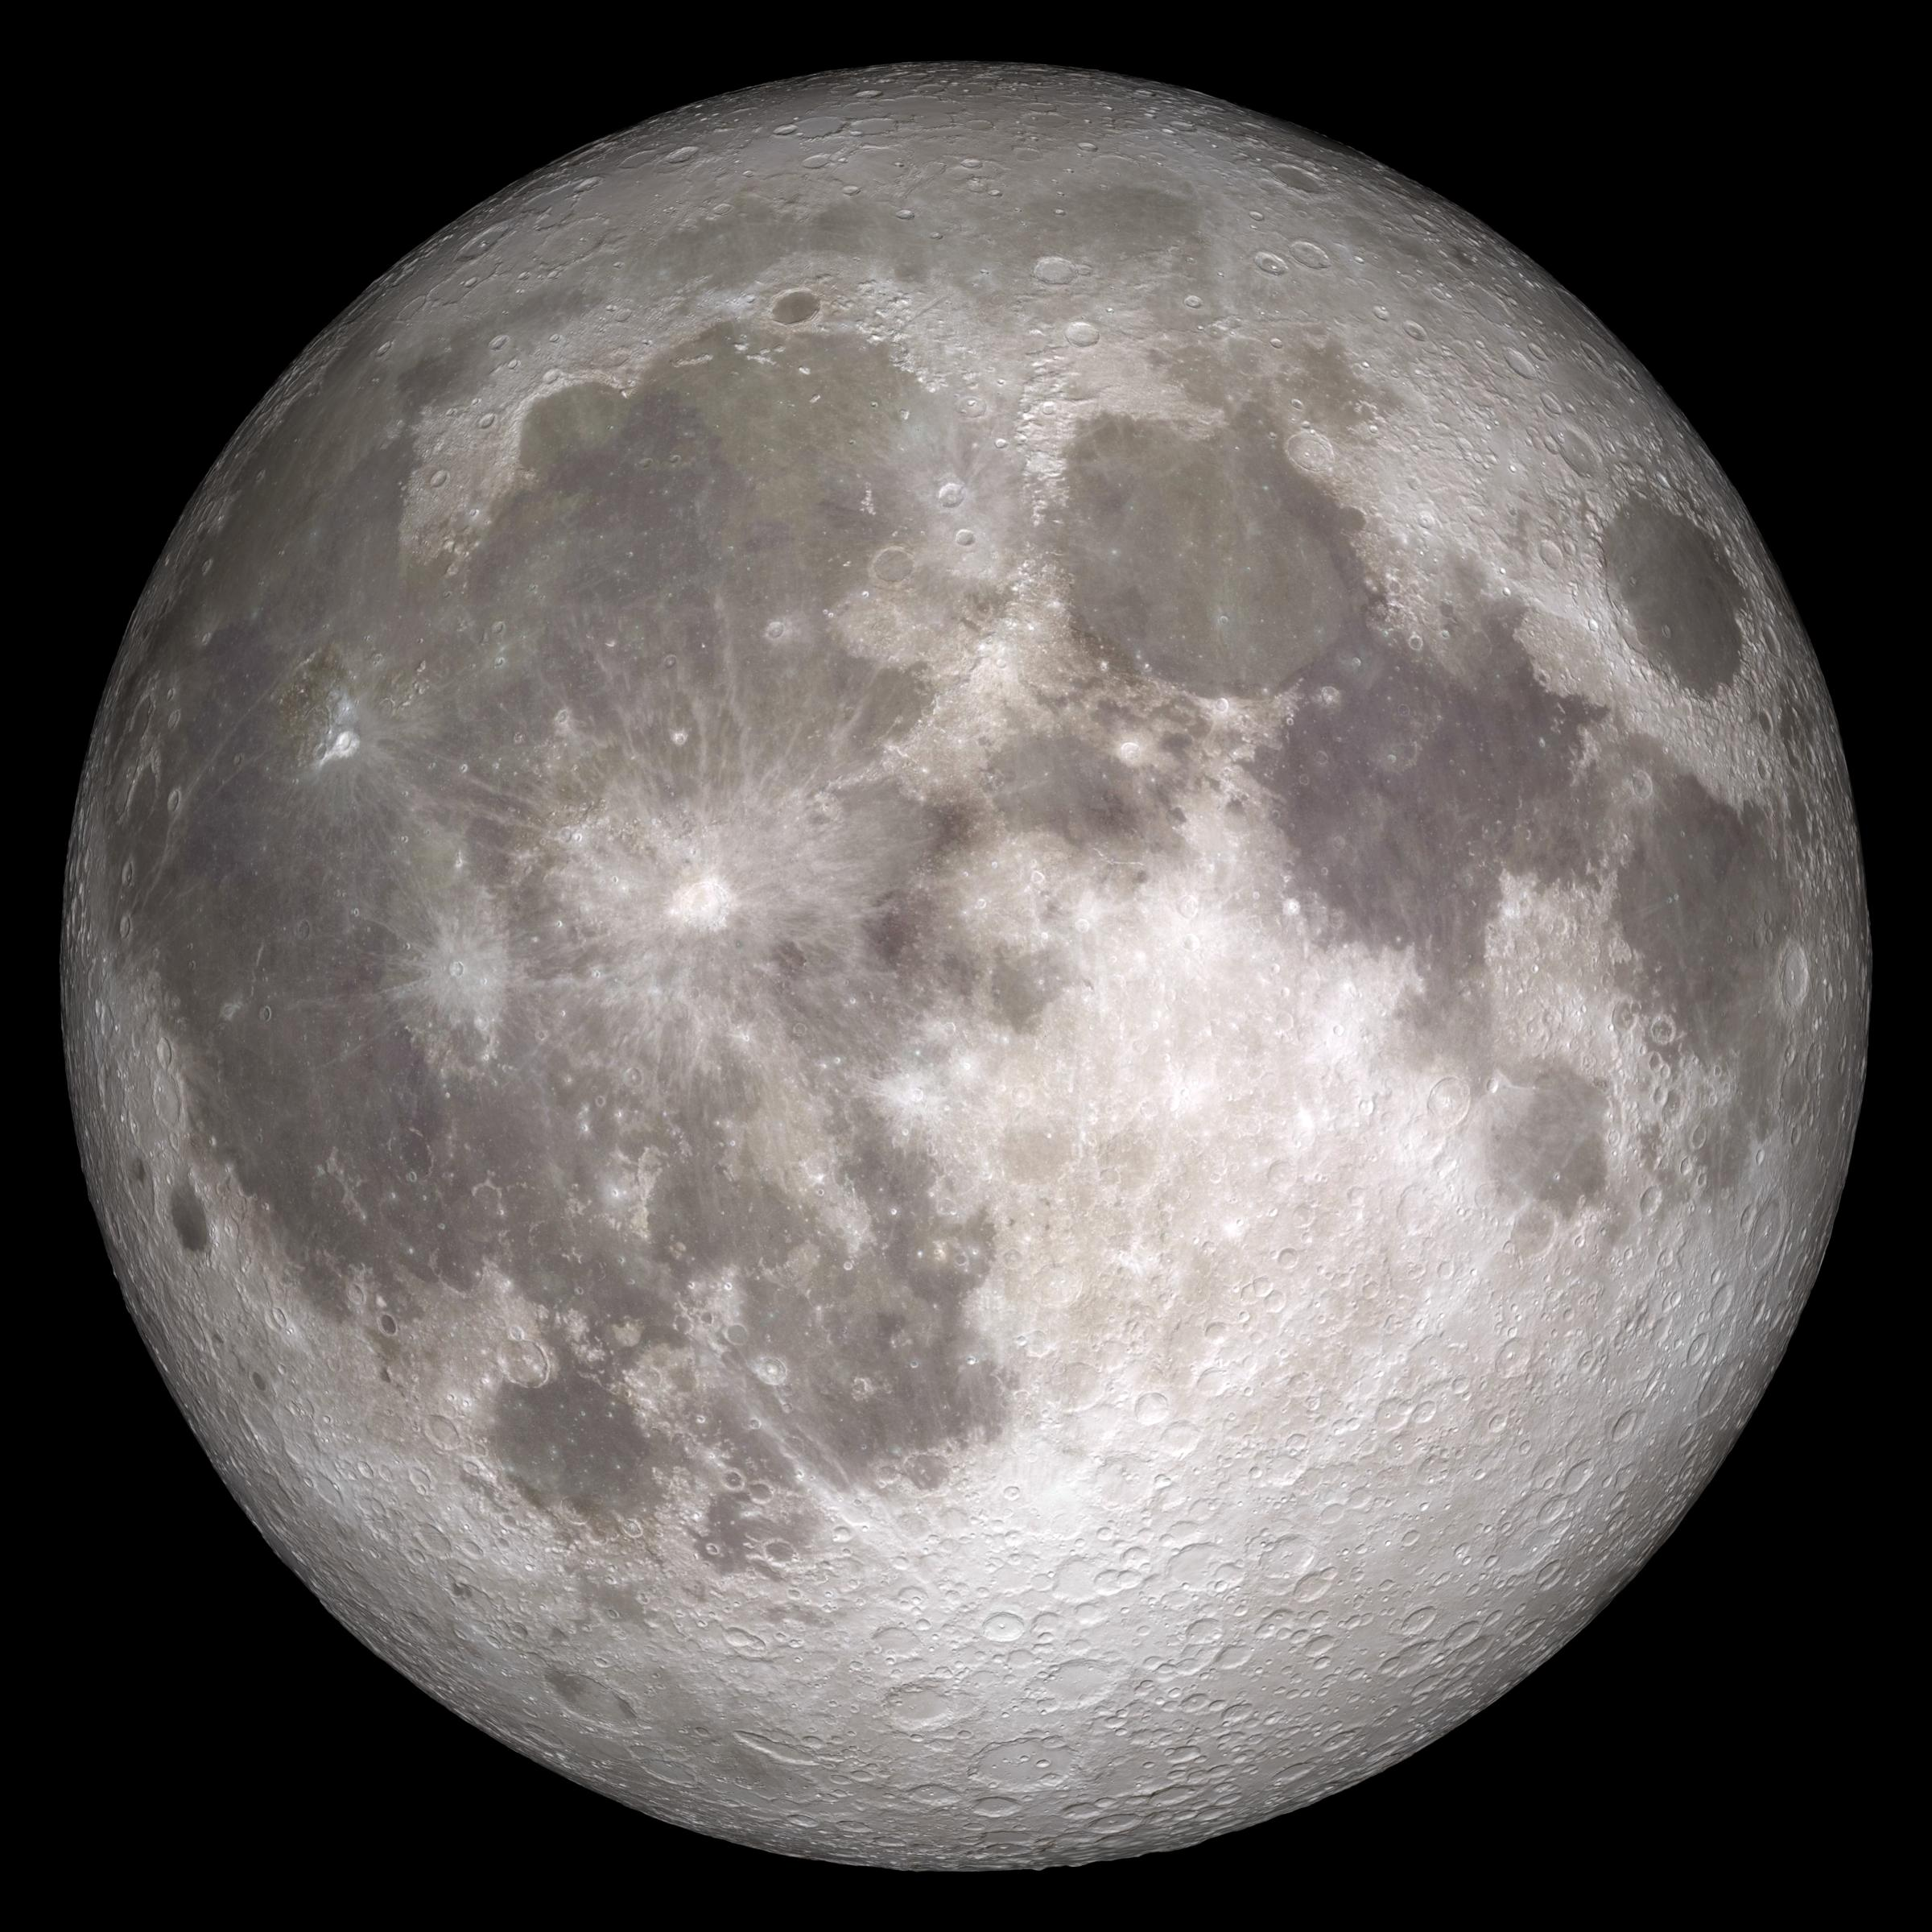
Full Moon
Notes:
NASA Goddard Space Flight Center. (2011, June 15). Full Moon [Digital image]. https://www.flickr.com/photos/gsfc/5836482263/in/photostream/

Slide 15
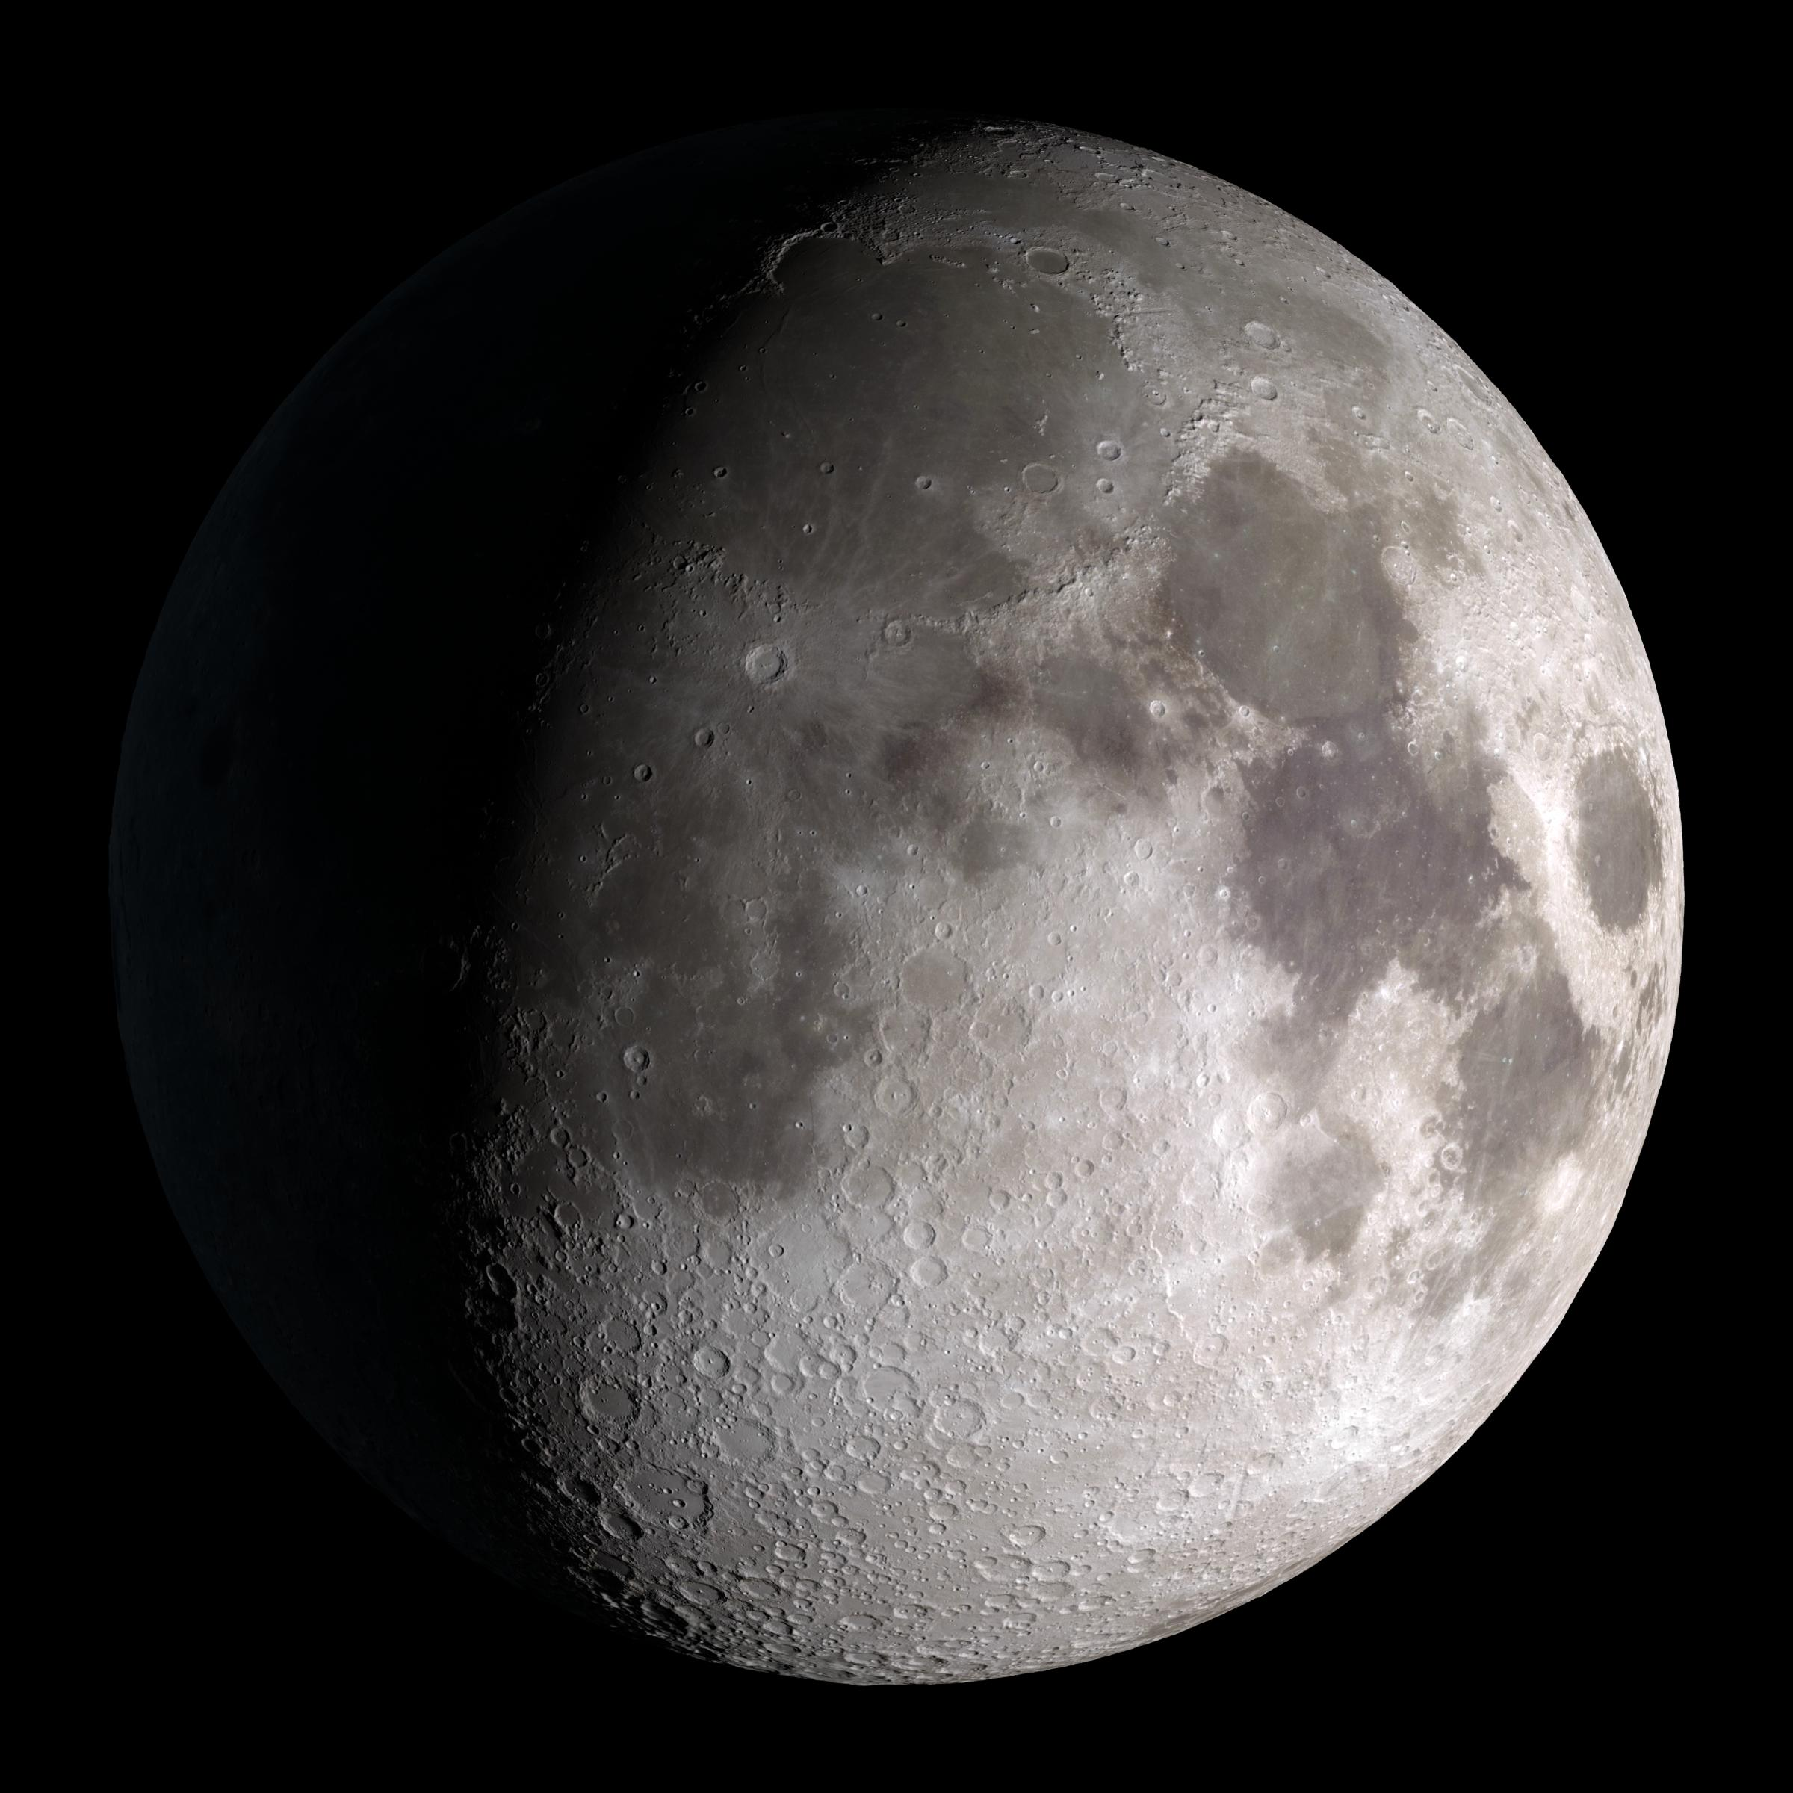
Waxing Gibbous
Notes:
NASA Goddard Space Flight Center. (2011, June 15). Waxing Gibbous [Digital image]. https://www.flickr.com/photos/gsfc/5837031188/in/photostream/

Slide 16
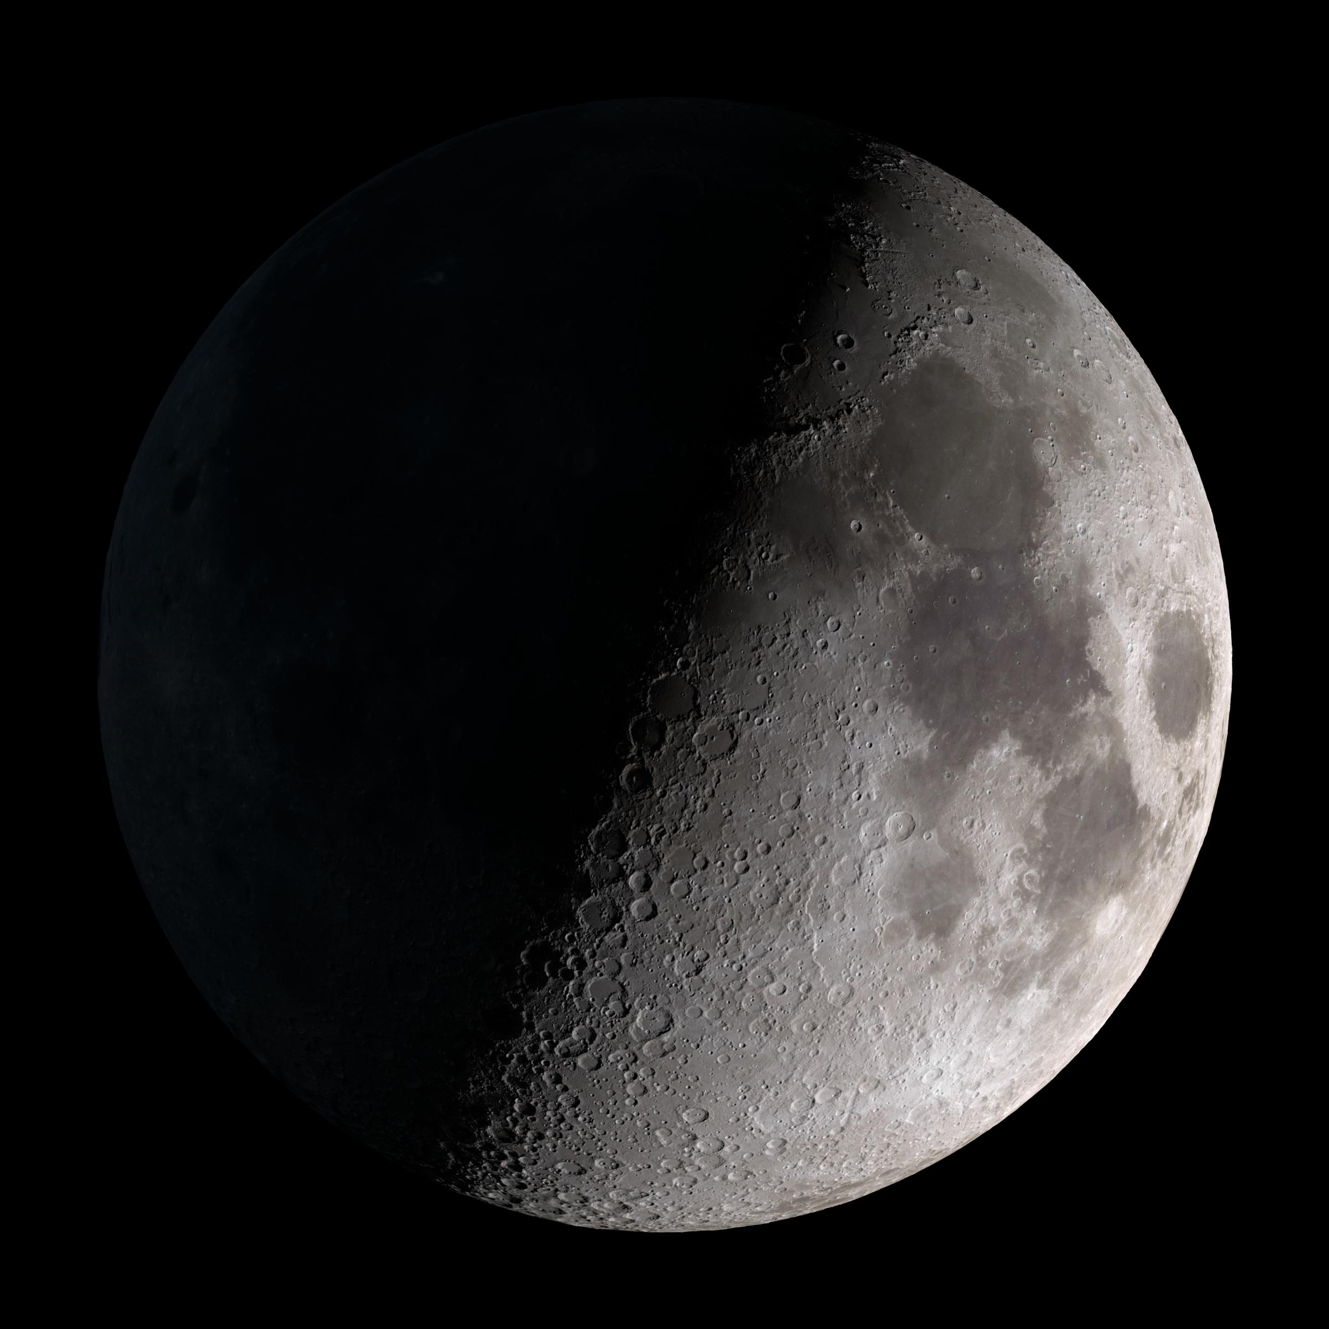
First Quarter
Notes:
NASA Goddard Space Flight Center. (2011, June 15). First Quarter [Digital image]. https://www.flickr.com/photos/gsfc/5837030890/in/photostream/

Slide 17
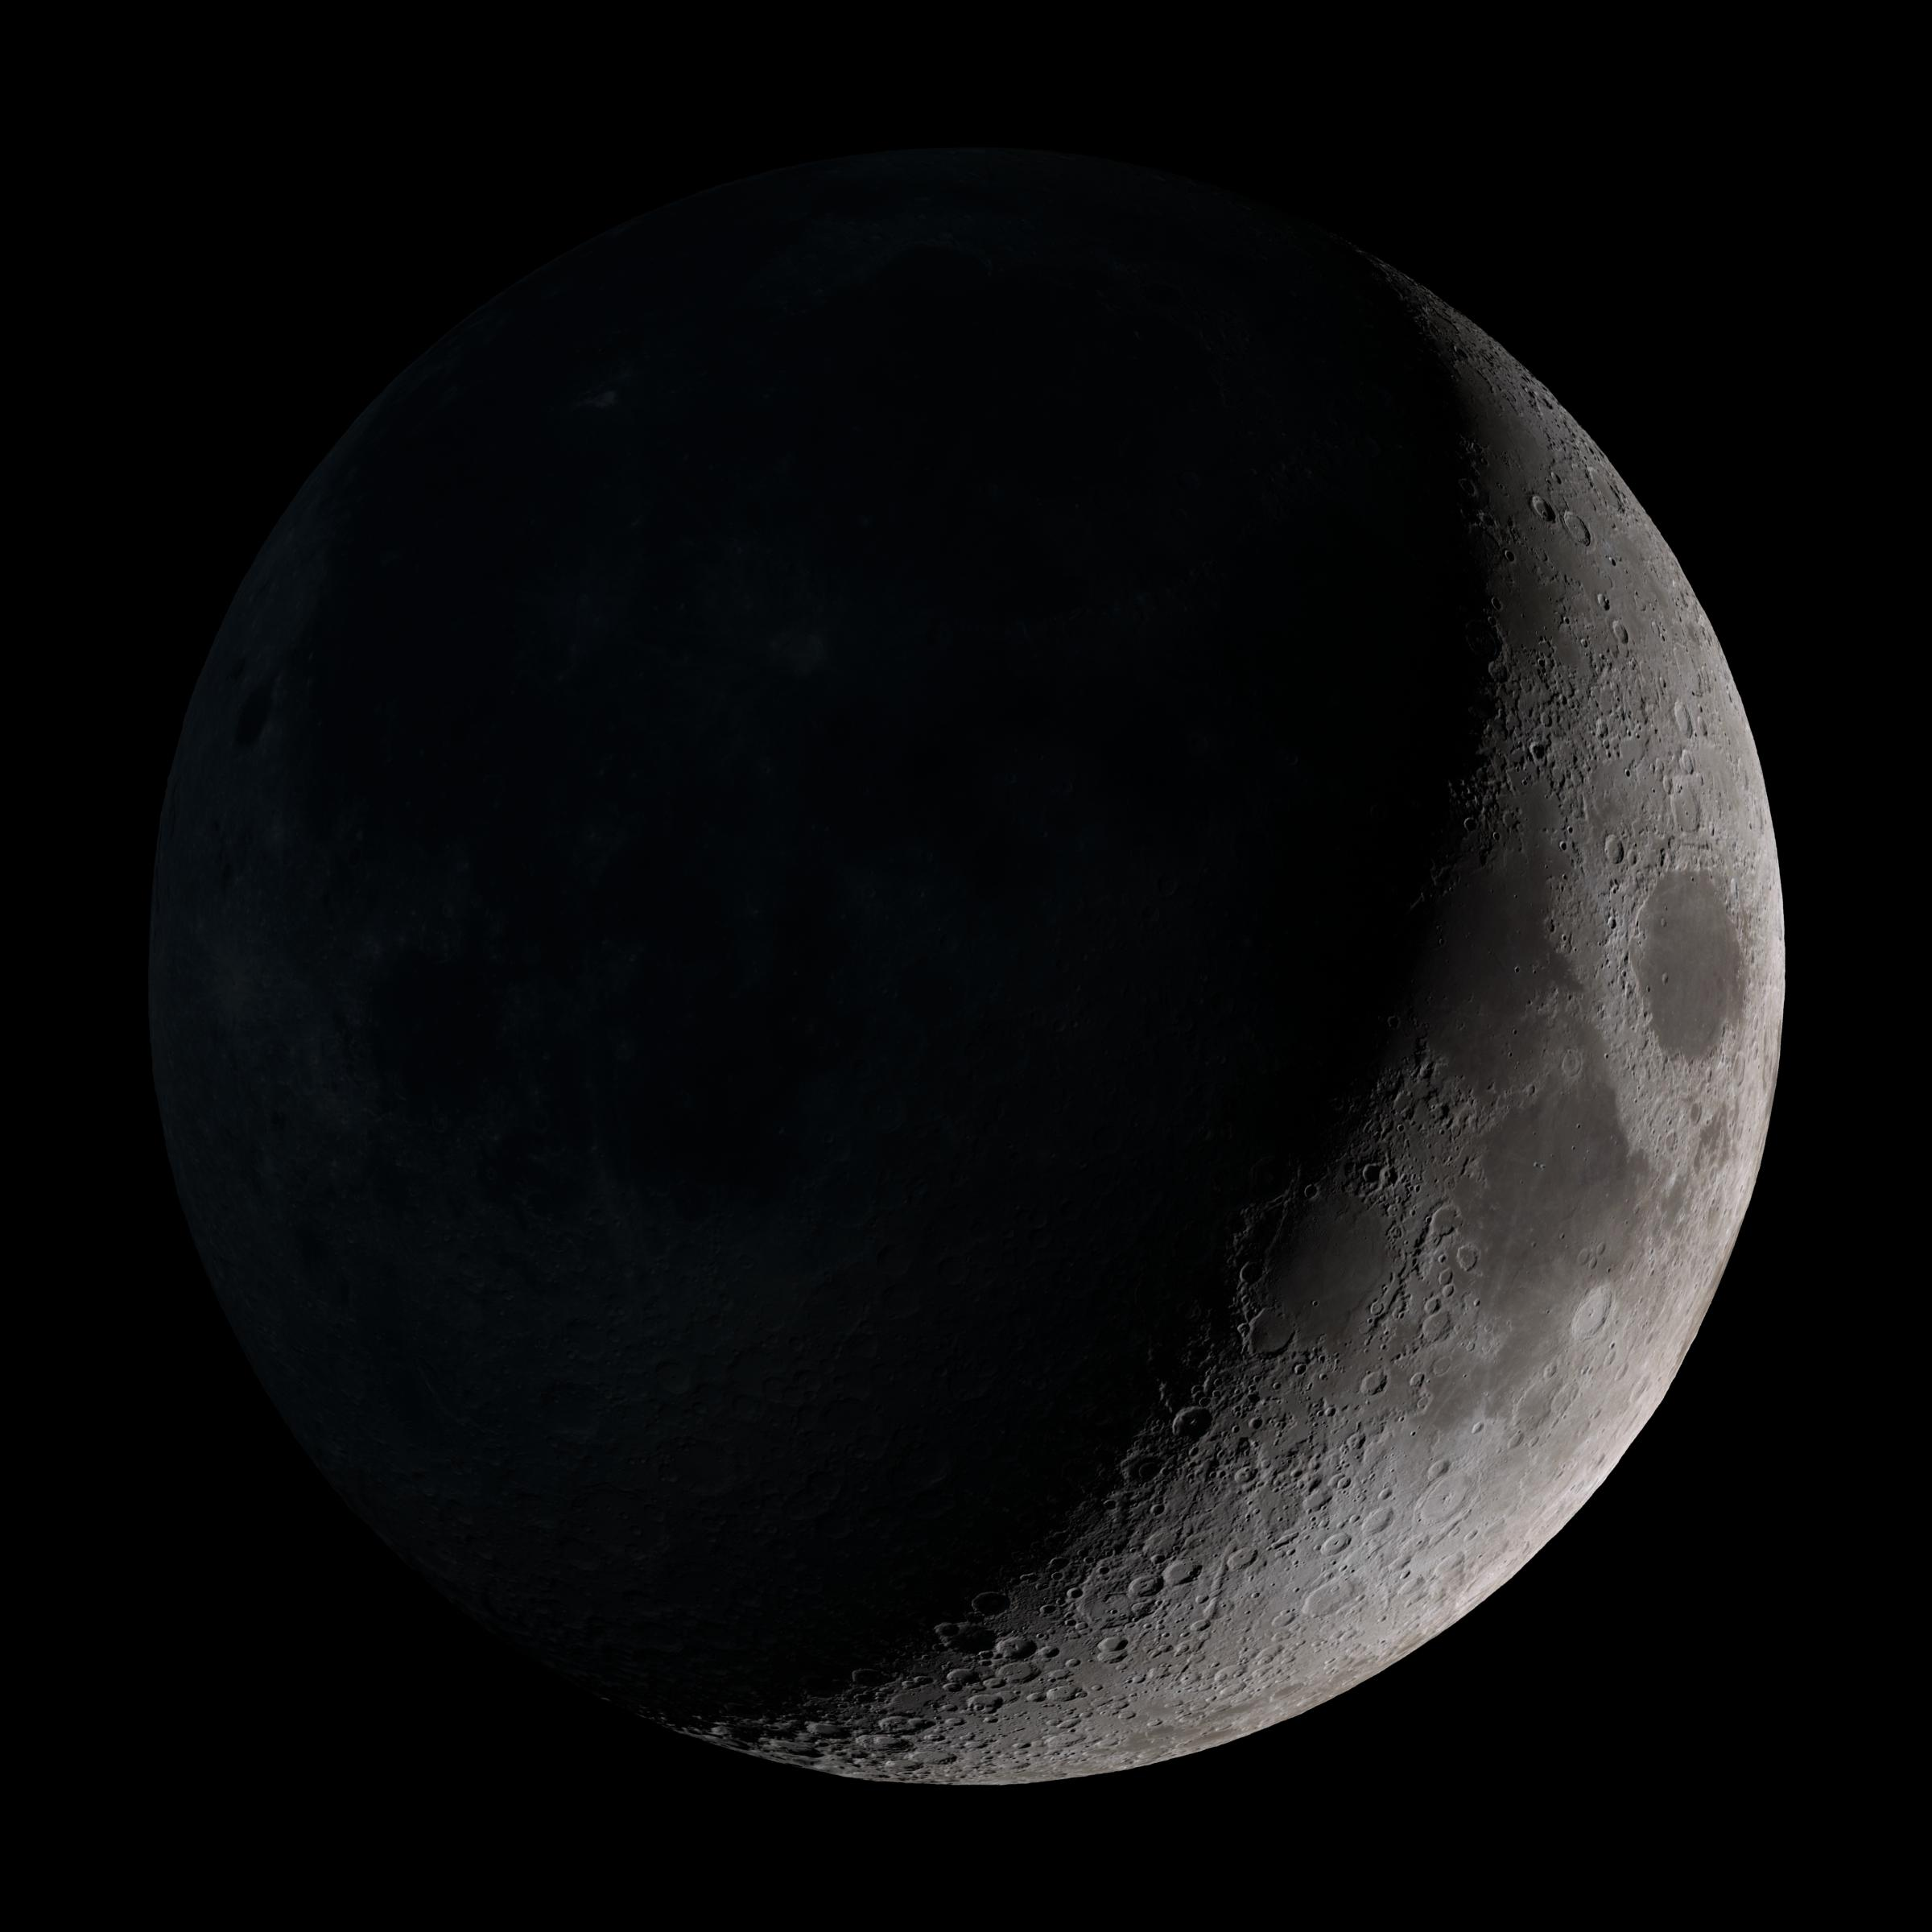
Waxing Crescent
Notes:
NASA Goddard Space Flight Center. (2011, June 15). Waxing Crescent [Digital image]. https://www.flickr.com/photos/gsfc/5836481331/in/photostream/

Slide 18
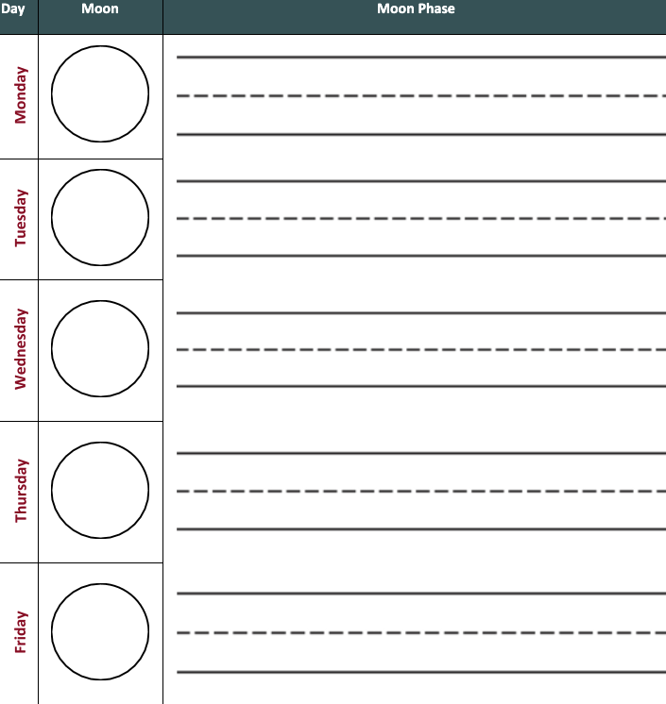
Moon Journal
Every Night:
Go out to look at the moon
Make some observations
Draw what you saw in your Moon Journal
Try to label what phase the moon is in

Slide 19
Moon Journal
What did the moon look like last night?
What do you think it will look like tonight?
Notes:
Clker-Free-Vector-Images. (2012, April 5). [Lunar Phases]. https://pixabay.com/vectors/lunar-phase-moon-lunar-phase-cycle-25451/

Slide 20
Moon Journal
Friday Night:
Go out to look at the moon.
Make some observations.
Draw what you saw in your Moon Journal.
Label what phase the moon is in.

Slide 21
Friday Night Prediction
What do you think the moon will look like on Monday?
What phase do you think it will be in on Monday night?
Notes:
Clker-Free-Vector-Images. (2012, April 5). [Lunar Phases]. https://pixabay.com/vectors/lunar-phase-moon-lunar-phase-cycle-25451/

Slide 22
Breaking News!
Record a video like a news report telling us what you have learned about the phases of the moon. What have you learned about the patterns in the moon? Can you make predictions about the moon?

Slide 23
Moon Book
Using paper cut into large circles and stapled together, make a moon book. Draw what each phase looks like on the right-hand pages. Write in your own words to describe the phase on the left-hand side. How can you use your book to make predictions?
Words
Picture

Slide 24
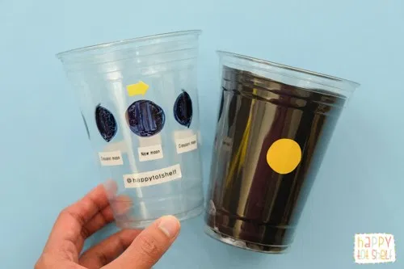
Phase Viewer
Make a moon phase viewer out of clear plastic cups, paper, and markers. As you rotate your cup, you can show everyone the phases of the moon. How does your phase viewer help you make predictions?
Notes:
Image from Happy Tot Shelf. (2020). Moon Phases Learning Toy. https://happytotshelf.com/moon-phases-learning-toy/

Slide 25
Moon Rocks
Your rocks did not come from the moon, but they can show the phases of the moon. Can you paint your rocks with black paint to show each phase? Can you put your rocks in order? How can your rocks help you make predictions?

Slide 26
Oreo Moons
Scrape away oreo fillings to show the phases of the moon in this tasty craft. How do your Oreo moons help you make predictions?

Slide 27
Choice Board
Breaking News! Record a video like a news report telling us what you have learned about the phases of the moon. What have you learned about the patterns in the moon? Can you make predictions about the moon? | Moon Book Using large paper circles, make a moon book with what the phase looks like on the right-hand pages and describe the phase in your own words on the left-hand side. How can you use your book to make predictions?
Make a moon phase viewer out of clear plastic cups, paper, and markers. As you rotate your cup, you can show everyone the phases of the moon. How does your phase viewer help you make predictions? Phase Viewer | These rocks didn’t come from the moon, but they show the phases of the moon. Can you paint your rocks with black paint to show each phase? Can you put your rocks in order? How can your rocks help you make predictions? Moon Rocks
Oreo Moons
Scrape away oreo fillings to show the phases of the moon in this tasty craft. How do your Oreo moons help you make predictions?

