Slide 2
Totally Different Stories
Perspective

Slide 3
Essential Questions:
How does perspective influence a reader's response?
How do authors use perspective to help readers?

Slide 4
Learning Objectives
Students will analyze perspective in two different pieces by Kate Chopin.
Students will compose a short writing from a specific perspective.

Slide 5
Caption This
Look closely at the images, paying attention to all of the details.
Use the handout to collect your thoughts about each image.
Share your caption with an elbow partner.

Slide 6
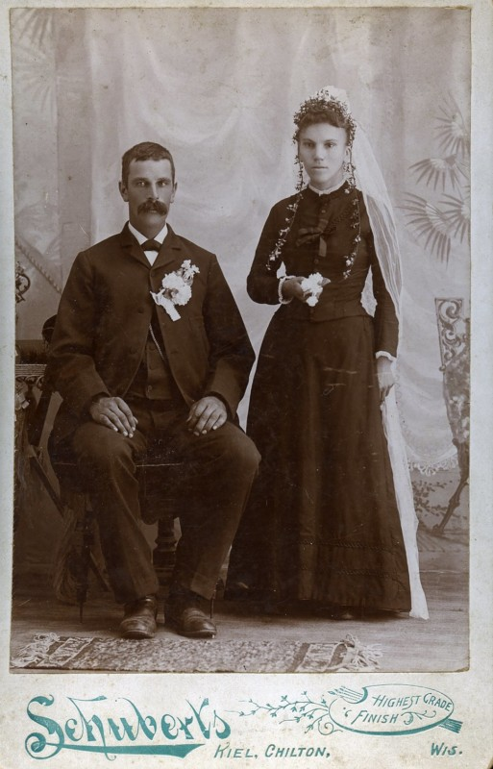
Caption This
Look closely at the image, paying attention to all of the details.
Use the handout to collect your thoughts about the image.
Share your caption with an elbow partner.
Notes:
https://petapixel.com/2017/07/03/wedding-photos-looked-like-late-1800s/
[Photograph]. (2017, June 29). I DO, I DO, The Ricco/Maresca Gallery, New York In 1116250554 843199625 F. Maresca (Comp.).

Slide 7
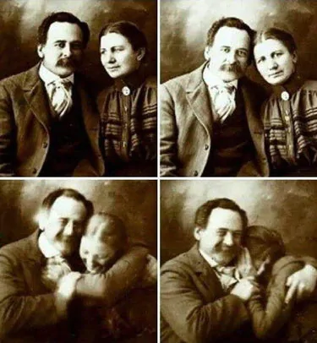
Caption This
Look closely at the image, paying attention to all of the details.
Use the handout to collect your thoughts about the image.
Share your caption with an elbow partner.
Notes:
U/AdamCannon. (2018). A Victorian couple trying not to laugh while having their portraits done. [Digital image]. Retrieved December 09, 2020, from https://www.reddit.com/r/aww/comments/9ae9xy/a_victorian_couple_trying_not_to_laugh_while/

Slide 8
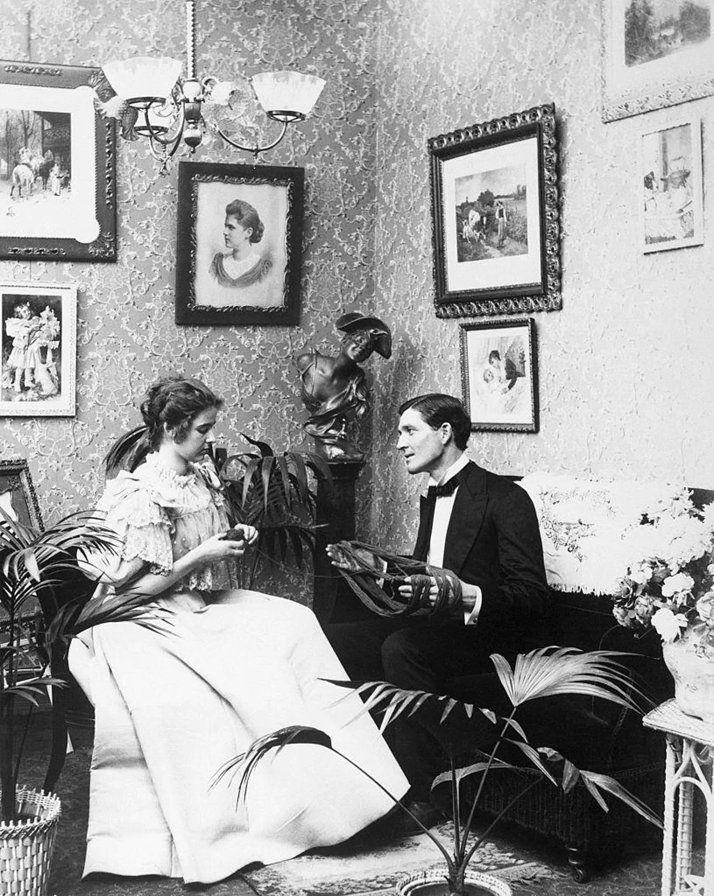
Caption This
Look closely at the image, paying attention to all of the details.
Use the handout to collect your thoughts about the image.
Share your caption with an elbow partner.
Notes:
Dillinger, S. (2019, March 21). Photos Of Adorable 19th-Century Couples. Retrieved December 09, 2020, from https://www.ranker.com/list/cute-1800s-couples-photos/samantha-dillinger

Slide 9
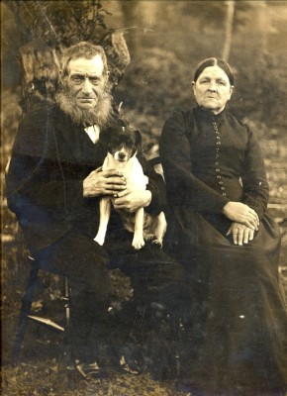
Caption This
Look closely at the image, paying attention to all of the details.
Use the handout to collect your thoughts about the image.
Share your caption with an elbow partner.
Notes:
Old couple with dog, photographed before 1900 [Photograph]. (1890). Bottesford Local History Archive In 1116285682 843222538 F. Hallam (Comp.).
https://www.bottesfordhistory.org.uk/content/catalogue_item/bottesford-local-history-archive/photographs-contributed-by-miss-margaret-taylor-and-mr-frank-hallam/old-couple-with-dog-photographed-before-1900

Slide 10
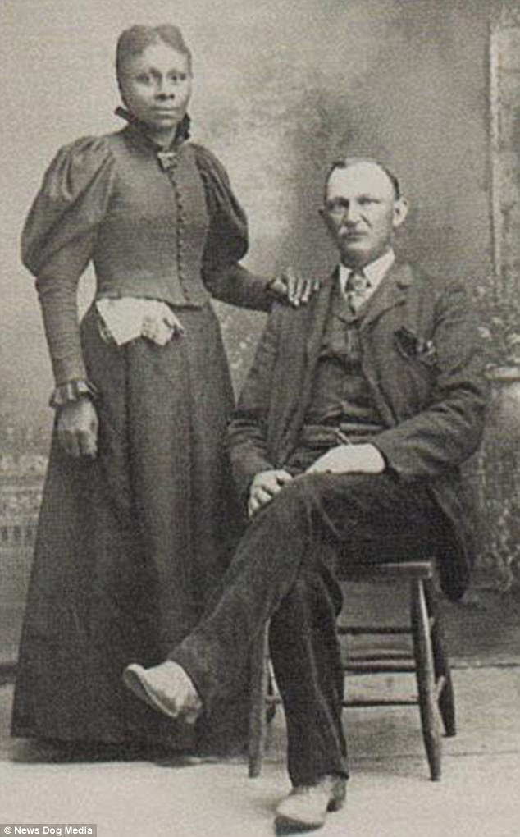
Caption This
Look closely at the image, paying attention to all of the details.
Use the handout to collect your thoughts about the image.
Share your caption with an elbow partner.
Notes:
Carter, H. (2018, January 18). The brave American couples who refused to let prejudice tear them apart - decades before laws prohibiting interracial marriages were finally banned [Digital image]. Retrieved December 09, 2020, from https://www.dailymail.co.uk/femail/article-5283243/19th-Century-images-capture-brave-interracial-couples.html

Slide 11
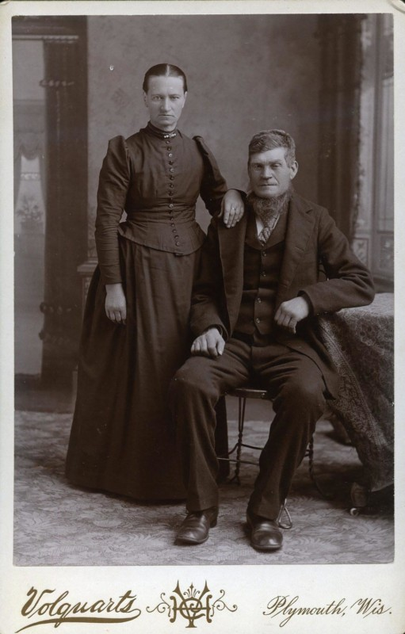
Caption This
Look closely at the image, paying attention to all of the details.
Use the handout to collect your thoughts about the image.
Share your caption with an elbow partner.
Notes:
https://petapixel.com/2017/07/03/wedding-photos-looked-like-late-1800s/
[Photograph]. (2017, June 29). I DO, I DO, The Ricco/Maresca Gallery, New York In 1116250554 843199625 F. Maresca (Comp.).

Slide 12
Always, Sometimes, Never True
Label each statement with one of the following:
Always True
Sometimes True
Never True
Include your reasons for selecting each label
Notes:
Instructor/Facilitator Notes:
Have students read through each statement, then label each as always true, sometimes true, or never true. Underneath each statement, ask students to right down their reasoning for the label.
Allow time for students to share out their thoughts and labels of the statements.

Slide 13
Always, Sometimes, Never True
There is no more lovely, friendly, and charming relationship or communion, or company than a good marriage.
Martin Luther

Slide 14
Always, Sometimes, Never True
Where there is love there is life.
Mahatma Gandhi

Slide 15
Always, Sometimes, Never True
What counts in making a happy marriage is not so much how compatible you are, but how you deal with incompatibility.
Leo Tolstoy

Slide 16
Always, Sometimes, Never True
What greater thing there is for two human souls than to feel that they are joined for life-to strengthen each other in all labor, to rest on each other in all sorrow, to minister to each other in silent unspeakable memories at the moment of the last parting?
George Eliot

Slide 17
Always, Sometimes, Never True
Marriage is not a ritual or an end. It is a long, intricate, intimate dance together, and nothing matters more than your own sense of balance and choice of partner.
Amy Bloom

Slide 18
Always, Sometimes, Never True
If there is such a thing as good marriage, it is because it resembles friendship rather than love.
Montaigne

Slide 19
Always, Sometimes, Never True
Love seems the swiftest, but it is the slowest of all growths. No man or woman really knows what perfect love is until they have been married a quarter of a century.
Mark Twain

Slide 20
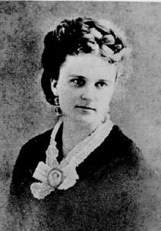
Kate Chopin Readings
Story of an Hour
Excerpts from The Awakening
Notes:
https://commons.wikimedia.org/wiki/File:Kate_Chopin.jpg

Slide 21
T-Chart
Take time to consider the character’s point of view and ask the following questions:
How are they feeling?
What are they thinking?
What are they going through?
Include evidence from the text on your T-Chart to support your claims

Slide 22
Different Perspectives
Now that you’ve finished reading, think about the different perspectives of Mrs. Mallard and Mr. Pontellier.
Write a journal entry from the point of view of one of the main characters:
Mrs. Mallard’s point of view while she is alone in her room after she found out that her husband was dead.
Mr. Pontellier's point of view in the midst of his wife leaving him.

Slide 23
I Think/We Think
How did the author’s use of perspective help you understand the character?
Answer this question on your own in the “I Think” column of the chart.

Slide 24
I Think/We Think
With a partner:
Discuss the question and provide an answer that encompasses both character perspectives.
How did the author’s use of perspective help you understand the character?
Provide your answer in the “We Think” column of the chart.

