Slide 2
How Does Your Garden Grow?
Conservation, Ecosystems, and Soil Health

Slide 3
Essential Question
Why should we care about soil health?

Slide 4
Learning Objective
Construct an evidence-based, scientific explanation for how soil health factors influence the growth of organisms.

Slide 5
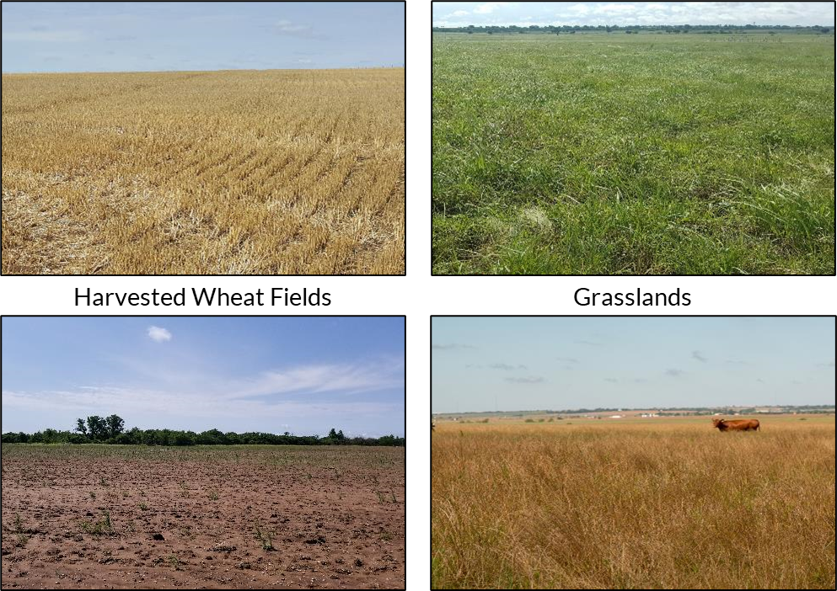
What do you notice? What is the cause?
Notes:
Show the students the series of pictures of soil and plants in different soil health conditions (healthy harvested field, bare field, plants growing in healthy and unhealthy soil). Have students do a photo deconstruction reflecting on what they observed in each photo, the potential causes for differences they notice, and what the healthy plants might have that the unhealthy plants do not.
If students do not get there themselves, guide part of the conversation toward what the plants are growing in (i.e., soil). While plants do not require soil to grow, in these cases soil is where the plants are taking in many necessary nutrients.
Photo Deconstruction: https://learn.k20center.ou.edu/strategy/d9908066f654727934df7bf4f5065b32
Photos: Heather Shaffery

Slide 6
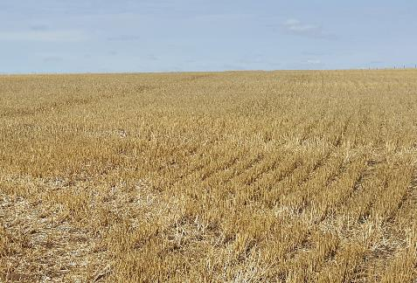
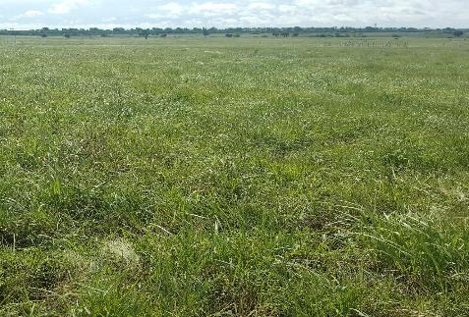
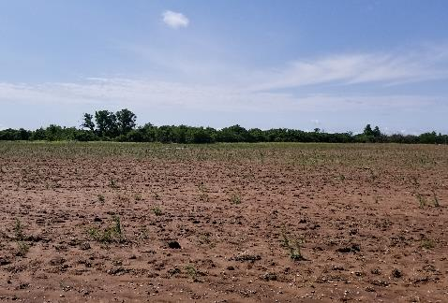
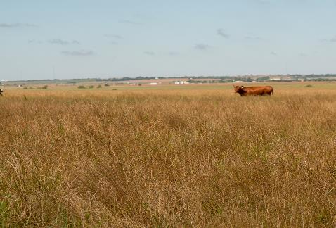
Summarize in one sentence what you think you know about these images.
Harvested Wheat Fields
Grasslands
Notes:
After the discussion, ask students to summarize what they think they know about the images in one sentence. Effective sentences should summarize the big takeaway each student gets from the conversation.

Slide 7
ASSESSING SOIL CHEMISTRY
Lab Investigation
Notes:
Now that the students have a sense that soil may be important to plant health, they will test the soil types to determine the level of the nutrients present. Have students analyze each soil sample, making sure to record the data for the most common soil chemistry tests: soil pH; and Nitrogen, Phosphorus, and Potassium levels.
Soil Samples
Have students collect soil samples from possible garden sites around campus. You may have students collect soil from multiple sites to use as a comparison. Students may even bring soil sample from home to test.
Preparing the Soil Samples:
All the tests require a soil solution which is best to prepare at least a day before to get better results due to the nutrients leaching into the water.
Have students create a soil solution by adding 100 mg of soil and 200 mL of water to a beaker or other container.
Have students use the stirring rod or sticks to blend the mixture.
Ensure that students clean the stirring rod thoroughly or use a different stirring utensil for each soil sample.
Testing the Soil Samples
Provide each group with a copy of the “Soil Investigation Handout.”
Prep Note: Edit the table to include the soil types the class has collected and any additional soil chemistry variables you may be testing.
Based on the specific directions for the soil test kit/materials you have purchased, review the procedure for soil testing with your students.
Prep Note: If you are using test strips that require a color comparison, it might be necessary to filter the water sample before collecting data. This is particularly true for nitrogen test strips. Depending on how murky the soil makes the water, it is usually clean enough after 2-3 rounds of filtering through a double or triple layer of coffee filters.
Safety Note: If your kit requires the use of chemicals, be sure to check the SDS in advance for safety and disposal procedures.
Have students document their process and results by taking photos using in-class technology (e.g., Chromebooks, tablets, digital cameras) or their phone’s camera.

Slide 8
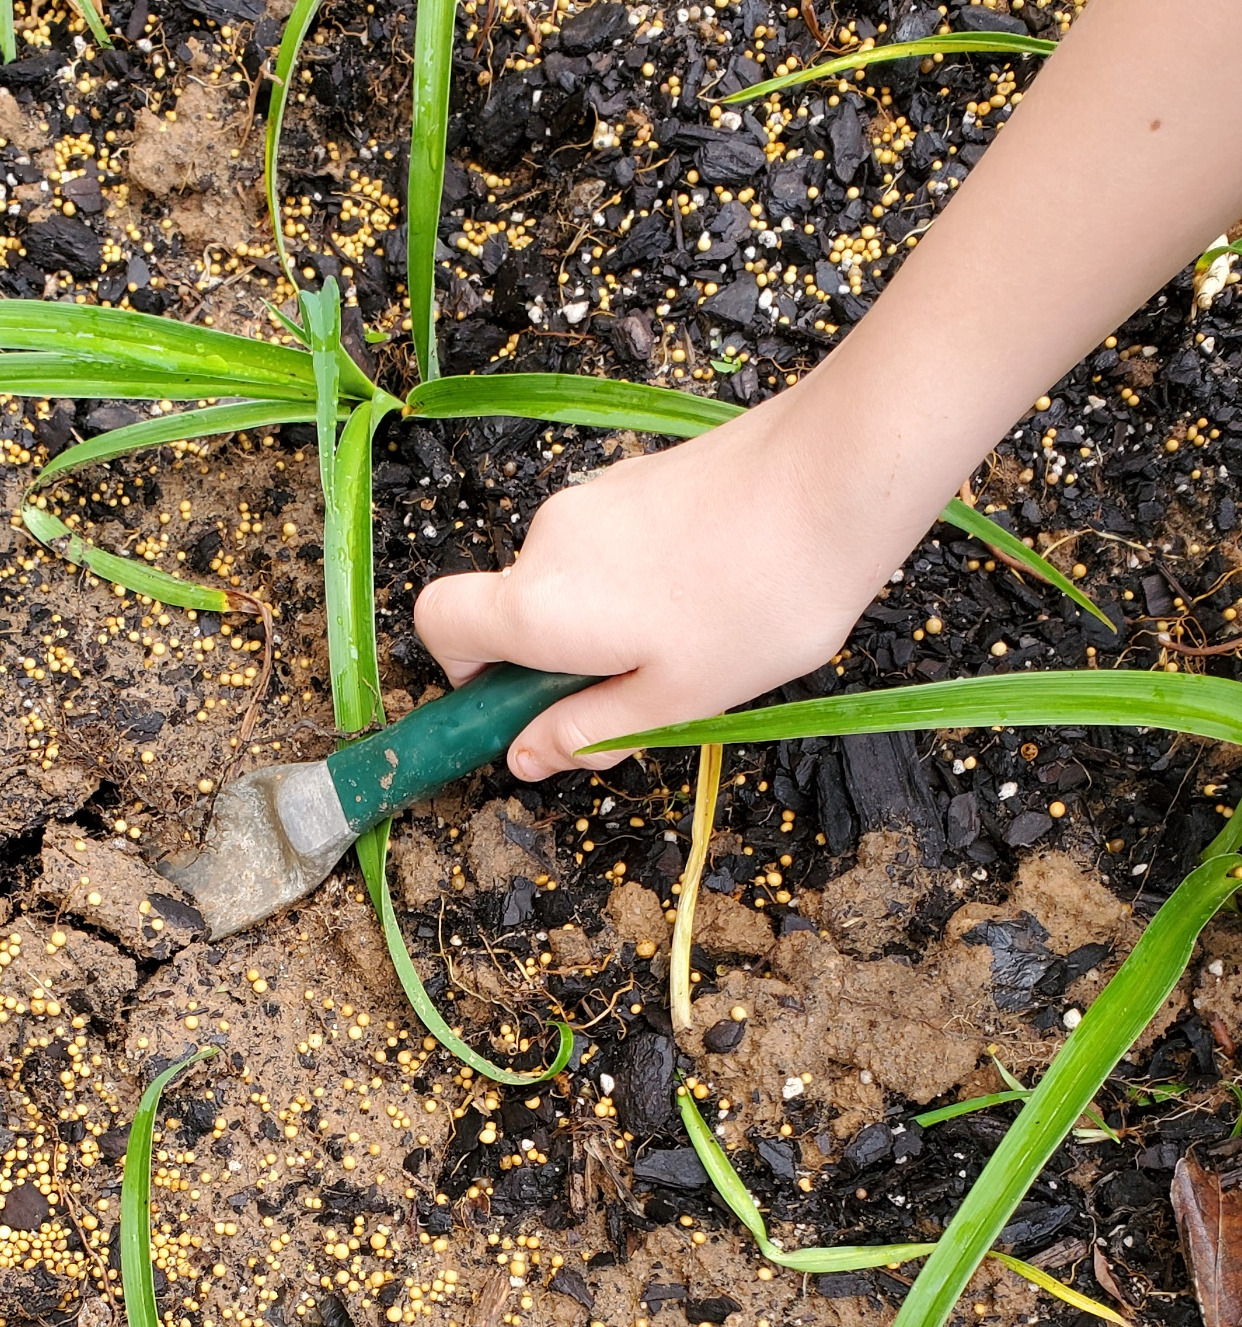
Soil Chemistry Investigation: Preparing the sample
Add 100 mg of soil to 200 ml of water to your breaker.
Stir the solution to blend the soil and water.
  Use a different stirring utensil for each soil sample.
Let the soil and water mixture sit overnight.
Notes:
Source: Photograph by K20 Center.

Slide 9
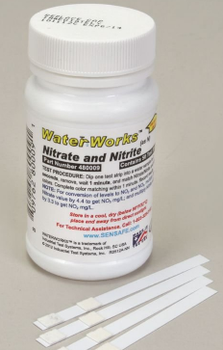

Soil Chemistry Investigation: Recording the data
Record the soil water sample type in your data table.
Dip each test strip into the sample solution.
  Do not touch the sample with your fingers or put more than ½ the pH strip in the sample.
Wait for 50-60 seconds.
Compare the color of your strip/pads on the strip to the color chart as soon as time is up.
Record the measurement in your table.
Repeat for the next sample.

Slide 10
Soil Chemistry Clean-Up
Wipe up any messes on your table.
Throw away garbage and gloves.
Notes:
Clean-Up
Have students clean up any soil and water messes and wash up surfaces as necessary.
Unless the testing materials have specific disposal instructions, trash and soil water can be disposed off in the regular trash and sink.
If any chemicals were added to the water samples, do not pour them down the drain without consulting their SDS sheets for disposal procedures.
To avoid clogs, do not pour any water that still has soil/sediment in it down drains.
Gloves should be removed by turning them inside out. (See a demonstration here if you are unfamiliar with the technique.) Goggles should be wiped clean/disinfected before being put away.

Slide 11
INVESTIGATING SOIL AND SOIL HEALTH
Online Research
Notes:
Students explore several sources to develop a basic understanding of soil properties and components of soil health.
Have students work in groups to gather information about general soil science, soil health, and soil functions. Each student should record important details in a Window Notes graphic organizer. They will leave the Nutrient Cycle box empty for now. If students have regular access to technology, they could also use Google Apps (e.g., Docs, Slides) to collaboratively fill out the notes. A variety of sources that students can use to gather information are provided in the Explore Sources attachment.

Slide 12
Soil and Soil Health Research
Use the Explore Resources handout to conduct your research. In groups, explore the sources listed on the handout:
Videos
Articles
Infographics
Be sure to identify sources when you collect information.
Notes:
Provide students a copy of “Explore Resources” handout, on paper or digitally.
Note: Several of the sources are YouTube videos which may require headphones or physical distance to avoid disturbing other working groups.

Slide 13
Soil and Soil Health Research
Soil Properties | Soil Health
Soil Chemistry | Nutrient Cycles Don’t write anything here yet!
Record what you learn in the first three boxes of your Window Notes sheet
Put the information under the correct headings.
If you aren’t sure where it belongs, be sure to ask!
Leave the Nutrient Cycles box empty.

Slide 14

Soil and Soil Health Research
What is soil?
How do we describe it?
How do we know if soil is healthy?
What are the benefits of having healthy soil?
What soil management practices or strategies can improve soil health?
Notes:
Create an anchor chart summarizing student findings for each of the three boxes they have filled in on their Window Notes. As a class, summarize the key points to create an anchor chart for each Window Notes box. Information from the soil chemistry data table can be incorporated into Soil Properties or Soil Health. Diagrams or drawings of soil horizons and details would also be helpful on an anchor chart.
These example questions can be used to help facilitate class discussion.
This is not a comprehensive list and the order of the questions doesn’t matter.
Add other relevant questions as necessary to scaffold students’ summaries.
Note: The purpose of this discussion is just to summarize the class’s research. Higher order questions should be saved for the Explain discussions when students are synthesizing information.

Slide 15

Breakout!
Soil Properties | Soil Health
Soil Chemistry | Nutrient Cycles
bit.ly/gardengrowbreakout
Notes:
Now that students have a general understanding of soil health, transition them into developing concepts about soil nutrients specifically. Students should work together to complete the “How Does Your Garden Grow?” breakout activity online. They should summarize the information they learn during the breakout in the Nutrient Cycles Window Note box and make additional notes in the other "windows" as necessary.
How Does Your Garden Grow? Breakout: https://bit.ly/gardengrowbreakout
The breakout should be completed collaboratively.
Students should summarize the information in the Nutrient Cycles Window Note box and add any new information to the other boxes as necessary.

Slide 16

Three Sticky Notes
Word
Phrase
Sentence

Slide 17
Nutrient Cycles
Word
Phrase
On a sticky note, summarize what you learned in the breakout using a single word.
On a sticky note, summarize what you learned in the breakout using a short phrase (fewer than 10 words).
Word
Phrase
Notes:
In their breakout groups, ask students to summarize what they learned from the breakout into a word and a phrase. Groups should attempt to create a single word and phrase.
If they can’t narrow it down to a single example, ask that they limit their responses to one sticky per person (e.g., a group of 3 could have up to 3 words and up to 3 phrases.)
Repeat the discussion process you used in the Explore debrief to develop a final anchor chart for Nutrient Cycles.
Ask students to share out their Words and Phrases at the beginning of the discussion.
If necessary, add any new information students discovered to the other three charts as well.

Slide 18
Soil Health
Sentence
You could write about how:
Nutrient cycles contribute to healthy soil;
Unhealthy soil might disrupt nutrient cycles;
Soil management practices can strengthen natural nutrient cycles;
Soil management practices can affect soil health.
In 1 sentence, describe a way nutrient cycles, soil health, and soil management practices relate to one another.
Sentence
Notes:
Now that students have familiarity with all the relevant content, they need to connect the pieces to develop a conceptual understanding.
Rather than just telling students what the connections are, help them synthesize the conceptual pieces for themselves.
As part of this process, ask students individually to write a single summary sentence over their learning up to this point on a sticky note. Their sentence should emphasize the connections among the information they've gathered during the Explore and Explain activities and discussions.
Instructional Note: The sticky-note summaries students have completed are the steps in a strategy called Three Post-It Notes. While they are typically written all at the same time, this lesson is scaffolds them to support the complexity of the synthesis students are doing.
Instructional Note: There are other ways to direct students' knowledge construction, but they should at least work out the connections provided on the slide.
Three Sticky Notes: https://learn.k20center.ou.edu/strategy/d9908066f654727934df7bf4f506d92f

Slide 19

Concept Card Mapping
Create either hand-drawn or digital concept maps.
If making hand-drawn maps, use physical card that is glued down.
Draw lines or paste string on hand-drawn maps to show connections among idea.
As a whole class, you might consider using string to physically connect concepts found on the four anchor charts.
Notes:
K20 Center. (n.d.). Concept card mapping. Strategy. https://learn.k20center.ou.edu/strategy/d9908066f654727934df7bf4f505c351
Create Your Mind Maps Online - On Any Device | MindMeister
Cmap Cloud (ihmc.us)

Slide 20

Metaphorical Thinking
Create your own metaphors to explain the connections you are making.
Notes:
K20 Center (n.d.). Metaphorical thinking. Strategy. https://learn.k20center.ou.edu/strategy/d9908066f654727934df7bf4f5068fc

Slide 21

Cognitive Comics
Use three-paneled frame to express your understanding of the connections between soil and its impact on the growing cycle.
You may be asked to display your comic strip for a gallery walk or a brief presentation to the whole class.
Notes:
K20 Center. (n.d.). Cognitive comics. Strategy. https://learn.k20center.ou.edu/strategy/fe96d3de46cfdc1f385aab7e7500a422

Slide 22
Soil Health and Plant Growth
In your group, come up with a question to test that is either about:
  What soil conditions (e.g., pH, N) will give plants the perfect number of resources for growth?
  OR
  How does a soil management strategy affect plant growth?
Notes:
MS-LS1-5 (OAS-S 7th grade)
The initial setup is one class, but analysis may be extended over weeks during growth cycle of plants.
Students grow plants in several types of soil to determine
optimal soil conditions for a specific type, and/or
the effectiveness of a specific soil health strategy for plant growth.
Prep Note: Look for plants with short growing times and try to find plants that could be grown in local conditions.
MS-LS1-5 (7th grade)
Have students generate a question about what soil conditions (e.g., pH, N) will provide optimal resources for a particular plant to grow. Alternatively or in addition, students might ask a question related to how a soil management strategy impacts plant growth.

Slide 23
Investigation
Provide instructions here based on what guidelines are in place for the class investigations
Provide instructions here for the type of research, if any, students need to conduct.
Notes:
MS-LS1-5 (7th grade)
Student investigations can be informal comparisons (e.g., how two different growing conditions have different impacts on plants) or controlled experimental design (e.g., the way a plant grows without any unique conditions compared to a depending on a different growing condition). Either way, make sure students have at least two different conditions to compare.
There are a variety of easy strategies for students to change soil conditions. Examples include adding hydrogen peroxide (O), fertilizer with different nutrient ratios (NPK), and vinegar or baking soda (pH) to soil. Either give students a little time to research methods based on what health factor they choose to target or provide them with the relevant practice.

Slide 24
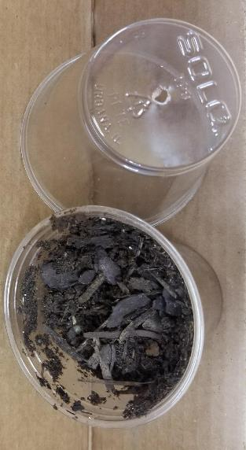
Growing Plants
Materials
Plastic cups
Soil
Seeds
Tray for cups
Container for water
Set-up Steps
  Punch holes in the bottom of plastic cups for drainage.
  Fill each cup with soil.
  Plant seeds in each cup.
  Create a schedule for watering and lighting.
Notes:
MS-LS1-5 (7th grade)

Slide 25
Collecting Data
How will you know there are differences between your plants?
What will you measure?
How will you measure it?
How will you make sure you take pictures the same way every day?
How will you know which conditions were “best” for your plants?
Notes:
MS-LS1-5 (7th grade)
Though it seems counterintuitive to design study details after setting up the investigation, students can’t collect any data until the plants grow. As long as students know in advance what conditions they are growing plants under, how they actually collect data does not need to be determined ahead of time. However, this can be done earlier in the process if that is more appropriate for a given class.
Students need to determine what data will help them answer their questions and a way to collect that data. For picture-taking, help students develop a plan to take consistent photos for comparison (e.g., height of camera, distance from plant, orientation).
Depending on time and the elements of investigations that are being emphasized, students can develop their own data tables or blank tables can be provided for them.

Slide 26
Investigation Presentations
If you researched what soil conditions are best for plant growth,
  Explain how soil health, nutrient cycles, and plant needs work together to affect plant growth;
  Explain how in nature the “best” soil would gain or develop the resources to meet plant needs.
Notes:
MS-LS1-5 (7th grade)
Students' presentations of their results should provide an explanation for how soil health, nutrient cycles, and plant needs interact to impact growth.
Explanations should emphasize how the best soil ended up with/developed the right resources to meet the plant's needs, for example
healthy soil has lots of bacteria which decompose plants
animals to add nitrogen to the soil for plants to use

Slide 27
Investigation Presentations
If you researched how soil management practices affect plant growth,
  Explain how soil health, nutrient cycles, and plant needs work together to affect plant growth;
  Explain how your management practice and nutrient cycles work together to make soil healthier.
Notes:
MS-LS1-5 (7th grade)
Students' presentations of their results should provide an explanation for how soil health, nutrient cycles, and plant needs interact to impact growth.
Explanation should instead emphasize how their management practice and nutrient cycles work together to make soil healthier, for example
adding peroxide puts more oxygen into the soil which helps make it compact so it drains water better

Slide 28
Investigation Presentations
Present the results of your investigations;
Explain the relationship between soil health and plant growth.
Explain how soil health, nutrient cycles, and plant needs interact to impact growth.
Explain how the best soil ended up with/developed the right resources to meet the plant's needs (e.g., healthy soil has lots of bacteria which decompose plants and animals to add nitrogen to the soil for plants to use).
Explain how your management method fits into/fixes/supports nutrient cycles to make the soil healthier (e.g., adding peroxide puts more oxygen into the soil which helps make it compact so it drains water better).
Notes:
MS-LS1-5 (7th grade)

