Slide 2
How Does Your Garden Grow?
Conservation, Ecosystems, and Soil Health

Slide 3
Essential Question
Why should we care about soil health?

Slide 4
Learning Objective
Develop a model to describe matter cycles and energy flows among living and nonliving parts of a local ecosystem.

Slide 5
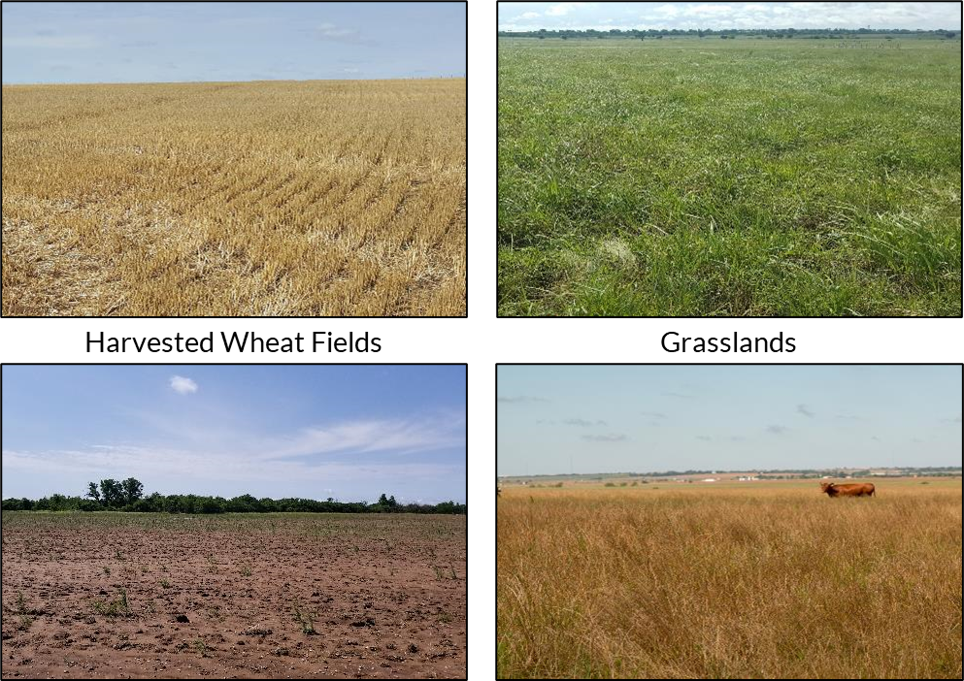
What do you notice? What is the cause?
Notes:
Show the students the series of pictures of soil and plants in different soil health conditions (healthy harvested field, bare field, plants growing in healthy and unhealthy soil). Have students do a photo deconstruction reflecting on what they observed in each photo, the potential causes for differences they notice, and what the healthy plants might have that the unhealthy plants do not.
If students do not get there themselves, guide part of the conversation toward what the plants are growing in (i.e., soil). While plants do not require soil to grow, in these cases soil is where the plants are taking in many necessary nutrients.
Photo Deconstruction: https://learn.k20center.ou.edu/strategy/d9908066f654727934df7bf4f5065b32
Photos: Heather Shaffery

Slide 6
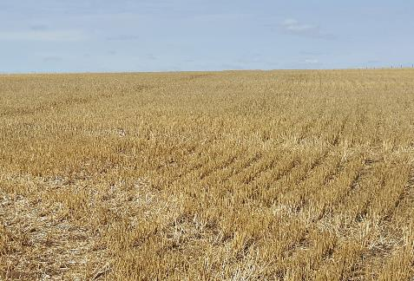
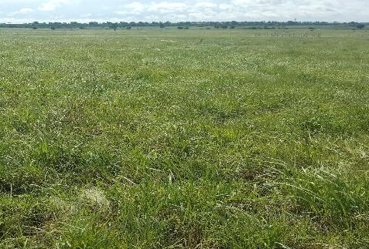
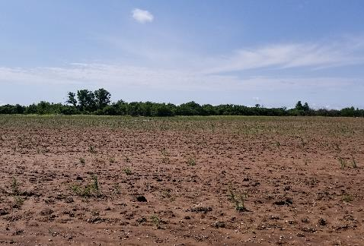
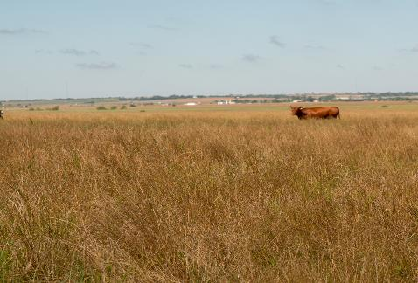
Summarize in one sentence what you think you know about these images.
Harvested Wheat Fields
Grasslands
Notes:
After the discussion, ask students to summarize what they think they know about the images in one sentence. Effective sentences will essentially summarize the big takeaway each student got from the conversation.

Slide 7
ASSESSING SOIL CHEMISTRY
Lab Investigation
Notes:
Once students have a sense that soil may be important to plant health, they will test the soil types to determine the level of the nutrients present. Have students analyze each soil sample, making sure to record the data for the most common soil chemistry tests: soil pH; and Nitrogen, Phosphorus, and Potassium levels.
Soil Samples
Have students collect soil samples from possible garden sites around campus. You may have students collect soil from multiple sites to use as a comparison. Students may even bring soil sample from home to test.
Preparing the Soil Samples:
All the tests require a soil solution which is best to prepare at least a day before to get better results due to the nutrients leaching into the water.
Have students create a soil solution by adding 100 mg of soil and 200 mL of water to a beaker or other container.
Have students use the stirring rod or sticks to blend the mixture.
Ensure that students clean the stirring rod thoroughly or use a different stirring utensil for each soil sample.
Testing the Soil Samples
Provide each group with a copy of the “Soil Investigation Handout.”
Prep Note: Edit the table to include the soil types the class has collected and any additional soil chemistry variables you may be testing.
Based on the specific directions for the soil test kit/materials you have purchased, review the procedure for soil testing with your students.
Prep Note: If you are using test strips that require a color comparison, it might be necessary to filter the water sample before collecting data. This is particularly true for nitrogen test strips. Depending on how murky the soil makes the water, it is usually clean enough after 2-3 rounds of filtering through a double or triple layer of coffee filters.
Safety Note: If your kit requires the use of chemicals, be sure to check the SDS in advance for safety and disposal procedures.
Have students document their process and results by taking photos using in-class technology (e.g., Chromebooks, tablets, digital cameras) or their phone’s camera.

Slide 8
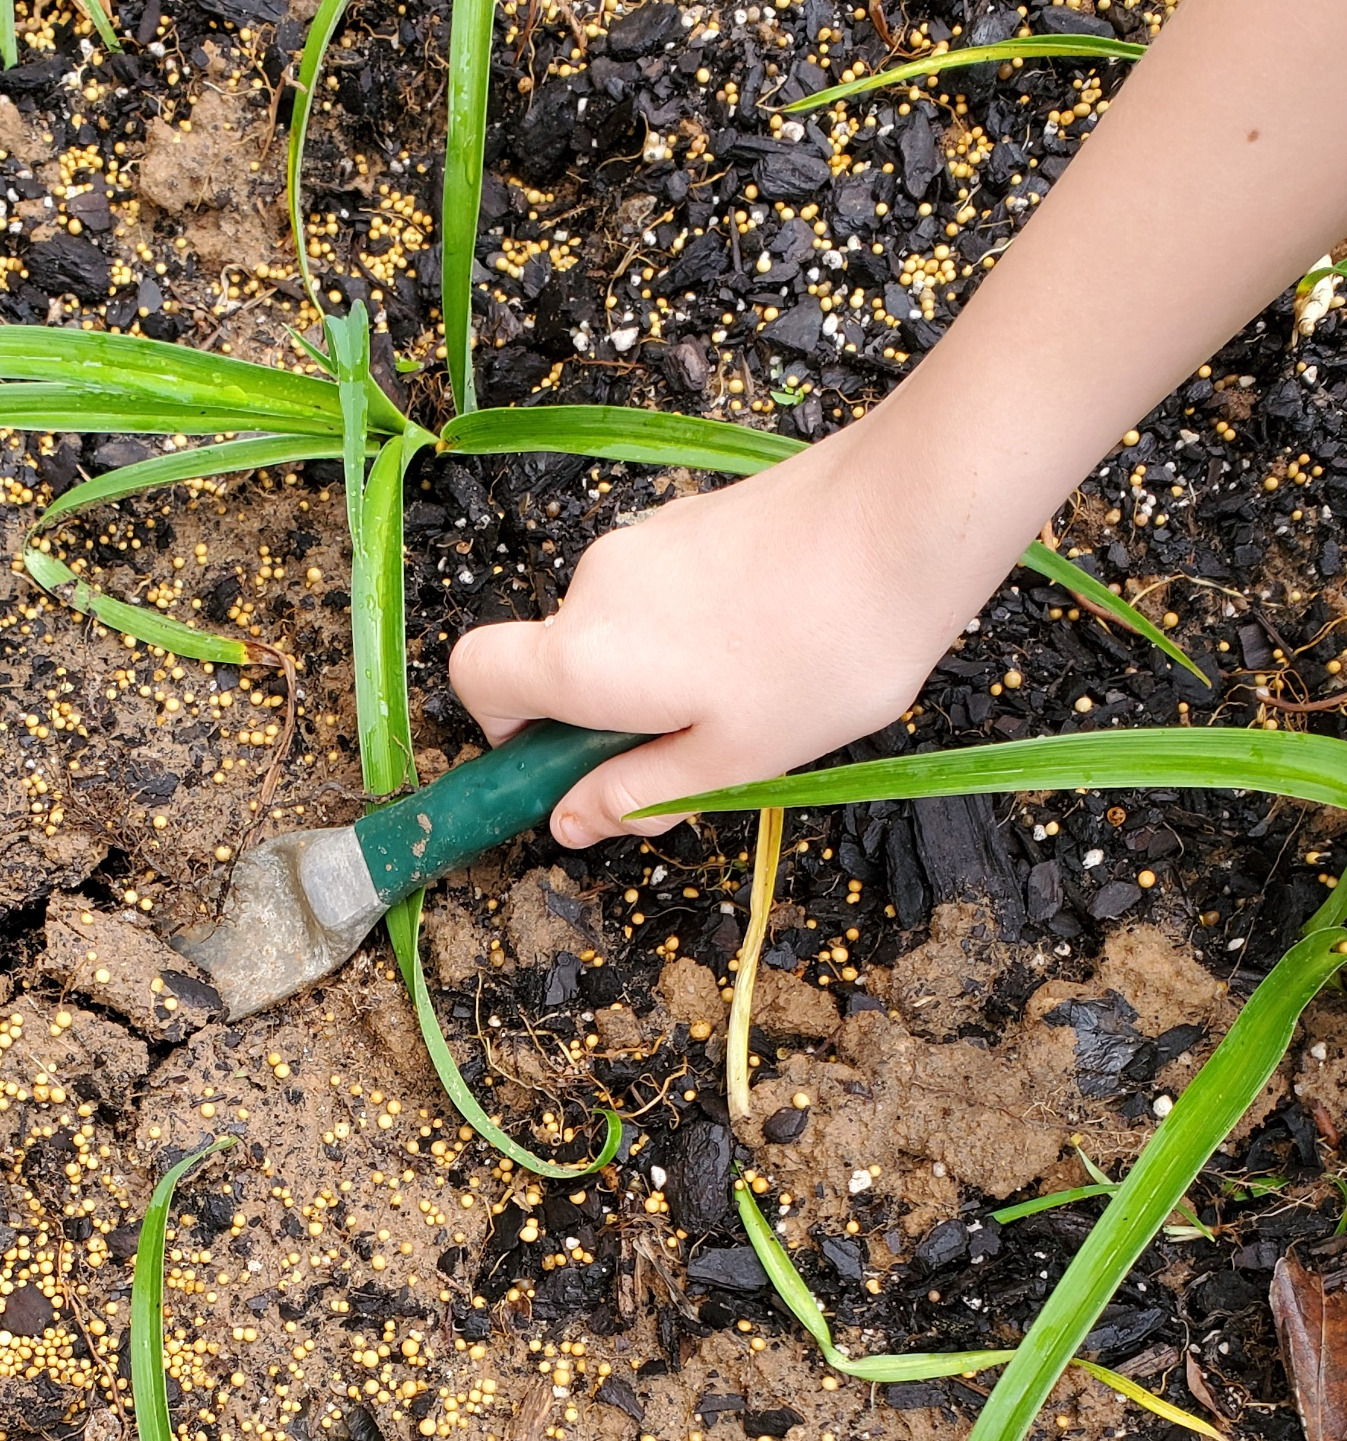
Soil Chemistry Investigation: Preparing the sample
Add 100 mg of soil to 200 ml of water to your breaker.
Stir the solution to blend the soil and water.
  Use a different stirring utensil for each soil sample.
Let the soil and water mixture sit overnight.
Notes:
Source: Photograph by K20 Center.

Slide 9
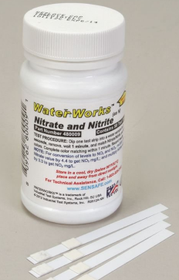

Soil Chemistry Investigation: Recording the data
Record the soil water sample type in your data table.
Dip each test strip into the sample solution.
  Do not touch the sample with your fingers or put more than ½ the pH strip in the sample.
Wait for 50-60 seconds.
Compare the color of your strip/pads on the strip to the color chart as soon as time is up.
Record the measurement in your table.
Repeat for the next sample.

Slide 10
Soil Chemistry Clean-Up
Wipe up any messes on your table.
Throw away garbage and gloves.
Notes:
Clean-Up
Have students clean up any soil and water messes and wash up surfaces as necessary.
Unless the testing materials have specific disposal instructions, trash and soil water can be disposed off in the regular trash and sink.
If any chemicals were added to the water samples, do not pour them down the drain without consulting their SDS sheets for disposal procedures.
To avoid clogs, do not pour any water that still has soil/sediment in it down drains.
Gloves should be removed by turning them inside out. (See a demonstration here if you are unfamiliar with the technique.) Goggles should be wiped clean/disinfected before being put away.

Slide 11
INVESTIGATING SOIL AND SOIL HEALTH
Online Research
Notes:
Students explore several sources to develop a basic understanding of soil properties and components of soil health.
Have students work in groups to gather information about general soil science, soil health, and soil functions. Each student should record important details in a Window Notes graphic organizer. They will leave the Nutrient Cycle box empty for now. If students have regular access to technology, they could also use Google Apps (e.g., Docs, Slides) to collaboratively fill out the notes. A variety of sources that students can use to gather information are provided in the Explore Sources attachment.

Slide 12
Soil and Soil Health Research
Use the Explore Resources handout to conduct your research. In groups, explore the sources listed on the handout:
Videos
Articles
Infographics
Be sure to identify sources when you collect information.
Notes:
Provide students a copy of “Explore Resources” handout, on paper or digitally.
Note: Several of the sources are YouTube videos which may require headphones or physical distance to avoid disturbing other working groups.

Slide 13
Soil and Soil Health Research
Soil Properties | Soil Health
Soil Chemistry | Nutrient Cycles Don’t write anything here yet!
Record what you learn in the first three boxes of your Window Notes sheet
Put the information under the correct headings.
If you aren’t sure where it belongs, be sure to ask!
Leave the Nutrient Cycles box empty.

Slide 14

Soil and Soil Health Research
What is soil?
How do we describe it?
How do we know if soil is healthy?
What are the benefits of having healthy soil?
What soil management practices or strategies can improve soil health?
Notes:
Create an anchor chart summarizing student findings for each of the three boxes they have filled in on their Window Notes.
These example questions can be used to help facilitate class discussion.
This is not a comprehensive list and the order of the questions doesn’t matter.
Add other relevant questions as necessary to scaffold students’ summaries.
Note: The purpose of this discussion is just to summarize the class’s research. Higher order questions should be saved for the Explain discussions when students are synthesizing information.

Slide 15

Breakout!
Soil Properties | Soil Health
Soil Chemistry | Nutrient Cycles
bit.ly/gardengrowbreakout
Notes:
Now that students have a general understanding of soil health, transition them into developing concepts about soil nutrients specifically. Students should work together to complete the “How Does Your Garden Grow?” breakout activity online. They should summarize the information they learn during the breakout in the Nutrient Cycles Window Note box and make additional notes in the other "windows" as necessary.
How Does Your Garden Grow? Breakout: https://bit.ly/gardengrowbreakout
The breakout should be completed collaboratively.
Students should summarize the information in the Nutrient Cycles Window Note box and add any new information to the other boxes as necessary.

Slide 16

Three Sticky Notes
Word
Phrase
Sentence

Slide 17
Nutrient Cycles
Word
Phrase
On a sticky note, summarize what you learned in the breakout using a single word.
On a sticky note, summarize what you learned in the breakout using a short phrase (fewer than 10 words).
Word
Phrase
Notes:
In their breakout groups, ask students to summarize what they learned from the Breakout into a word and a phrase. Groups should attempt to create a single word and phrase.
If they can’t narrow it down to a single example, ask that they limit their responses to one sticky per person (e.g., a group of 3 could have up to 3 words and up to 3 phrases.)
Repeat the discussion process you used in the Explore debrief to develop a final Anchor Chart for Nutrient Cycles.
Ask students to share out their Words and Phrases at the beginning of the discussion.
If necessary, add any new information students discovered to the other three charts as well.

Slide 18
Soil Health
Sentence
You could write about how:
Nutrient cycles contribute to healthy soil;
Unhealthy soil might disrupt nutrient cycles;
Soil management practices can strengthen natural nutrient cycles;
Soil management practices can affect soil health.
In 1 sentence, describe a way nutrient cycles, soil health, and soil management practices relate to one another.
Sentence
Notes:
Now that students are familiar with all the relevant content, they need to connect the pieces to develop a conceptual understanding.
Rather than just telling students what the connections are, help them synthesize the conceptual pieces for themselves.
As part of this process, ask students individually to write a single summary sentence over their learning up to this point on a sticky note. Their sentence should emphasize the connections among the information they've gathered during the Explore and Explain activities and discussions.
Instructional Note: The sticky-note summaries students have completed are the steps in a strategy called Three Sticky Notes. While they are typically written all at the same time, this lesson is scaffolds them to support the complexity of their syntheses.
Instructional Note: There are other ways to direct students' knowledge construction, but they should at least work out the connections provided on the slide.
Three Sticky Notes: https://learn.k20center.ou.edu/strategy/d9908066f654727934df7bf4f506d92f

Slide 19

Concept Card Mapping
Create either hand-drawn or digital concept maps.
If making hand-drawn maps, use physical card that is glued down.
Draw lines or paste string on hand-drawn maps to show connections among idea.
As a whole class, you might consider using string to physically connect concepts found on the four anchor charts.
Notes:
Source: K20 Center. [n.d.]. Concept card mapping. Strategy. https://learn.k20center.ou.edu/strategy/123
Create Your Mind Maps Online - On Any Device | MindMeister
Cmap Cloud (ihmc.us)

Slide 20

Metaphorical Thinking
Create your own metaphors to explain the connections you are making.
Notes:
Source: K20 Center (n.d.). Metaphorical thinking. Strategy. https://learn.k20center.ou.edu/strategy/146

Slide 21

Cognitive Comics
Use three-paneled frame to express your understanding of the connections between soil and its impact on the growing cycle.
You may be asked to display your comic strip for a gallery walk or a brief presentation to the whole class.
Notes:
Source: K20 Center. (n.d.). Cognitive comics. Strategy. https://learn.k20center.ou.edu/strategy/198

Slide 22
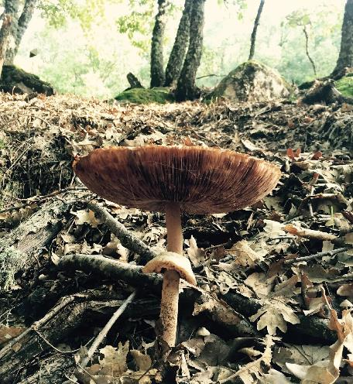
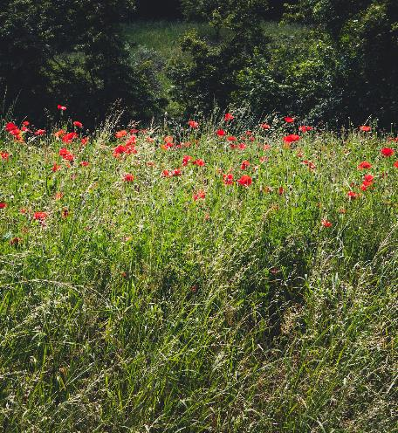
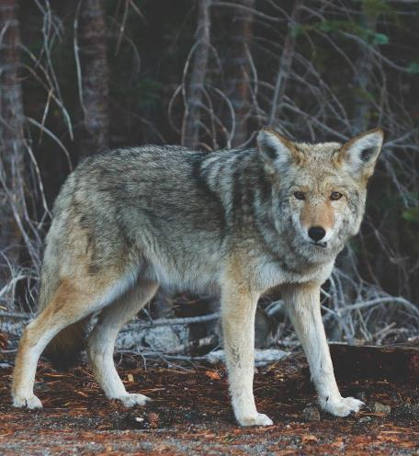
Ecosystem Functions
What are the functions of these groups in an ecosystem?
Decomposers
Producers
Consumers
Photo by Roberto Arias
Photo by Alberta Tessaro
Photo by Josh Felise
Notes:
MS-LS2-3 (OAS-S 6th grade)
Students will construct a model of matter and energy transfers in their local ecosystem or the ecosystem from which their soils were sampled.
MS-LS2-3 (6th grade)
In small groups or as a class, develop a list of functions performed by different types of organisms in an ecosystem based on prior knowledge and any information collected during the previous parts of the lesson
(e.g., decomposers break down organic material to release carbon and nitrogen, producers take in carbon and give off oxygen during photosynthesis, etc.).
These trophic groups should at least include decomposers, producers, and consumers.
Roberto Arias on Unsplash: https://unsplash.com/photos/ihpiRgog1vs
Alberta Tessaro on Unsplash: https://unsplash.com/photos/8Qeelw9kL4s
Josh Felise on Unsplash: https://unsplash.com/photos/mblYxasm0nk
Unsplash: https://unsplash.com/

Slide 23
Food Webs
Construct model food webs of the school or neighborhood ecosystem.
Use arrows to show where matter and energy flow.
Label the arrows with what causes matter and energy to flow.
Notes:
MS-LS2-3 (6th grade)
Using this information, students should construct model food webs of their school or neighborhood ecosystem..
Note: If soil samples were not taken from the school, then use the sample location's ecosystem instead.
Include arrows between organisms to show the direction that matter and energy flow.
Indicate what process causes matter and energy to flow
(e.g., consumers eating producers and bacteria fixing nitrogen in the soil would both be causes of matter and energy flow).

Slide 24
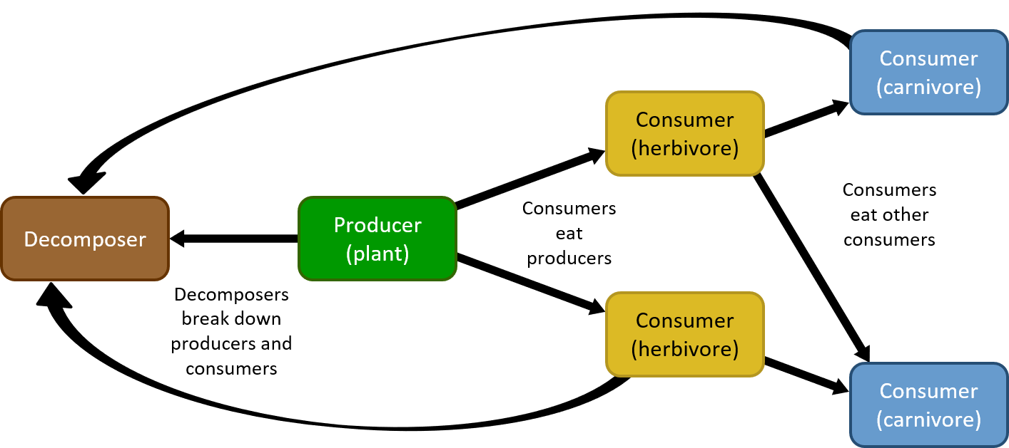
Food Webs
Notes:
MS-LS2-3 (6th grade)
Use this slide as an example of how to construct a food web.
Students should already be familiar with this process from 5th grade (5-LS2-1), so this slide is intended to serve as a review.
Ask students to provide the information before progressing through the animations.
Where do decomposers get their energy?
What organisms do producers provide energy to?
What organisms do herbivores provide energy to?
Between decomposers and producers, in what direction do matter and energy flow?
Between producers and consumers, and among consumers, in what direction do matter and energy flow?
What causes matter and energy to flow to decomposers?
What causes matter and energy to flow among producers and consumers?

Slide 25
Ecosystem Webs
Add parts of the environment to your food web.
Pick one nutrient you measured in the soil investigations.
Use arrows in a new color to show where that nutrient flows in and out of the system.
Label the arrows with what causes the nutrient to flow in and out of the system.
Notes:
MS-LS2-3 (6th grade)
Once students have created food web models, they should add environmental elements to them to construct "ecosystem webs."
Students should select one key nutrient from their soil tests as a focus.
Using a new color, students should add arrows showing the flow of their nutrient into and out of both the living and non-living parts of the system, AND
indicate what causes the nutrient to flow from one place to another.
For example, carbon is taken from the air into plants during photosynthesis and it enters the air and soil during decomposition]

Slide 26
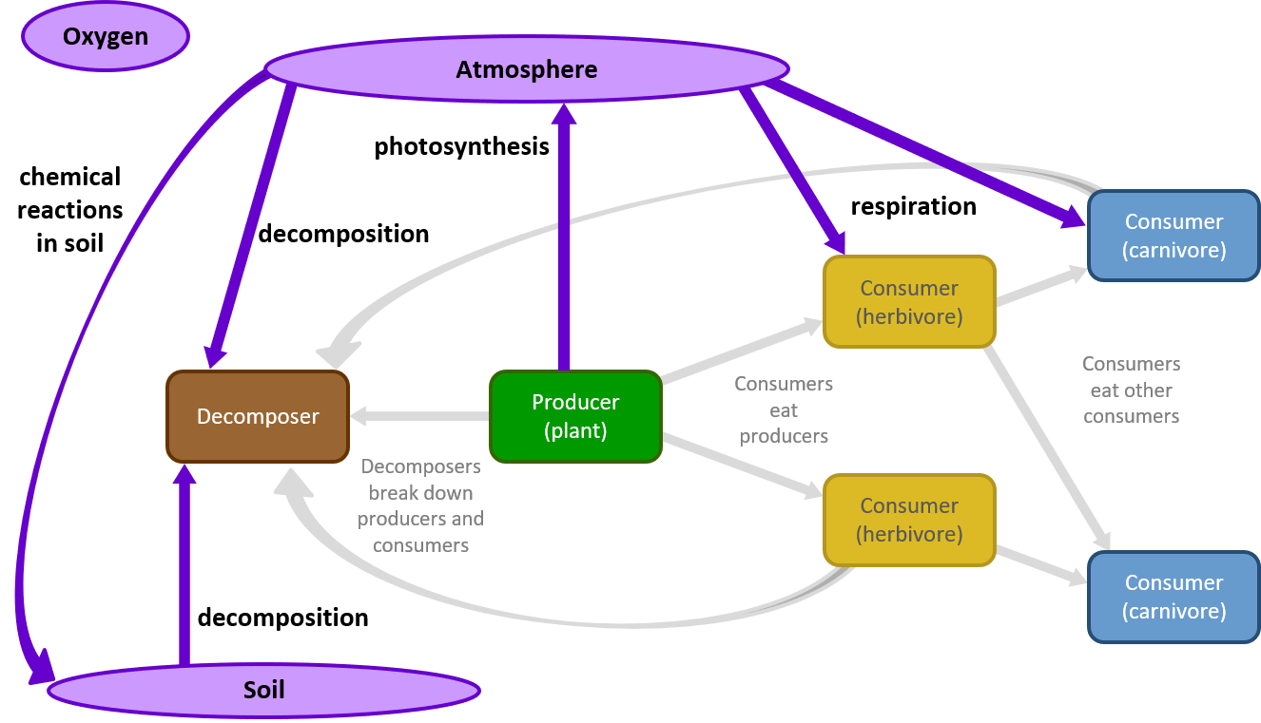
Ecosystem Webs
Notes:
MS-LS2-3 (6th grade)
Use this slide as an example of how to construct an ecosystem web. Oxygen is the example element used.
Soil and atmosphere are only two examples of environmental elements you could ask students to include. Water, rocks/sediment, humans, etc. would also be appropriate, depending on the nutrient students select.
Oxygen (matter) moves between
living and non-living parts of an ecosystem,
From organisms to and from atmosphere and soil
and between the non-living parts as well.
From atmosphere to soil

