Slide 2
Who Bleached My Coral?
Photosynthesis and Coral Reef Health

Slide 3
Healthy Coral Reefs
Notes:
BBC Earth. (2018, May 23). The Coral Reef: 10 hours of Relaxing Oceanscapes | BBC Earth [Video]. YouTube. Retrieved August 11, 2022, from https://www.youtube.com/watch?v=nMAzchVWTis&ab_channel=BBCEarth

Slide 4
Coral Bleaching
Replace this text with your chosen images or show your image search online here.

Slide 5
Coral Reefs 101
Notes:
National Geographic. (2017, November 7). Coral Reefs 101 | National Geographic [Video]. YouTube. Retrieved August 11, 2022, from https://www.youtube.com/watch?v=ZiULxLLP32s

Slide 6
Essential Question
How do photosynthesis and the relationship between coral and their symbiotic algae explain coral bleaching?

Slide 7
Lesson Objective
Construct a scientific, evidence-based explanation for the role of photosynthesis in an organism’s cycle of matter and energy.

Slide 8
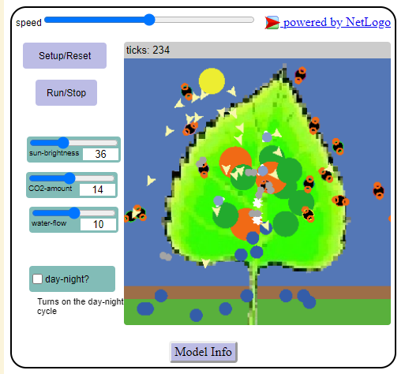
Leaf Photosynthesis Activity
Go to this link on your personal device:
http://k20.ou.edu/photosynthesis
Complete the Leaf Photosynthesis Activity.
Notes:
Concord Consortium. (n.d.) Leaf photosynthesis. Concord Consortium. Retrieved August 11, 2022, from https://learn.concord.org/resources/651/leaf-photosynthesis

Slide 9
I Think, We Think
Think about environmental conditions that might:
Stress coral enough to evict their algae
Affect photosynthesis (either negatively or positively)
Write your ideas in the “I Think” column of the t-chart
Be ready to share your thoughts
Add others’ ideas to the “We Think” column of the t-chart

Slide 10
Chat Stations
Visit the five stations around the classroom with your group
Read the card on each station and discuss the conditions described in the reading
Write down a summary of each reading in your Coral Bleaching Graphic Organizer

Slide 11
Claim, Evidence, Reasoning (CER)
Read the Flower Gardens Bleaching article
Write a claim, evidence, and reasoning response to the question:
What caused the bleaching of Flower Gardens Banks National Marine Sanctuary?
Write your response in the CER graphic organizer

Slide 12
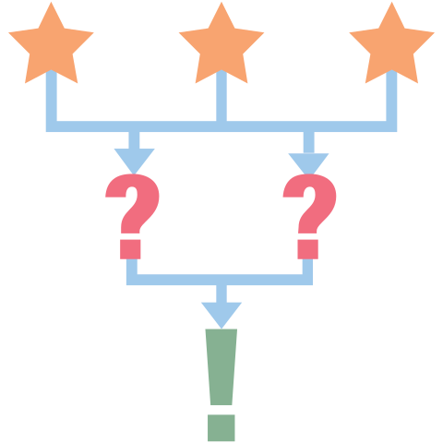
3-2-1
On the back of your CER handout, write your answers to the following questions:
3 - What are three things you have learned?
2 - What are two questions you still have?
1 - What is one thing you found interesting?

