Slide 2
Conflict and Choice in Tangerine
Character Development

Slide 3
I Notice, I Wonder
You are about to watch a video clip.
As you watch, consider:
What observations you can make about the characters’ choices?
What questions do you have?
Notes:
I notice, I wonder card here

Slide 4
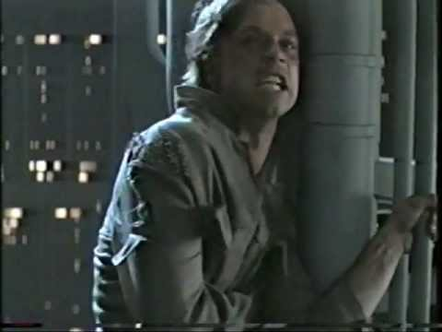
TheTrueVoiceOfRock. (2013, April, 11). Star Wars "I am your father" Scene Full - UNEDITED 2000 vhs [Video]. YouTube. https://www.youtube.com/watch?v=Lbjru5CQIW4
Notes:
Star Wars video here

Slide 5
5-minute Writing Prompt
Has one of your family members ever done something bad or something you thought was wrong?
How did it make you feel? How did you react?
How did other members of your family react?
Did they tell them they were wrong, or did they try to help?
Notes:
I notice, I wonder card here

Slide 6
Essential Question
How do a character’s choices affect the development of that character?

Slide 7
Character Development
What does it mean when a character develops in a story?
Do characters always develop in a story?
What can affect character development?

Slide 8
Virtual Field Trip
Go to maps.google.com.
Type in “Tangerine, Florida.”
Follow the steps on the Virtual Field Trip handout.

Slide 9
Virtual Field Trip Reflection
What did you find out about the city of Tangerine?
How would you feel if you had to move there?

Slide 10
Tangerine by Edward Bloor
As you read Schmoop’s introduction to Tangerine by Edward Bloor, annotate the text for:
specific information about character development in the story
clues about character development in the story

Slide 11
Predictions: What is the main problem?
On the Prediction Handout, answer the following questions:
What do you predict the main problem in the novel Tangerine will be?
What makes you think this? Refer to the introduction we read for support.

Slide 12
Predictions: Peer Review
On the Anchor Chart, post your predictions.
We will refer to your predictions throughout reading the novel.

