Slide 2
To Limit, or Not To Limit: That Is the Government’s Question
U.S. Government

Slide 3
Essential Questions
What are limited and unlimited governments?
Which countries have limited governments, and which countries have unlimited governments?

Slide 4
Lesson Objectives
Compare and contrast characteristics of limited and unlimited governments.
Categorize past and present countries as having limited or unlimited governments.

Slide 5
Fiction in the Facts
An absolute monarchy means the leader has unlimited power.
A limited government means the government has no power over citizens.
In a democracy, the government can do only what the constitution allows for.

Slide 6
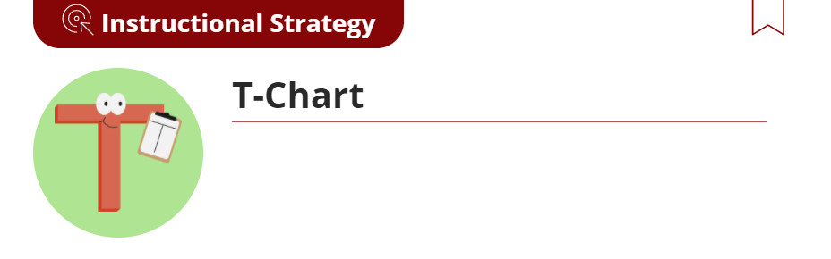
Characteristics of Unlimited and Limited Governments
Read the article about unlimited and limited governments.
As you read, fill out the T-Chart with evidence from the article.
Discuss what you wrote with your group.
Continue to fill in your T-Chart as a group.

Slide 7
Google Earth Tour: Government Power
View the Google Earth tour here: t.ly/Nv07
As you select each location, read the biography of the country.
Decide whether the government has limited or unlimited power.
Write the name of the country and your choice on a sheet of notebook paper or on the Country Biographies handout.

Slide 8
Characteristics of Limited and Unlimited Governments
View the quotes about governmental power posted around the room.
Move to the quote that most appeals to you.
Discuss with others who chose the same quote what attracted you to it.
Move to the quote that most repels you.
Discuss with students who selected the same quote what repelled you.

Slide 9
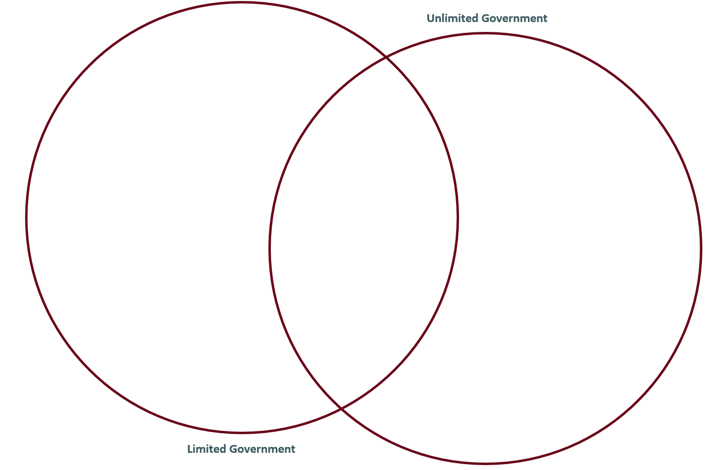
Venn Diagram
Characteristics of
Limited Governments
Shared
Characteristics
Characteristics of
Unlimited Governments

