Slide 2
What’s Under Our Feet?
Evidence of Common Ancestry and Diversity

Slide 3
Essential Question
How can we use patterns in fossils to understand the diversity of life forms that have existed in the past and
in the present?

Slide 4
Lesson Objectives
We will use information about the number, locations, and kinds of different fossils in Oklahoma:
to make inferences about life in the past and how life has changed over time; and
to analyze the relationships among living things based on similarities in physical appearance.

Slide 5
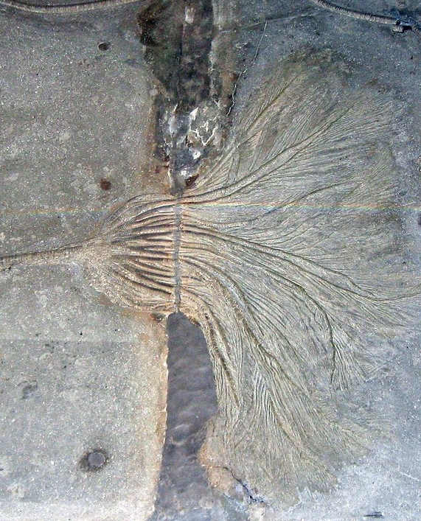
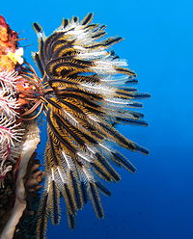
What do you notice? What do you wonder?
Write one thing you notice and one thing you wonder when you look at these images.
Notes:
If students have difficulty coming up with things to write, you may ask guiding questions to help them get started, such as:
What kind of organism is this?
What environment do you think it might live in?
Does it look like any animal or plant that you have seen before?
Why would we find this in Oklahoma?
Are there other marine organisms that once lived in Oklahoma?
After giving students 3–5 minutes to record what they notice and wonder, have a few students share out. Then, inform students that these types of fossils can be found in Oklahoma and ask them how such fossils could be found in a landlocked state.
Strategy: K20 Center. (n.d.). I Notice, I Wonder. Strategies. https://learn.k20center.ou.edu/strategy/180
Image sources:
St. John, J. (2011, January 30). Seirocrinus subangularis (fossil crinoid) [Photograph]. Flickr. https://www.flickr.com/photos/jsjgeology/35674916591/in/photostream/
Vasenin, A. (2010, September 15). Crinoid on the reef of Batu Moncho Island [Photograph]. Wikimedia Commons.
https://commons.wikimedia.org/wiki/File:Crinoid_on_the_reef_of_Batu_Moncho_Island.JPG

Slide 6
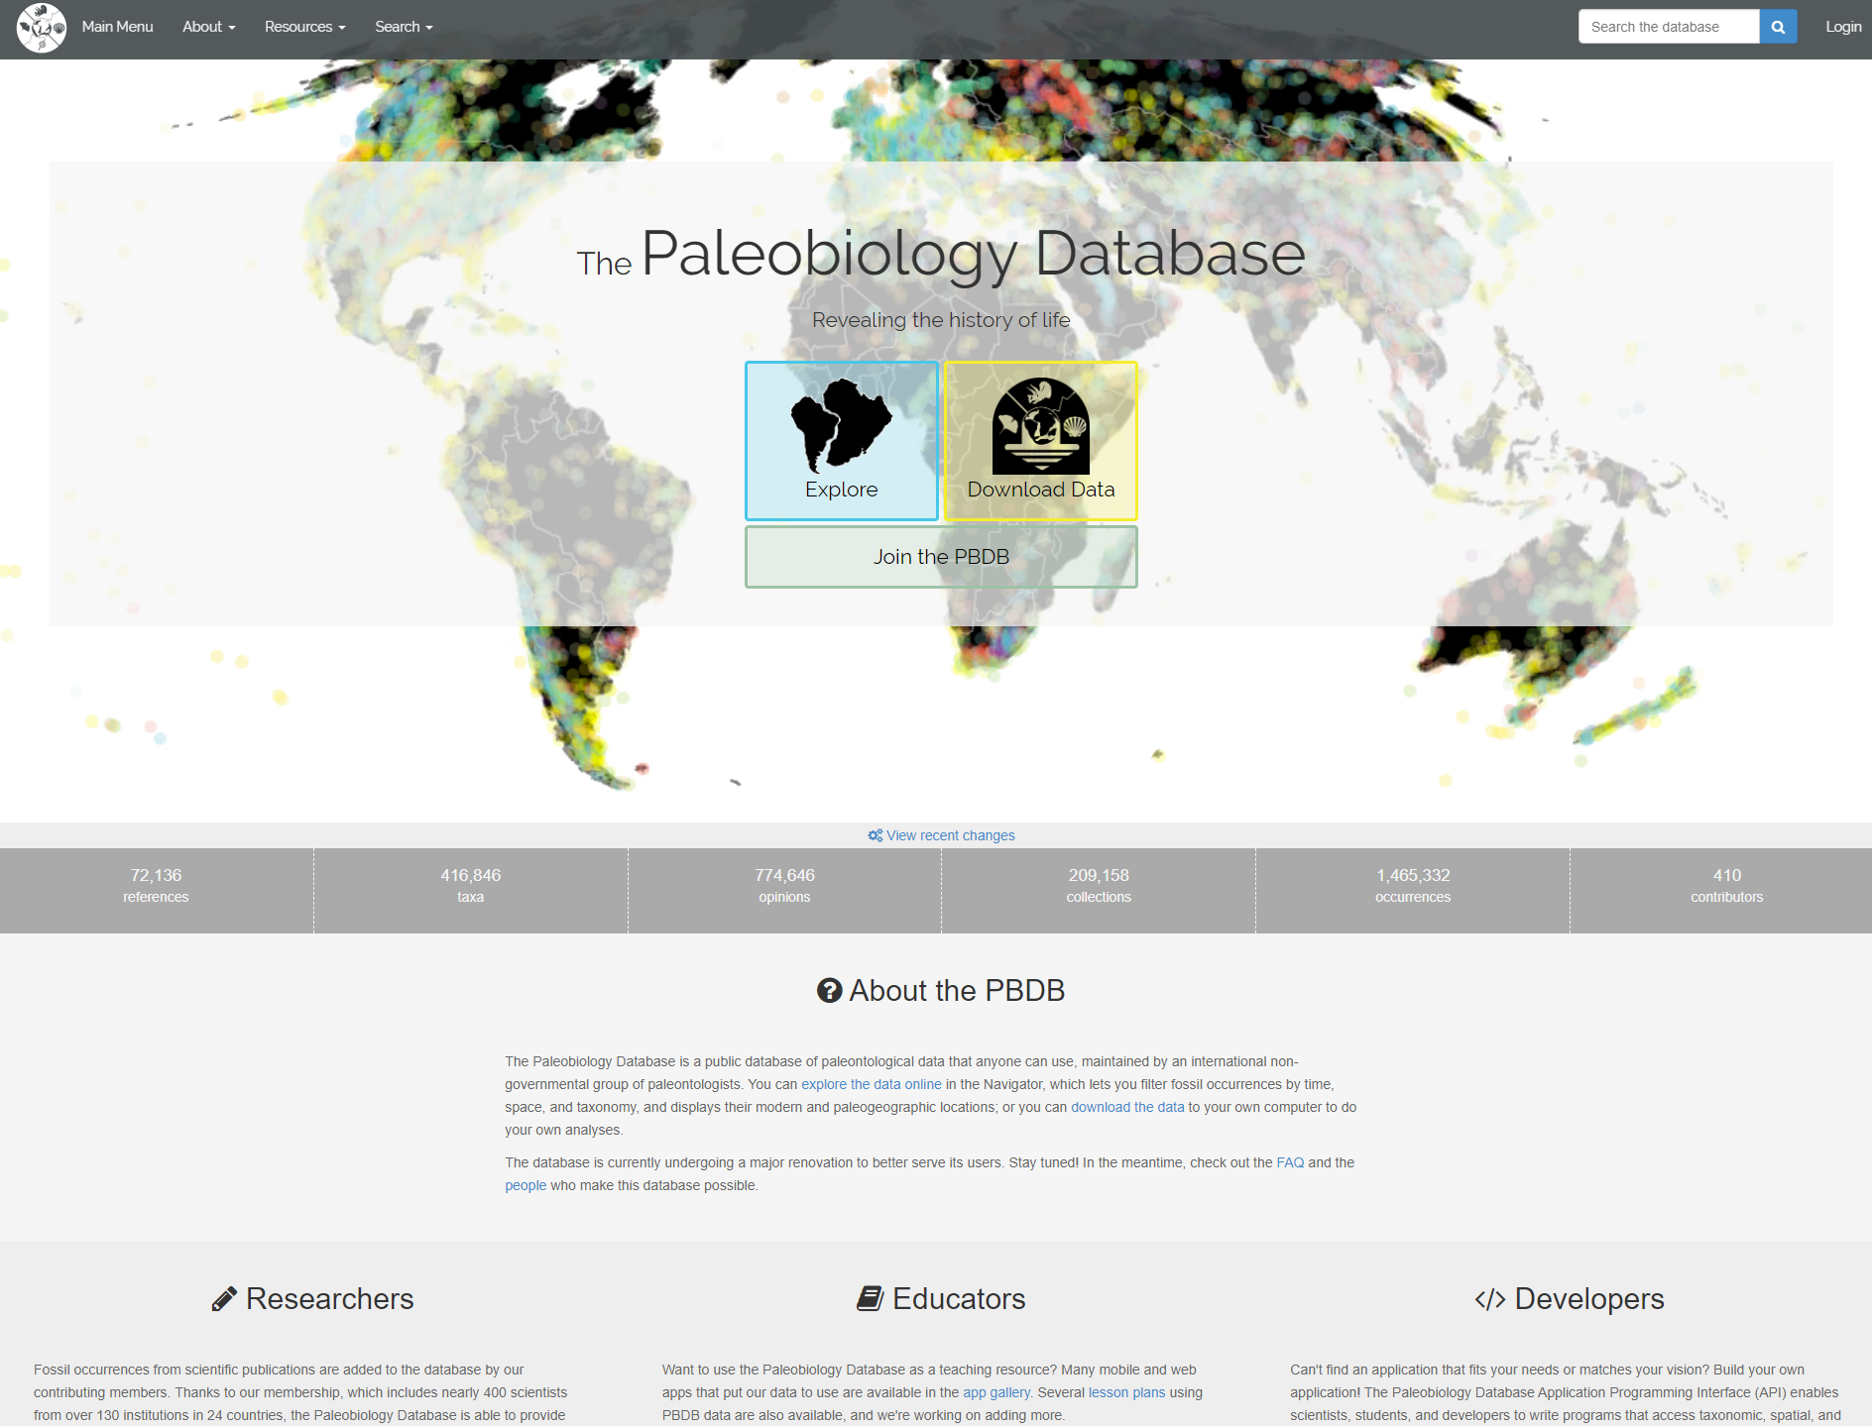
Where are these fossils in Oklahoma?
Go to paleobiod.org and use your handout as a guide.
Your screen should look like this.
Select the “Explore” button.

Slide 7
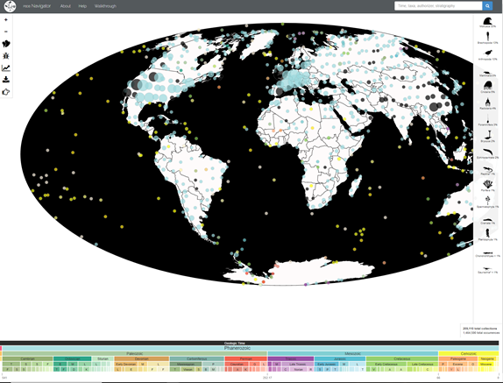
Where are these fossils in Oklahoma?
Now, your screen should look like this.
Each dot represents a collection of fossils.
The larger the dot, the bigger the collection.

Slide 8
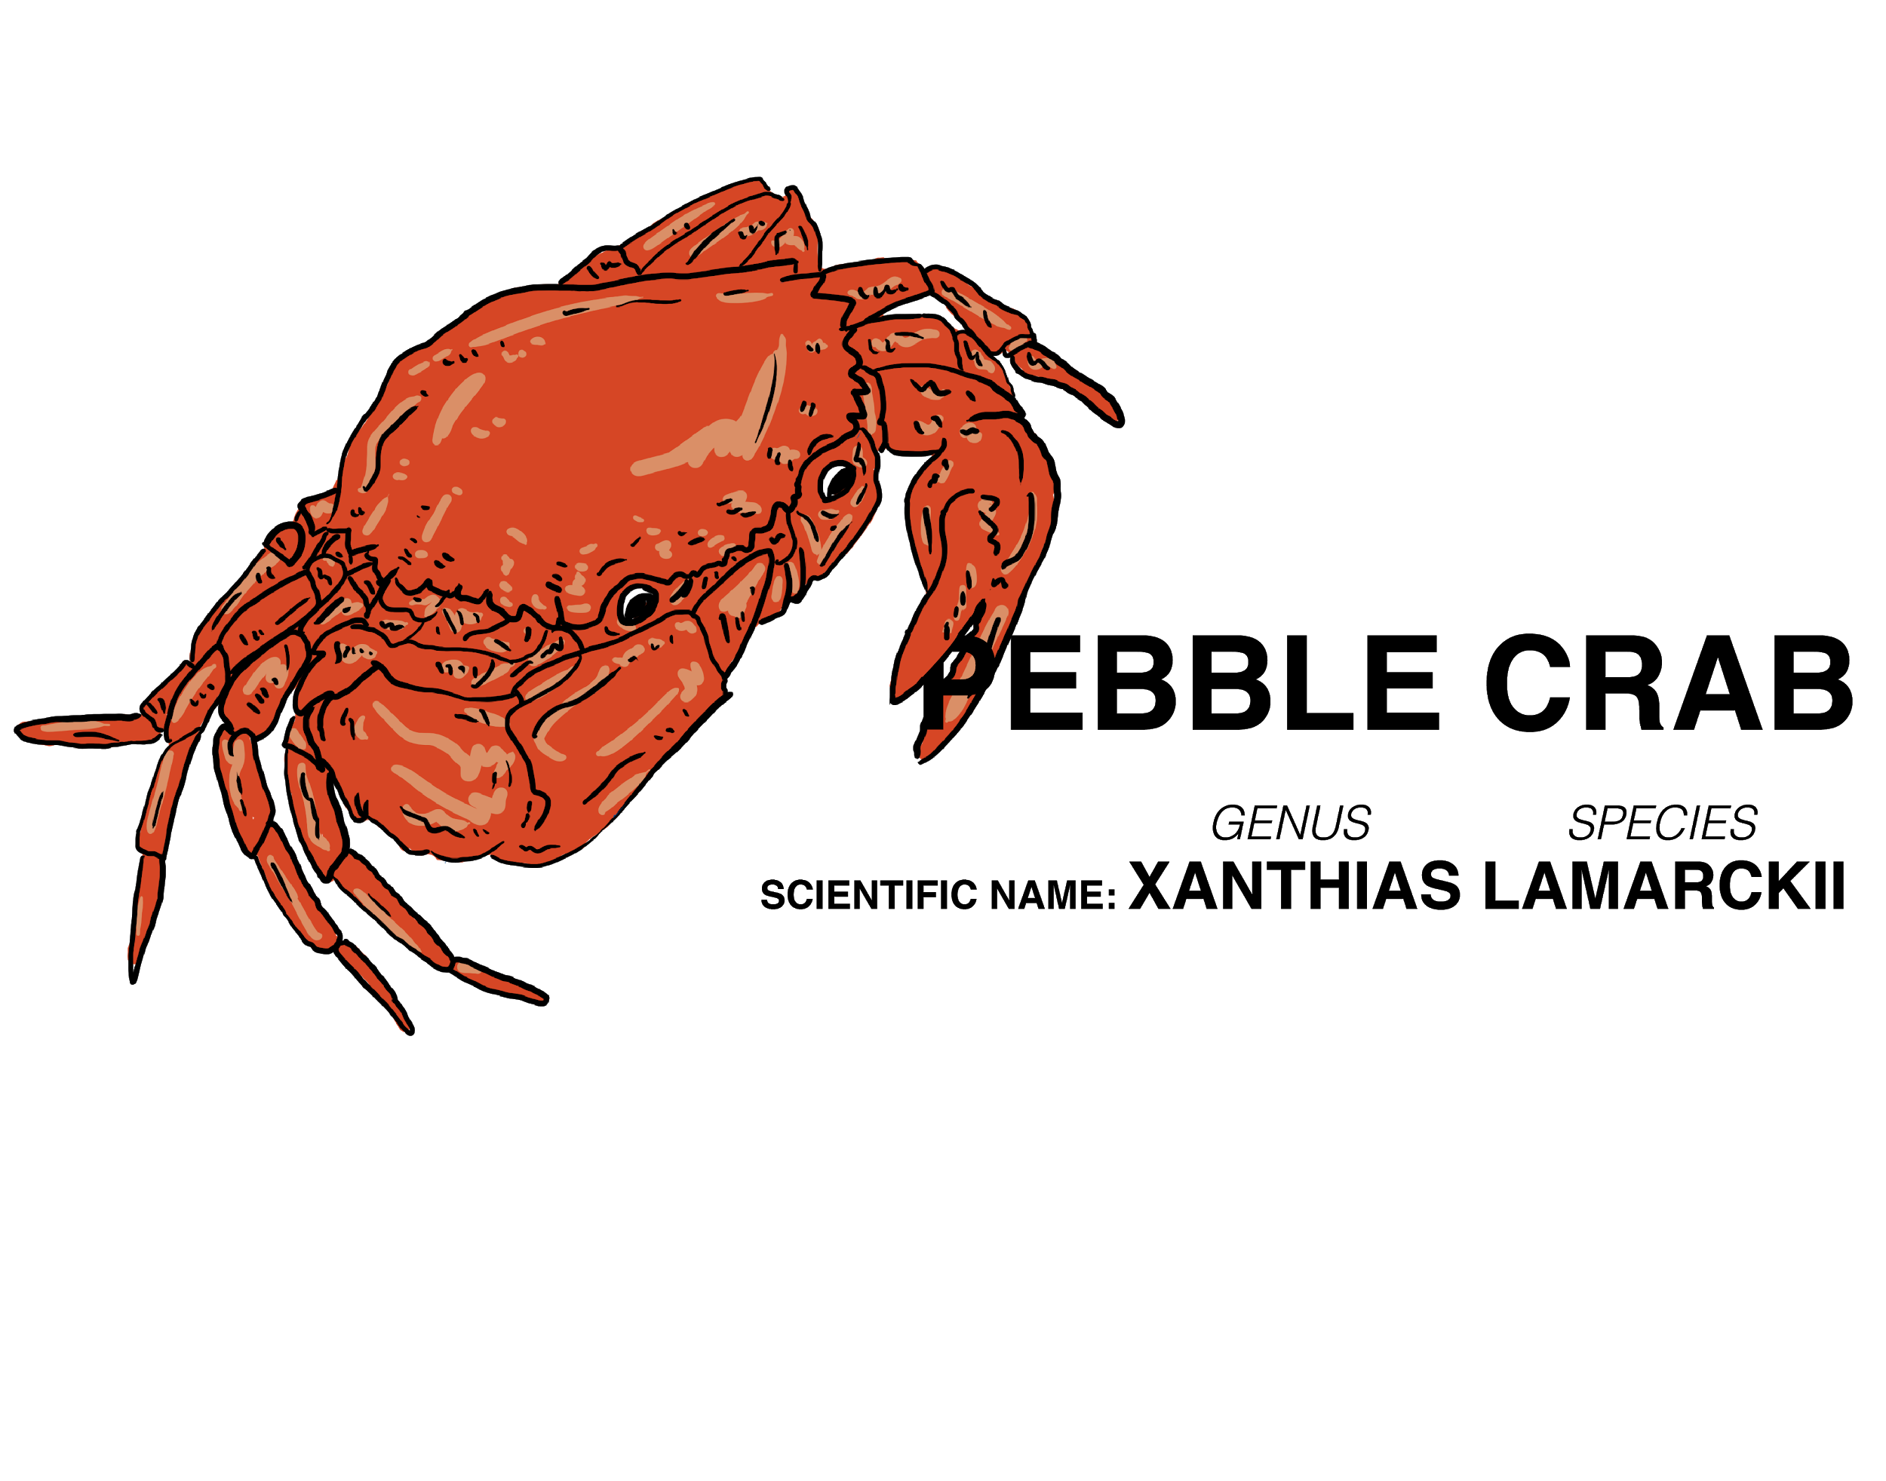
Scientific Names
All livings things have a
binomial, or scientific, name.
  Binomial means it consists of two terms (e.g., Homo sapiens).
Common names often change by region and language, so scientists use binomial names to ensure everyone knows what organism is being discussed.
The website you will use is an actual database of fossils found all over the world, so it uses only scientific names
to ensure consistency.
Notes:
The website students will use only allows searching by scientific name, so students will need a brief introduction to this concept.

Slide 9
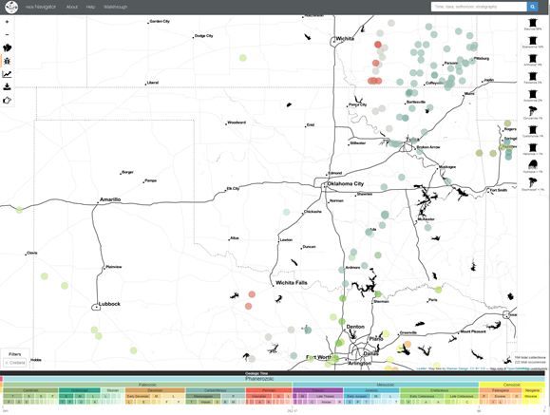
Where are these fossils in Oklahoma?
In the search box on the top-right side of the screen, type the phylum name Cnidaria.
  This is the group that the organism from the beginning
  of the lesson belongs to.
Zoom in and drag to show mainly Oklahoma on the map.
Follow the directions on the handout and answer each question with your group.

Slide 10
3-2-1
On your handout, answer the following questions based on what you have learned so far:
What are three inferences you can make about the animal you chose
to investigate?
What are two things you found interesting about the animal you chose
to investigate?
Describe one modern-day animal you think might be related to the animal you chose to investigate. Explain your answer.
Notes:
Strategy:
K20 Center. (n.d.). 3-2-1. Strategies. https://learn.k20center.ou.edu/strategy/117

Slide 11
Extending Your Knowledge
Work in your groups to create a presentation that includes:
The name of the species (both the common and scientific names).
A picture or drawing of the organism.
The location on an Oklahoma map where its fossils are usually found.
  Use paleobiodb.org for this.
The time frame in which the organism was alive. When did it go extinct?
A description of other species that are anatomically similar to your species.
Would these species have existed before or after yours? Why?
A prediction about the environment the organism would’ve lived in.
  Include the amount of water/rainfall, plants found in the area, temperature,
  and physical landscape.
Notes:
Presentations do not have to be limited to posters or slides—you may have students brainstorm which delivery methods they think will work best for their groups. Provide students with the Extending Your Knowledge rubric and instructions (attached to the lesson) to help guide their work.

Slide 12
Tweet Up
Choose ONE of the following prompts and respond with a tweet. Use 280 characters or fewer and include a hashtag.
What patterns do you notice about the diversity and complexity of life over time?
What similarities or differences do the fossil species from the beginning of the lesson have compared with the modern-day species?
How might changes in the environment affect the patterns of diversity we see in the fossil record?
How can fossils be used as evidence that modern-day species are related
to species from the past?
Notes:
Strategy:
K20 Center. (n.d.). Tweet Up. Strategies. https://learn.k20center.ou.edu/strategy/130

