Slide 2
Woman Crush Wednesday: Rachel Carson
Grades 9-10 Science

Slide 3

Bell Ringer
Answer the following questions to the best of your knowledge before we begin today’s lesson:
What is natural selection?
Can you name any examples of chemicals or products that have been developed to control populations of pests or organisms?
Why do you think a single formula doesn’t work to control all disease-carrying organisms?

Slide 4
Essential Questions
How have female scientists shaped science today?
What effects can humans have on our ecosystem?

Slide 5
Lesson Objectives
Illustrate the contributions of a particular scientist, Rachel Carson, as a way to humanize the field of science.
Summarize how changes in one part of an ecosystem affect other parts of the ecosystem.
Explain how a group of organisms changes over time.

Slide 6
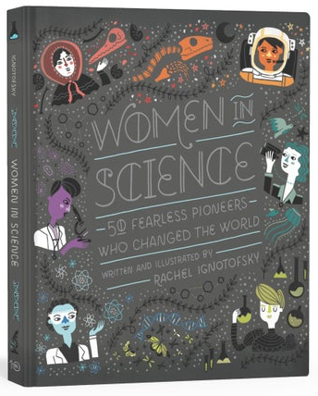
Who Was Rachel Carson?
Familiarize yourself with Rachel Carson and her contributions to science using one of the following options:
Read the excerpt from Women in Science.
Watch the video Rachel Carson: A History for Kids.
Notes:
Book: Ignotofsky, R. (2016). Women in science: 50 fearless pioneers who changed the world. Berkeley, CA: Ten Speed Press.
Image source: McKissick, K. (2016, April 28). Women in science: The next science art book you need. Scientific American. https://blogs.scientificamerican.com/symbiartic/women-in-science-the-next-science-art-book-you-need/
Video source: https://www.youtube.com/watch?v=rtX9yf62BXU

Slide 7

Who Was Rachel Carson?
Notes:
Video source: https://www.youtube.com/watch?v=rtX9yf62BXU

Slide 8

Inside Out
On your handout, use the innermost circle to record what you know about Rachel Carson from the reading or the video.
Discuss what you know with a partner, and use the middle circle to record anything your partner knows about Rachel Carson that you didn’t already record.

Slide 9
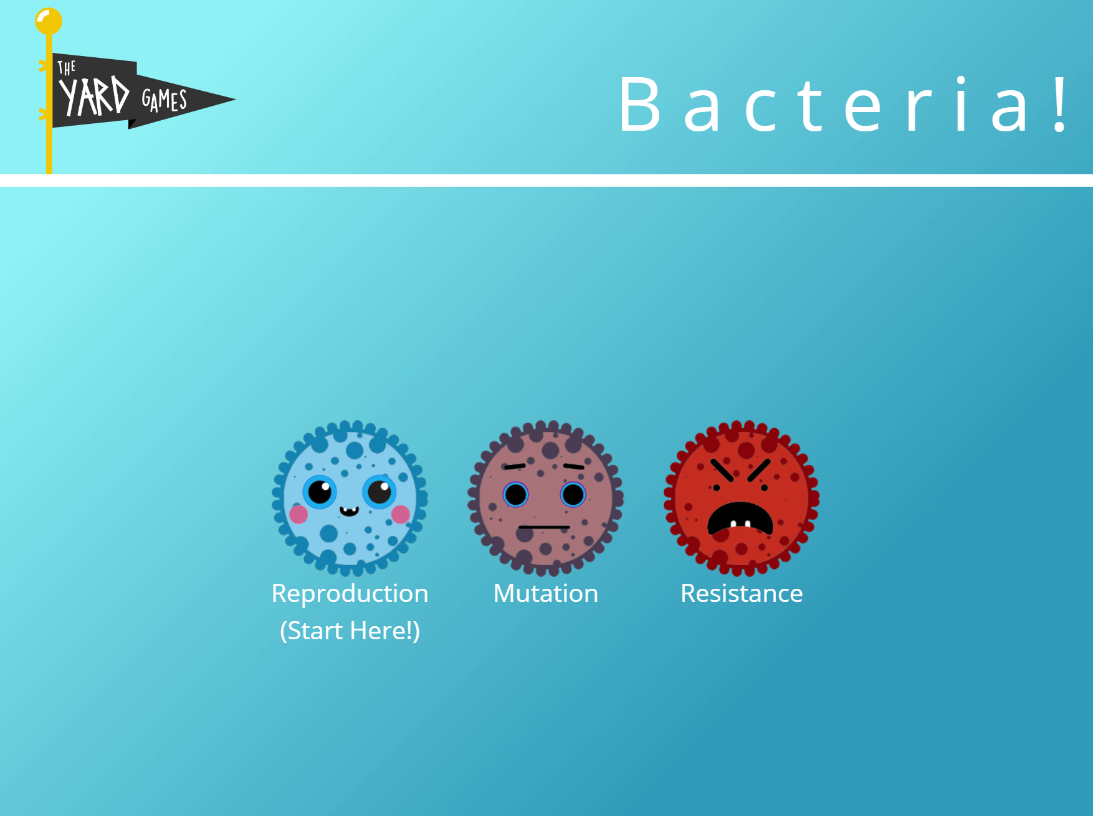
Antibiotic Resistance Game
https://www.brainpop.com/games/antibioticresistancegame/
What does resistance mean?
How is antibiotic resistance selected for in bacteria?
How do other organisms adapt to stimuli from the environment?
Notes:
Game source: BrainPop. (n.d.). Antibiotic resistance [Game]. https://www.brainpop.com/games/antibioticresistancegame/

Slide 10
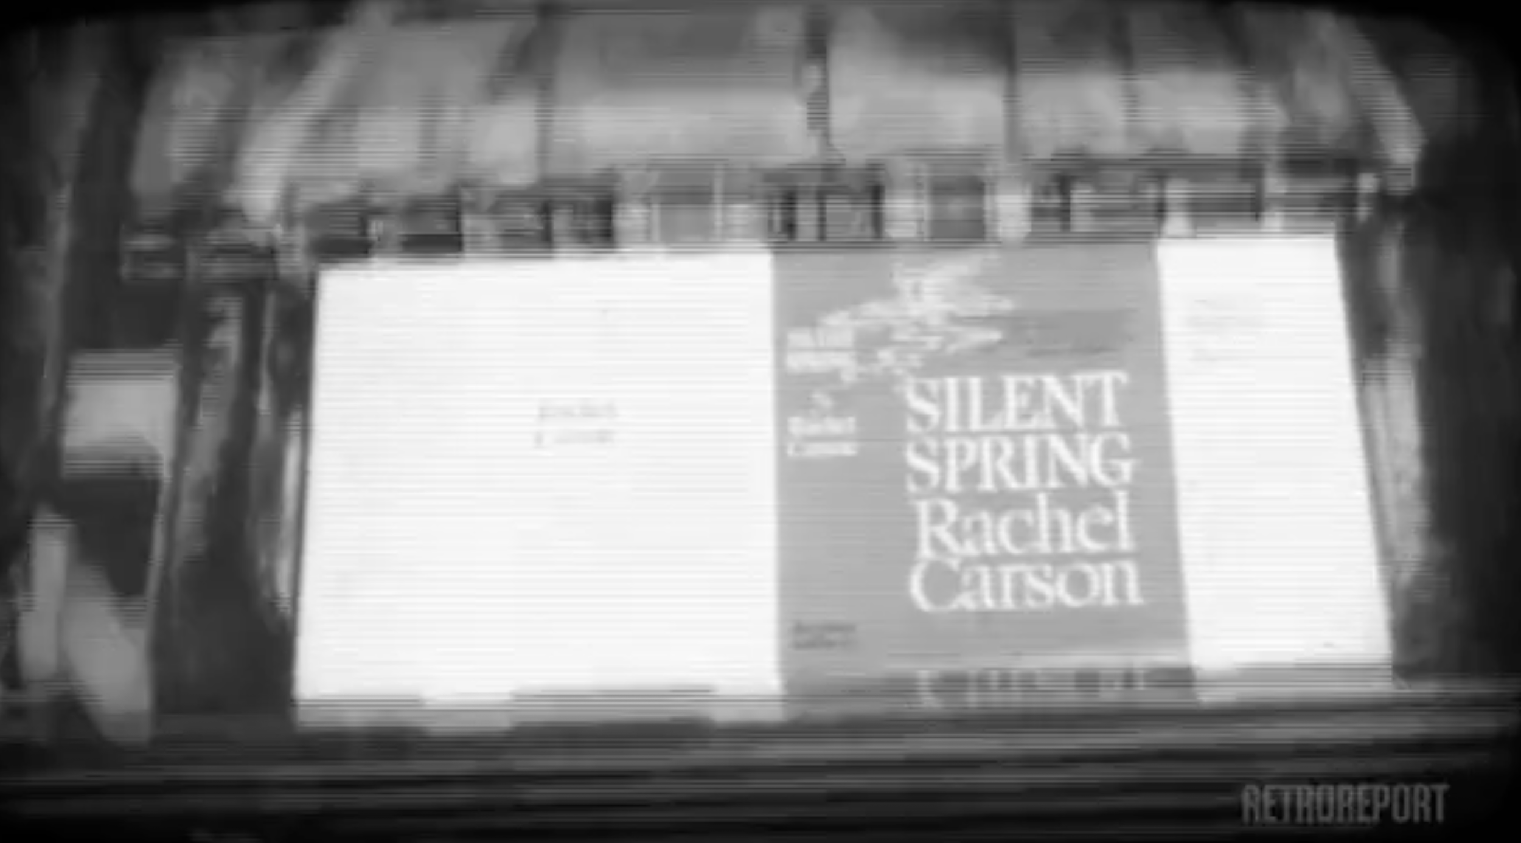
Controlling Disease: Lessons from Silent Spring
Notes:
Video source: https://www.pbslearningmedia.org/resource/amex29rc-sci-silentspringlessons/lessons-from-silent-spring-for-controlling-disease-rachel-carson-american-experience/

Slide 11
Inside Out
On your handout, add anything you learned from the video to the outermost circle.
According to the video, how did the changes Rachel Carson brought about with Silent Spring affect other parts of the ecosystem?

Slide 12

Six-Word Memoirs
Create a Six-Word Memoir to summarize your learning from this lesson. You may choose to complete your memoir about either:
Rachel Carson
Natural selection
Example: If the subject were Rosa Parks, you might write,
"Refused to move. Launched a movement."

Slide 13

Carousel
This activity will be done in two rounds. You will be a presenter during one of the rounds and a carousel member during the other.
Presenting: Share your Six-Word Memoir, and then give a brief description about why you chose to represent the topic with those six words.
Carouseling: Walk around to each of the presenters and listen to their Six-Word Memoirs. Use your sticky notes to provide feedback.

