Slide 1
Of Mice and Men in the Great Depression
Lesson 1: Introduction to Background & Setting
High School ELA

Slide 2
Lesson Objectives
Identify and summarize societal issues of the Great Depression.
Connect Great Depression issues to the novel’s background and setting.
Compare the issues of the Great Depression with today’s societal issues.

Slide 3
Essential Questions
What was society like during the 1930s?
How does understanding the 1930s prepare us for reading Of Mice and Men?

Slide 4
I Think | We Think
What do you observe? In this column, write down your observations of each Depression-era photo. 1. 2. 3. 4.

Slide 5
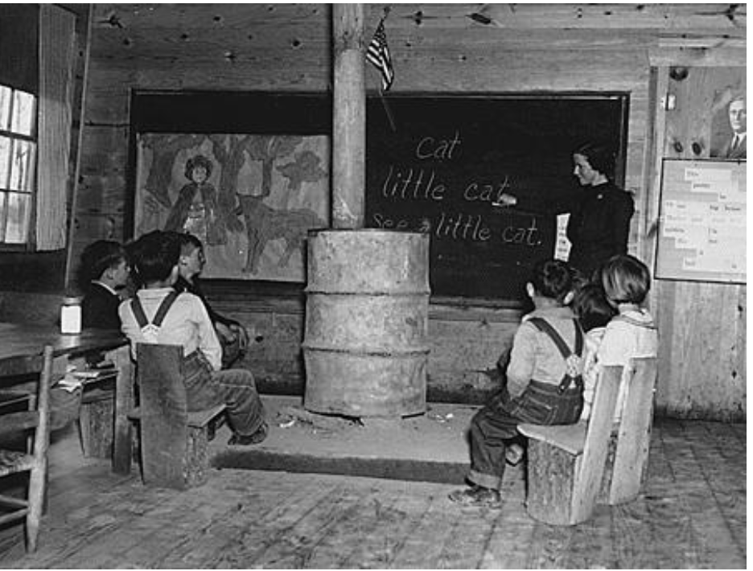
1
Elementary School in Alabama (1935)
Notes:
Source: Franklin D. Roosevelt Presidential Library & Museum. (1935). School--Alabama [Image]. http://www.fdrlibrary.marist.edu/archives/collections/franklin/index.php?p=digitallibrary/digitalcontent&id=3325
This photograph is in the public domain.

Slide 6
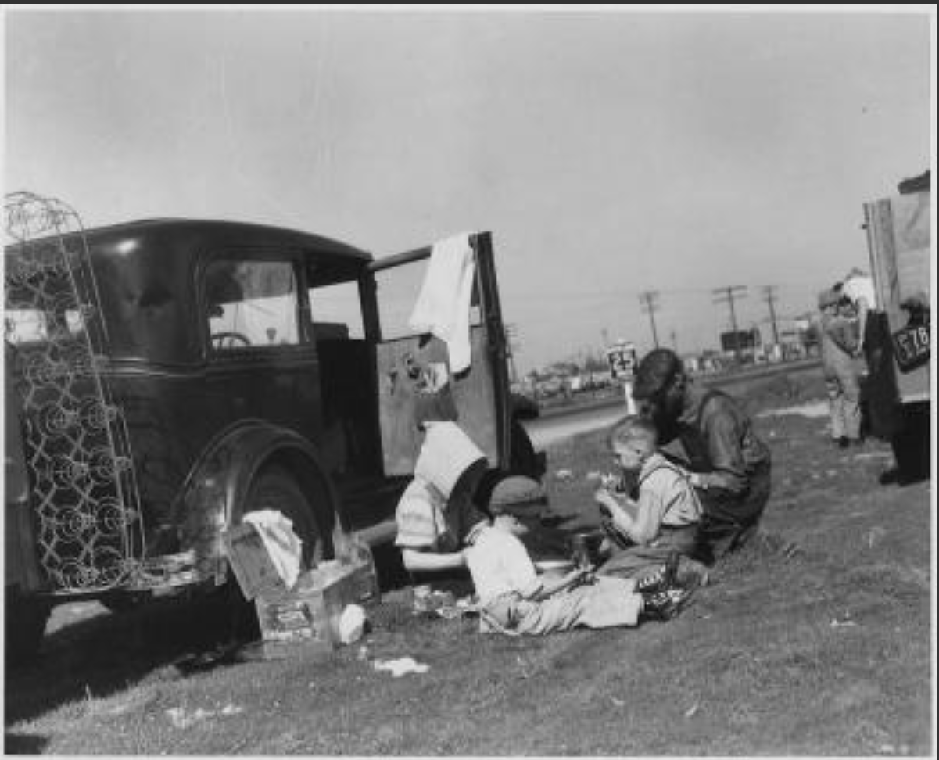
2
Migrants Eating Lunch (1935)
Notes:
Source: Franklin D. Roosevelt Presidential Library and Museum. (1935). Migrants [Image]. http://www.fdrlibrary.marist.edu/archives/collections/franklin/index.php?p=digitallibrary/digitalcontent&id=3508
The photograph is in the public domain.

Slide 7
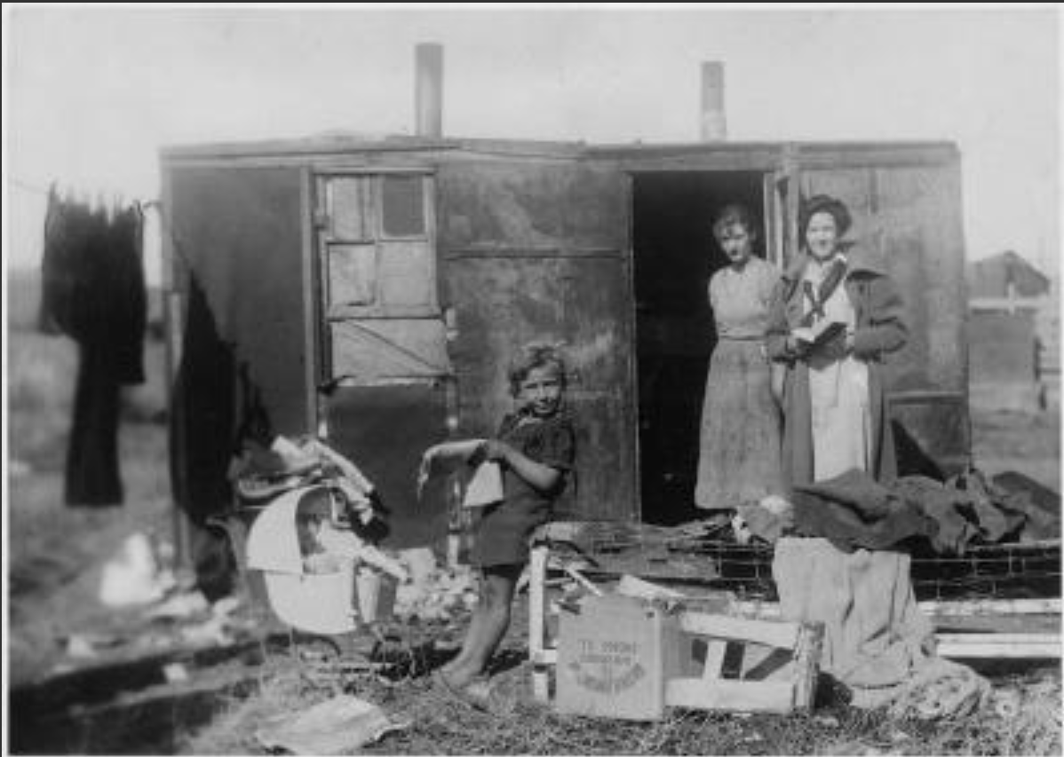
3
A Visit from the Public Health Nurse (no date), presumed early 1930s
Notes:
Source: National Archives. (n.d.). Social Security: Public Health nursing made available through child welfare services [Image]. Franklin D. Roosevelt Library Public Domain Photographs, 1882-1962. https://catalog.archives.gov/id/195887
This photograph is in the public domain.

Slide 8
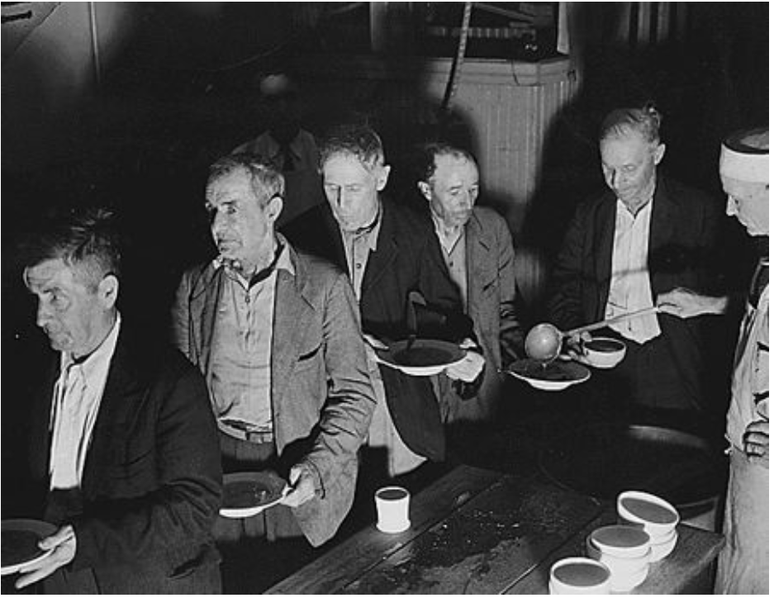
4
Soup Kitchen in Washington, DC (1936)
Notes:
Source: Franklin D. Roosevelt Presidential Library and Museum. (1936, June). Works Progress Administration. Washington, DC. Unemployed shown at Volunteers of America soup kitchen [Image]. http://www.fdrlibrary.marist.edu/archives/collections/franklin/index.php?p=digitallibrary/digitalcontent&id=3296
This photograph is in the public domain.

Slide 9
I Think | We Think
What do you observe? In this column, write down your observations of each Depression-era photo. 1. 2. 3. 4. | What do these pictures tell you about the Great Depression? With your group, write statements about what life may have been like during the era of the Great Depression.

Slide 10

CUS and Discuss
As you read your text:
CIRCLE important ideas.
UNDERLINE supporting details.
SUMMARIZE what you read in two or three sentences.
Be prepared to DISCUSS what you read.
Notes:
This Photo by Unknown Author is licensed under CC BY-SA

Slide 11
Inverted Pyramid Discussion
Partners
Find a partner who read the same text. Discuss your main ideas and summary of the reading.

Slide 12
Inverted Pyramid Discussion
Partners combine with another pair who read the same text. Share main ideas and summary of the reading.
Pairs Share
Partners

Slide 13
Inverted Pyramid Discussion
Form a group of five. Each group should have a representative who read a different text (1-5).
Summarize and share what you read with each other.
One to Five Groups
Pairs Share
Partners

Slide 14
Concept Map
Women in the Great Depression
American Society in the Great Depression
The Great Depression
Minorities in the Great Depression
The Great Migration West
The Intellectually & Physically Disabled

Slide 15
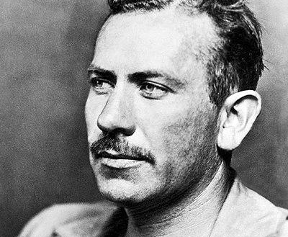
Of Mice and Men: Background & Setting
Background:
The novel was published in 1937.
Steinbeck wrote about the Great Depression as a young man.
Steinbeck lived in California.
Setting:
Lenny and George (main characters) are migrant ranch workers in California.
Lenny is intellectually disabled.
John Steinbeck in 1939
Notes:
Image source: McFadden Publications, Inc. (1939, November). Photograph of John Steinbeck. Wikimedia Commons. https://commons.wikimedia.org/wiki/File:John-Steinbeck-1939.jpg

Slide 16
Of Mice and Men: Predictions
Steinbeck wrote about what he knew—the Great Depression, migrant workers, and life in California.
What predictions can you make about what might happen in this story?
John Steinbeck in 1939
Notes:
Image source: McFadden Publications, Inc. (1939, November). Photograph of John Steinbeck. Wikimedia Commons. https://commons.wikimedia.org/wiki/File:John-Steinbeck-1939.jpg

Slide 17
Two-Minute Paper: Choose One Topic
What issues exist with poverty today? How do these issues compare with the poverty of the Great Depression?
How do women fare in the workplace today as compared to during the Great Depression?
What problems do immigrants and minorities face today? Is discrimination better, worse, or the same?
How has treatment of the intellectually and physically disabled changed over the decades? Does discrimination still exist for people with disabilities?

