Slide 1
The Bigger the Heart, the Bigger the Attraction
Science

Slide 2
Essential Question
How do physical properties influence gravitational interactions?

Slide 3
Learning Objective
Construct and present arguments using evidence to support the claim that gravitational interactions depend on the masses of interacting objects.

Slide 4
Bell Ringer: Love Letter to Earth
You want to ask someone out to the football game. You find your crush in the hall, the two of you lock eyes, and you say:
“Even if Earth didn’t have gravity, I’d still fall for you.”
On your paper, write down an explanation of why this statement is funny. Also, if you want, write down whether you think your crush will like it or not.

Slide 5
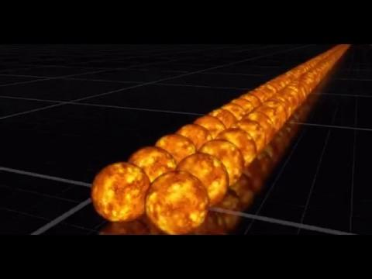
Mass: Black Hole vs. Sun
What is the message being presented here?
Context: Video is showing the number of suns that could fit into a black hole
Notes:
Video Source: Puiu, T. (2017, March 16). The mass of a supermassive black hole relative to the Sun explained in one crazy GIF. ZME Science. https://www.zmescience.com/space/supermassive-black-hole-vs-sun/

Slide 6
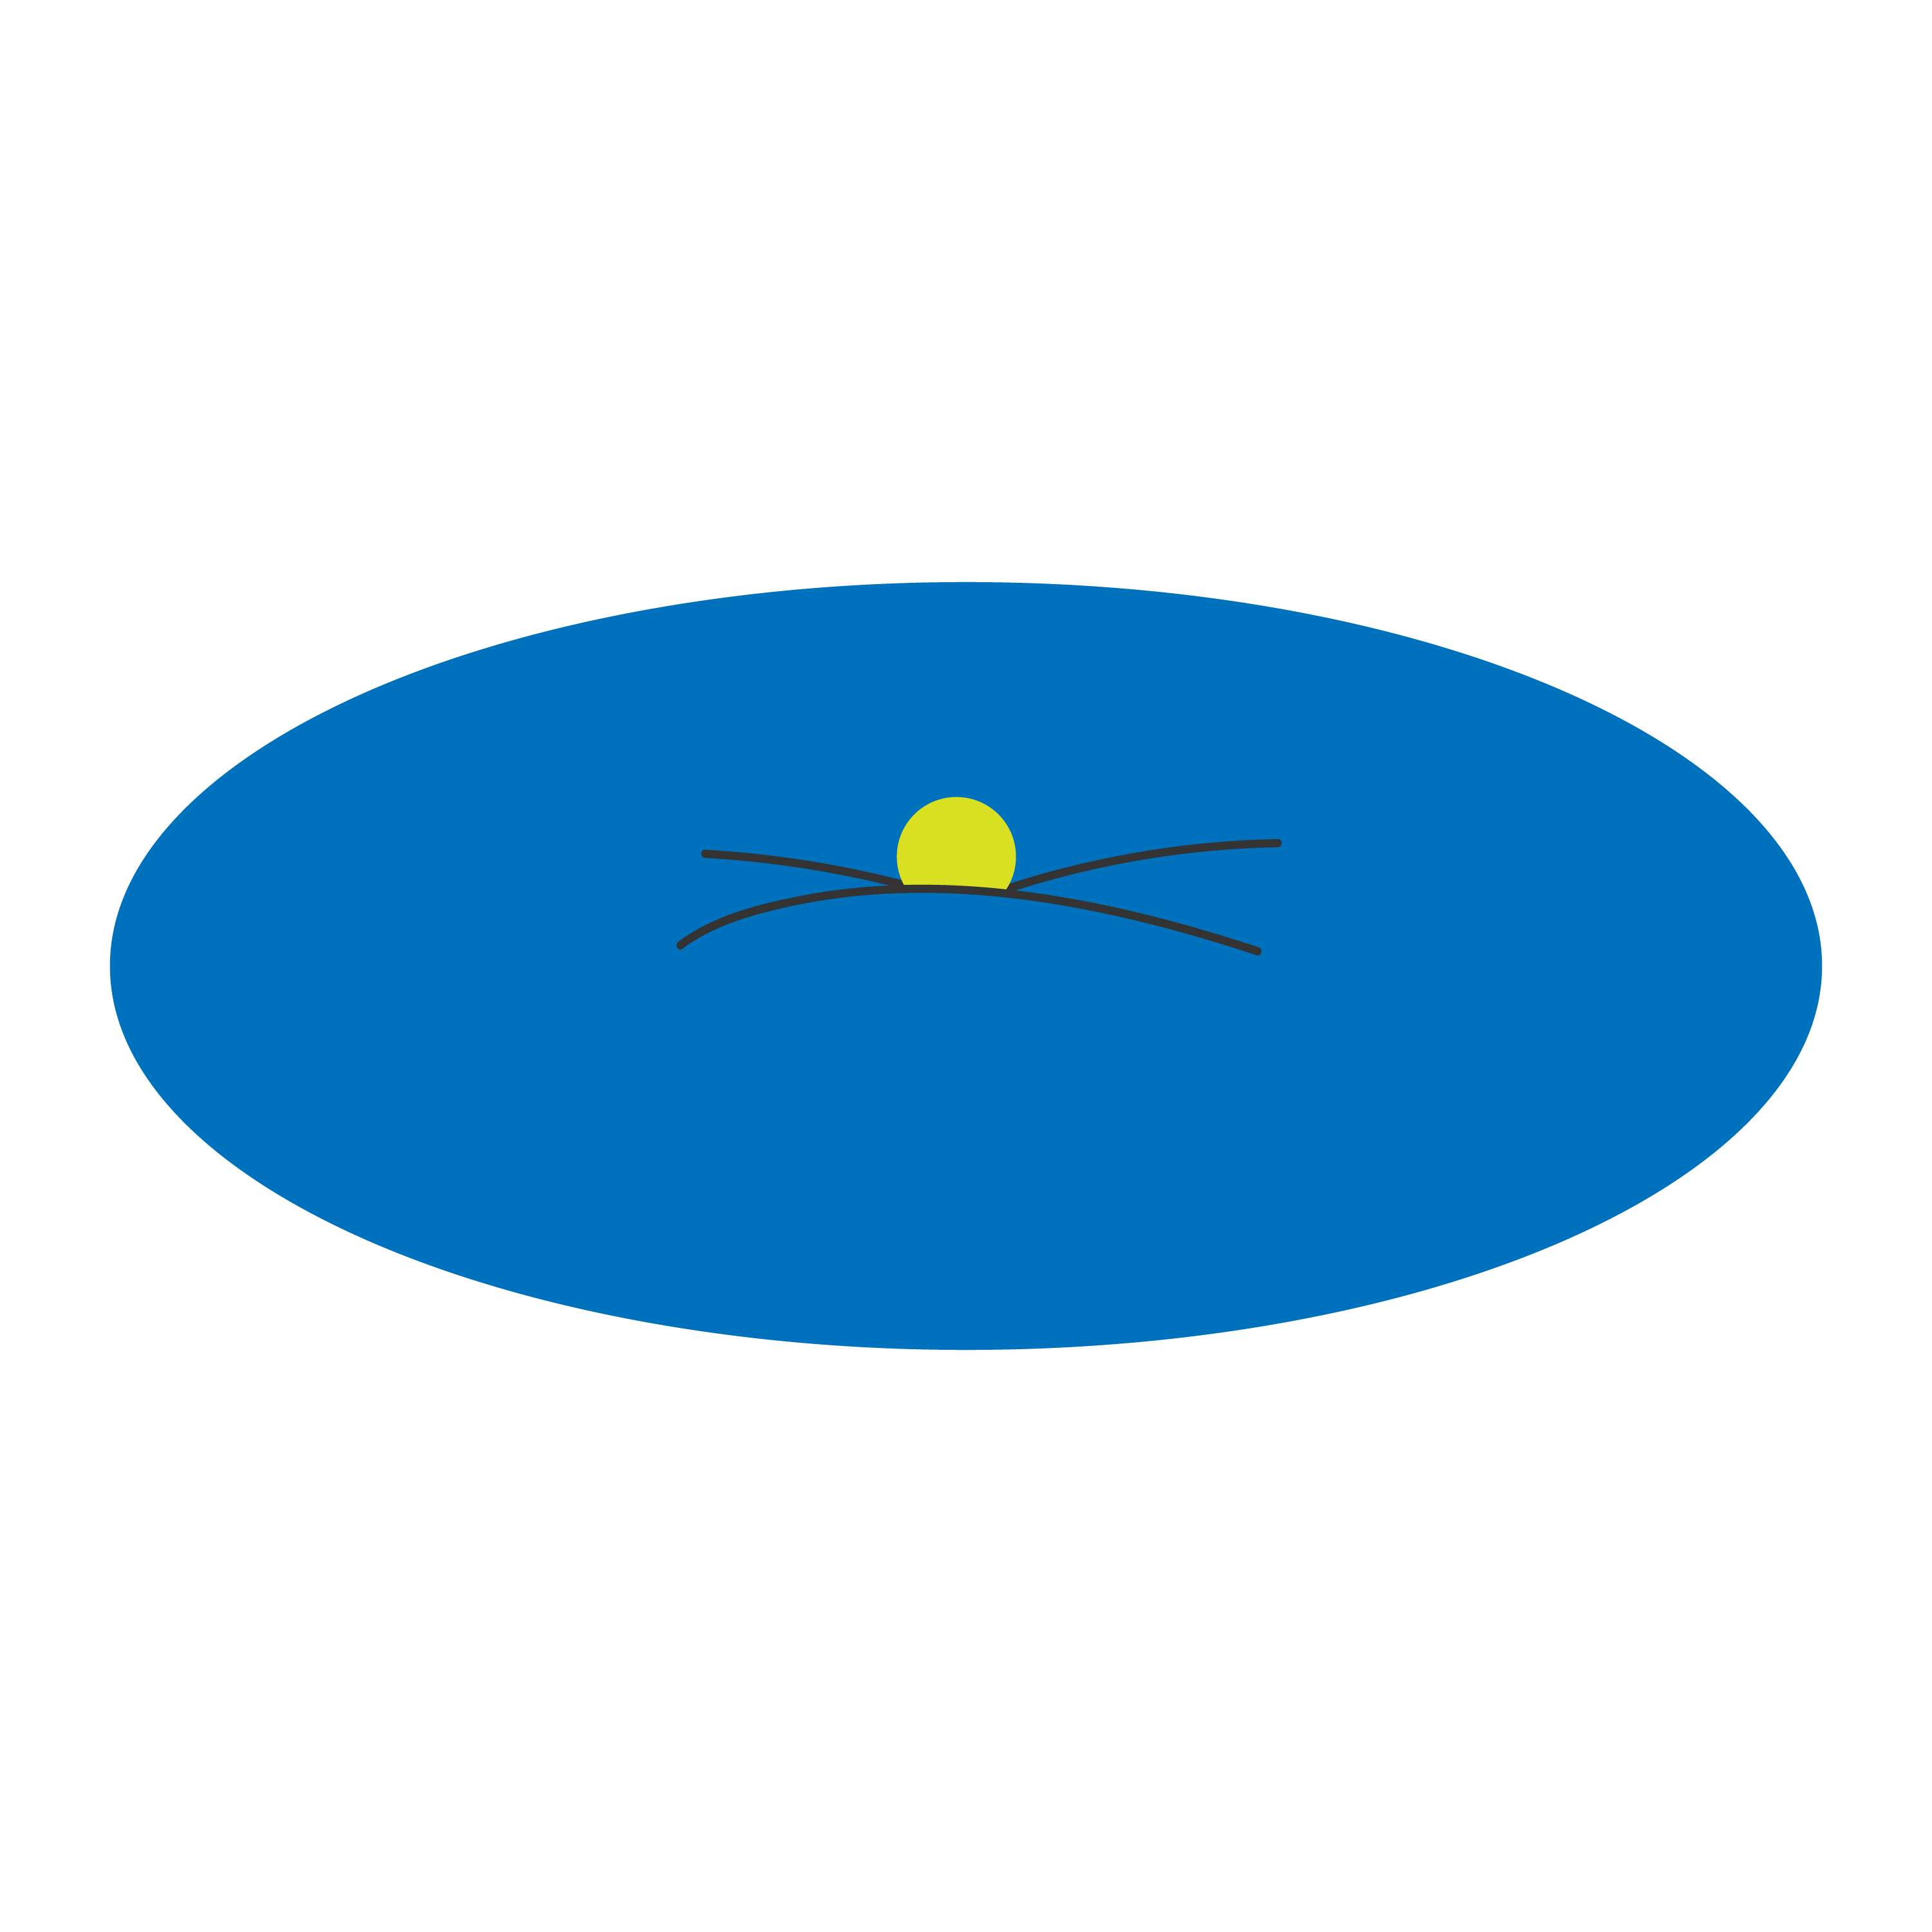
Gravity Bucket Lab
Follow the procedures outlined in the handout, and document all the observations you can.
Notes:
Image source: https://nightsky.jpl.nasa.gov/download-view.cfm?Doc_ID=317

Slide 7
Let’s Talk & Think it Out
How was gravity represented in this lab?
What factors influence the amount of gravity?
How do the answers in Stage 2, Question 2 influence the amount of gravity?
Why did we need the gravity bucket to model the system, rather than just using the original system?
How did this lab change the way you think about the solar system?

Slide 8
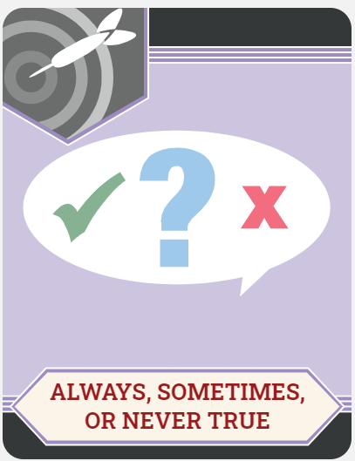
Always, Sometimes, or Never True
Determine whether each statement is:
Always True
Sometimes True
Never True
Some of the statements will be more difficult to assess right now. Try them all, but don’t get stuck on a statement. Move on if you’re not sure.

Slide 9
How the Planets Measure Up
Complete the handout comparing data of all the planets in our solar system.
Again, try not to feel discouraged, and talk it out with your group if you need to.
Revisit your Always, Sometimes, or Never True statements. Does your answer for any of them change? Are some easier to answer now?

Slide 10
Always, Sometimes, or Never True
The farther the ball dipped into the gravity bucket, the lower the gravitational pull it had.
Never True
The steel ball, which was heaviest, dipped lower.

Slide 11
Always, Sometimes, or Never True
When there was a heavy ball and a light ball in the gravity bucket, the light ball would roll in toward the heavy ball.
Sometimes True
Although the light ball would roll toward the heavy ball, sometimes they were too far apart to roll together and would not move.

Slide 12
Always, Sometimes, or Never True
Black holes have higher gravitational pull than the sun.
Always True
It was easier to get things to orbit the baseball than the steel ball.

Slide 13
Always, Sometimes, or Never True
Gravity is greater when objects are closer in distance to each other.
Always True
Things close together always rolled together.

Slide 14
Always, Sometimes, or Never True
The greater the volume of an object, the greater the gravitational pull.
Sometimes True
Gravity is related to mass. As we increase mass, we often increase volume proportionally.

Slide 15
Always, Sometimes, or Never True
The greater the mass of an object, the greater the gravitational pull.
Sometimes True
Everything rolled quickly toward the steel ball, but if the distance had been greater, this might not have been the case.

Slide 16
Always, Sometimes, or Never True
Distance influences the gravitational pull between two objects.
Always True
In the table, the closer the planet, the faster it orbited around the sun.

Slide 17
Always, Sometimes, or Never True
Mass influences the gravitational pull between two objects.
Always True
In the table, Jupiter had a lot of mass and a lot of gravity.

Slide 18
Mass: Black Hole vs. Sun Revisited
Notes:
Video Source: Puiu, T. (2017, March 16). The mass of a supermassive black hole relative to the Sun explained in one crazy GIF. ZME Science. https://www.zmescience.com/space/supermassive-black-hole-vs-sun/

Slide 19
C-E-R: Claim, Evidence, Reasoning
Based on what you have learned, what claim can you make about the gravitational pull of a black hole versus the sun?
What evidence do you have to support your claim?
What reasoning (supporting details or assurance) do you have to support your evidence and claim?

