Slide 2
The M.A.I.N. Cartoons of WWI
Understanding the Causes of World War I

Slide 3
Essential Questions
What were the causes of World War I?
Why were so many nations involved in World War I?

Slide 4
Lesson Objectives
Analyze the factors that led to the first world war.

Slide 5
Think and Respond
Think about the following question:
What causes a nation to go to or participate in a war?
Write a response on the sticky note and place on the board.

Slide 6
Card Sort - Causes of World War I
The card sort has four categories:
Militarism
Alliances
Imperialism
Nationalism
Choose which category pairs with each card. Once everyone is finished, we will share out.

Slide 7

Political Cartoon Analysis - T.A.C.O.S.
Time Period: Narrow down the time period and the region the cartoon takes place in.
Action: Describe what is happening in the cartoon.
Caption: If there is a caption, write it down.
Objects: List the different objects including any symbols shown or use of color.
Summary: Write one sentence that describes the meaning of the cartoon.

Slide 8
Anchor Chart Creation
Include the following information on your anchor chart:
The political cartoon analyzed in your group.
The country(ies) featured in the cartoon.
The overall meaning of the political cartoon.
The MAIN category that the cartoon fits into.
How this cartoon explains a cause of World War I
Anchor charts should use a variety of colors and include images.

Slide 9
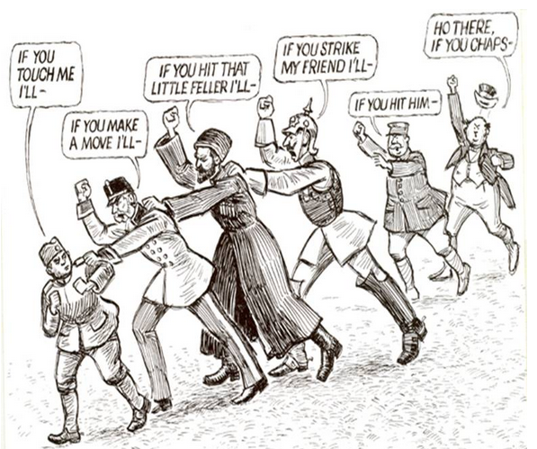
Notes:
Harding, N. (1912, December 4). Https://commons.wikimedia.org/wiki/File:Chain_of_Friendship_cartoon.jpg. https://commons.wikimedia.org/wiki/File:Chain_of_Friendship_cartoon.jpg

Slide 10
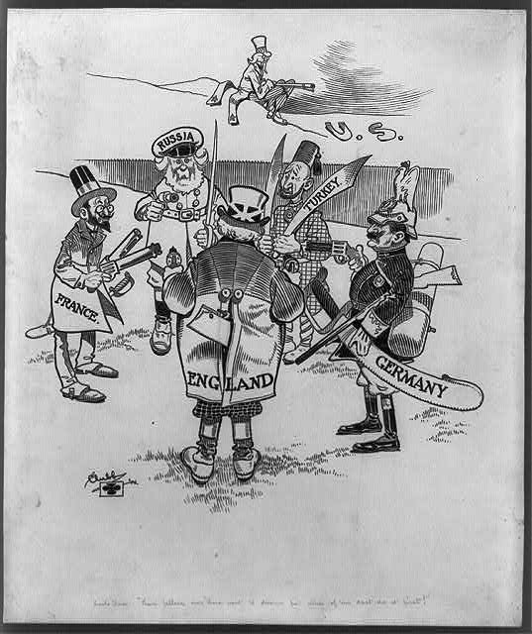
Notes:
Melina DrugaMost kids have an active imagination.My imagination has stayed strong into adulthood. (2021, April 08). The causes of World War ONE: Part 1 – political alliances. https://www.melinadruga.com/the-causes-of-world-war-one-part-1-alliances/

Slide 11
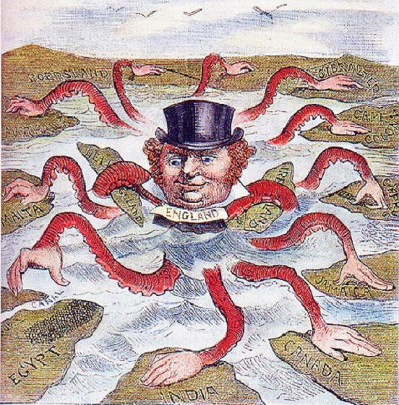
Notes:
WikiMedia Commons. (2019, June 7). https://commons.wikimedia.org/wiki/File:English_imperialism_octopus.jpg

Slide 12
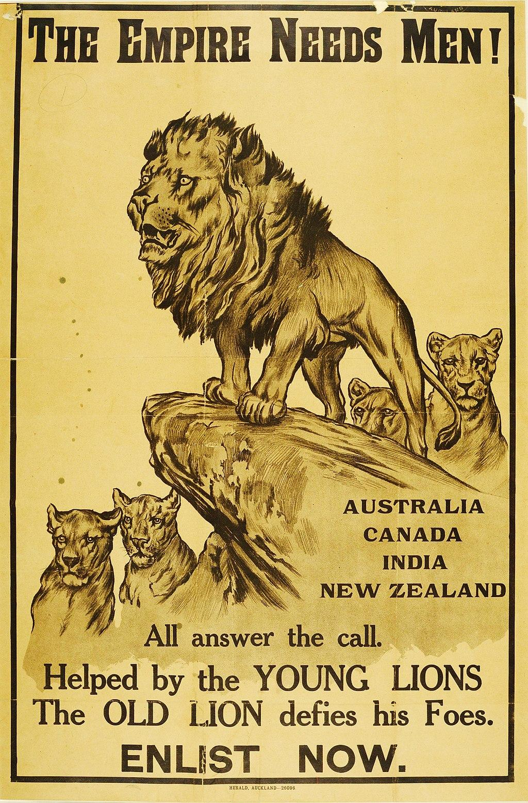
Notes:
Online collection. (n.d.). from https://collection.nam.ac.uk/detail.php?acc=2005-11-219-1

Slide 13
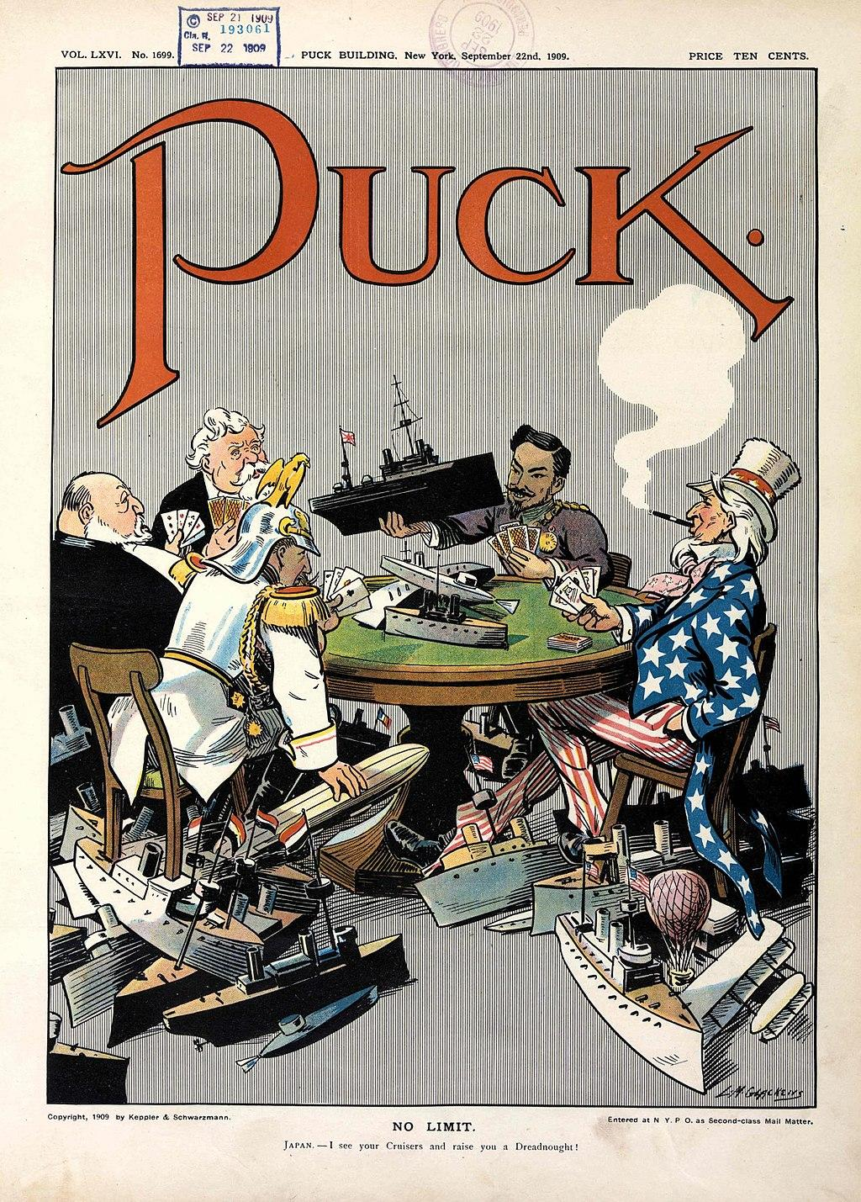
Notes:
Glackens, L. (1909, September 22). No limit. https://www.loc.gov/pictures/item/2011647506/

Slide 14
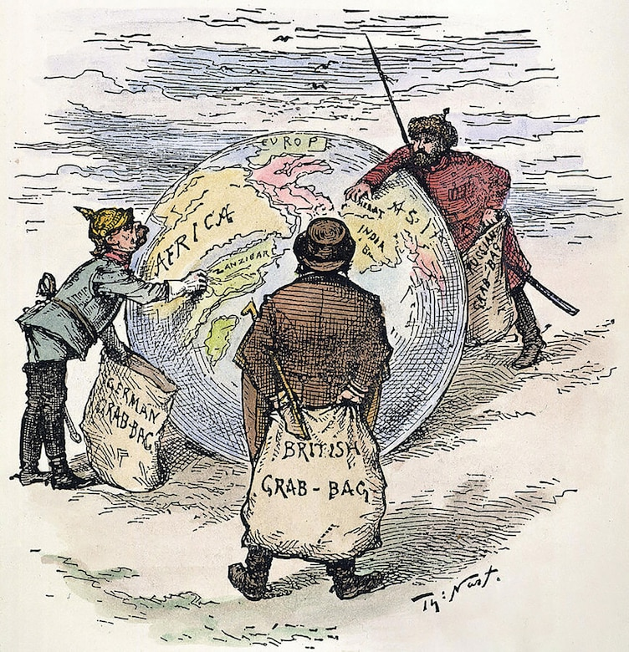
Notes:
Chapter 2: Past eras of great Power Competition: Historical insights and implications. (2020, November 04). https://www.whs.mil/News/News-Display/Article/2405315/chapter-2-past-eras-of-great-power-competition-historical-insights-and-implicat/

Slide 15
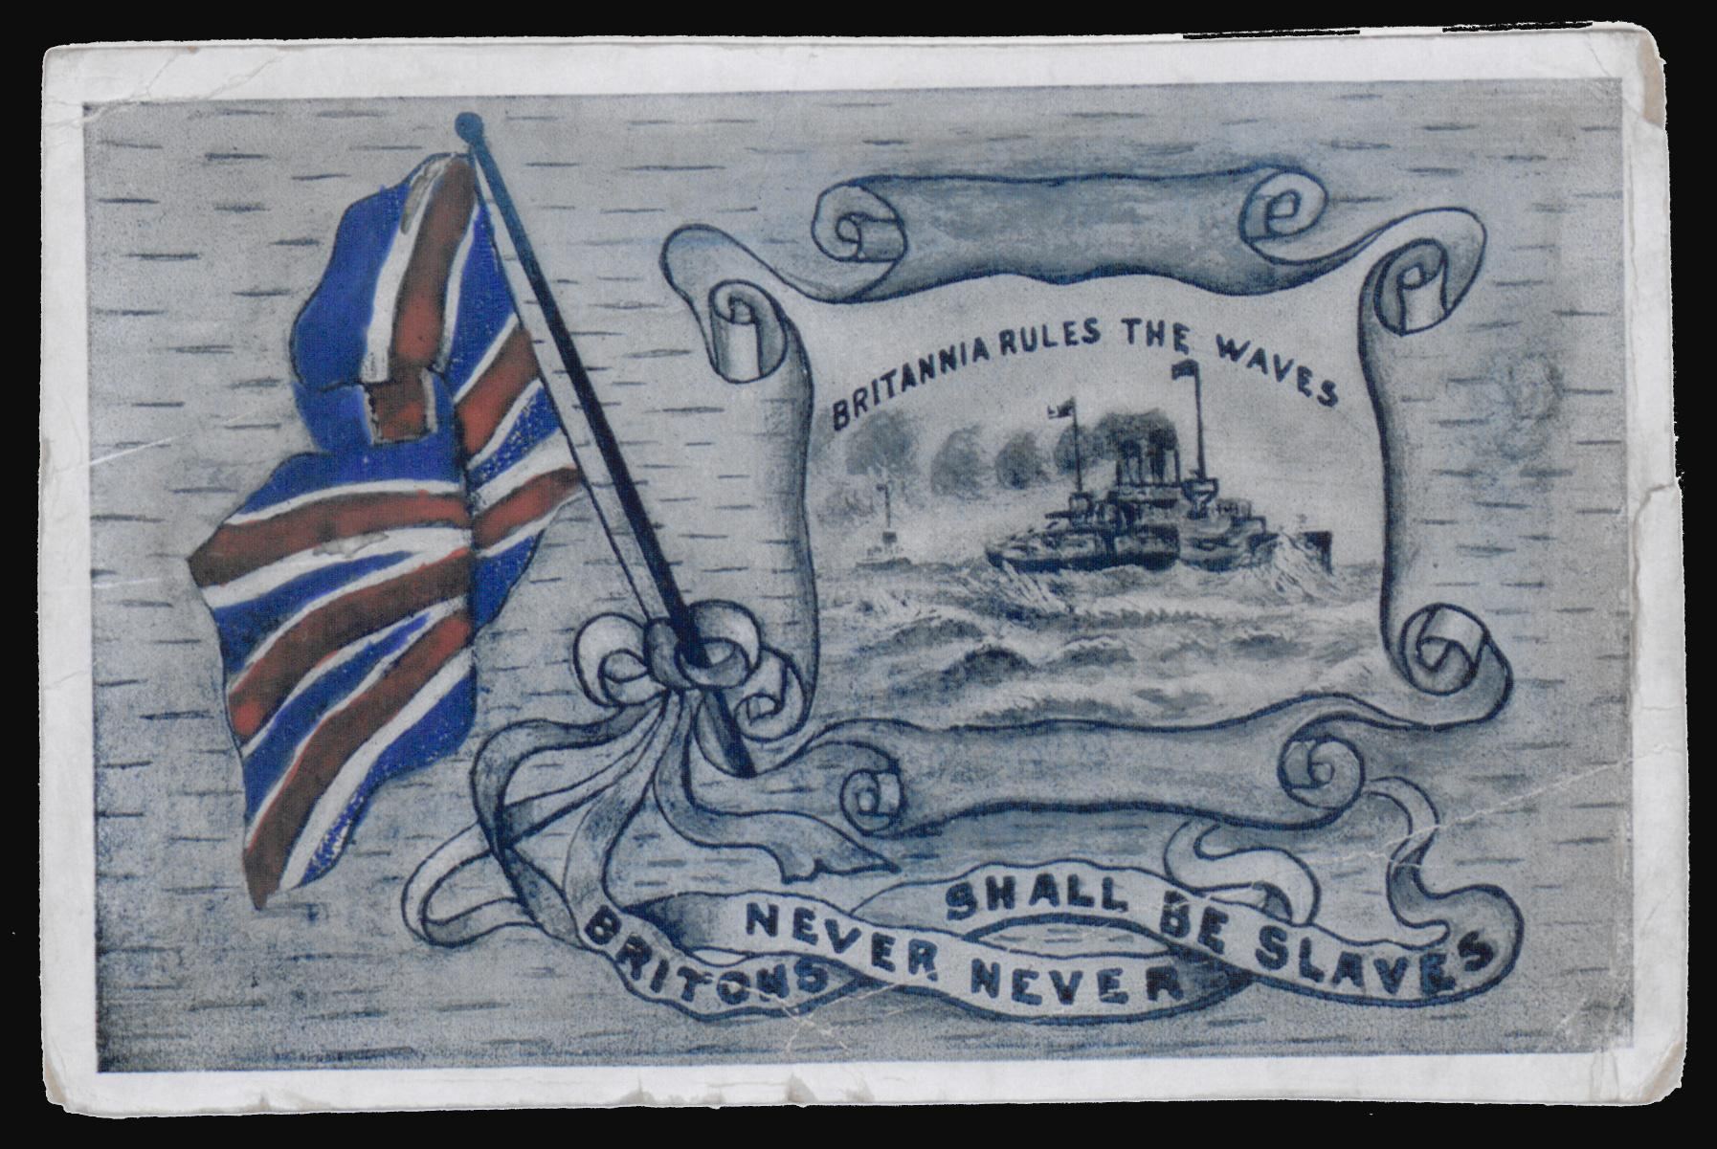
Notes:
Britannia rules the waves. (2013, November 13). https://www.bl.uk/collection-items/britannia-rules-the-waves

