Slide 2
People Here, People There, People, People Everywhere
Tokyo and Population Density

Slide 3
Objective
Essential Questions
By the end of this lesson, students will understand the population density of the Greater Tokyo Area and how city planning helps accommodate large populations of people within an area.
Can too many people live in one area?
How does city planning help accommodate large amounts of people living in one area?

Slide 4

Notes:
Source: Lu, Hanson. (17 May 2019.). People. Unsplash. [Photo Image]. https://unsplash.com/photos/WrNbw7UeNqI

Slide 5
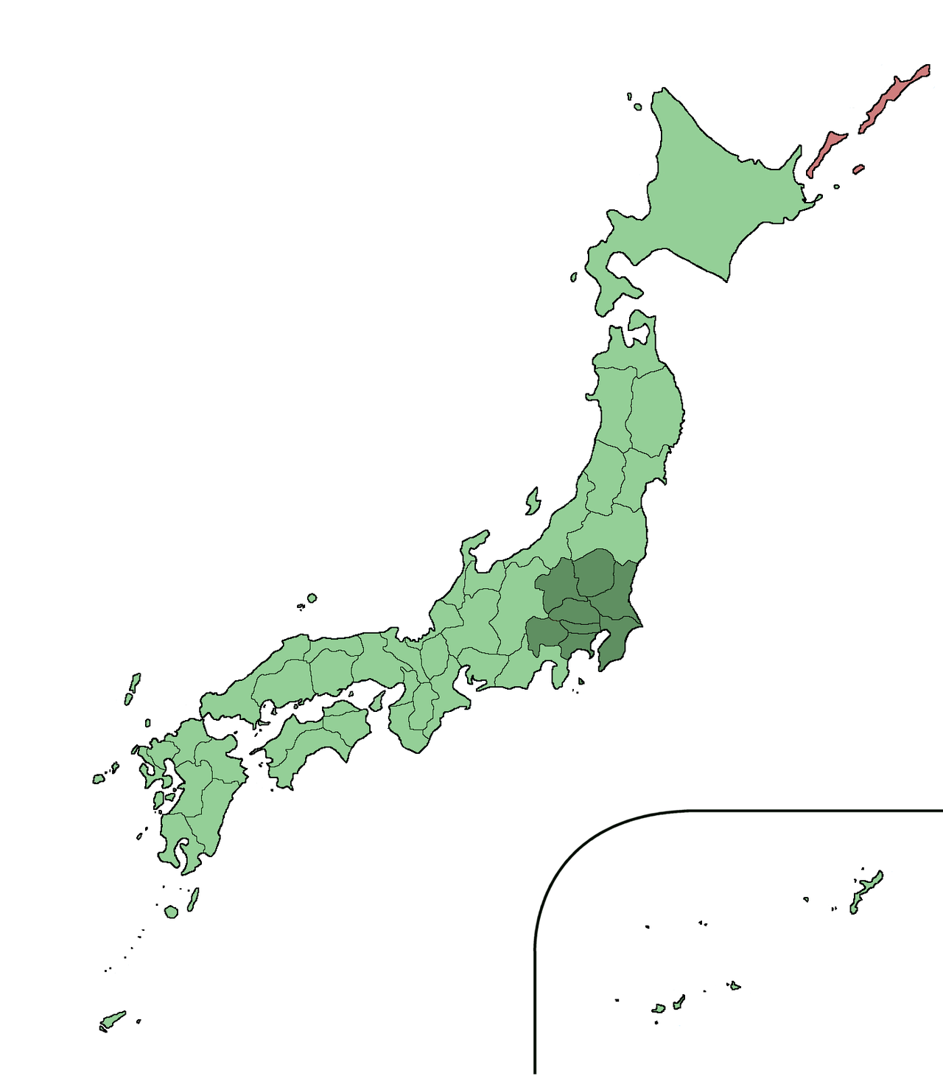
Population Facts
Total population of Japan: 126.8 million
Tokyo Metropolis: 13 million
Greater Tokyo Area: 38 million within 5,200 square miles
Population density: 7,307 per sq. mile
Notes:
Have a class discussion about how small the island of Japan is, and reveal Japan’s total population (126.8 million). Point out the Greater Tokyo Area (shaded in dark green), which surrounds Tokyo Bay. Tell students that 38 million people live in this area (including the surrounding suburbs). Tell the students that they are going to look at some additional graphics and maps to get a better understanding of the population density there.
Image Source:
Qrsk075. (2011, June 18). Location of Greater Tokyo Area. [Photo Image]. Wikimedia Commons. https://commons.wikimedia.org/wiki/File:Greater_Tokyo_Area.png

Slide 6
Pictures of Tokyo
Picture 1
Picture 2
Picture 3
Notes:
For picture 2, make sure to zoom in as much as you can on the actual sleeping capsule picture instead of the entire article.
Picture 1:
Chris 73. (2007). Rush hour at Ueno station in Tokyo, 2007. [Photo Image]. Wikipedia. https://en.wikipedia.org/wiki/Passenger_pusher#/media/File:Rush_hour_at_Ueno_02.JPG
Picture 2:
Crowe, R. (2018). 10 unique capsule hotels in Tokyo that are worth staying at. [Photo Image]. The Travel. https://www.thetravel.com/10-unique-capsule-hotels-in-tokyo-that-are-worth-staying-at/1/
Picture 3:
Carlson, L. V. (2006, July 2). Shibuya Station Crossing. [Photo Image] Wikimedia Commons. https://upload.wikimedia.org/wikipedia/commons/0/09/Shibuya_Station_Crossing.JPG

Slide 7
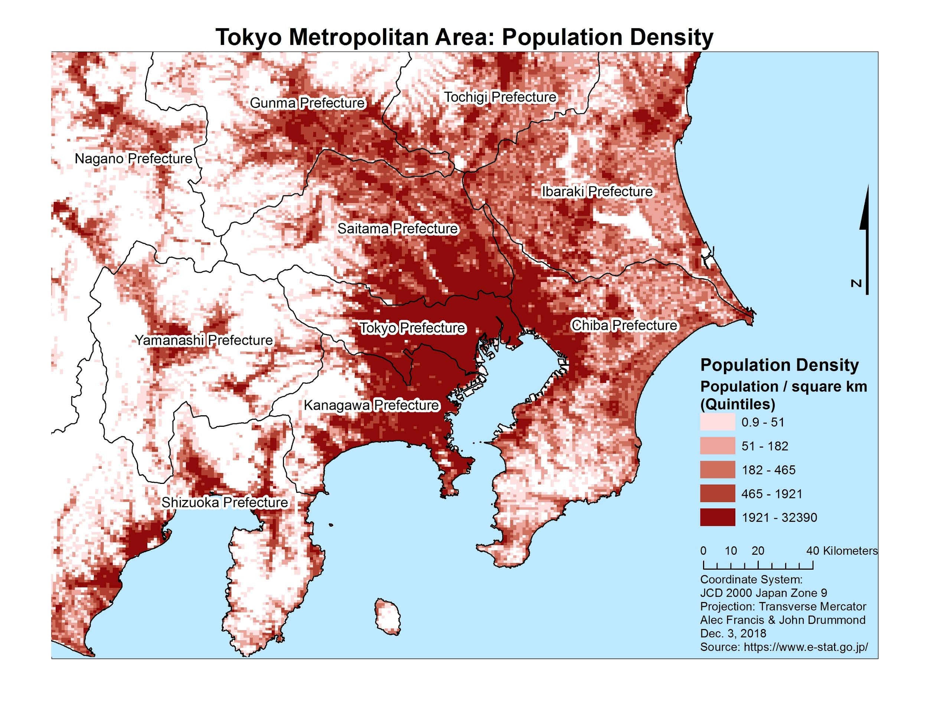
Notes:
Francis, A. & Drummond, J. (2018, December 3). Mapping social vulnerability in the Tokyo metropolitan area. [Photo Image]. The University of British Columbia. https://blogs.ubc.ca/socialvulnerabilitytokyo/analysis/

Slide 8
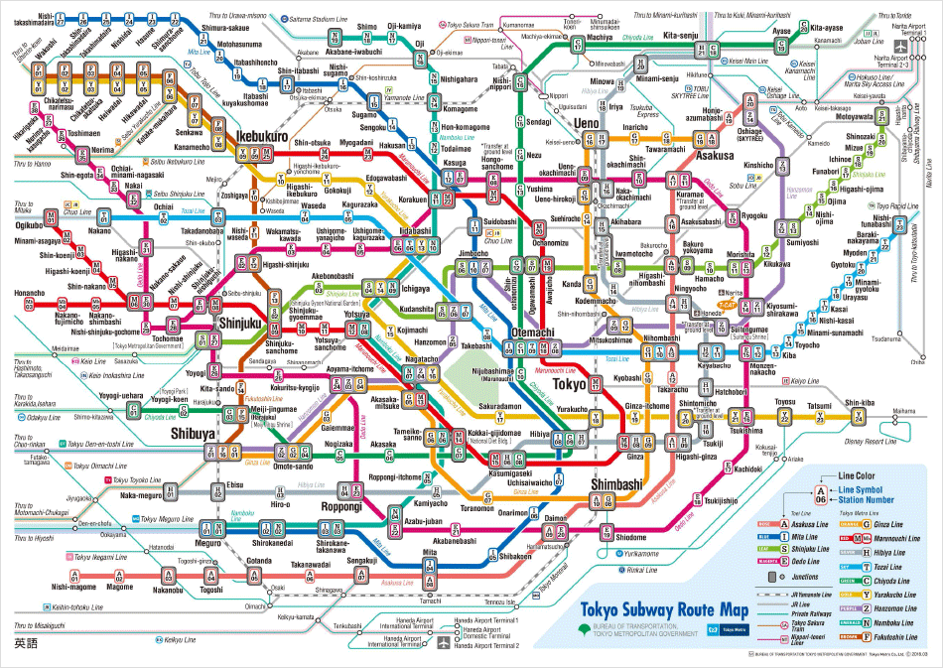
Notes:
Tokyo Metro. (n.d.). Tokyo subway route map. [Photo Image]. https://www.tokyometro.jp/en/subwaymap/

Slide 9
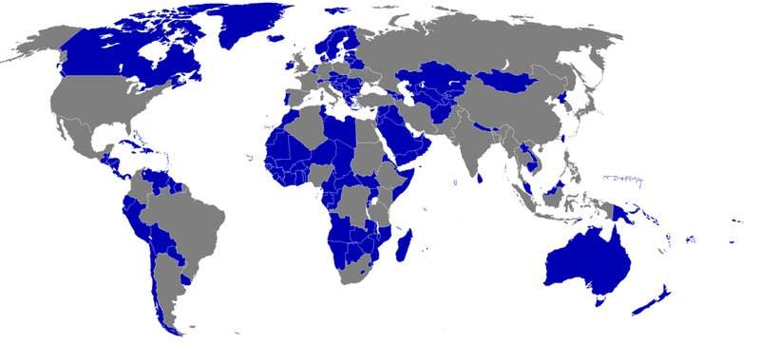
Countries with Smaller Populations than Tokyo Prefecture:
Notes:
Make sure to point out to students that this map was made in 2016 with the most current data regarding the Greater Tokyo Area and the current populations of the world at that time. Since then, the populations of Iraq and Uganda have both surpassed that of the Greater Tokyo Area, but not by much.
Crerar, S. (2016, January 17). 16 maps of Tokyo that'll make your city seem insignificant. [Photo Image]. BuzzFeed. https://www.buzzfeed.com/simoncrerar/tokyo-is-a-mega-city

Slide 10
Window Notes Conclusions
With your partner, fill out the lower left-hand box, writing down conclusions and statements about the Tokyo Prefecture. Specifically:
What do you now know about Tokyo’s dense population?
How do Tokyo officials deal with population issues?

Slide 11
More Information on Tokyo
As you read, keep in mind this question: “How does Tokyo plan or prepare for dense population-related issues?”
After you finish reading, jot down answers you found from the reading in the lower right-hand box.

Slide 12
City Planning
As you watch the video, jot down notes in the left-hand box that could help you answer the following questions:
What does a city planner do? What is their daily work?
How does city planning help manage large populations of people?
What other aspects go into city planning?
Share your answers with your partner.

Slide 13

Interview with Jane Hudson: City Planner
K20 Center. (2020, May 26). ICAP - People here, people there, people everywhere. [Video]. YouTube. https://youtu.be/neRA3yz7bwQ
Notes:
K20 Center. (2020, May 26). ICAP - People here, people there, people everywhere. [Video]. YouTube. https://youtu.be/neRA3yz7bwQ

Slide 14
Summarizing Your Thoughts
With your partner, answer the essential questions in the right-hand box:
“Can too many people live in one area?”
“If so, in what ways can they work and live together comfortably?”

