Slide 2
Where in the World?
Introduction to Latitude and Longitude
Map Study Lesson #1

Slide 3
Essential Questions
Why is understanding maps and globes important?
How can longitude and latitude help me know where I live?

Slide 4
Lesson Objectives
Describe the purpose and features of maps and globes.
Make connections between locating specific places on a map and the lines of latitude and longitude.

Slide 5
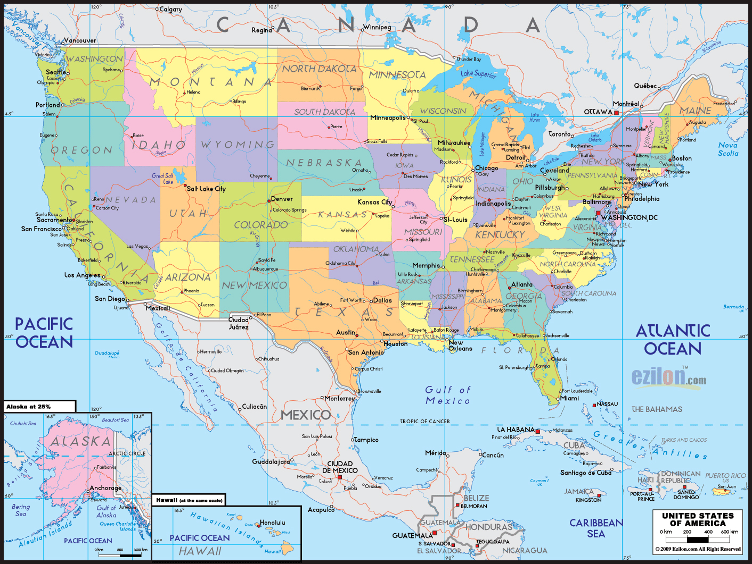
Maps and Globes
Notes:
Image sources:
N.a. (June 2017). Large political and administrative map of the United States with roads and major cities. Mapsland. https://www.mapsland.com/north-america/usa/large-political-and-administrative-map-of-the-united%20states-with-roads-and-major-cities
Zimmerman, P. (February 2020). Photo of globe on wooden table. Pexels. https://www.pexels.com/photo/photo-of-globe-on-wooden-table-3747527/

Slide 6
Explain
Look at the map. What do you know about maps and globes?
Write it on your sticky note.
Share with your partner.

Slide 7
Add to the Know column!
KWL Chart
K What I Already Know | W What I Want to Know | L What I Have Learned

Slide 8
Add to the Want to Know column!
KWL Chart
K What I Already Know | W What I Want to Know | L What I Have Learned

Slide 9
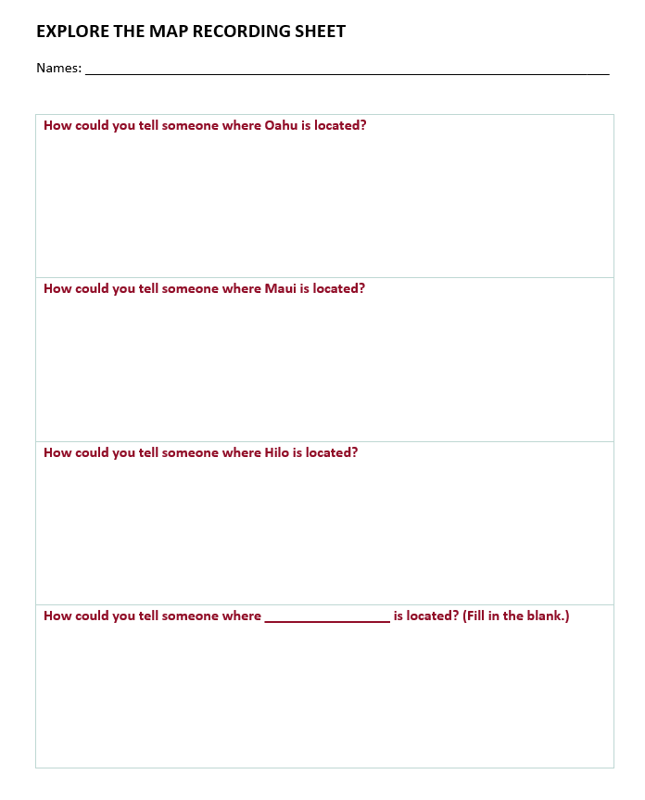
Explore the Map
Explore
Notes:
Map is in the attachments

Slide 10
Watch one of the following videos. Pause to discuss. Draw and label a globe or map.
Explain
Dr. Nagler's Laboratory: Longitude and Latitude
Andy Jensen's: Latitude and Longitude
Notes:
Consider using a BrainPOP video about latitude and longitude if you have a subscription to BrainPOP.

Slide 11
Focus Vocabulary
Globe
Map
Locate
Equator
North Pole
South Pole
Latitude Lines
Longitude Lines
Imaginary

Slide 12
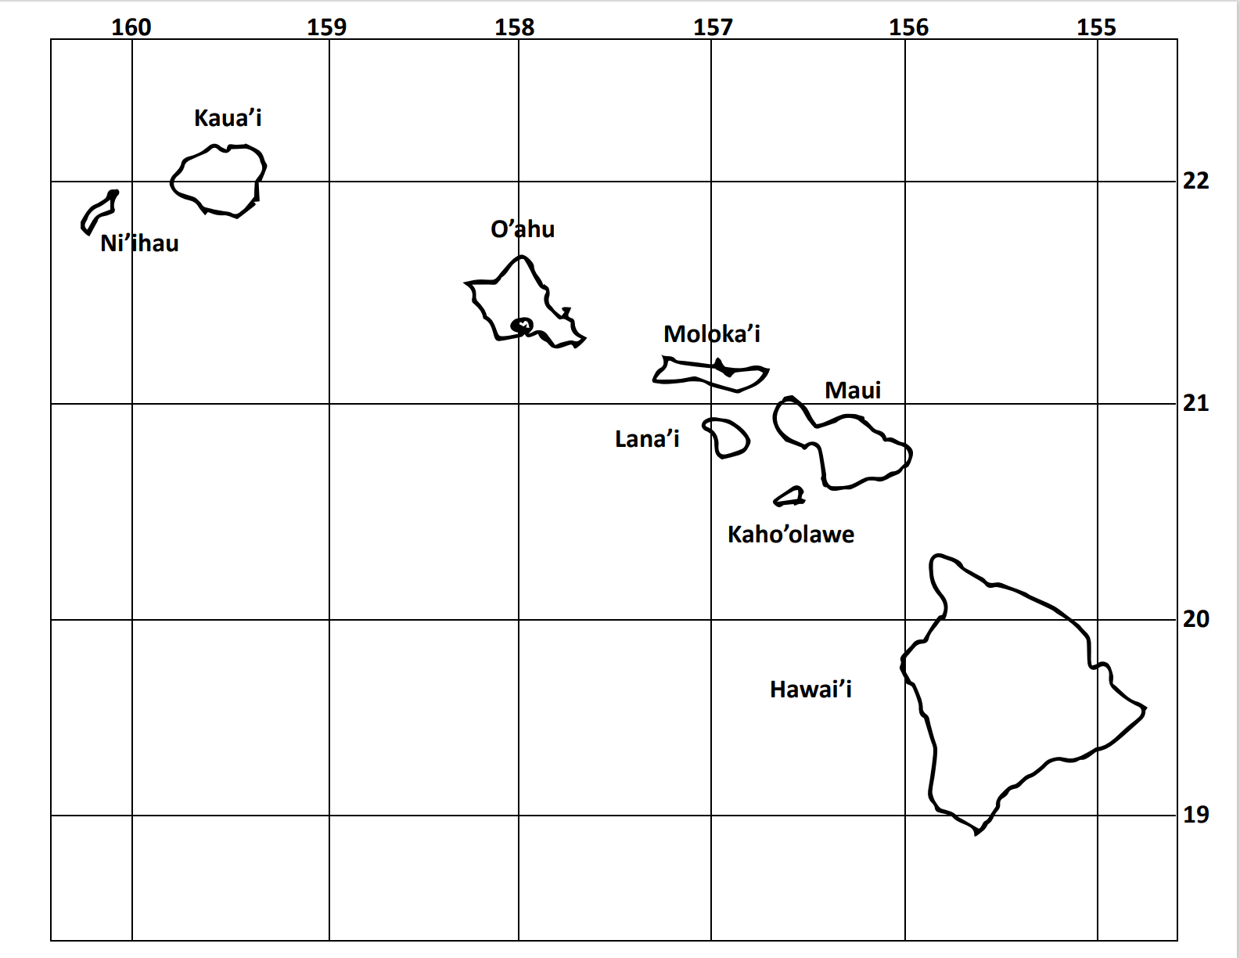
Let’s work together!

Slide 13
Revisit the Essential Questions:
Why is understanding maps and globes important?
How can longitude and latitude help me know where I live?

Slide 14
Add to the What I Have Learned column!
KWL Chart
K What I Already Know | W What I Want to Know | L What I Have Learned
Notes:
This Photo by Unknown Author is licensed under CC BY-SA-NC

Slide 15
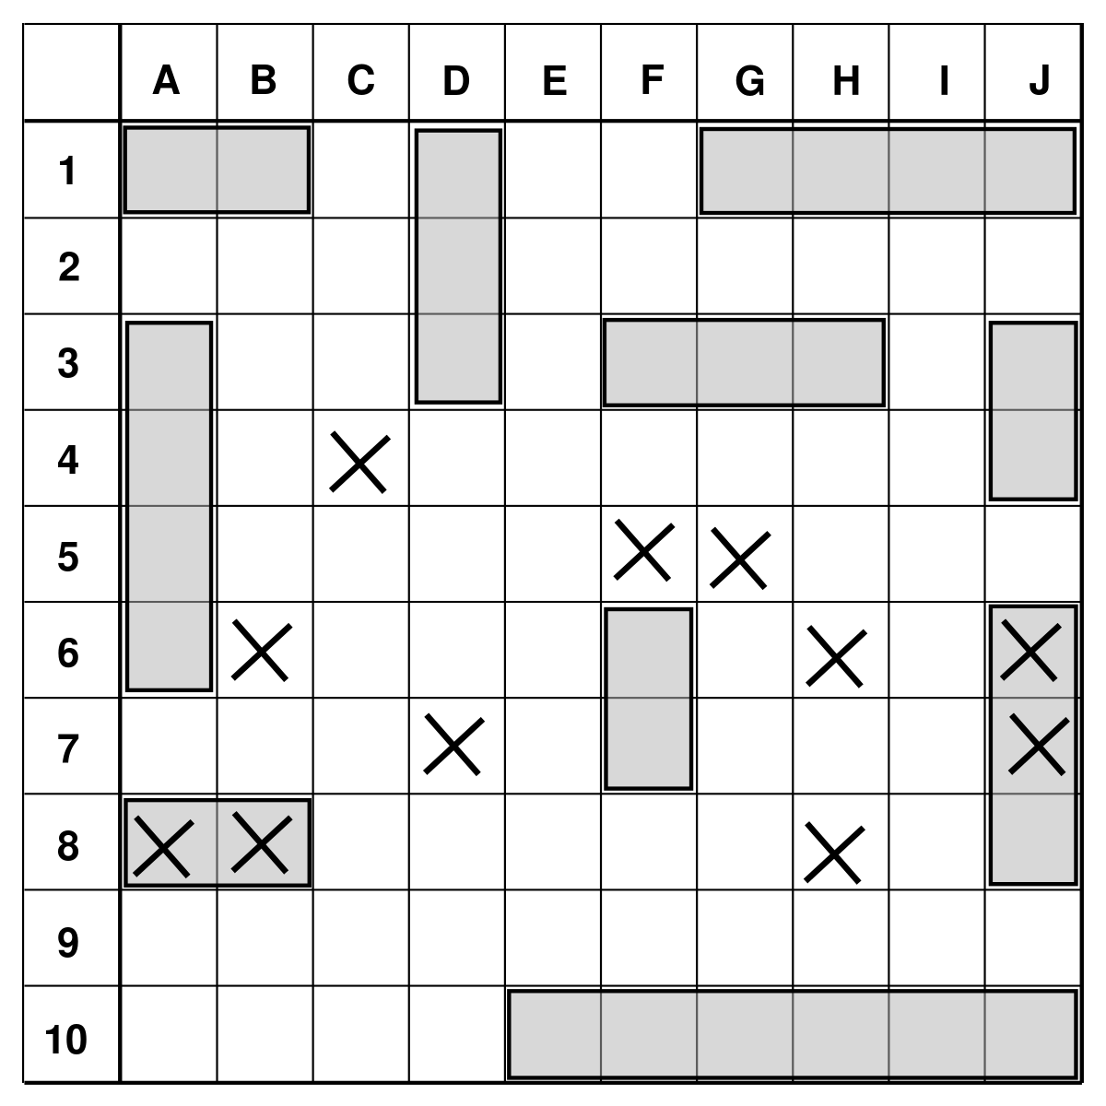
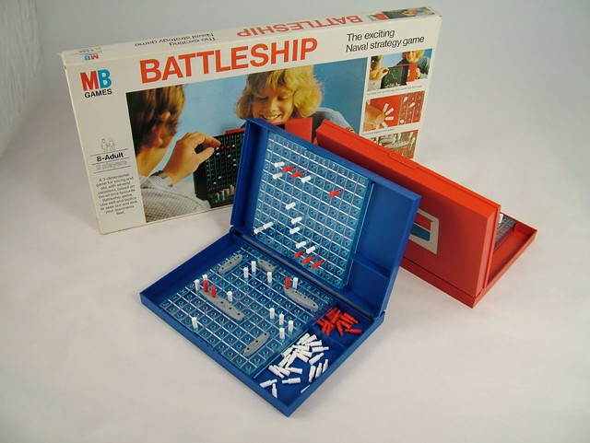
Time to Play Battleship
Extend
While playing Battleship, think about how the game is like finding places on the globe or map.
Try using the words longitude and latitude to find your partner’s battleships.
Notes:
This Photo by Unknown Author is licensed under CC BY-SA-NC
This Photo by Unknown Author is licensed under CC BY-SA

Slide 16
Show what you have learned!
Show what you know about maps and globes.
Show what you know about how to locate places.
You may write, draw, label, and color to show what you KNOW!
Don’t forget to put your name on your work.

