Slide 2
Where in the World Can I Find Mountains, Beaches, Cities, and More?
Geographic Features Around the World
Map Study Lesson #3

Slide 3
Essential Questions
What makes places unique and different?
Why is having an understanding of maps, globes, resources, and geographic features important?

Slide 4
Lesson Objectives
Identify and locate basic landforms, bodies of water, continents, and oceans on a map;
Describe a variety of the earth’s natural resources and ways in which people use them;
Use Google Earth to locate landforms, bodies of water, continents and oceans, and specific geographic features

Slide 5
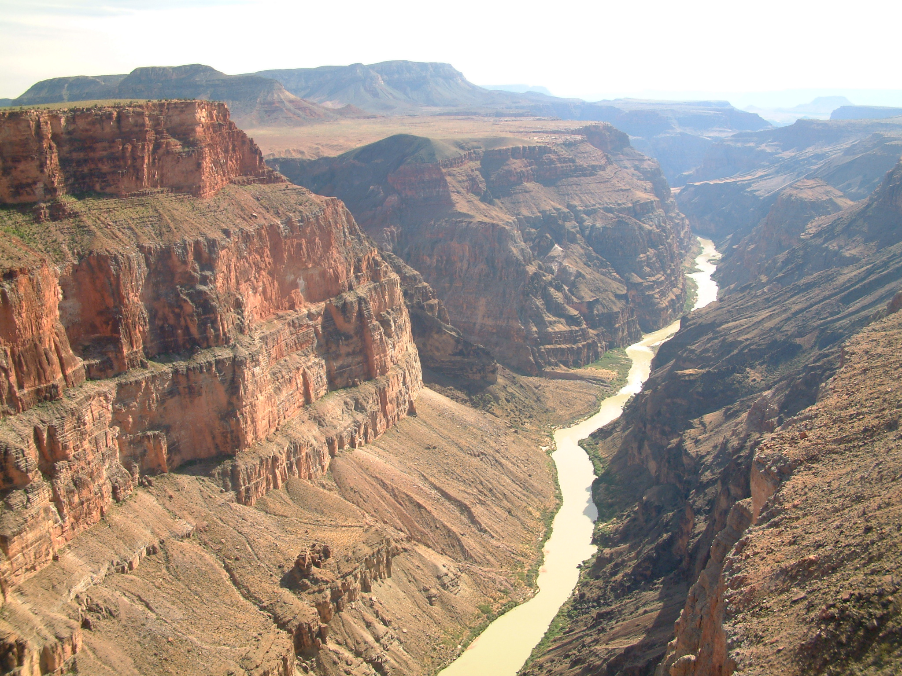
Photo Slides of Geographic Features
Print slides 5-15 to use in the Explain part of the lesson to make the chart.
Chart Example:
With possible student responses
Photos in this column | What features did you see? What are the characteristics of this feature? What is the nae of the feature?
Grand Canyon | big rocks, water, grass on the hills, layers on the rocks, flat at the top, steep sides The features are a canyon, river, and valley. The canyon has deep walls and a valley. It has a river running through it.

Slide 6
Grand Canyon National Park
Notes:
This Photo by Unknown Author is licensed under CC BY-SA
Wikimedia. (n.d.). Grand Canyon National Park. [Digital image]. https://upload.wikimedia.org/wikipedia/commons/0/04/-conservationlands15_Social_Media_Takeover%2C_Feb_15th%2C_BLM_Winter_Bucket_List%2C_Grand_Canyon-Parashant_National_Monument_in_Arizona_for_Its_Dark_Sky_Park_Status_(16353386300).jpg

Slide 7
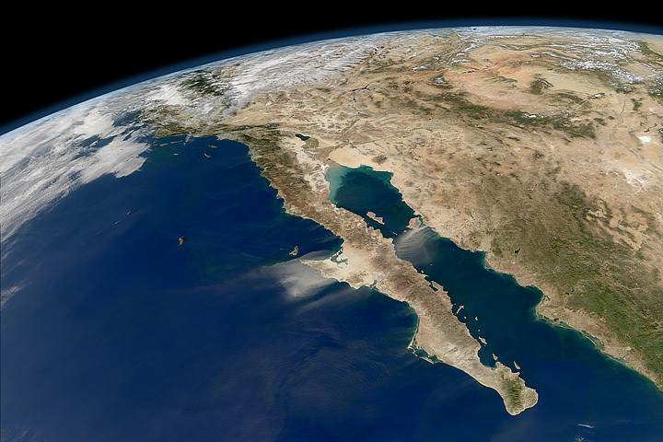
Baja California Peninsula
Notes:
Flickr.com. (n.d.). Baja California Peninsula. [Aerial Photo]. https://live.staticflickr.com/7155/6660030421_4d5cb5cd2f_b.jpg

Slide 8
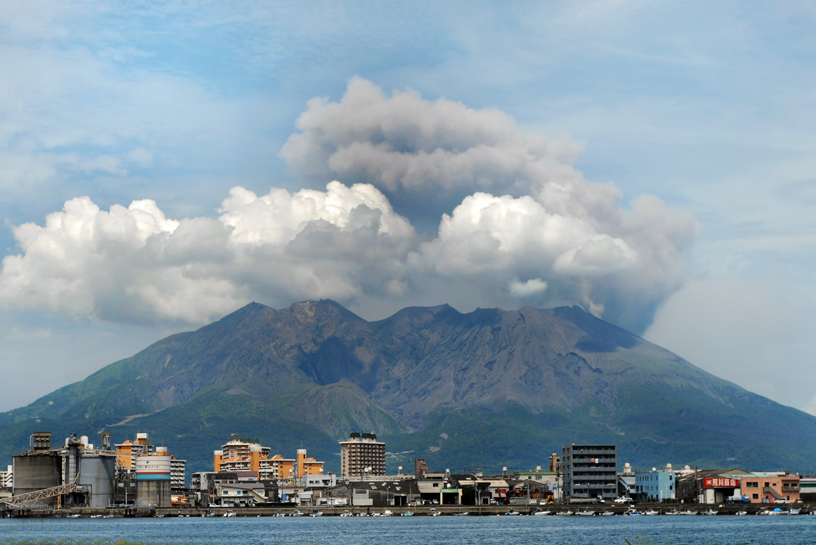
Sakurajima, Japan
Notes:
Wikimedia. (n.d.). Sakurajima, Japan. [Digital image]. https://upload.wikimedia.org/wikipedia/commons/0/02/Kagoshima_cityscape_against_the_background_of_Sakurajima_volcano._Japan%2C_East_Asia.jpg

Slide 9
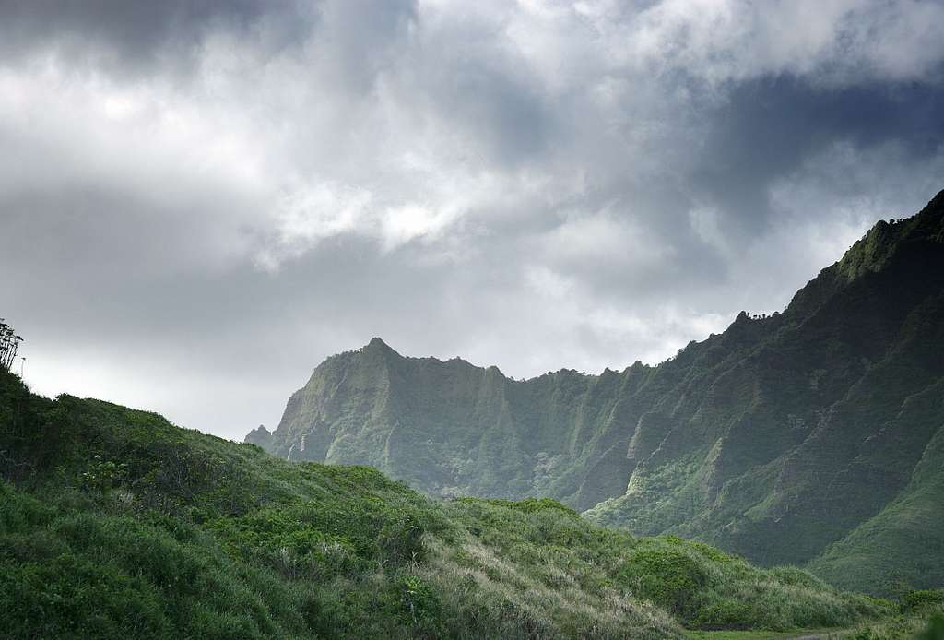
Wood Valley, Hawaii
Notes:
Picryl.com (n.d.) Wood Valley, Hawaii. [Digital image]. https://cdn4.picryl.com/photo/2019/09/23/storm-in-the-mountains-hawaii-fae0dd-1024.jpg

Slide 10
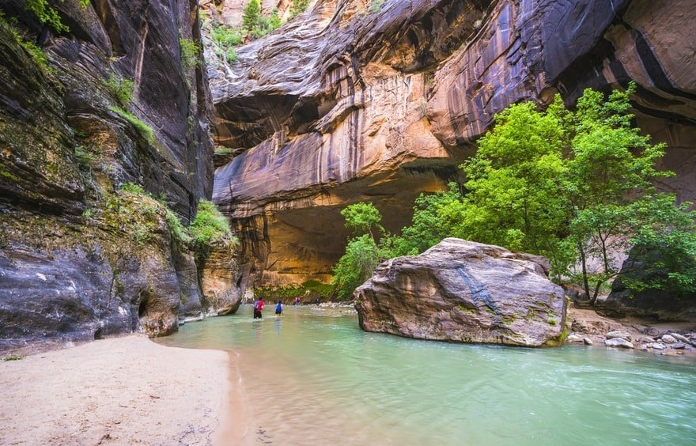
The Narrows, Utah
Notes:
Travel in USA. (n.d.). The Narrows, Utah. [Digital image]. https://www.travelinusa.us/wp-content/uploads/sites/3/2019/12/shutterstock_474048757.jpg

Slide 11
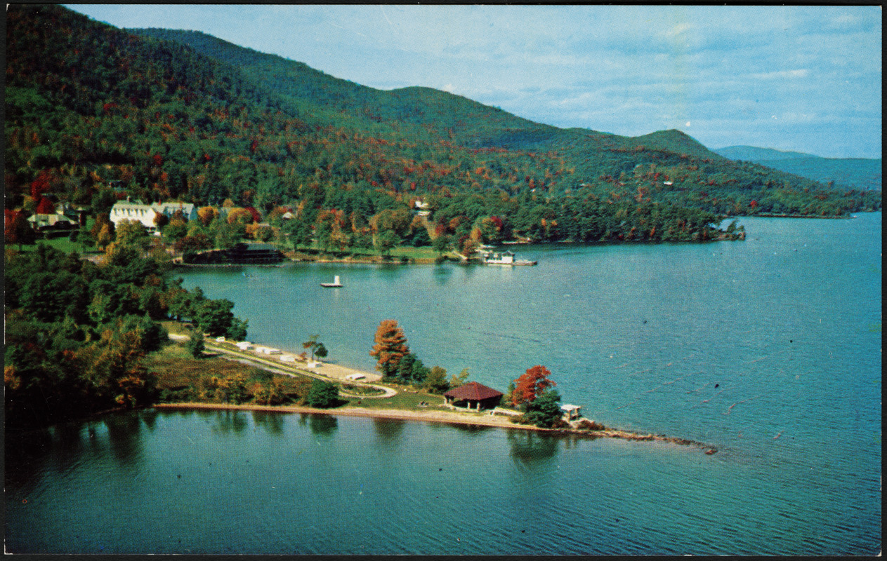
Lake George, New York
Notes:
This Photo by Unknown Author is licensed under CC BY-SA-NC
Digital Commonwealth. (n.d.). Lake George, New York. [Postcard/Digital image]. Cliff Smith YMCA Postcard Collection. https://ark.digitalcommonwealth.org/ark:/50959/vm416w818

Slide 12
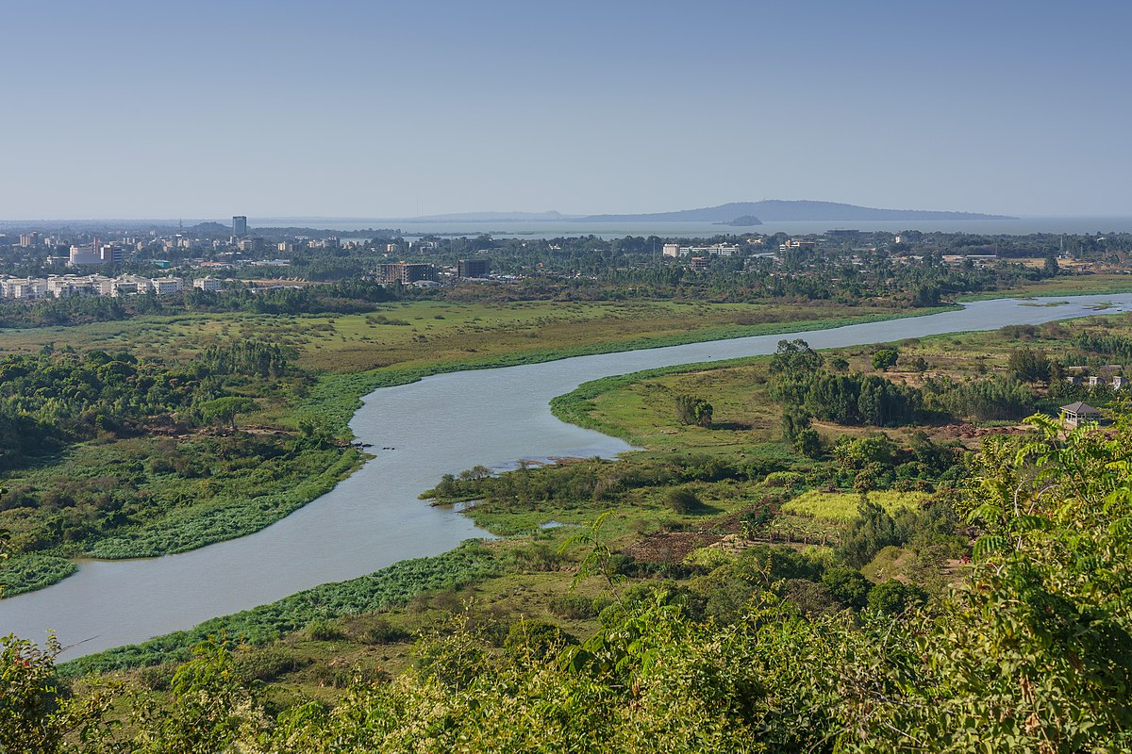
Nile River Basin
Notes:
Wikimedia. (n.d.). Nile River. Bahir Dar. [Digital image]. https://upload.wikimedia.org/wikipedia/commons/thumb/0/0b/ET_Bahir_Dar_asv2018-02_img32_view_from_Bezawit.jpg/1200px-ET_Bahir_Dar_asv2018-02_img32_view_from_Bezawit.jpg

Slide 13
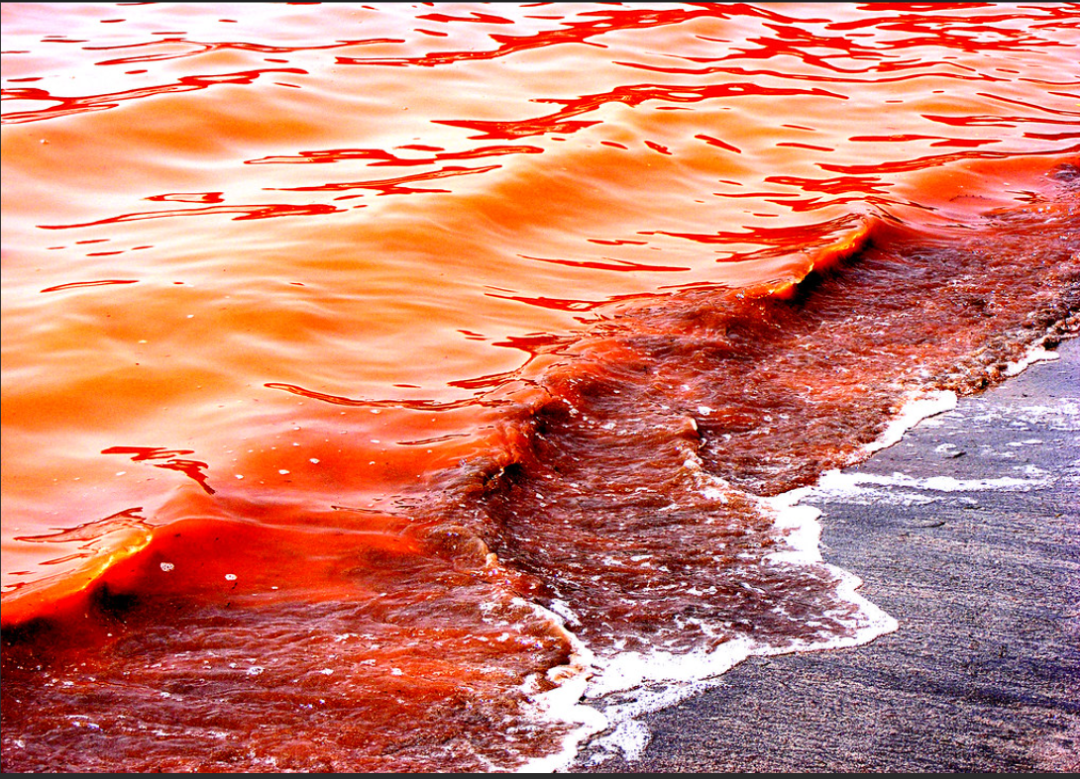
Red Sea
Notes:
Flicker. [2008]. The Red Sea. [Digital Image]. https://flickr.com/photos/st-stev/2432121049/

Slide 14
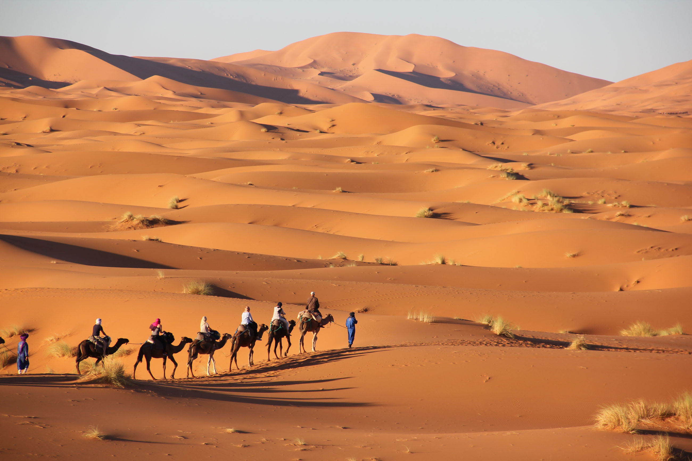
Sahara Desert
Notes:
Wikimedia. (n.d.). Sahara. Merzouga. [Digital image]. https://upload.wikimedia.org/wikipedia/commons/a/a9/Merzouga_sahara.jpg
This Photo by Unknown Author is licensed under CC BY-SA

Slide 15
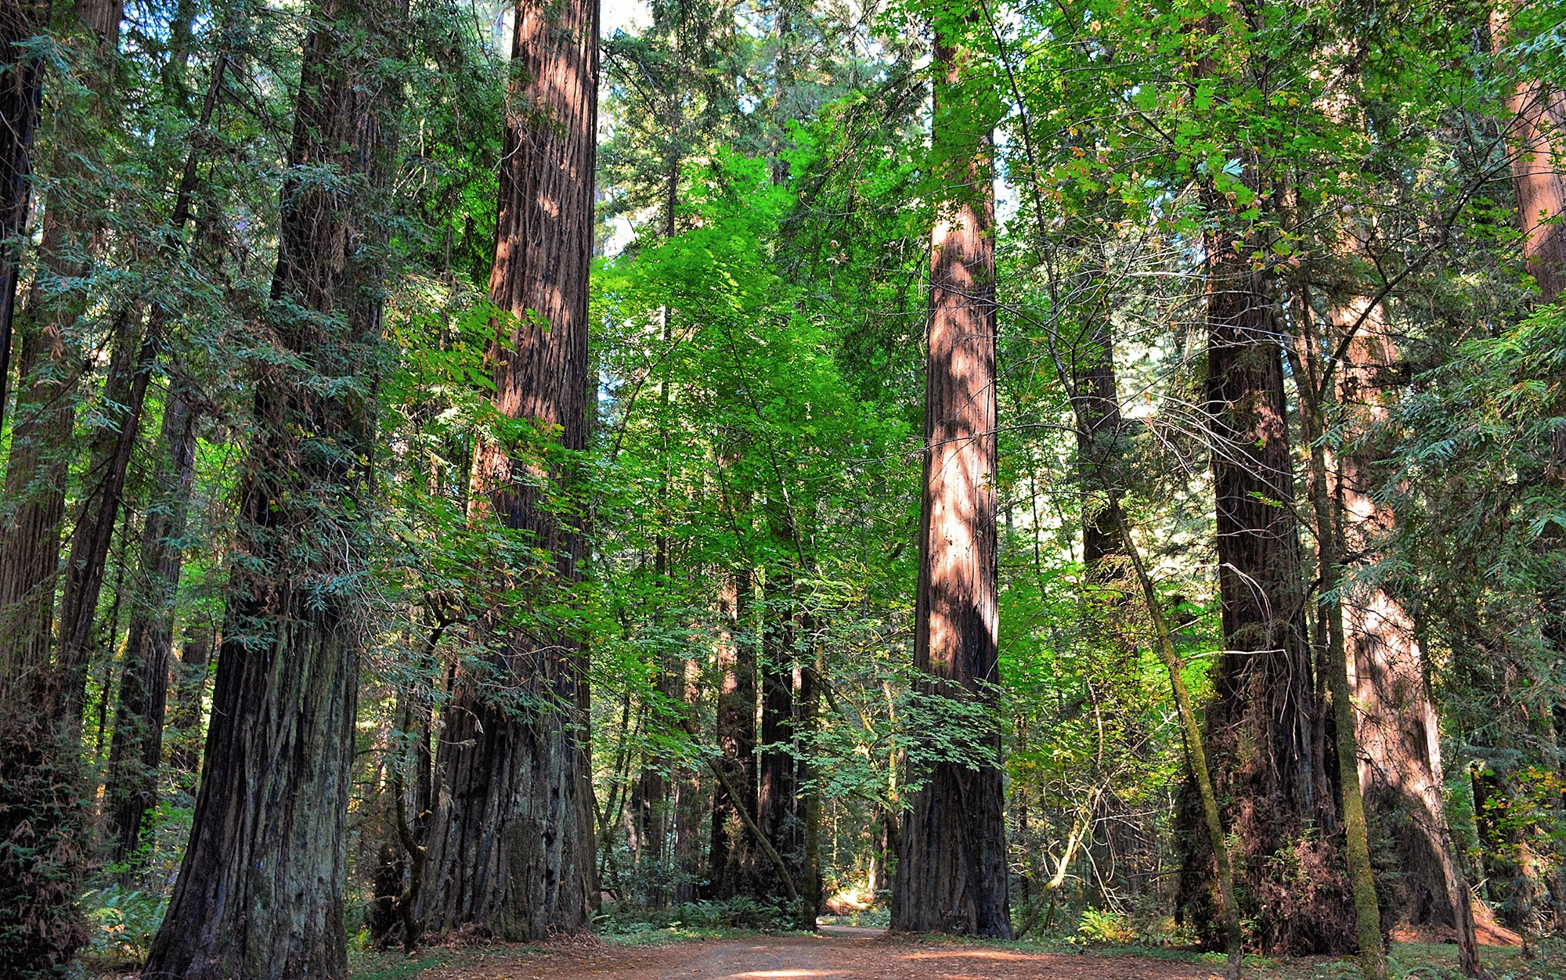
Redwood National Park
Notes:
CDN Images. (n.d.). Redwood National Park. [Digital image]. https://cdn-images-1.medium.com/max/2000/1*18Zts411Eit_dm7CyqLurA.jpeg

Slide 16
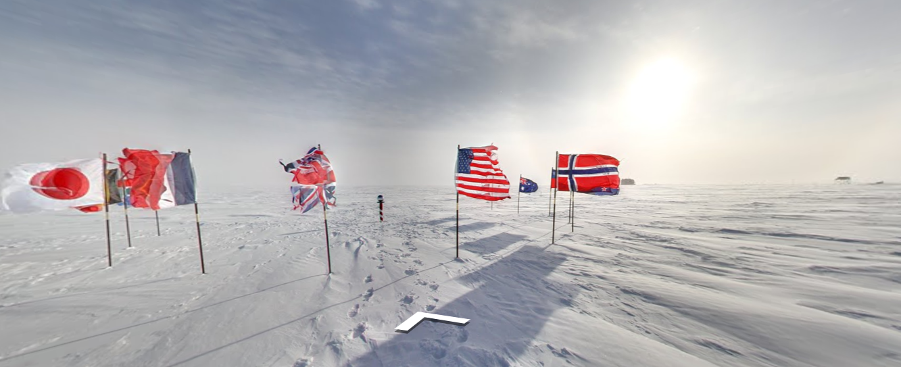
Ceremonial South Pole
Notes:
Virtual Globe Trotting. (n.d.). Ceremonial South Pole. Antarctica. [Aerial image]. Google Maps. https://virtualglobetrotting.com/map/ceremonial-south-pole/view/google/

Slide 17
Essential Questions
What makes places unique and different?
Why is having an understanding of maps, globes, resources, and geographic features important?

