Slide 2
To Whom It May Concern
Writing a Professional Email

Slide 3

Card Sort
Sort the cards into the following categories:
Introductory Salutation
Body
Closing
Notes:
https://learn.k20center.ou.edu/strategy/147

Slide 4
Card Sort
Sort the cards into the following categories:
Professional Communication
Unprofessional Communication

Slide 5
Professional Communication
How would you describe a professional email?

Slide 6
Unprofessional Communication
How would you describe an unprofessional email?
Notes:
Source: https://learn.k20center.ou.edu/strategy/147

Slide 7
Essential Question
Why does professional communication matter?

Slide 8
Lesson Objectives
Write an organized, focused email that adheres to a professional tone and structure and abides by the standard writing process.

Slide 9
Reasons to Write an Email to a Teacher
Question about homework
Idea to share that was not shared in class
Thanks for help
Notification about an absence or a problem
Scheduling time to meet after class

Slide 10
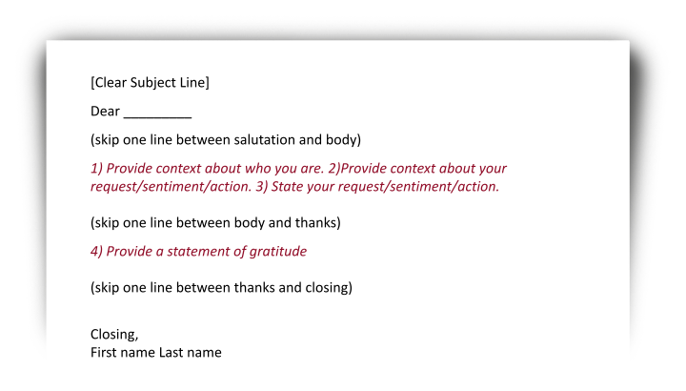
Elements of an Email
Subject line
Formal greeting
Personal context about yourself
Context about a request, sentiment, or action
A stated request, sentiment, or action
Statement of gratitude
Formal closing

Slide 11
Question about the Quiz Grade
Dear Mr. Jones,
This is Chris Mears from your 2nd Current Events Class. I have a question about the graded quiz that was passed back today. The quiz I received in class has a 92% on it, but my online grade is an 82%. When you are able, would you please check my online grade?
I appreciate your help.
Thank you,
Chris Mears
Subject Line
Formal Greeting
Personal Context
Context about the request, sentiment, or action
State the request, sentiment, or action
Statement of gratitude
Formal Closing

Slide 12

Brainstorming Your Email
Who can you write an email to?
Why are you going to write that person an email?
Notes:
[905513]. (July 2016). Hello, Bonjour, Hi, Greeting. Pixabay. https://pixabay.com/vectors/hello-bonjour-hi-greeting-foreign-1502369/

Slide 13
Writing Your Email: Don’t Forget!
Subject line
Formal greeting (salutation)
Personal context about yourself
Context about a request, sentiment, or action
A stated request, sentiment, or action
Statement of gratitide
Formal closing

Slide 14
Revising and Editing Your Email
Make sure to check the following:
  Tone
  Proofread
  Clarity
  Word choice
  Length
  Time
  Recipient’s name
Complete your email self-review and include it at the bottom of your email.
Notes:
[905513]. (July 2016). Hello, Bonjour, Hi, Greeting. Pixabay. https://pixabay.com/vectors/hello-bonjour-hi-greeting-foreign-1502369/

