Slide 2
Setting: Where It’s At
ELA

Slide 3
Essential Questions
What is the nature of conflict?
How can the setting of a story affect conflict?

Slide 4
Learning Objective
Students will analyze how the setting in a piece of writing can affect the conflict.

Slide 5
Fairy Tale Scenarios
Little Red Riding Hood - Large, urban city, modern day. Consider how Little Red Riding Hood would react to strangers she encountered on her travels to her grandmother’s house. Would she be more aware of her surroundings?
Jack and the Beanstalk - a scientific laboratory in the year 2200. Consider how Jack got his hands on the magic beans. Were they created in a lab? Did they contain deadly DNA?
Snow White - Zombie apocalypse after a deadly virus ravaged the land. Consider where Snow White might live at this time and who her enemy might be. Does she meet up with the Seven Dwarves?
Sleeping Beauty - in a vampire’s castle, modern day. Consider how Sleeping Beauty ended up in a vampire’s castle. Is she now a vampire? Does she really sleep all day and night?

Slide 6
Elbow Partner
Share your thoughts with a partner. Discuss which scenario you chose and how the conflict and/or characters of the story might change based on the new setting.

Slide 7
Prologue: Romeo and Juliet

Slide 8
Annotating a Text
How to annotate:
Circle: Unknown words
Put a box around: Words that give you a clue to the setting of the story
Highlight: Emotionally charged words
Underline: Repeated words or phrases
In the margins write: Connections you make with the text or any questions you have about the text

Slide 9
3-2-1 Strategy
Share your thoughts using the following prompts:
Write 3 words that gave you insight to the setting
Write 2 inferences you could make about the plot
Write 1 prediction

Slide 10
Elbow Partner
Share your answers two the 3-2-1 prompts with an elbow partner. Discuss why you chose those answers.

Slide 11
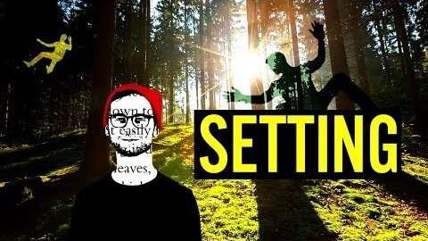
The Importance of Setting in a Story

Slide 12
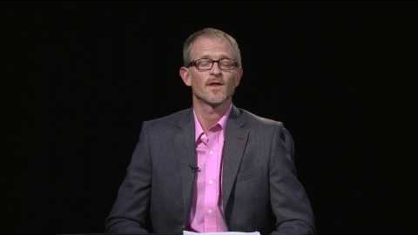
Romeo and Juliet Interview: Introduction

Slide 13
Prologue Revision
In this activity, you will rewrite the Prologue from Romeo and Juliet using a different setting, conflict, and characters. When planning your revision, consider carefully how the setting has impacted/will impact the conflict in your story.

Slide 14
Modern Version of Prologue
In beautiful Verona, where our play takes place, there are two families, both equally noble. From their old grudge there is an outbreak of new fighting, in which they stain their refined hands with fellow citizens' blood. A pair of ill-fated lovers from the deadly bloodlines of these two feuding households commit suicide. Their sad and tragic deaths put an end to their parents' fighting. Now, for the two hours in which we are onstage, we will present the story of their love and death, which was the only thing that could stop their families' rage. If we've left anything out of this prologue, just listen with patient ears—we will work to make everything understood.
https://www.litcharts.com/shakescleare/shakespeare-translations/romeo-and-juliet/prologue

Slide 15
I Used to Think, But Now I Know
On the left side of your T-chart, write what you knew about setting in a story before you started the lesson.
On the right side of your T-chart, write everything you now know about setting.

Slide 16
Flipgrid
Using the information you entered in your T-chart, reflect on what you have learned about the setting in a story and how it affects other story elements.
Write your reflection down on a blank sheet of paper and practice before you record your presentation on Flipgrid.
Be sure to speak clearly and stay on topic.

Slide 17
Resources
Flocabulary. (2017, April 6). The Importance of Setting in a Story [Video]. Youtube.
https://youtu.be/30CPmgVQNks
Florman, Ben. (2014, May 11). Romeo and Juliet: A Shakescleare Translation. LitCharts. https://www.litcharts.com/shakescleare/shakespeare-translations/romeo-and-juliet/prologue
myShakespeare. (2017, April 25). Romeo and Juliet Interview: Introduction [Video]. Youtube. https://youtu.be/sVuO_Rb93NI
Shakespeare’s Globe. (2019, March 11). Prologue Romeo and Juliet [Video]. Youtube.
https://youtu.be/ejUW6OXuPuk
K20 Center. (n.d.). I used to think, but now I know. Strategies. https://learn.k20center.ou.edu/strategy/137
K20 Center. (n.d.). Annotating text. Strategies. https://learn.k20center.ou.edu/strategy/114
K20 Center. (n.d.). 3-2-1. Strategies. https://learn.k20center.ou.edu/strategy/117

