Slide 2
Thank You for Being a Friend
Writing a Thank You Note

Slide 3
Essential Question
Why is it important to give thanks?

Slide 4
Lesson Objectives
We will be able to write a formal thank you letter that adheres to a structure and the writing process.
We will reflect on the importance of expressing gratitude.

Slide 5

Collaborative Word Cloud
What words come to mind when you hear the phrase “giving thanks”?
Consider synonyms for the following:
  Thankful
  Gratitude

Slide 6
Notes:
Add the Collaborative Word Cloud to this slide.

Slide 7
Reasons to Write a Thank You Note
When you receive a favor
When you are given a gift
After an interview
When you have been a guest
Just because

Slide 8
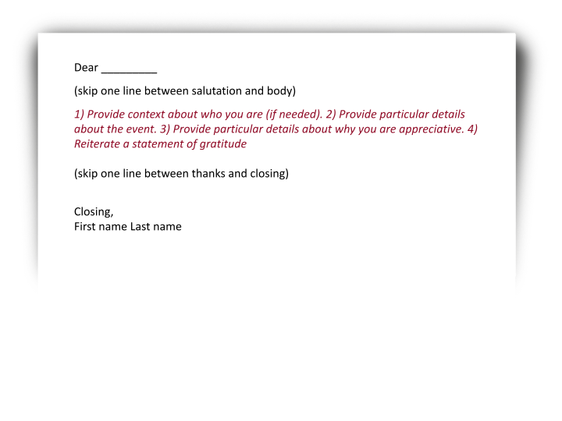
Formatting a Thank You Note
Appropriate greeting
Personal context (if needed)
Particular details about the event
Particular details about why you are appreciative
Reiterate a statement of gratitude
Appropriate closing

Slide 9
Dear Ms. Banks,
My name is Quin, and I was one of the students in the class you helped out in when Mr. Doe was sick. I am so appreciative of the extra help you gave me on the math work. Thank you for staying a little late to explain the steps to me.
Sincerely,
Quin
Appropriate Greeting
Personal Context
Particular details about why you are appreciative
Reiterate a statement of gratitude
Appropriate Closing

Slide 10

Brainstorming Your Thank You Note
Who can you write a thank you note to?
Why are you going to write that person a thank you note?
Notes:
Kerfant, A. (October 2014). Thank You, Gratitude, Appreciation. Pixabay. https://pixabay.com/illustrations/thank-you-gratitude-appreciation-490606/

Slide 11
Writing Your Thank You Note: Don’t Forget!
Appropriate greeting
Personal context (if needed)
Particular details about the event
Particular details about why you are appreciative
Reiterate a statement of gratitude
Appropriate closing

Slide 12
Revising and Editing Your Thank You Note
Re-read
Edit
Revise
Notes:
Kerfant, A. (October 2014). Thank You, Gratitude, Appreciation. Pixabay. https://pixabay.com/illustrations/thank-you-gratitude-appreciation-490606/

Slide 13
Essential Question
Why is it important to give thanks?

Slide 14

Word Splash
Choose three words from the word cloud.
Use these in a reflection that answers the question:
  Why is it important to give thanks?
Write at least three sentences.

