Slide 2
What Do You Want to Talk About?
Inner and Outer Dialogue

Slide 3
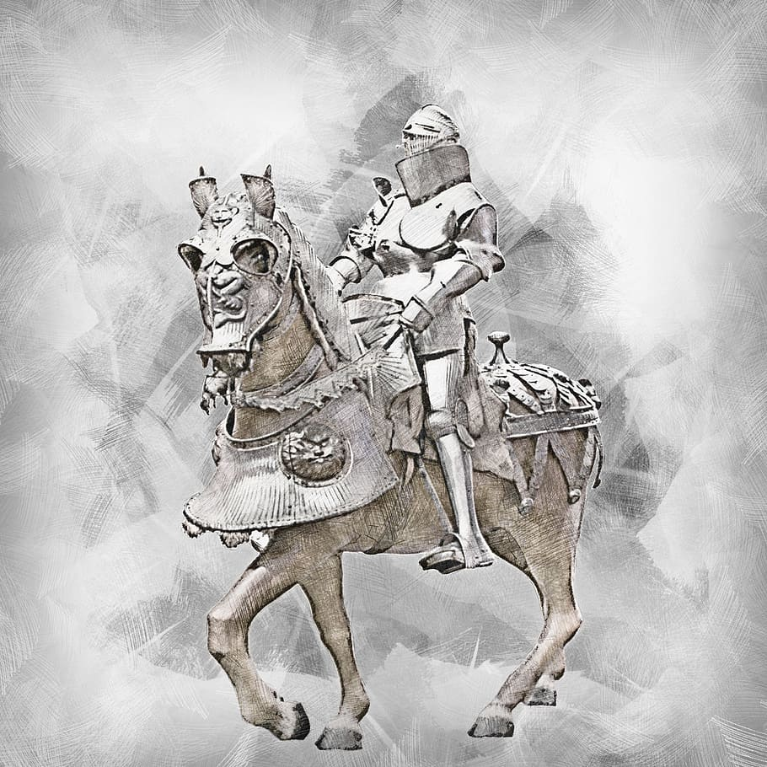
Notes:
[Armour, knight, horse, historic, museum, medieval, warrior, metal]. (n.d.).https://www.piqsels.com/en/public-domain-photo-jdlwt

Slide 4
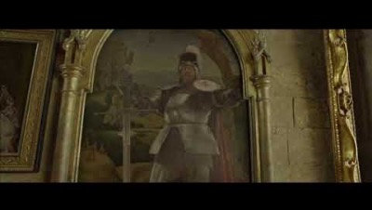
Notes:
Sir Cadogan asks for the password - Harry Potter and the prisoner of AZKABAN deleted scene [Video file]. (2020, December 21). https://www.youtube.com/watch?v=_7VNlLeNDGQ

Slide 5
Essential Question
How can art facilitate conversations?

Slide 6
Lesson Objectives
Connect works of art with writing dialogue to explore how art can facilitate conversations.
Write dialogue to reveal a character’s thoughts and provide information about the media of classic art.

Slide 7

How Am I Feeling? What Am I Thinking?
Divide your sticky note in half.
Label one half “How am I feeling?”
Label the other half “What am I thinking?”
Notes:
https://literarydevices.net/dialogue/

Slide 8
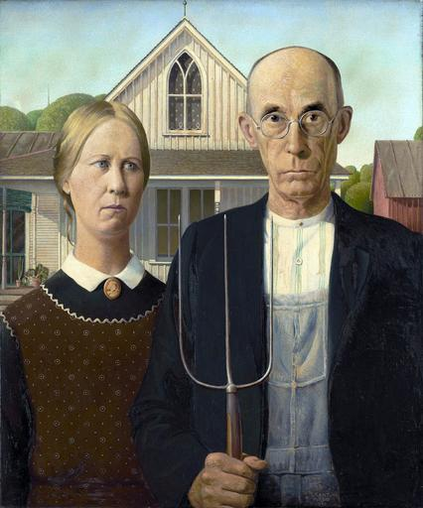
American Gothic
Choose one character
On your sticky note, answer the following questions as if you were the character you chose:
  How am I feeling?
  What am I thinking?
Notes:
Wood, G. (2012, May 15). American Gothic [Digital image]. https://commons.wikimedia.org/wiki/File:Grant_DeVolson_Wood_-_American_Gothic.jpg

Slide 9
Dialogue
A literary technique in which writers employ two or more characters to be engaged in conversation with one another.
In a nutshell, it’s when characters talk to each other.
Notes:
https://literarydevices.net/dialogue/

Slide 10
Quote
Dialogue is easy. It’s what you’ve been doing almost every day, most of your life.
-Josip Novakovich

Slide 11
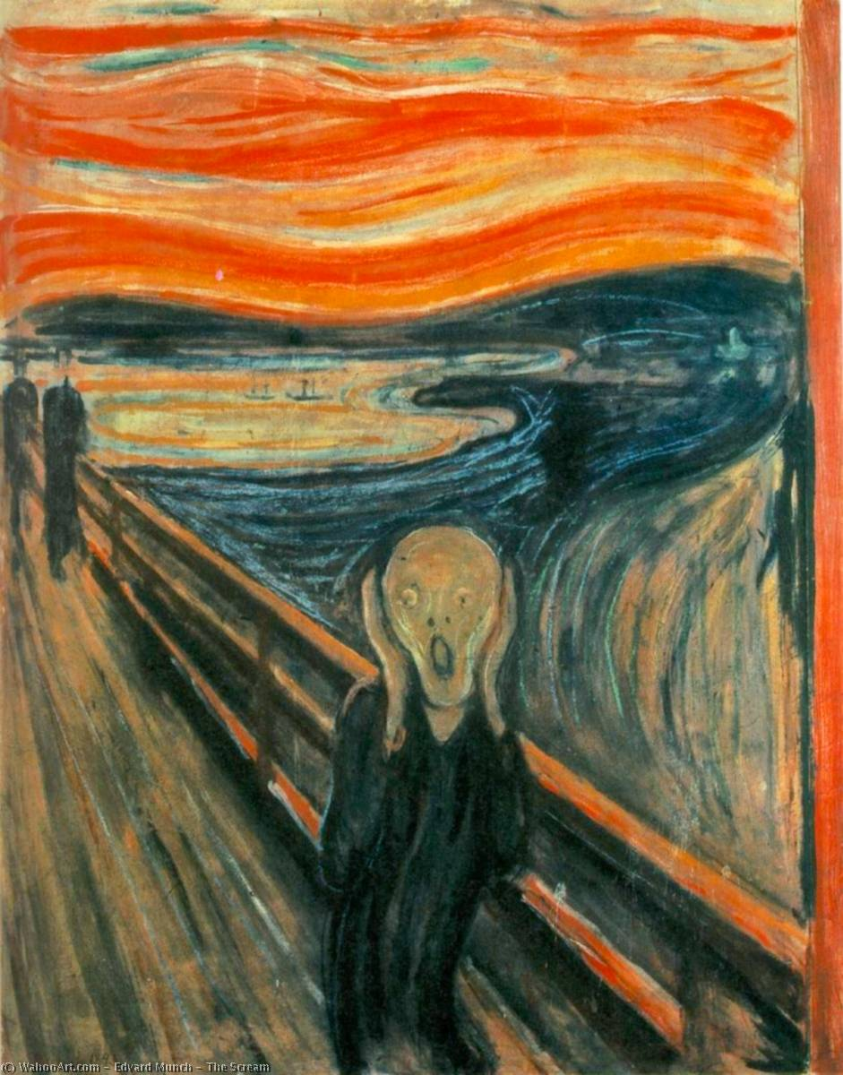
The Scream
On your sticky note answer the following questions as if you were the character in the image:
  How am I feeling?
  What am I thinking?
Notes:
Munch, E. (2019, March 7). The Scream [Digital image]. https://commons.wikimedia.org/wiki/File:Edvard-Munch-The-Scream.jpg

Slide 13
External Dialogue
A simple conversation between two characters
Use quotation marks for dialogue said out loud
Punctuation goes inside the quotation marks
Notes:
https://literarydevices.net/dialogue/

Slide 14
External Dialogue - Examples
“Hey!” she whispered, “Are you sleeping?”
“Knock, knock,” he said.
“Who’s there?” they asked.
“Who’s look out!” they cried.
“I see you, I see you,” he said, waving and grinning wildly.

Slide 15
Internal Dialogue
The characters speak to themselves and reveal their personalities
Also referred to as internal monologue
Do not use quotation marks with internal dialogue
Some writers use italics, although it’s not a firm rule
Notes:
https://literarydevices.net/dialogue/

Slide 16
Internal Dialogue - Examples
Surely that wasn’t the last cookie.
I wonder what the big deal is, she pondered.
Their excitement grew. Where are we going?

Slide 17
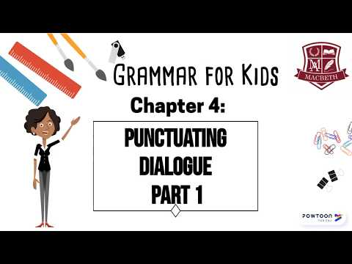
Punctuating Dialogue
Notes:
https://www.youtube.com/watch?v=vZ4BbyBUSmA

Slide 18
Punctuating Dialogue
“Think of a door…”
What does this mean when punctuating dialogue?
Consider:
Quotation mark placement
Capitalization
Comma placement
Dialogue tags
Notes:
https://www.youtube.com/watch?v=vZ4BbyBUSmA

Slide 19

Card Sort
Choose two (2) pieces of dialogue to accompany one (1) work of art
  One (1) piece of internal dialogue
  One (1) piece of external dialogue

Slide 20
Card Sort
On a separate sheet of paper:
Write an explanation for why the piece of internal dialogue matches your work of art
Write an explanation for why the piece of external dialogue matches your work of art
Get creative with your justifications!

Slide 21
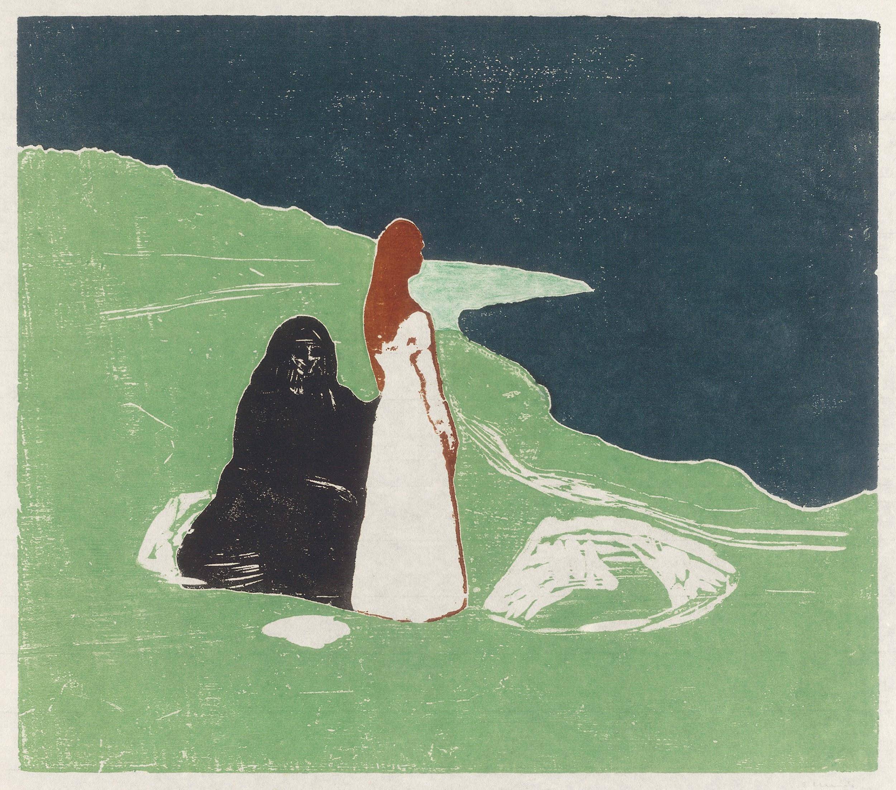
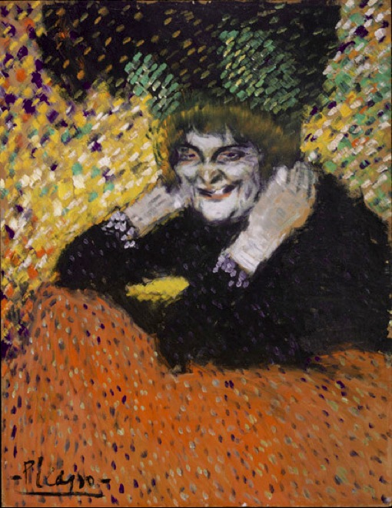
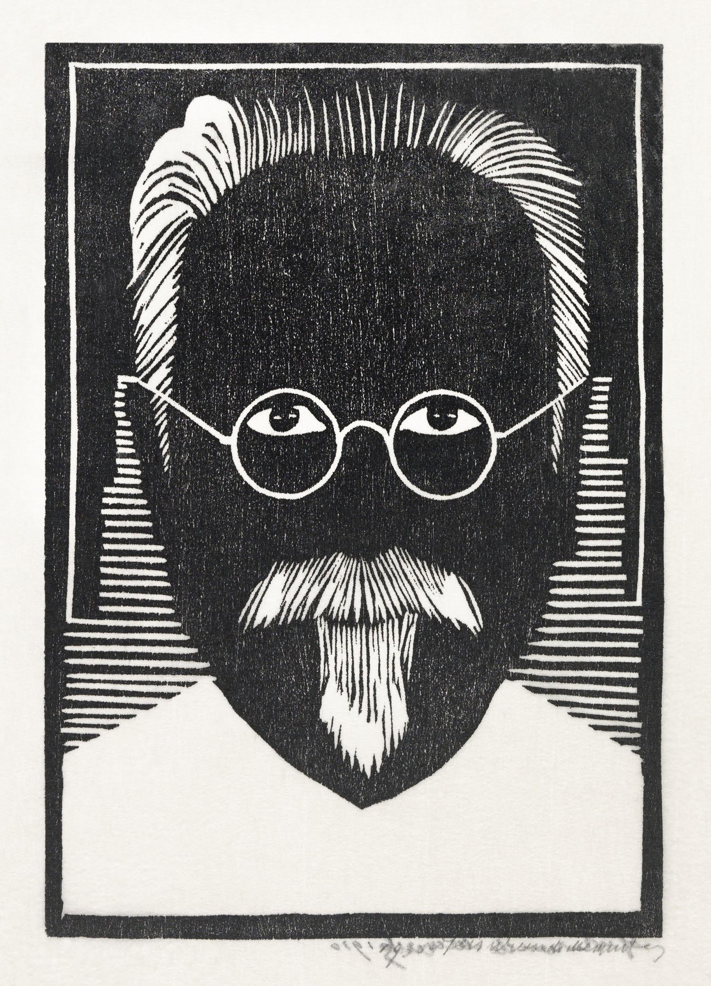
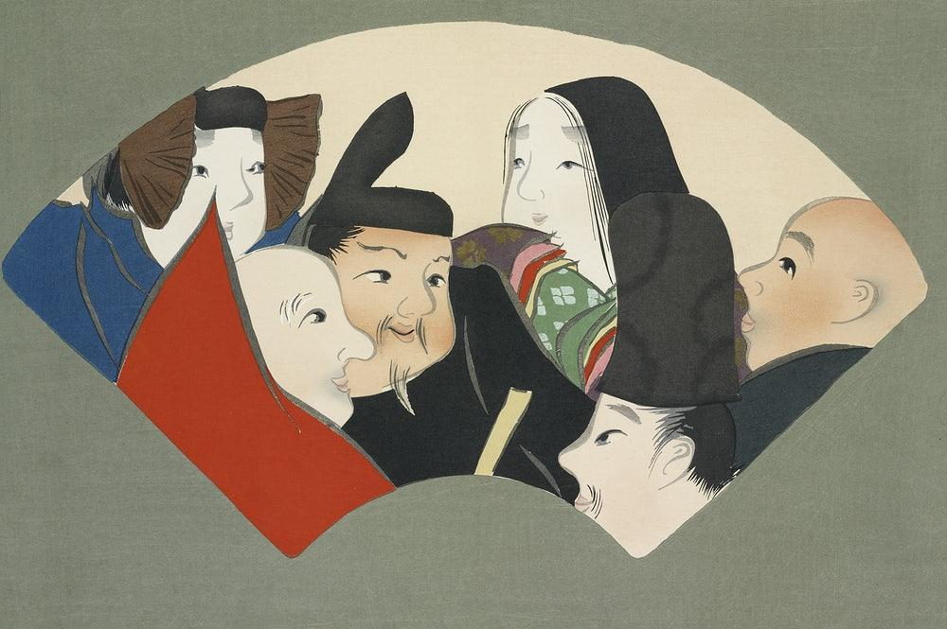
Notes:
Jessurun de Mesquita, S. (n.d.). Self–portrait with glasses and goatee (Zelfportret met bril en sik) [Digital image]. https://www.rawpixel.com/image/2698105/free-illustration-image-portrait-black-and-white-glasses
Munch, E. (n.d.). Two Women on the Shore [Digital image]. https://www.rawpixel.com/image/2043765/two-women-the-shore
Picasso, P. (n.d.). Old Woman (Woman with Gloves) [Digital image]. https://en.wikipedia.org/wiki/Philadelphia_Museum_of_Art#/media/File:Pablo_Picasso,_1901,_Old_Woman_(Woman_with_Gloves),_oil_on_cardboard,_67_x_52.1_cm,_Philadelphia_Museum_of_Art.jpg
Sekka, K. (n.d.). Rokkasen from Momoyogusa–Flowers of a Hundred Generations [Digital image]. https://www.rawpixel.com/image/2049622/japanese-woodcut-print-kamisaka-sekka

Slide 22
Composing Dialogue
Review the handout, Internal and External Dialogue Examples
Review the rules for punctuating dialogue
Choose one of the works of art to write dialogue for based on the character. Include the following:
  Four (4) sentences
  Character’s response to “How am I feeling?” and “What am I thinking?
  Use external dialogue between characters, internal dialogue, or both

Slide 23

How am I feeling? What am I thinking? with Flipgrid
Use your handout for details
Upload your chosen work of art in the Flipgrid post
Record your dialogue in the post. If the dialogue is between two characters, try two voices!
Write a reflection of your process

Slide 24
Essential Question
How can art facilitate conversations?

