Slide 2
Things to Do With a Strip of Paper: Mobius Bands
A Math Lesson

Slide 3
Essential Question
What is a Mobius band, and what can I do with it?

Slide 4
Lesson Objectives:
Students will be able to:
Make predictions and conjectures and draw conclusions throughout the problem-solving process based on patterns and the repeated structures in mathematics. Students will create, identify, and extend patterns as a strategy for solving and making sense of problems.

Slide 5
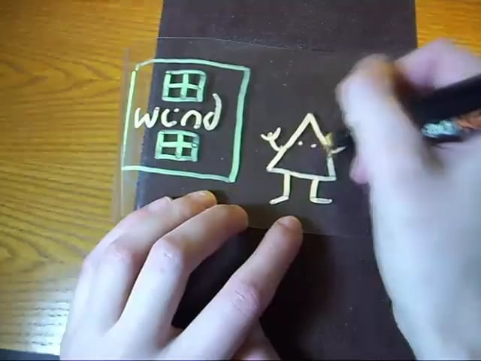
The Story of Wind and Mr. Ug

Slide 6
What’s Happening Here?
Think: Take a moment to think silently about what you think is happening in the world of Wind and Mr. Ug.
Pair: Discuss what you think is happening with an elbow partner.
Share: Raise your hand to share what you think with the class.

Slide 7
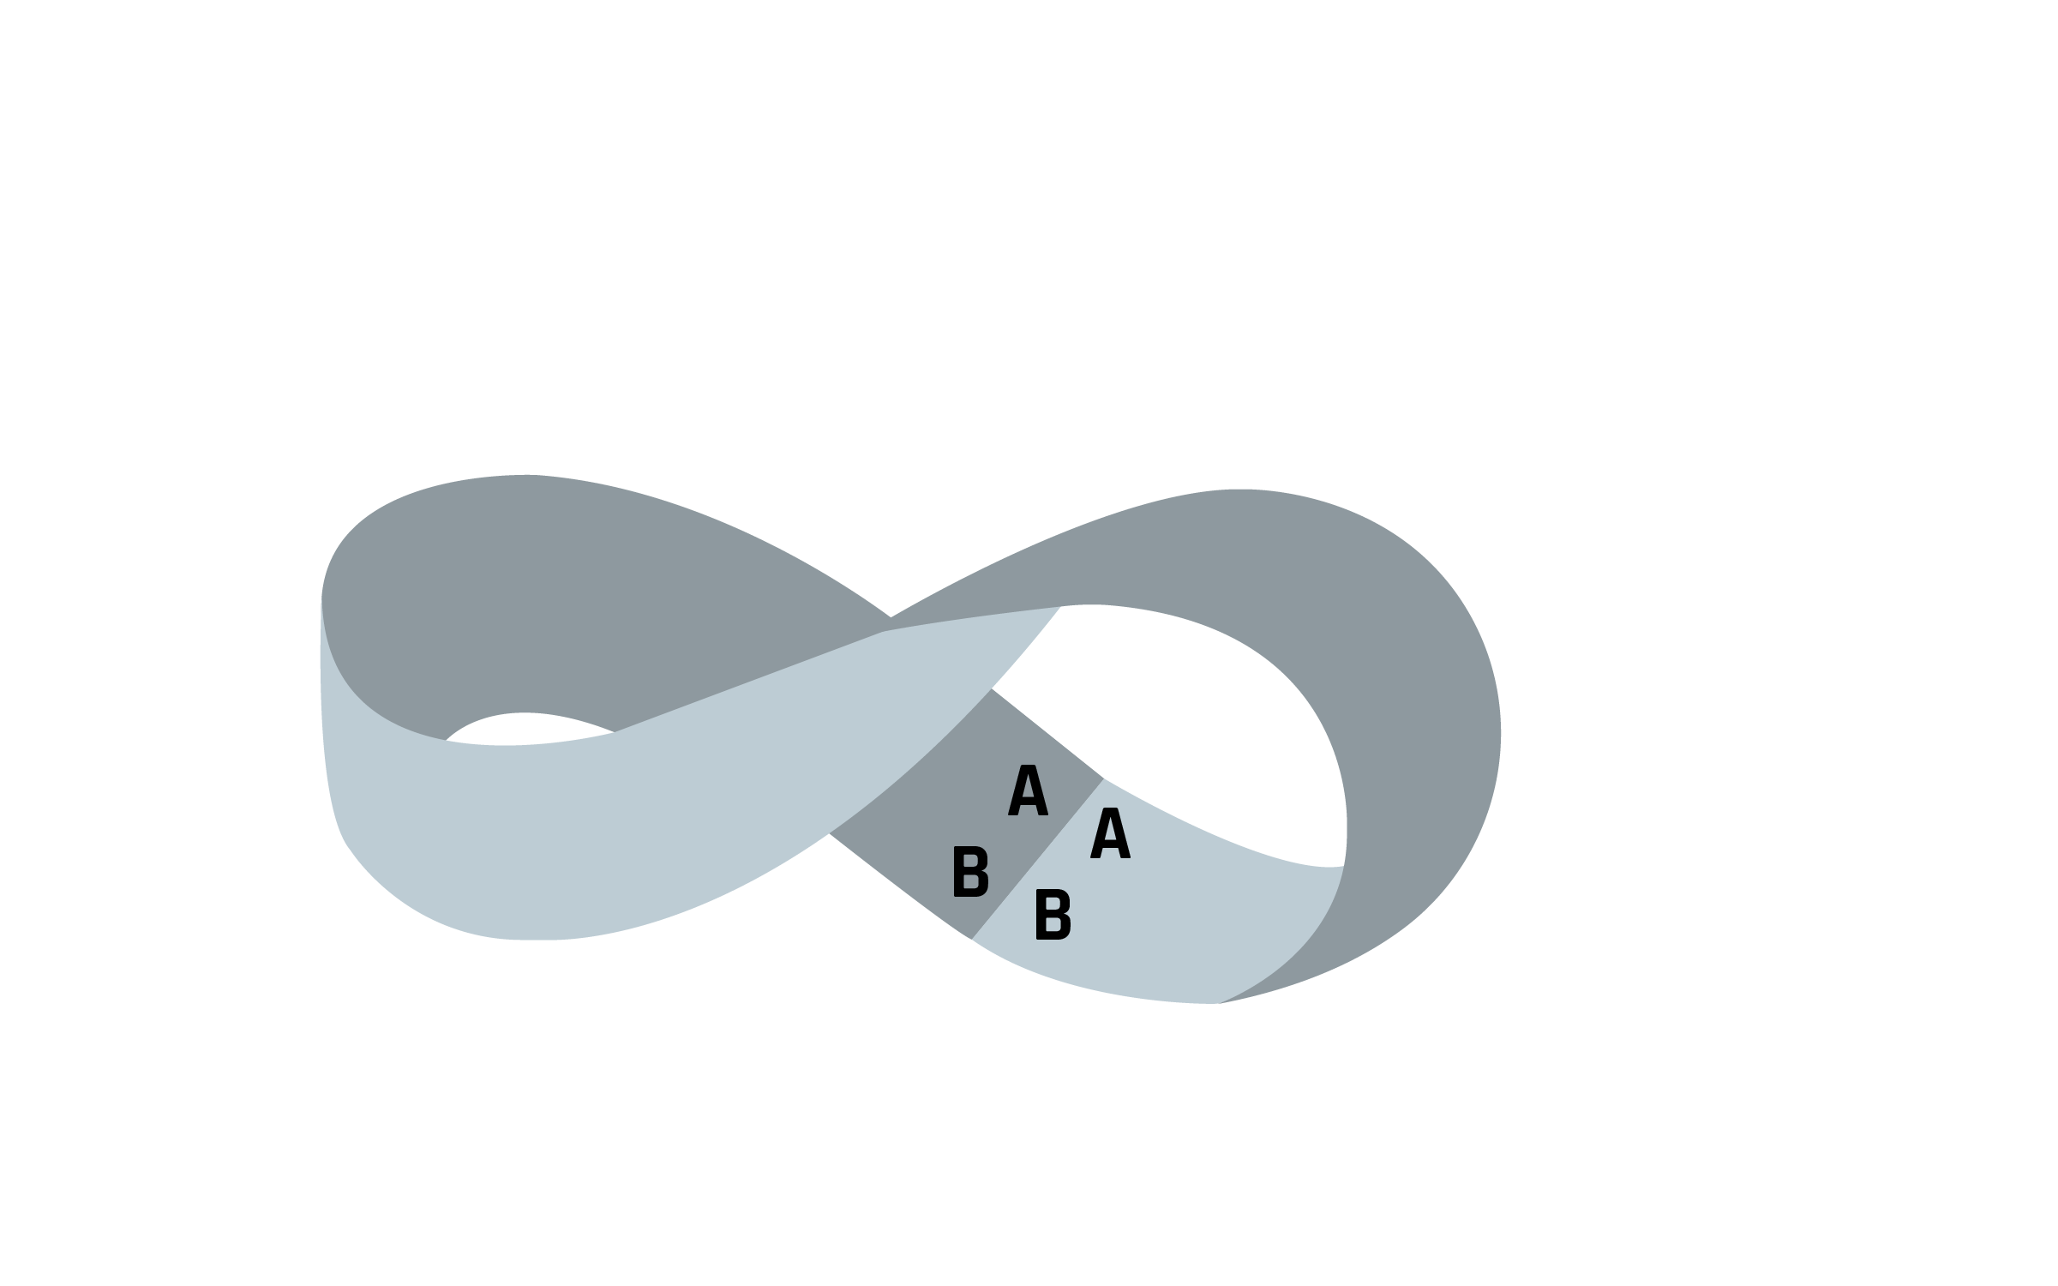
Building a Mobius Band
Label your strip of paper like you see in the first image. Twist one end of the strip. Match A to A and B to B. Tape or glue the ends together.
(If you match A to B and B to A, you have a cylindrical loop, but that isn’t what we want for this structure.)

Slide 8
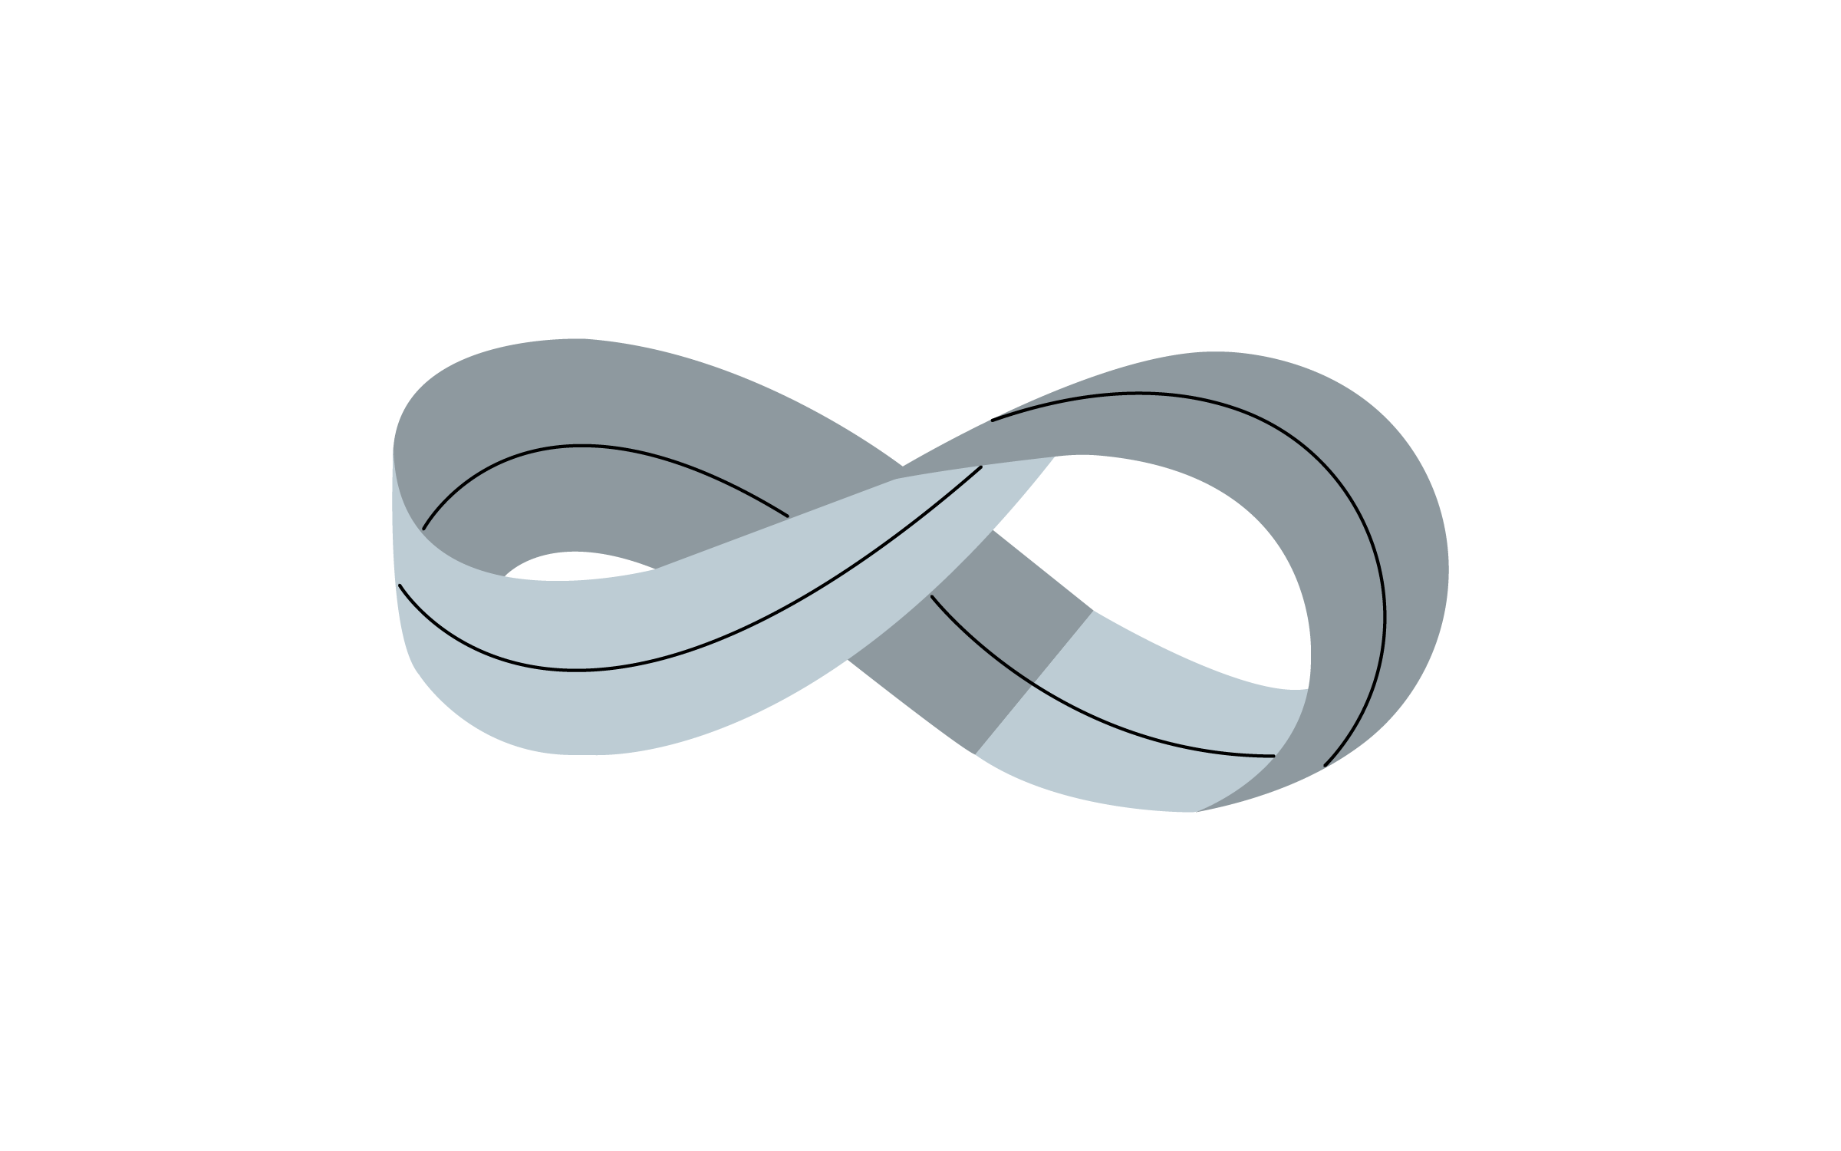
Wind and Mr. Ug’s World
Draw a line down the center of your Mobius band. Discuss the following questions with your partner:
How many lines did you draw around your Mobius band?
How many sides does your Mobius band have?
How many edges does your Mobius band have?
Does this information help explain the world of Wind and Mr. Ug? Explain.

Slide 9
The Mobius Band Effect
Come to an agreement with your partner about the questions on your handout. Write down your response and explanation for each question.

Slide 10
Mobius Bands: What Are They?
A Mobius band (or strip) is a one-sided, one-edged, 3D object that is “unorientable.” This object is responsible for the launch of the mathematics field of topology.
Fun fact: Some factories use conveyor belts in the shape of Mobius bands. The belt doesn’t wear out as quickly, because its entire surface area is being used instead of just one side.

Slide 11
Extension Activity #1
Take your first Mobius band with the line down the center.
What do you think will happen if you cut along the line? Write down your predictions.
Now, cut down the center.
What happened? Describe the result.
How did this compare to your prediction?
Is this new object a Mobius band? Explain!

Slide 12
Extension Activity #1 Result:
A twisted loop, but not a Mobius Band.

Slide 13
Extension Activity #2
Make a new Mobius band.
What do you think will happen if you cut 1/3 of the way from the edge? Write down your predictions.
Now, cut 1/3 of the way from the edge all the way around.
What happened? Describe the result.
How did this compare to your prediction?
Are these new objects Mobius bands? Explain!

Slide 14
Extension Activity #2: Continued
What do you think would happen if we cut one quarter from the edge? One fifth?
How much longer is the bigger loop than the smaller loop? Write down your prediction.
Cut both loops to disconnect them. Measure the two loops. What did you find?

Slide 15
Extension Activity #2 Result:
Two loops; one is a twisted loop with a Mobius band linked

Slide 16
Extension Activity #3
Make two cylindrical loops (not Mobius bands).
Connect the two loops to form a right angle.
It should look like this. →

Slide 17
Extension Activity #3: Continued
What do you think will happen when we cut down the center of each loop all the way around?
Cut both loops down the center. Cut all the way through!
What was the result? Was this similar to your prediction?

Slide 18
Extension Activity #3 Result:
A square

Slide 19
What? So What? Now What?
What? Explain what you did in this activity.
So what? What did you learn that you did not know before?
Now what? Where do you think you might use Mobius bands in your everyday life?

