Slide 2
What’s Mindset Got to Do With It?
Identifying and Shifting a Fixed Mindset to a Growth Mindset
Notes:
Before you facilitate this lesson prepare all materials and review all attached or linked resources. Print, cut, and organize the student Growth Mindset and Fixed Mindset Card Sort Statements (1 set for each pair of students) and print the Card Sort Placemat (11” x 17”). To reuse these items, consider labeling card sort sets and laminating all reusable materials. Additionally, watch the videos linked in the Explain part of the lesson to confirm they are still active and are appropriate for your students. You may choose to only use one specific video, use a couple of videos, or have students Jigsaw the videos which would allow for a deep discussion with a variety of examples and non-examples of a growth mindset.

Slide 3
Essential Question
How can our thoughts and beliefs about failure affect our success in school and life?

Slide 4
Lesson Objectives
Students will reflect on their own mindset and current beliefs that affect a growth mindset.
Students will develop a plan to foster a growth mindset.

Slide 5
Think, Pair, Share
1. Think about the questions on the next slide.
2. Write your thoughts on a sheet of paper.
3. Pair up with a partner.
4. Share what you wrote with your partner.
Notes:
Begin the session with a modified version of the instructional strategy Think-Pair-Share, in which the students first think then write their responses down, and then pair and share out their responses with a partner.

Slide 6
Think, Pair, Share
Think of a time in your life when you worked really hard at something (maybe it was something challenging or difficult).
Why did you spend so much time or put so much effort working on it?
How did you "grow" from that experience? What did you learn?
Notes:
Pose the first three questions to students, allowing them time to reflect upon each question and then record their response before moving onto the next question in the set. Once all students have a response recorded, they should use the next three to five minutes to share their responses with their partners.
You can alter the questions/phrases to meet the needs of your students. For example, if you have a student who doesn't find very many things to be challenging, you could use other phrases such as, "spent a lot of time doing," or "practiced a lot." When discussing how students grew, consider additional phrases like, "How did you get better?" or "Did you learn something else in the process?"

Slide 7
Based On Our Discussion:
Can you “grow” when dealing with situations that are challenging or you don’t like or enjoy?
What would happen if you approached all situations that you do not like or find challenging with the same "mindset” or attitude?
Notes:
Next students will begin to discuss the last two questions as a whole group. Keep in mind, we are not formalizing or defining terms for a Growth or Fixed Mindset yet. That will naturally occur later in the lesson. To begin the whole group discussion, ask students, “Based on what you and your partner discussed, can you “grow” when dealing with situations that are challenging or you don’t like or enjoy?” Allow students to briefly share a few thoughts and examples.
Then ask, “What would happen if you approached all situations that you do not like or find challenging with the same "mindset” or attitude?” Allow students to reflect and then share a few responses.
The second question in this series introduces the term “mindset.” If students ask about that word, consider only sharing some synonyms like attitude, outlook, perspective, etc. We are not formalizing or defining terms for a Growth or Fixed Mindset yet. That will naturally occur later in the lesson after watching the video(s) and discussing further.
Possible Responses:
Students should see the connection to working hard pays off even when we don’t really enjoy something or it is hard for us.
“Yes, you can grow during challenging or tough situations because when I was learning to draw in art class it was really hard, but with all the practice I did inside and outside of class I can now draw almost anything!” “I don’t really enjoy reading in classes because the texts are often hard for me to understand, but I found that as I read more books on my own that I enjoy, it has made understanding what I read for my classes a little bit easier.”
“If I approached math as I approached learning to draw, then I may get better at math.” “I would improve my understanding or ability.”

Slide 8
Card Sort Activity
Growth Mindset
Fixed Mindset
Read each statement
Based on where you
And then place the cards
Think they best fit
Notes:
Now that your students have had an opportunity to reflect on a specific time when they worked hard and how those situations impact our attitudes or mindsets, allow them to explore some mindset statements. These statements demonstrate both a fixed and a growth mindset. Students will work in small groups using both the Growth Mindset and Fixed Mindset Card Sort Statements and the Card Sort Placemat to complete the activity. This Card Sort activity has a variety of statements that demonstrate both fixed and growth mindsets. The goal for your students, right now, is to explore the different statements with a partner and see if they can determine which type of mindset it is that they are reading about.
As you introduce this activity, students will need to have a basic understanding of the terms “Growth” and “Fixed” on the Card Sort Placemat. Ask students what those two words could mean in this context. If they are unsure, ask them what the root ‘grow’ and ‘fixed’ mean to them. Furthermore, ask how would they describe those words or what examples might they provide to a younger child.
Possible Responses:
“Growth means to change and fixed means to remain the same/unchanged.” “Flowers and people grow and get taller, but lights are ‘fixed’ to a wall or ceiling so they don’t move.”
This activity sets the stage for student inquiry about both growth and fixed mindsets. Students should not worry about “right” or “wrong” answers when sorting these statements. They will revisit the card sort later on in the lesson and be allowed to adjust the placement of any statement.

Slide 9
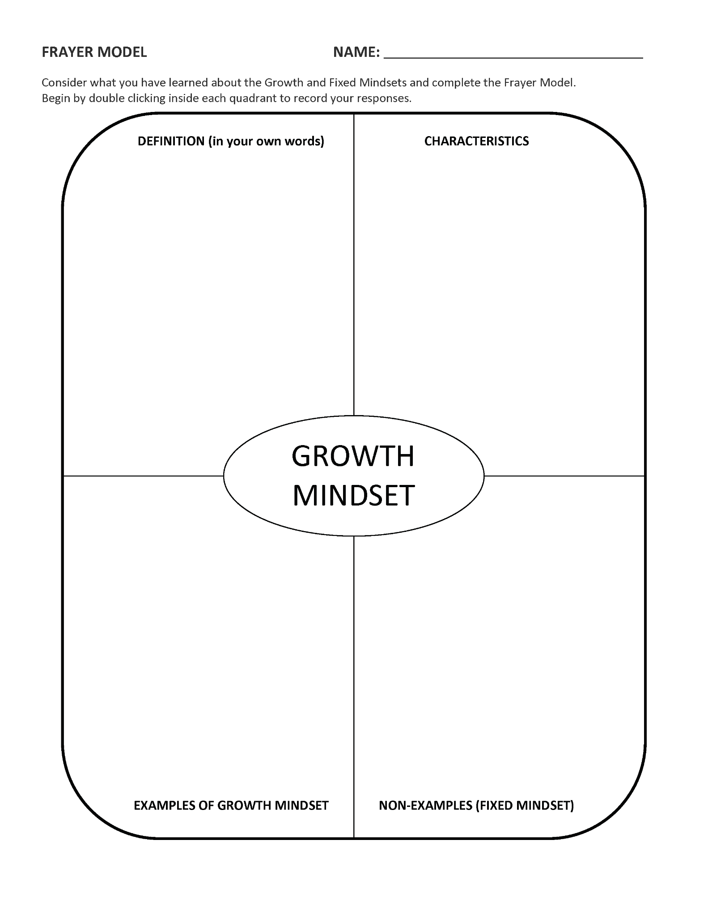
What is Mindset?
Watch the assigned video(s) and take notes using your copy of the Frayer Model.
Discuss the video(s) and notes with your partner. Identify additional important information and add it to your notes.
Notes:
After students have completed the card sort activity, instruct them to watch one (or more) of the following videos independently:
The Most Powerful Mindset for Success (10 minutes)
Growth Mindset Video (2.5 minutes)
Believe in Yourself (3 minutes)
Growing Your Mind (3 minutes)
The Power of Belief-Mindset and Success (11 minutes)
Students will use the Frayer Model as a note sheet while they watch the assigned video(s). They will record definitions, characteristics, examples, and non-examples on the Frayer Model document.
Depending upon the class structure and time available, the video(s) and the Frayer Model activity could be completed by students on the first day of the lesson or assigned as homework to allow them time to watch and process the information at their own pace. The videos are structured within the lesson to support student inquiry by allowing them to actively gather and synthesize the new information about growth mindset.
After watching the video(s) and recording a few notes about growth mindset on their Frayer Model, student pairs will briefly discuss the video(s) they watched and what they recorded on their Frayer Model. Their video notes should be similar, but depending upon the video(s) watched and a student’s prior experience, they may have connected with different characteristics and examples. These similarities and differences should be applied as they revisit their card sort from earlier in the lesson.

Slide 10
Card Sort Remix
Growth Mindset
Fixed Mindset
Review the statement cards
Make sure you can justify why it is that mindset
Move any to a new position
Based on the information gained from the video(s)
Notes:
Students apply their new understanding of growth and fixed mindsets by reviewing the sorted cards. While reviewing the sorted cards, students do two things (1) move statement cards as needed based on their deeper understanding of growth and fixed mindset and (2) discuss the justification for each placement (why it signifies growth or fixed mindset). Walk around and listen to the student discussions as they are working.

Slide 11
Choose One!
Choose one sorted statement. It could have been the easiest or toughest to sort.
Record the statement and justification on the bottom of your Frayer Model.
Share out your selection.
Notes:
Once all of the groups have finalized their card sorts, instruct students to choose one sorted statement that was either easy or hard for them to sort. They record that statement at the bottom of their Frayer Model document, along with why it was easy or difficult to place and their justification for the final placement.
Student pairs will share their selection with the whole group to wrap up that activity.

Slide 12
What Does Growth Mindset Mean to You?
How has your thinking about struggle and failure changed in light of this new information?
How does knowing about a growth mindset change the way you treat yourself when you struggle and fail?
How does believing in a growth mindset change the way you approach a new challenge or something difficult?
Notes:
Extending the lesson, students will begin to consider how growth and fixed mindsets impact the way they approach situations in their own life. You may facilitate the next four questions as a whole group discussion, or allow students to first individually reflect and then share a few responses with the whole group.
Allowing students to formalize their understanding of a growth mindset, ask, “What does Growth Mindset mean to you?” Then ask students the three questions listed below. These questions allow students to gain a deeper personal understanding of their mindset and will encourage reflective thinking and student conversation.
Be sure to discuss, as part of this dialogue, how mindset can change based on context. For example, one person can have a growth mindset about learning to skateboard but have a fixed mindset about learning math.

Slide 13
Stories that Inspire Us
Watch one of the assigned videos.
Identify and record on your Frayer Model:
Examples and situations that displayed either a growth or fixed mindset.
How the actions and words of others impacted the speaker’s mindset.
Notes:
To evaluate students’ understanding of mindset allows them to choose one of the videos below to watch. While watching the video, students will identify examples and situations within the speaker’s story that displayed either a growth or a fixed mindset. Additionally, students will consider how the actions and words of others could have impacted the speaker’s mindset. These examples will be recorded on the Frayer Model sheet from earlier under the Example and Non-example titles.
Deshauna Barber Story - An Inspiring Story of Overcoming (about 6 minutes)
How to Change the Way You See Yourself | Rock Thomas | Goalcast (about 8 minutes)
Don’t Be Afraid to Fail Big, To Dream Big (about 5 minutes)
Going Through Tough Times (about 8 minutes)
Jonathan Mooney - Reimagining Learning (about 8 minutes) ***could maybe only watch the first 1/2 of the video***
Every Child Has The Right To THIS Kind of Education (about 3 minutes ***USES a cuss word***)
After students watch one of the videos and have identified examples, debrief what was recorded and how their stories can inspire us to develop a growth mindset.
To encourage reflection through writing, students may create a summary or reflection after the discussion. These may be submitted as an assignment, but make sure students know that before they begin writing. Stories are powerful teaching tools and provide great examples of mindset without actually using the terms fixed and growth. Student’s understanding can be fully assessed by applying their knowledge to these situations and stories and assessed through their writing.

Slide 14
Growth Mindset Goal Activity
THINK of a situation or experience that you approach with a fixed mindset.
WHY does that situation or experience keep you from success or how does it challenge you?
WHAT can you do to approach the situation or experience with a growth mindset?
WHO might help you succeed? WHO might hinder your success?
WHAT other strategies could you apply to accomplish this growth mindset?
CREATE a growth mindset goal statement.
Notes:
Now that students can identify a growth mindset and the situations or experiences that impact it, it is time for them to identify when they have a fixed mindset. If we can name it, we can change it! Using the Student Growth Mindset Goal Activity Sheet, have your students brainstorm a few situations or experiences they approached with a fixed mindset. This activity will be most effective if the statements are personal internal or external struggles, obstacles, or challenges they have encountered. However, if they cannot think of any personal examples, they may use statements or ideas explored throughout the lesson. Once the fixed mindset examples are recorded, they will rephrase and reframe them to construct a growth mindset. They will also create a goal for how they plan to overcome that fixed mindset.
Possible Responses
THINK - I am going to fail the upcoming test.
WHY - I forgot to bring my notes home or I didn’t take good notes during class.
WHAT - I could get in the habit of putting my notes in my bag at the end of class.
WHO - Friends from class, my teacher, or my parents could maybe help me.
WHAT - I could call a friend from class and they might send me a copy of their notes. Then I'll have more information with me to study before the test.
CREATE - To be successful on the upcoming test, I will take better notes, ask questions when I am unsure about the content, and bring my notes home to study each night.
As students adapt their mindsets and begin to shift from fixed to growth, they can revisit their statements on the Student Growth Mindset Goal Activity Sheet and celebrate their growth. Each time they work to develop their own growth mindset they will color in one of the wrinkles on the brain. The goal is for students to work throughout the year, across all subjects, to develop a growth mindset. Developing a growth mindset is a journey. Students should recognize the growth and change within their mindsets and celebrate it. This would be similar to celebrating one’s success in academics or extracurricular activities.

