Slide 2
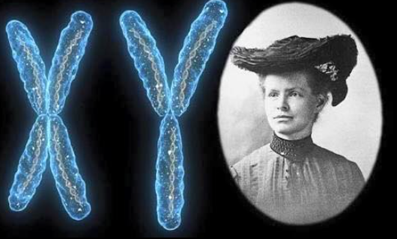
Woman Crush Wednesday: Nettie Stevens
Grades 9-10 Science
Notes:
Image source: https://twitter.com/gwisci/status/1017520573256216576

Slide 3
Essential Questions
What role do sex chromosomes play in human genetics and heredity?
How have women in history shaped science today?

Slide 4
Lesson Objectives
Explain how sex chromosomes affect heredity.
Determine the contributions of Nettie Stevens to science.

Slide 5

What is a Pioneer?
Can you think of any pioneers?
What makes that person a pioneer?
List the characteristics someone needs in order to be a pioneer.
Notes:
Book: Ignotofsky, R. (2016). Women in science: 50 fearless pioneers who changed the world. Berkeley, CA: Ten Speed Press.
Image source: https://www.amazon.com/Women-Science-Fearless-Pioneers-Changed/dp/1607749769/ref=sr_1_1?dchild=1&keywords=Women+in+Science%3A+50+Fearless+Pioneers+Who+Changed+the+World&qid=1621348020&sr=8-1

Slide 6
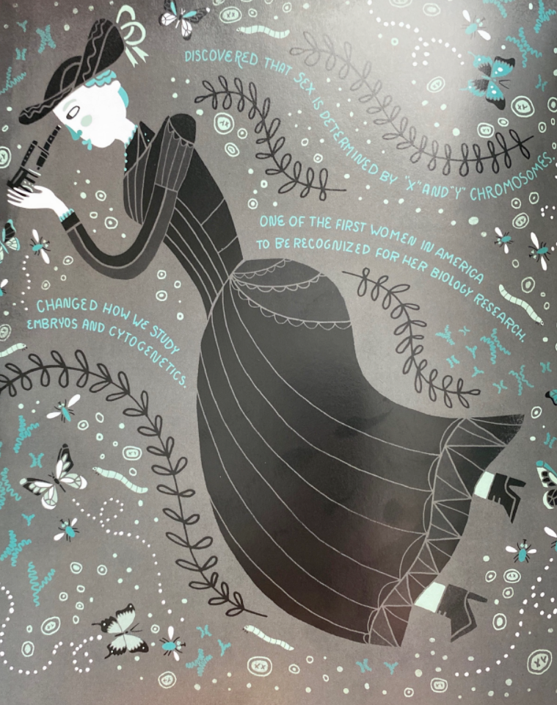

Nettie Stevens
Nettie Stevens Video
Notes:
Image source: Britannica. (2021, Jul 3). Nettie Stevens. {Digital Image]. https://www.britannica.com/biography/Nettie-Stevens
Image source: Igntofosky, R. (2016)..Women in Science: 50 Fearless Pioneers Who Changed the World. New York: Potter/TenSpeed/Harmony..
K20 Center. (2021, Nov 12). Woman crush Wednesday: Nettie Stevens. [Video]. https://www.youtube.com/watch?v=GA6BsBEMjtE

Slide 7
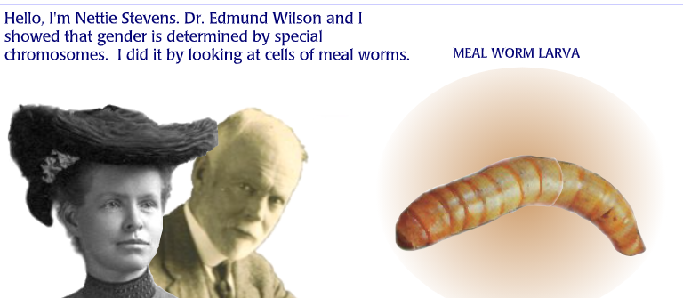
Discovery of Sex Chromosomes
Notes:
DNA Learning Center. (2011). Specialized chromosomes determine gender. DNA Learning Center. http://www.dnaftb.org/9/animation.html

Slide 8
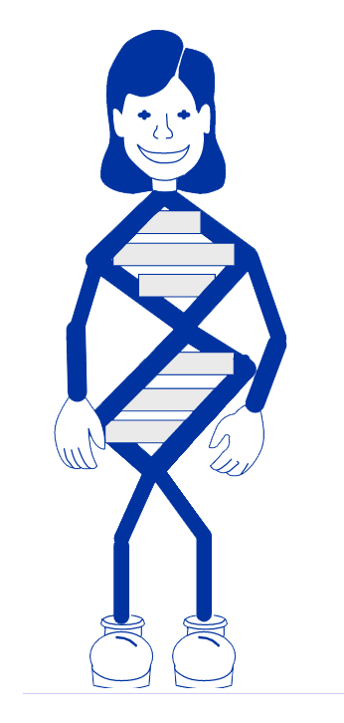
You’re the Scientist: Find the Babies’ Genders
Follow the steps in this link to Test Your Genetics Knowledge
Notes:
http://www.dnaftb.org/9/problem.html

Slide 9
Sex Linked Traits & Inheritance
What is a sex-linked trait?
  Traits that are influenced by genes from X chromosomes
Why do X chromosomes result in certain traits?
  X chromosomes are larger and have more genes than Y chromosomes.
How are sex-linked disorders passed on?
  Males are usually affected since they inherit one
  X chromosome (which may be mutated) from their mothers.
  Females are the carriers, and the mutation is masked
  because they have second (unmutated) X chromosome.
Notes:
Audio source: https://www.genome.gov/genetics-glossary/Sex-Linked#:~:text=And%20in%20humans%20this%20is,and%20also%20Fragile%20X%20syndrome.

Slide 10
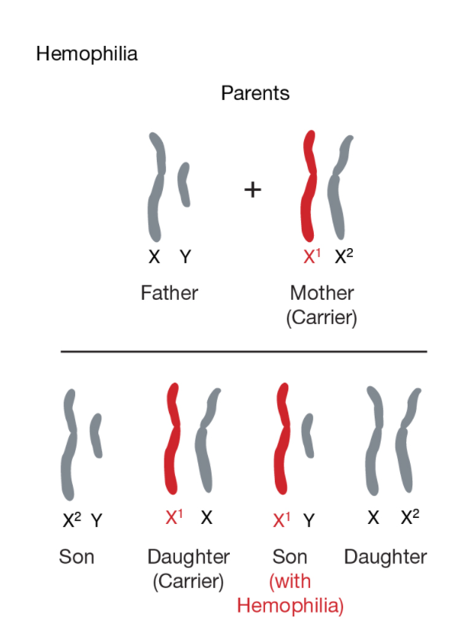
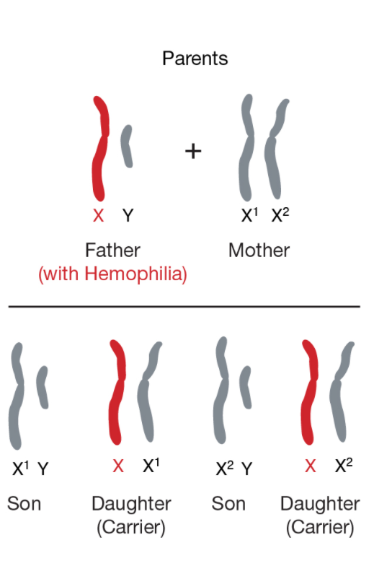

Sex-Linked Disorders in Humans
Click the button below to learn more:
Notes:
Image and audio source: https://www.genome.gov/genetics-glossary/Sex-Linked#:~:text=And%20in%20humans%20this%20is,and%20also%20Fragile%20X%20syndrome.

Slide 11

Your Turn
Goal: Create a Flipgrid
on a human sex-linked genetic disorder.
Select a topic from the choice board on the following slide.
Notes:
Flipgrid. (2021). Downloads + Media. [image]. https://blog.flipgrid.com/downloads
K20 Center. (n.d.). Flipgrid. Tech Tools. https://learn.k20center.ou.edu/tech-tool/1075

Slide 12
Choice Board
Hemophilia
Fragile X Syndrome
Turner Syndrome
or Trisomy X or
Klinefelter Syndrome
Red-green Color Blindness
Amelogenesis Imperfecta (AI)
Rett Syndrome
Duchenne Muscular Dystrophy
Ocular Albinism
Notes:
May be a good site to recommend to teachers to share with students. https://rarediseases.org/
Rare disease database https://rarediseases.org/for-patients-and-families/information-resources/rare-disease-information/

Slide 13
Content Checklist |  | Flipgrid Checklist
 | Name of disorder |  | In your own words
 | Genetic cause |  | Split time evenly among group members
 | Who inherits it |  | 3-4 minutes in length
 | Percent of the population it affects |  | Cite sources
 | Symptoms
 | Treatment
 | Survival Rate
[insert Flipgrid link or QR code here]

Slide 14
Bell Ringer
Watch at least two of your classmates’ Flipgrid presentations.
[insert Flipgrid link or QR code here]

Slide 15




Help Nettie Go Viral!
Nettie may have been overlooked back in her
day, but now that you’ve seen the work she has
done and the impact it has made, it’s your turn to use social media to help her
go viral!
Notes:
image sources:
Facebook. (2021). Facebook brand resources: Instagram. [image] https://en.facebookbrand.com/instagram/assets/instagram?audience=instagram-landing
Facebook. (2021). Brand resources: Facebook app. [image]. https://en.facebookbrand.com/facebookapp/assets/f-logo/
TikTok. (2021). TikTok logo. [image]. https://www.tiktok.com/
Twitter. (2021). Brand toolkit. [image]. https://about.twitter.com/en/who-we-are/brand-toolkit
K20 Center. (n.d.). Flipgrid. Tech Tools. https://learn.k20center.ou.edu/tech-tool/1075

Slide 16
That’s a Wrap
How did Nettie’s work help you better understand
the disorder you researched?
Notes:
K20 Center. (n.d.) Bell Ringers and Exit Tickets. Strategies. https://learn.k20center.ou.edu/strategy/125

