Slide 2
A Parallel Perspective
Writing Equations of Parallel Lines

Slide 3
Essential Question
How do you know that a line is parallel to another line?

Slide 4
Lesson Objectives
Identify and verify parallel lines.
Apply mathematical understanding of parallel lines to solve problems.

Slide 5
Parallel Processing
Look at the lines within each image.
Which lines are parallel?
Are any of the lines parallel?

Slide 6
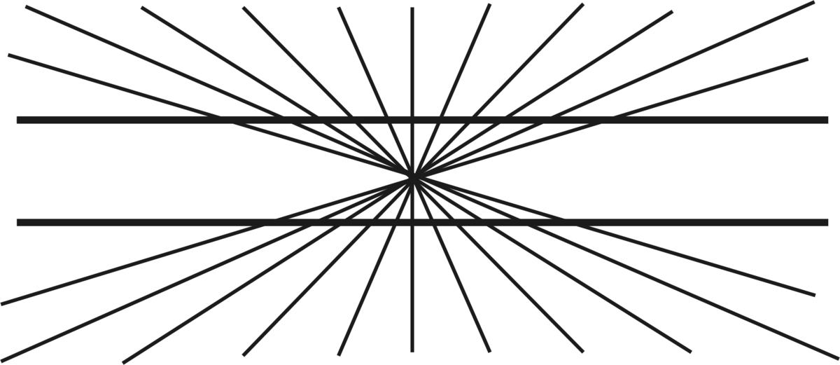
Parallel Processing: Image 1
Notes:
Wolfram MathWorld. (2022). Hering Illusion. Wolfram. https://mathworld.wolfram.com/HeringIllusion.html

Slide 7

Parallel Processing: Image 2
Notes:
Fibonacci. (2007). Zöllner illusion. Wikimedia Commons. https://commons.wikimedia.org/wiki/File:Zollner_illusion.svg

Slide 8

Parallel Processing: Image 3
Notes:
Fibonacci. (2007). Café wall illusion. Wikimedia Commons. https://commons.wikimedia.org/wiki/File:Caf%C3%A9_wall.svg

Slide 9
Parallel Processing: Image 1
Image 1 is an optical illusion, published by Ewald Hering in 1861.
The two horizontal lines are straight and parallel. They appear to bow because the other lines simulate perspective, giving a false sense of depth.
Because our brain perceives depth, our eyes misinterpret the image.
Notes:
Wolfram MathWorld. (2022). Hering Illusion. Wolfram. https://mathworld.wolfram.com/HeringIllusion.html

Slide 10
Parallel Processing: Image 2
Image 2 is an optical illusion, published by Johann Karl Friedrich Zöllner in 1860.
The lines with a negative slope are all parallel. They appear to be anything but
equidistant from each other due to the vertical or
horizontal segments one each line.
Scientists are unsure of why we do not see the lines as parallel.
Notes:
Fibonacci. (2007). Zöllner illusion. Wikimedia Commons. https://commons.wikimedia.org/wiki/File:Zollner_illusion.svg

Slide 11
Parallel Processing: Image 3
Image 3 is known as the Café Wall Illusion and was noticed by Richard Gregory and Priscilla Heard on a café wall in Bristol, England and published in 1979.
The gray, horizontal lines are parallel. The image is a tessellation of black and white rectangles that are shifted horizontally of each other.
Scientists are unsure but believe that the colors are what causes the illusion.
Notes:
Fibonacci. (2007). Café wall illusion. Wikimedia Commons. https://commons.wikimedia.org/wiki/File:Caf%C3%A9_wall.svg

Slide 12
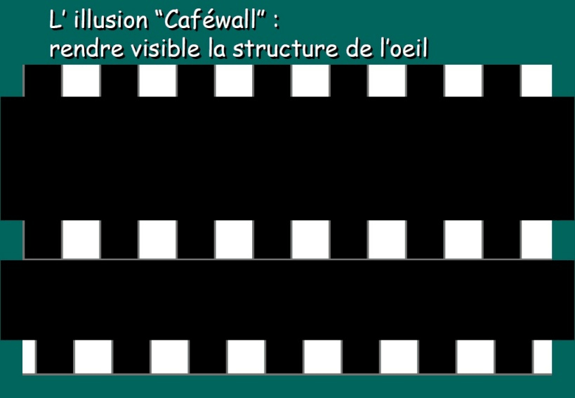
Parallel Processing: Café Wall
These illusions help neuropsychologists study how our brains process visual information.
Notes:
Hans-Werner34. (2005). CAFEWALL ANIM.gif. Wikimedia Commons. https://commons.wikimedia.org/wiki/File:CAFEWALL_ANIM.gif

Slide 13
Perspective Drawings
Look at the lines within each image.
Which lines are parallel?
Are any of the lines parallel?

Slide 14
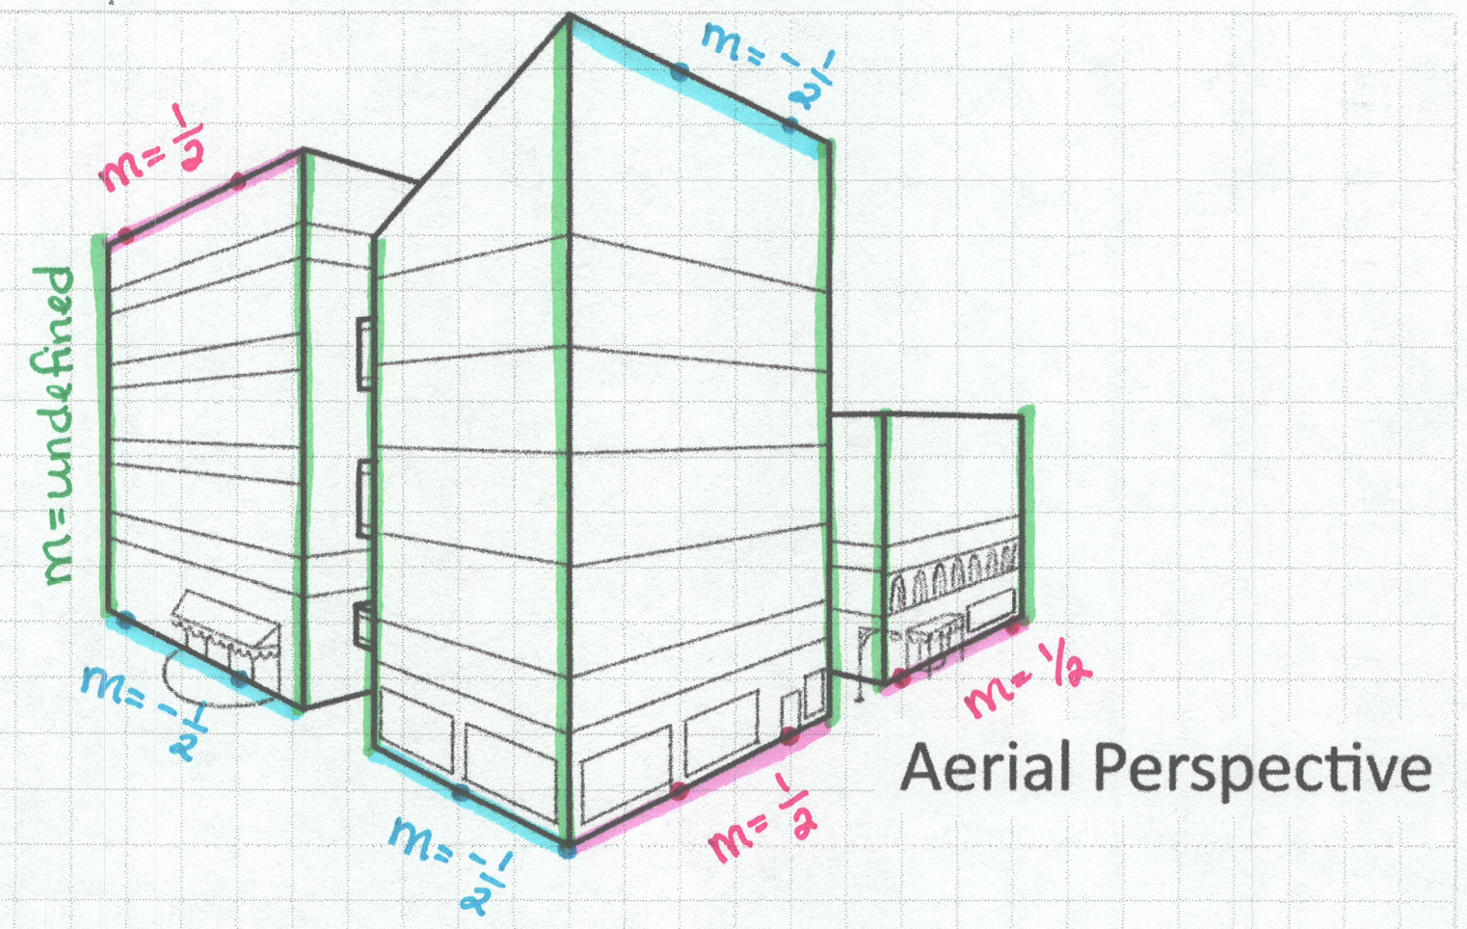
Perspective Drawings (Sample Response)

Slide 15
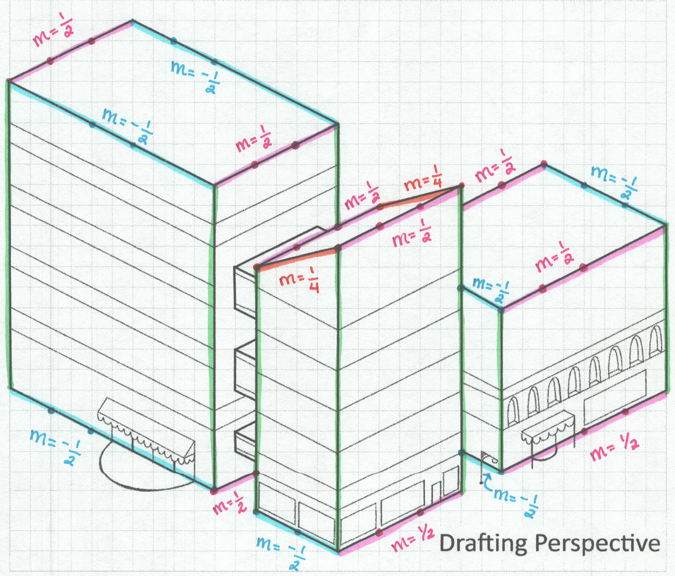
Perspective
Drawings
(Sample Response)

Slide 16
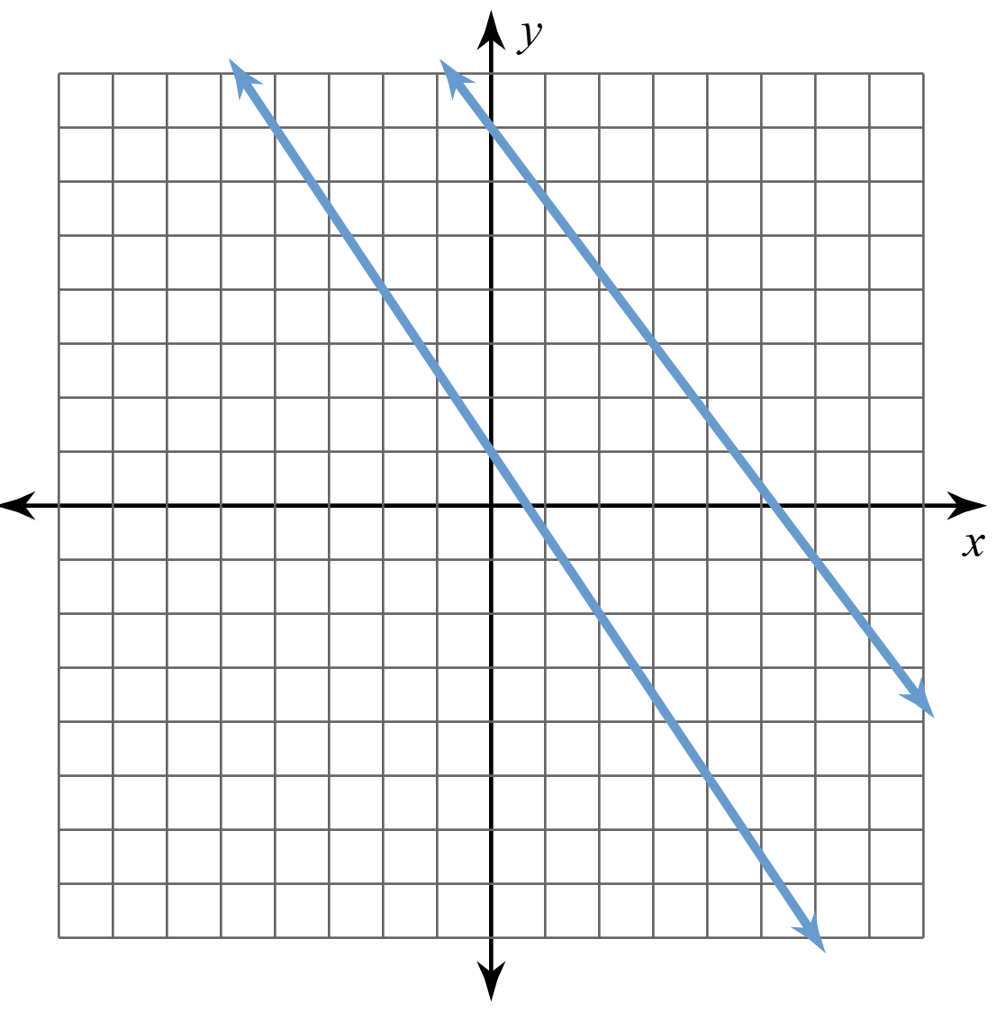
Are These Lines Parallel?
Yes or No?
Explain your thinking.

Slide 17
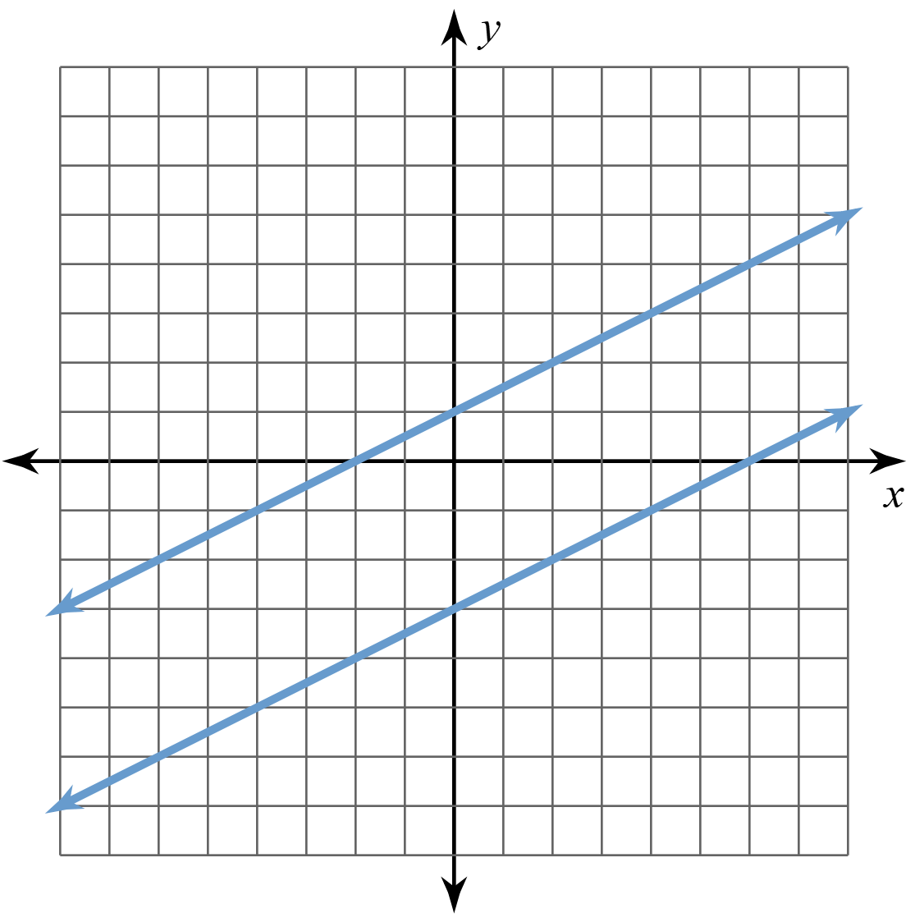
Are These Lines Parallel?
Yes or No?
Explain your thinking.

Slide 18
Point-Slope Form
Remember, when you know the slope and a point, you can use point-slope form to easily write the equation of a line.

Slide 19
Writing Equations
Write the equation for a line that passes through the point (2, 1) and is parallel to the line y = 3x + 5.

Slide 20
Writing Equations
Write the equation for a line that passes through the point (–1, 4) and is parallel to the line y – 4 = –2(x – 3).

Slide 21

I Have Who Has
Read your card carefully and find the
person who has the equation of a line parallel to your line that goes through your given point.
“I have…” is the answer to someone’s question.
“Who has…” is the question you are seeking an answer for.
Notes:
K20 Center. (n.d.). I Have Who Has. Strategies. https://learn.k20center.ou.edu/strategy/1497

Slide 22
I Have Who Has: Key
Card Set A
Card Set B
Card Set C
18
11
17
10
2
24
8
22
14
29
1
7
28
6
27
3
21
13
23
15
12
30
9
16
26
20
19
5
25
4
Card Set D
Card Set E
Notes:
K20 Center. (n.d.). I Have Who Has. Strategies. https://learn.k20center.ou.edu/strategy/1497

Slide 23

Exit Ticket
Individually, find the missing vertex of the parallelogram given 3 of the vertices.
Notes:
K20 Center. (n.d.). Bell Ringers and Exit Tickets. Strategies. https://learn.k20center.ou.edu/strategy/125

Slide 24
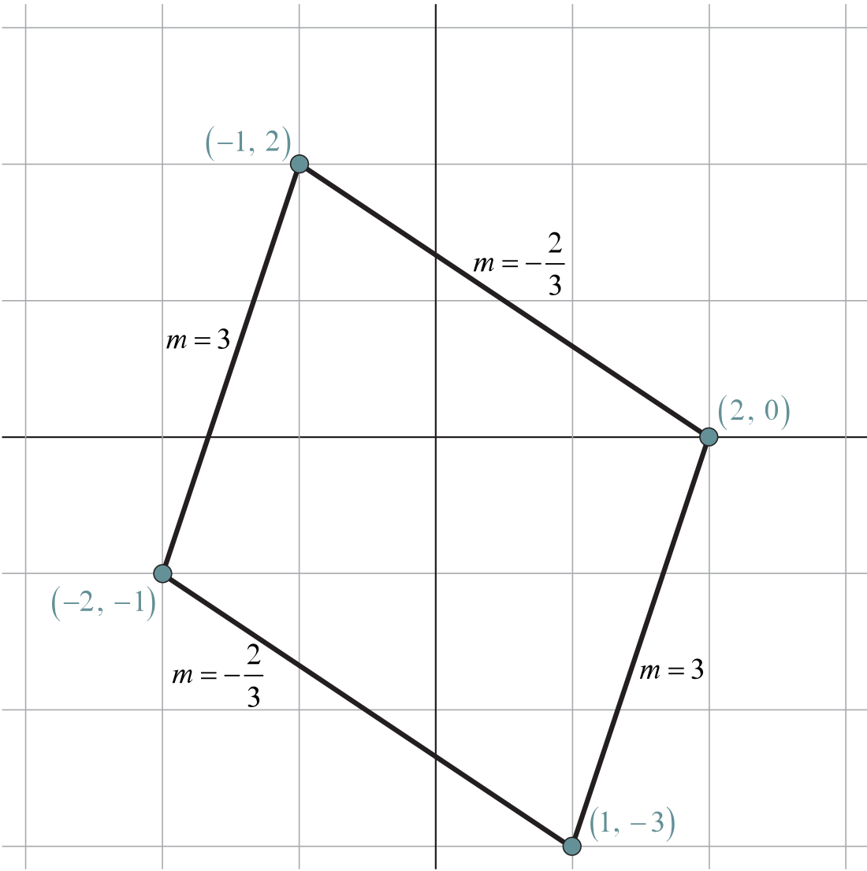
Exit Ticket
(Sample Solution)
The fourth vertex
is at (1, –3).

