Slide 2
Who Are They Really?
Characterization in The Outsiders

Slide 3
Who do you admire?
Consider a family member, a friend, and athlete, etc.
Brainstorm words that could be used to describe that person
On a blank piece of paper, write your descriptive words

Slide 4
Essential Question
How do characters come to life to the reader?

Slide 5
Lesson Objectives
Students will be able to identify examples of characterization in both film and text
Students will be able to construct an argument on a character’s personality based on the characterization.

Slide 6
What kind of people do you see?
Flip over your paper
As you watch the video clip write down
A description for the character
Specific evidence that supports your description

Slide 7
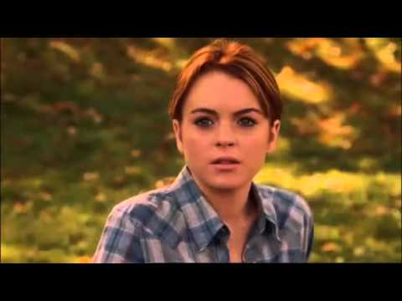

Slide 9
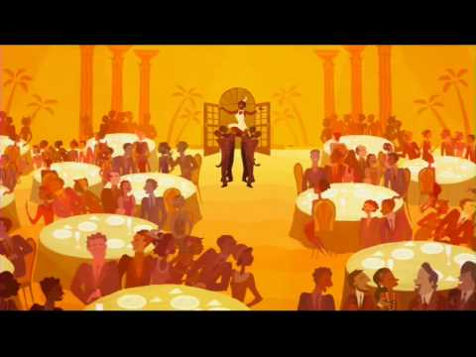

Slide 10
Characterization
The process by which the writer reveals the personality of a character.

Slide 11
The STEAL Method
Five elements of characterization
Speech, Thoughts, Effects on others, Actions, and Looks
Consider the character from the previous video.
Did you notice these elements?

Slide 12
Speech
The words a person chooses can reveal a lot about who they are.
When they speak to other characters, look at;
What they say
How they say it

Slide 13
Thoughts
What is revealed through the character’s private thoughts and feelings?
Consider what a character;
Thinks
Believes
Values
What motivates a character

Slide 14
Effects on others
This element focuses on the relationships the character has with others and how they treat each other.
How do the characters feel or behave in reaction to him/her?

Slide 15
Actions
What does the character do?
How does the character behave?
How does the character react to people and events?

Slide 16
Looks
How is the character’s physical appearance described?
Physical Features
Clothing
Body Language

Slide 17
Characterization in The Outsiders
In small groups, examine one character from The Outsiders and identify at least four examples of characterization
Identify the corresponding component of STEAL for each of the examples

Slide 18
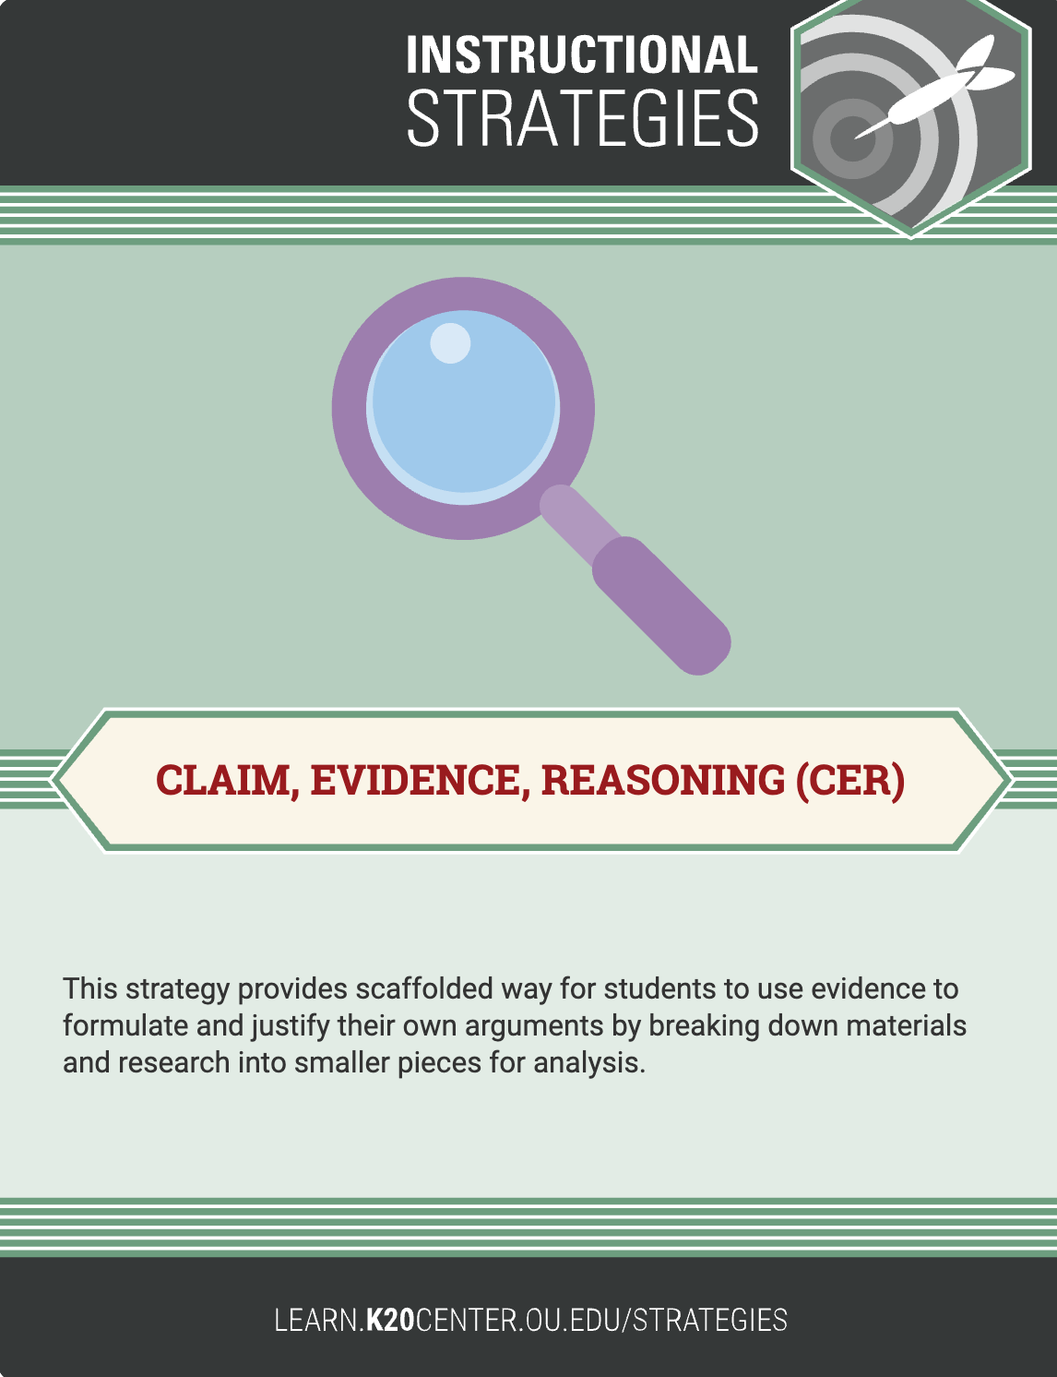
Claim, Evidence, Reasoning (CER)
Use evidence to create and justify your argument
Think about the character you examined with your group
What type of person do you believe _________ is?

Slide 19
Claim, Evidence, Reasoning (CER)
Write a 3-4 sentence paragraph that supports your claim
Use the evidence and reasoning from the CER organizer

