Slide 2
Power to the People
The Civil Rights Movement and the Black Panther Party

Slide 3
Essential Questions
Does society treat everyone fairly or justly?
How are people currently advocating for social justice?

Slide 4
Lesson Objectives
Students will define social justice and explain why members of communities advocate for social justice.
Students will compare social injustices in present day to those the Black Panther Party fought against.
Students will create their own program to advocate for social justice in their own communities.

Slide 5
Elbow Partner
Turn to your partner and discuss:
“Do you believe society treats everyone fairly or justly?”
Share out your responses.

Slide 6
Elbow Partner
Turn to your partner and discuss:
“Can you think of examples of how members of society were treated unfairly during the Civil Rights era or before?”
Share out your responses.

Slide 7
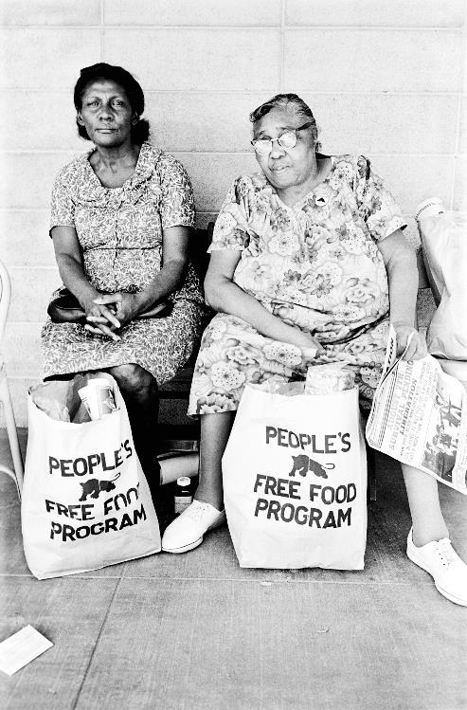
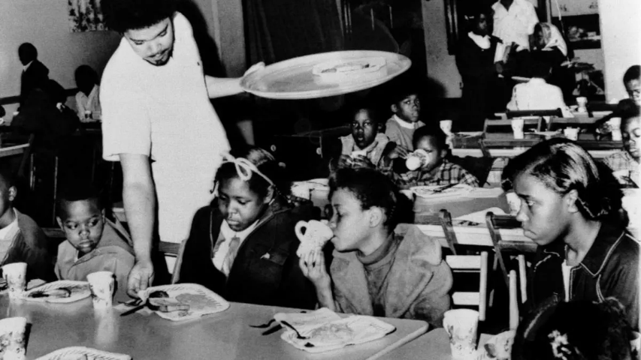
Source: William P. S. Bill Whitfield, member of the Black Panther chapter in Kansas City, serving free breakfast to children before they go to school. Associated Press. https://www.history.com/news/free-school-breakfast-black-panther-party
Source: James, S. People’s free food program. https://www.anothermag.com/fashion-beauty/9194/retracing-the-creative-legacy-of-the-black-panthers
Notes:
People’s Free Food Program
Left: Source: James, S. (2016, October 19). People’s free food program [Photograph found in Steven Kasher Gallery, Palo Alto]. Retrieved February 26, 2021, from https://www.anothermag.com/fashion-beauty/9194/retracing-the-creative-legacy-of-the-black-panthers (Originally photographed 1972)
Right: William P. S. (1969, April 16). Bill Whitfield, member of the Black Panther chapter in Kansas City, serving free breakfast to children before they go to school. [Photograph]. Associated Press. https://www.history.com/news/free-school-breakfast-black-panther-party

Slide 8
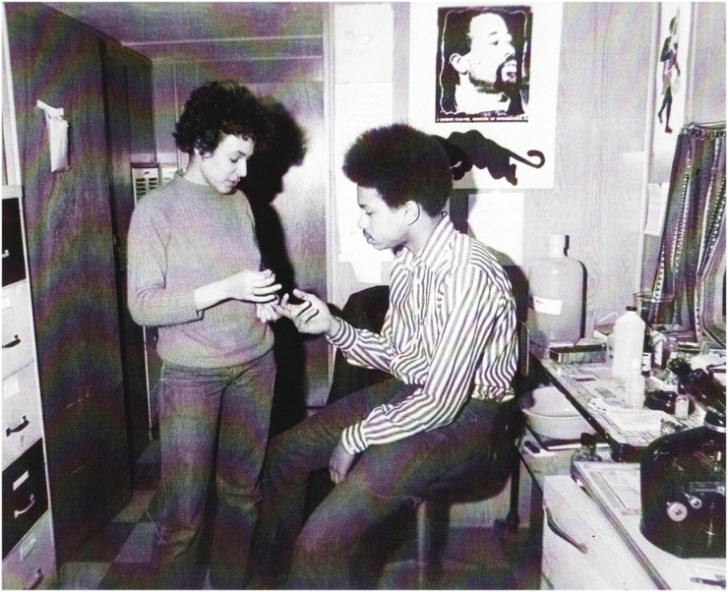
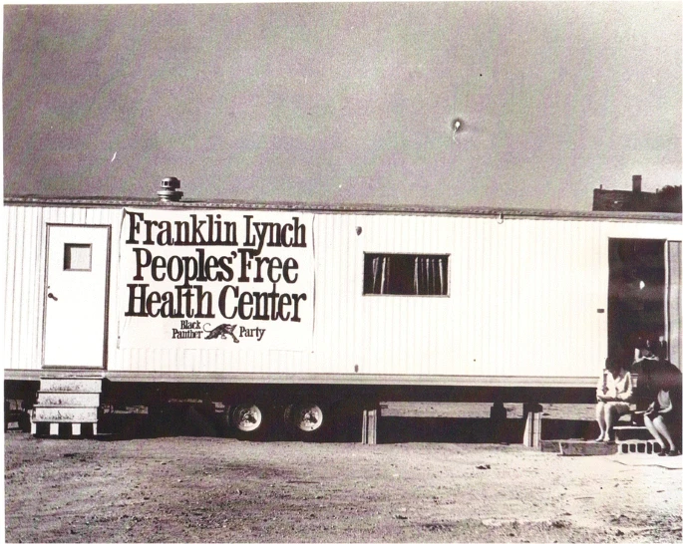
Source: Bassett, M.T. (2019). No justice, no health: The Black Panther Party’s fight for health in Boston and beyond. J Afr Am St 23, 352–363
Source: Bassett, M.T. (2019). No justice, no health: The Black Panther Party’s fight for health in Boston and beyond. J Afr Am St 23, 352–363
Notes:
Peoples’ Free Health Center
Bassett, M.T. (2019). No justice, no health: The Black Panther Party’s fight for health in Boston and beyond. J Afr Am St 23, 352–363. https://doi.org/10.1007/s12111-019-09450-w

Slide 9
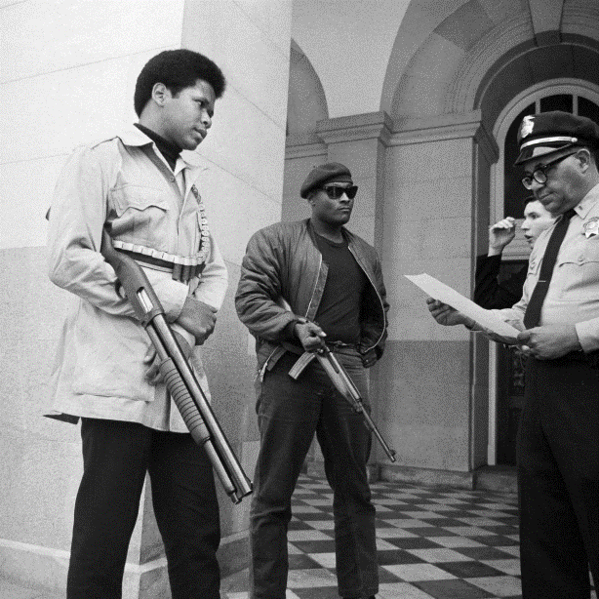
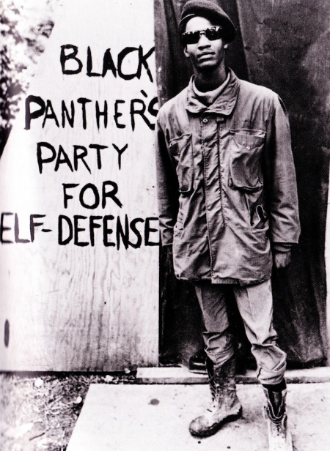
Source: Morgan, T. (2018, August 30). The NRA supported gun control when the Black Panthers had the weapons. History.com. https://www.history.com/news/black-panthers-gun-control-nra-support-mulford-act
Source: Chiles, N. (2015, March 26). 8 Black Panther Party programs that were more empowering than federal government programs. Atlanta Black Star. https://atlantablackstar.com/2015/03/26/8-black-panther-party-programs-that-were-more-empowering-than-federal-government-programs/2/
Notes:
Black Panther Party for Self-Defense
Left: Morgan, T. (2018, August 30). The NRA supported gun control when the Black Panthers had the weapons. History.com. https://www.history.com/news/black-panthers-gun-control-nra-support-mulford-act
Right: Chiles, N. (2015, March 26). 8 Black Panther Party programs that were more empowering than federal government programs. Atlanta Black Star. https://atlantablackstar.com/2015/03/26/8-black-panther-party-programs-that-were-more-empowering-than-federal-government-programs/2/

Slide 10
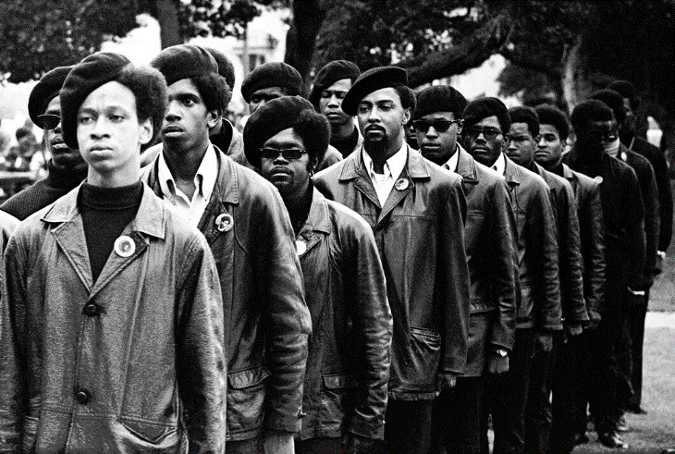
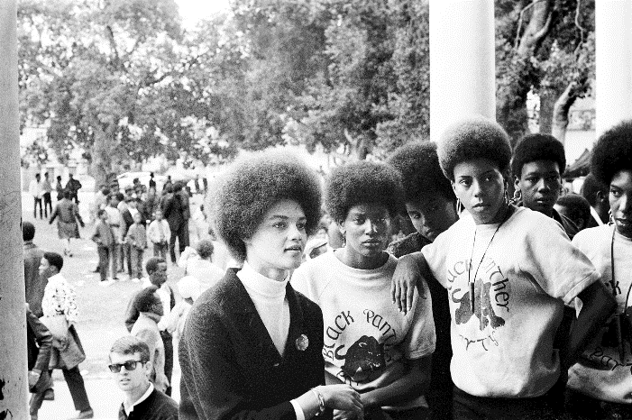
Source: James, S. (2016, October 19). Panthers line up at a Free Huey rally. https://www.anothermag.com/fashion-beauty/9194/retracing-the-creative-legacy-of-the-black-panthers.
Source: James, S. (2016, October 19). Kathleen Cleaver at a Free Huey rally. https://www.anothermag.com/fashion-beauty/9194/retracing-the-creative-legacy-of-the-black-panthers
Notes:
Black Panther lined up at Free Huey Rally
Left: James, S. (2016, October 19). Panthers line up at a Free Huey rally [Photograph found in Steven Kasher Gallery, Oakland]. Retrieved February 26, 2021, from https://www.anothermag.com/fashion-beauty/9194/retracing-the-creative-legacy-of-the-black-panthers (Originally photographed 1968, July 28)
Right: James, S. (2016, October 19). Kathleen Cleaver at a Free Huey rally [Photograph found in Steven Kasher Gallery, Oakland]. Retrieved February 26, 2021, from https://www.anothermag.com/fashion-beauty/9194/retracing-the-creative-legacy-of-the-black-panthers (Originally photographed 1968, July 28)

Slide 11
“Social justice means equal rights and equitable opportunities for all.”
Notes:
The San Diego Foundation. (2016, March 24). What is social justice? The San Diego Foundation. https://www.sdfoundation.org/news-events/sdf-news/what-is-social-justice/

Slide 12
Categorical Highlighting
As you read the article, Rise of the Black Panther Party, use the Categorical Highlighting strategy to highlight important parts in the reading that answer the questions:
What led to the rise of the Black Panther Party?
How did the Black Panthers advocate for social justice in their communities?

Slide 13
3-2-1
Find the following in the article:
3 things from the reading or Ten Point Program that stood out the most to you and why they stood out to you.
2 points from the Ten Point Program that are still relevant today and why you chose those points.
1 example from the reading or Ten Point Program showing how the Black Panther Party advocated for social justice in their communities.

Slide 14
Exit Ticket
“Social justice means equal rights and equitable opportunities for all.”
Answer the following questions and hand in as you leave:
How does your Five Point Program help promote social justice in your community?
What is one point you saw on a classmate’s program that will promote social justice?
Notes:
The San Diego Foundation. (2016, March 24). What is Social Justice?. The San Diego Foundation. https://www.sdfoundation.org/news-events/sdf-news/what-is-social-justice/

