Slide 2
The Test for Being Human
Thematic Links between AI and Frankenstein

Slide 3
Essential Question
What does it mean to be human?
Is having humanity the same as being human?

Slide 4
Learning Objective
Students will be able to analyze a variety of texts to draw a conclusion for the proposed question and defend their argument.

Slide 5
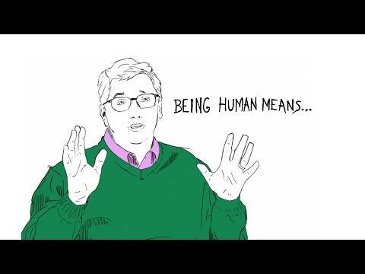
What does it mean to be human?
Notes:
Gates, B. (2015, June 9) What does it mean to be human? [video]. YouTube. https://www.youtube.com/watch?v=Uw6CUQdb5H8

Slide 6

What does it mean to be human?
Notes:
Vlogbrothers. (2015, June 9). What does it mean to be human? [video]. YouTube. https://www.youtube.com/watch?v=2FPpwxHtXLU

Slide 7
What does it mean to be human?
Type here
Respond to one of the videos or answer with your own opinion.
Type here
Type here
Type here
Type here
Type here
Notes:
TEACHERS: If you’d like to use this as an interactive response board, add as many sticky notes as you need for your class OR teach your students how to copy and paste to create a new sticky before adding to the board.

Slide 8
What does it mean to be human?
We usually think about being human in the context of what it isn’t.
We have a hard time defining humanity, but we find it much easier to define what it is NOT.

Slide 9
Artificial Intelligence
Artificial intelligence, or AI, begins to blur the line of what it means to be human.
If we are only defining humanity by what it is not, then AI makes that distinction much harder.

Slide 10
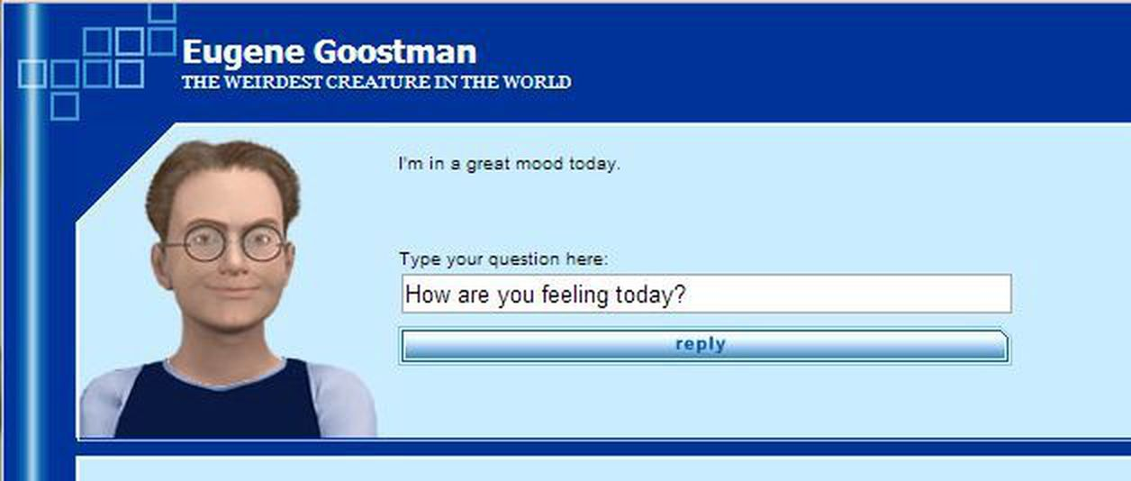
Artificial Intelligence
Computer scientist and mathematician Alan
Turing created a test to determine a machine’s ability to show intelligent behavior equivalent
to humans.
He predicted that by the year 2000, machines would be able to convince 30% of the judges that they were human within 5 minutes of questions.
One such AI, Eugene Goostman, did so in 2014.

Slide 11
Can AI Really Pass the Turing Test?
After reading the article, let’s see if artificial intelligence can pass our own Turing Test. You will:
Be placed into 5 stations.
Follow the directions at each station to complete each poll.
At the end, we will discuss the results of our Turing Test and see if any AI creation was able to pass!

Slide 12
Can AI Really Pass the Turing Test?
Now that we’ve seen the results, what surprised you?
What questions does this cause you to have?

Slide 13
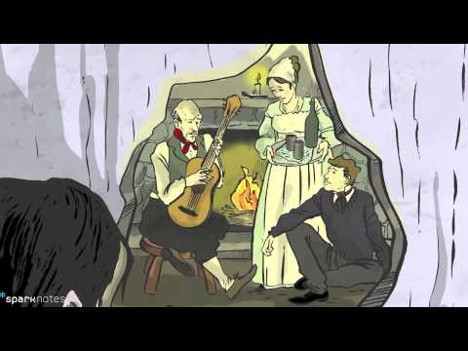
A Human Like Creation: Frankenstein
Humans have been attempting human-like creations for a very long time. One story of such a creation has become part of pop culture. That story is Frankenstein.
Notes:
SparkNotes. (2010, October 13). Video SparkNotes: Mary Shelley's Frankenstein summary [Video]. YouTube. https://www.youtube.com/watch?v=XRppXdKDY_c

Slide 14
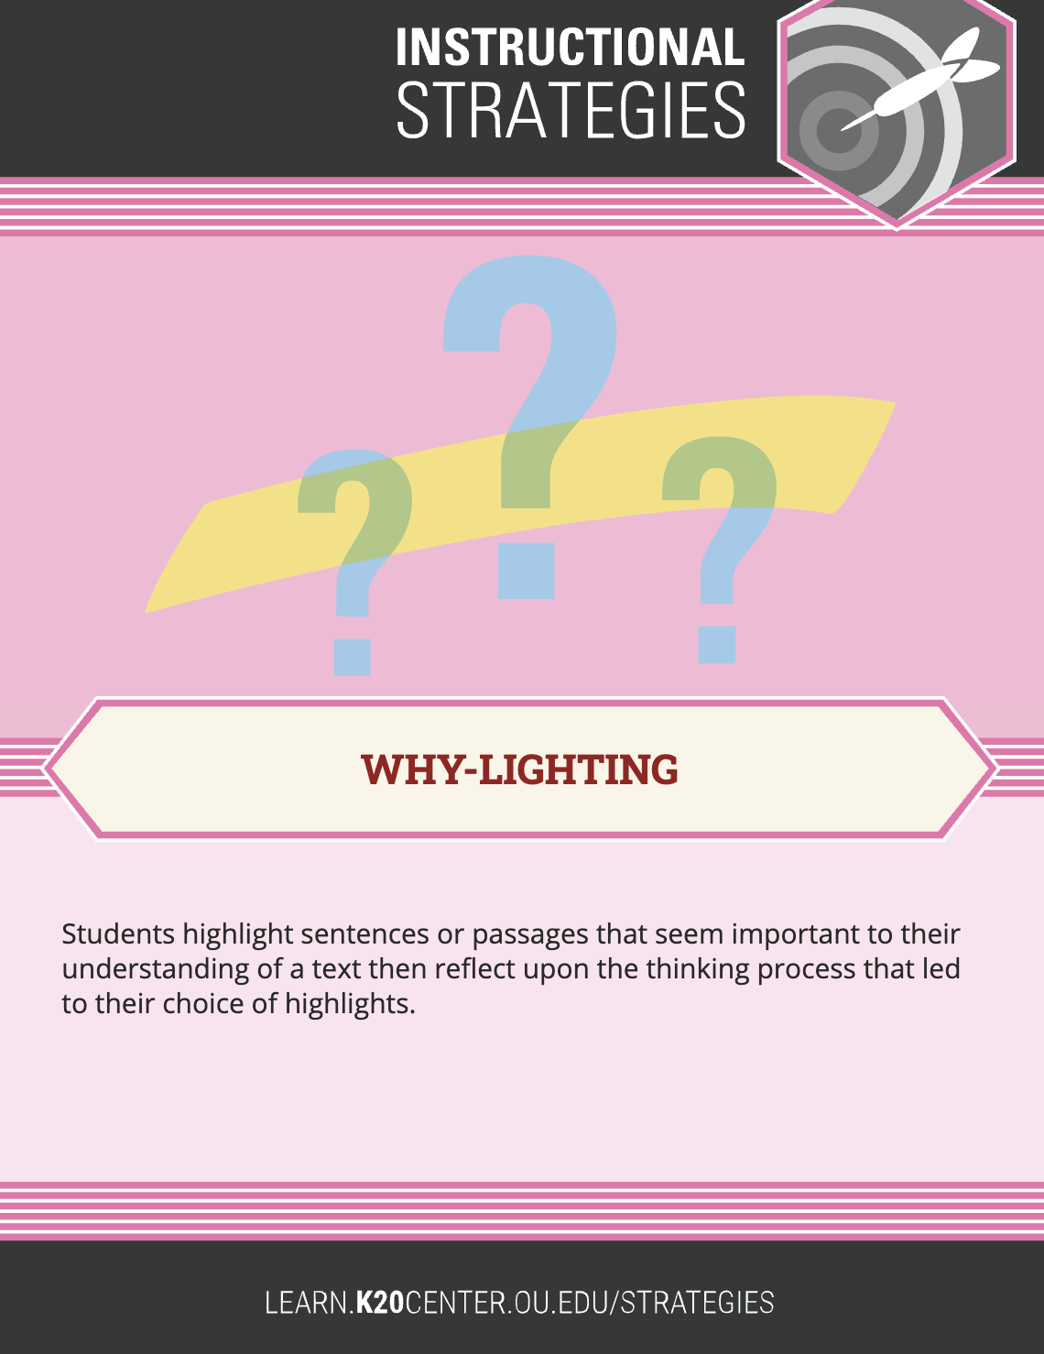
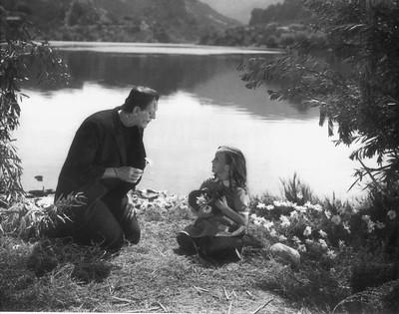
A Human Like Creation: Frankenstein
As you read the passage, why-light where you see instances of the creature’s humanity and explain.
Notes:
Image: Insomnia Cured Here. (October 10, 2007). Frankenstein [Photograph]. Flickr. https://www.flickr.com/photos/89093669@N00/1538943238
\

Slide 15
Frankenstein: Discussion
Does the creature have humanity? Why or why not?
Is having humanity the same as being human?
Why do you think humans have rejected the creature?
How has his interactions with humans changed the creature?

Slide 16
Human-Like Creations
The story of Frankenstein and the story of AI is one of technology created by humans to be human-like.
This brings up the questions:
What can technology never replace?
What to do we give up when we adopt technology and what do we get?

Slide 17
Human-Like Creations
Philosophical Chairs Planning Sheet
Try to answer these questions as you watch the following videos.
What can technology never replace?
What to do we give up when we adopt technology and what do we get?
Is having humanity the same as being human?

Slide 18
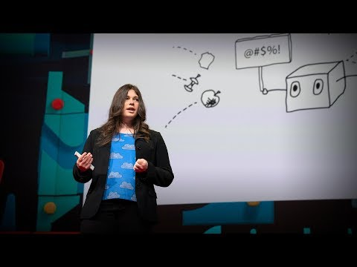
Human-Like Creations
Notes:
TED. (2019, November 13). The danger of AI is weirder than you think | Janelle Shane YouTube. [Video]. https://www.youtube.com/watch?v=OhCzX0iLnOc

Slide 19
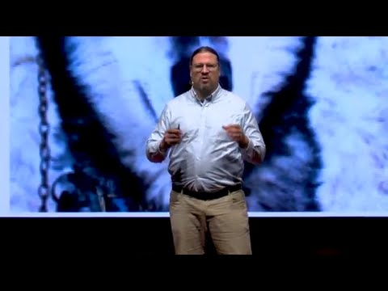
Human-Like Creations
Notes:
TED. (2017, December 15). The Real Reason to be Afraid of Artificial Intelligence | Peter Haas | TEDxDirigo. YouTube. [Video]. https://www.youtube.com/watch?v=TRzBk_KuIaM

Slide 20
Philosophical Chairs
Is having humanity the same as being human?

Slide 21
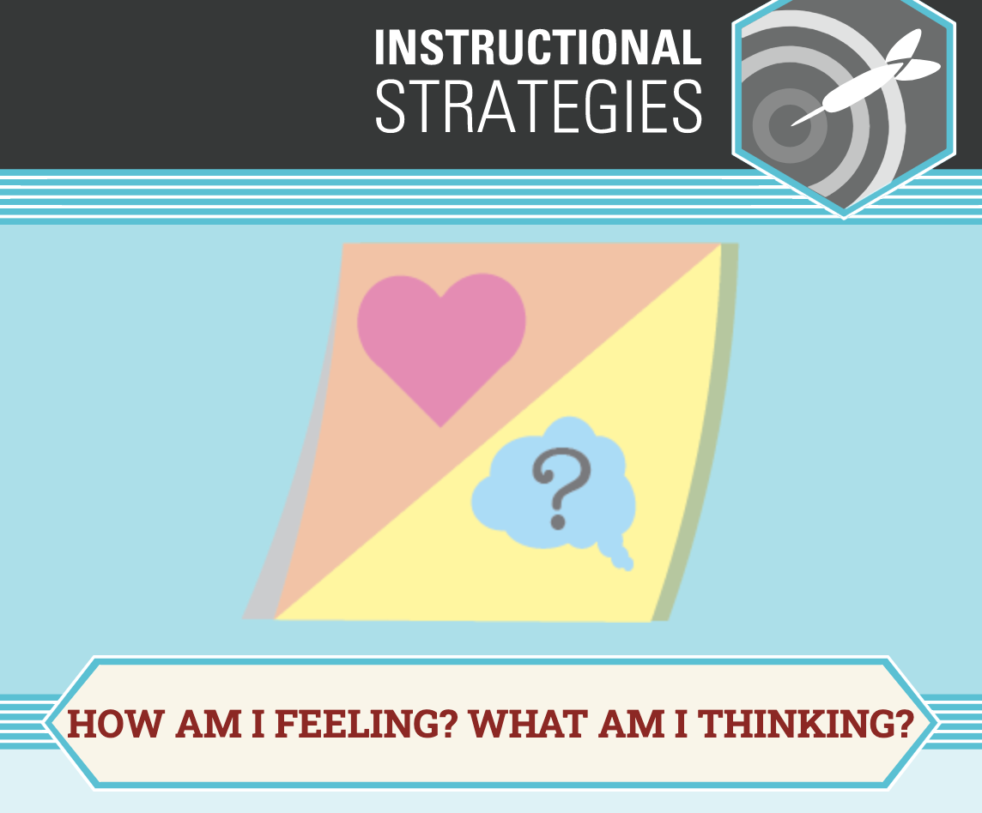
Tech Detox Extension Activity
Go without your phone, computer, or television for 24 hours.
Afterward, write a response about the experience, using the How am I Feeling? What am I Thinking? frame.

